Slide 1
Raising Ducks & Turkeys
in Zambia
Breeds, Husbandry, Feeding, Water & Disease Management
Veterinary Training Resource | ELGF Ministry | elgf.org

Slide 2
Duck Breeds in Zambia
Waterfowl Production for Meat & Eggs

Slide 3
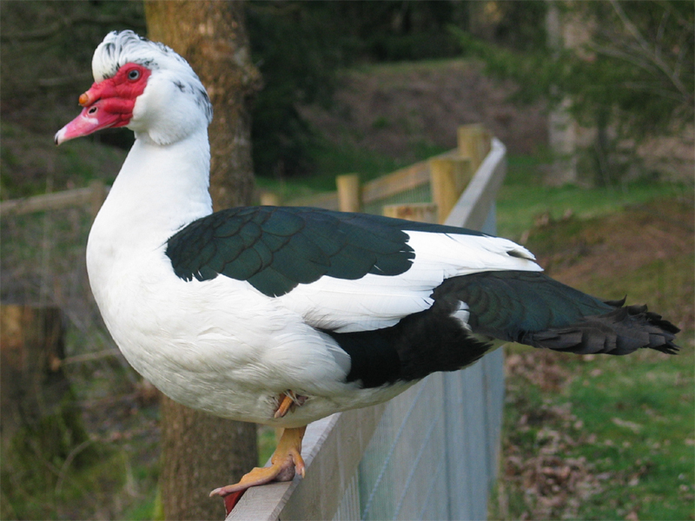
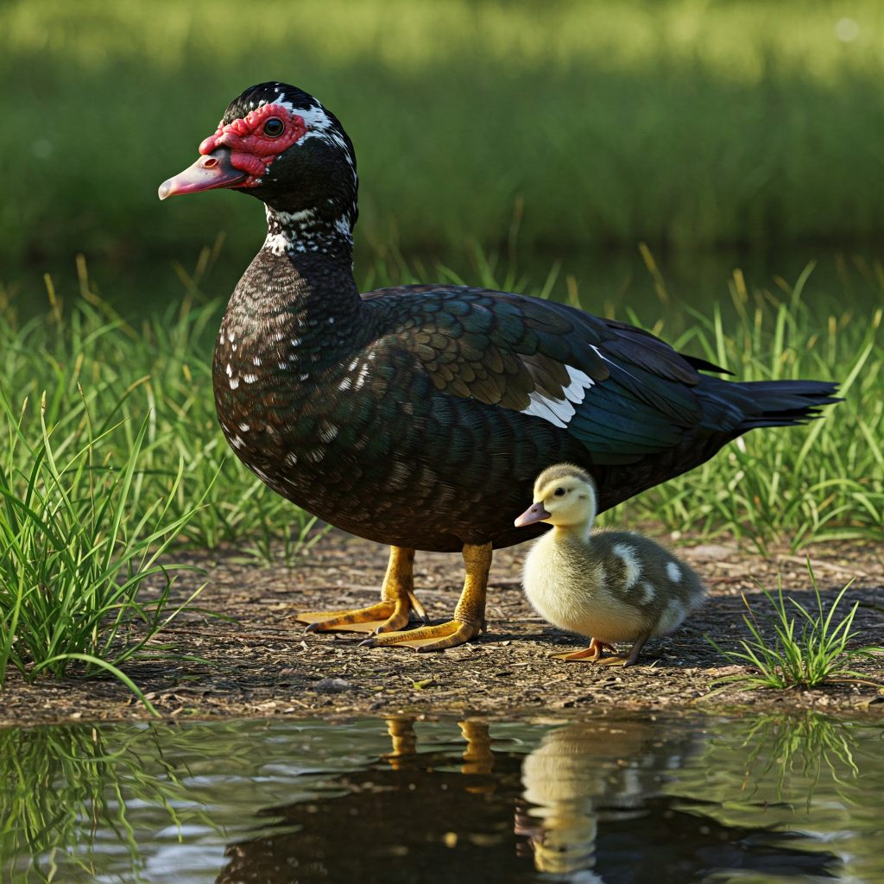
Muscovy Duck
One of Zambia's Most Widely Kept Duck Breeds
Origin: South America – thrives in tropical Africa
Body weight: Males 4–6 kg, Females 2–3 kg
Lean, flavourful meat – highly prized
Minimal quacking – quieter than other ducks
Excellent brooders – hens hatch own ducklings
High disease resistance under Zambian conditions
Integrates well with ELGF pay-it-forward model
Key Metrics
Body weight:
3–5 kg (male)
Market wt:
1.5–2.5 kg
Eggs/year:
60–120
Egg size:
70–80 g
Incubation:
35 days
Market age:
12–16 weeks

Slide 4
Muscovy Duck Management
Advantages
Management Tips
Not picky about housing - simple shelter sufficient
Disease resistant - minimal health problems
Excellent foragers - low feed costs
Natural brooding and mothering ability
Live longer than chickens (8-12 years)
Effective pest control (insects, snails, termites)
Can be left unsupervised
Adapt to presence/absence of water
Quiet - minimal noise disturbance
Housing: Simple, dry shelter with good ventilation
Do not require pond but benefit from water access
Need water for mating to produce fertile eggs
Incubation: 35 days (longer than other ducks)
Feed: Rice, corn, cassava + foraging
Space: Can coexist with crop farms
Drakes can be aggressive during breeding
Regular deworming recommended
Notes:
Muscovy ducks require minimal management compared to other poultry. They do not destroy flowers or vegetables, making them ideal for integrated crop-duck farming systems. While they don't require a pond, providing access to water significantly improves fertility rates and egg production. Muscovies are excellent mothers and will naturally incubate eggs and raise ducklings. However, they can be territorial, and drakes may become aggressive during breeding season. Starting with a minimum of 12 ducks is recommended for a viable flock. Cultural myths about ducks being 'dirty birds' have limited duck farming uptake in Ghana, but these misconceptions are gradually being overcome.

Slide 5
Muscovy Duck
Characteristics
Production Performance
Origin: Central/South America
Large size - significant sexual dimorphism
Drakes: 2.7-4.5 kg (6-10 lbs)
Ducks: 1.5-2.0 kg (3.5-4.5 lbs)
Red caruncles (facial warts) on face
Variable plumage: white, black, mixed
Quiet - do not quack like other ducks
Strong flyers, can perch in trees
Egg production: 60-80 eggs/year (scavenging)
100-125 eggs/year (improved management)
Egg weight: 72-75g (larger than chicken eggs)
Dressing percentage: 70-71% (males)
Lean meat: 98% fat-free
Meat similar to steak/ham in taste
Excellent brooders - 2-3 broods/year
Market age: 10-14 weeks
Notes:
Muscovy ducks are the most popular breed in Ghana due to their hardiness, low maintenance requirements, and dual-purpose capabilities. Unlike true ducks (which belong to Anas species), Muscovies are actually a separate species (Cairina moschata) and do not quack. They are quieter than other ducks, making them suitable for urban/suburban settings. In West Africa, Muscovies are valued for their lean, high-quality breast meat that commands premium prices. They adapt well to various climates from tropical heat to -12°C, making them ideal for Ghana's conditions. Muscovies are excellent foragers and can thrive on minimal supplementation, eating insects, snails, grass, and kitchen scraps.

Slide 6
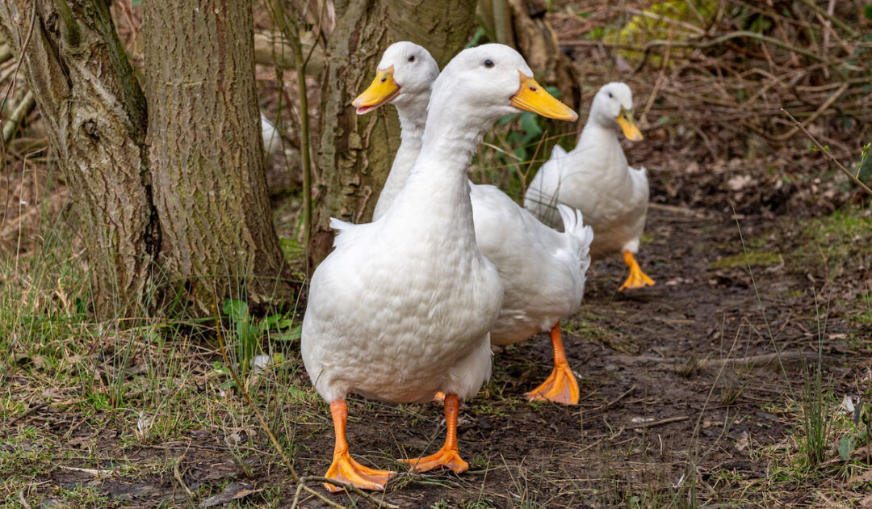
Pekin Duck
Commercial Meat Production Breed
Breed Characteristics
Origin: China (imported to West 1873)
Most popular commercial duck breed worldwide
White plumage with orange/pink bill and legs
Upright posture (similar to Indian Runner)
Docile, calm temperament
Fast growth - ready for processing at 7 weeks
Market weight: 2.5 kg at 49 days
Adult weight: 3.6-5.0 kg
Dual purpose: Excellent for both meat and eggs
Egg production:
200+ eggs/year
Egg weight:
75-90g
Market age:
7-8 weeks
Adaptability:
Confinement or range free-range
Notes:
Pekin ducks are the dominant breed for commercial meat production globally. In Ghana and East Africa, they are gaining popularity for their rapid growth and high meat yield. China produces 60% of the world's duck meat, primarily using Pekin ducks. The breed's white plumage results in a clean-looking carcass preferred by consumers. Pekins are less broody than other ducks, requiring incubation or broody chickens to hatch eggs. They are hardy, fertile, and one of the largest duck breeds. Duck meat sells for GH₵450+ per kg in Ghana. Pekins are particularly popular with Asian restaurants, hotels, and food processors. They require commercial duck feed for optimal growth but can supplement with locally available grains (rice bran, broken rice, cassava).

Slide 7
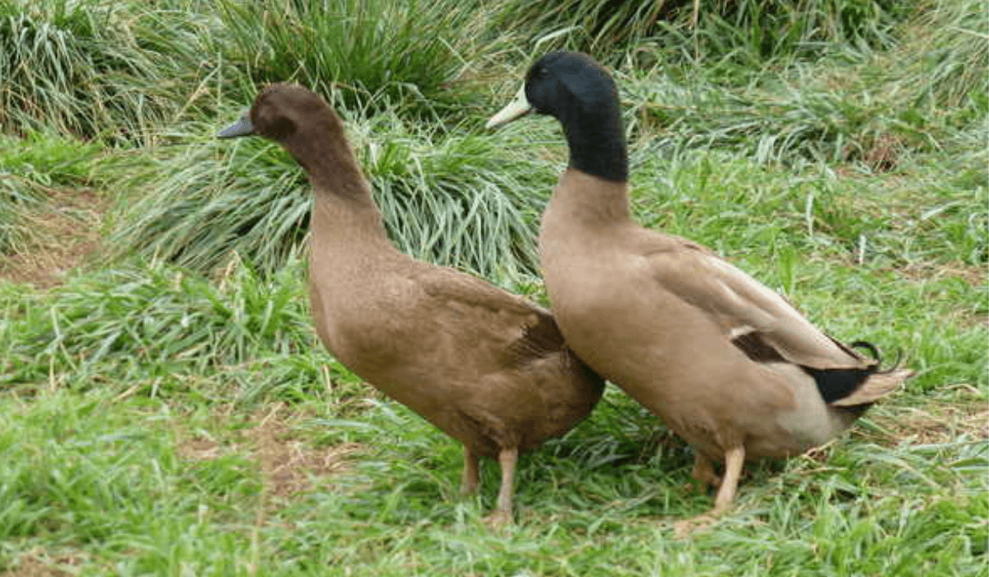
Khaki Campbell Duck
Breed Characteristics
Superior Egg Production Breed
Exceptional Egg Production
Origin: England (late 1800s)
Cross: Rouen × Runner × Mallard
Light breed: 4-4.5 lbs (1.8-2.0 kg)
Khaki brown plumage
Drakes: darker head with green sheen
Active, energetic temperament
Excellent foragers
Hardy in hot and cold climates
300-340 eggs per year
World record: 365 eggs in 365 days!
Egg color: White/cream/green-tinted
Egg weight: 75-85g
Start laying: 5-7 months
Lay throughout the year
Rarely go broody (continuous laying)
Superior to chickens in egg production
Notes:
Khaki Campbell ducks are renowned as one of the best egg-laying duck breeds in the world, exceeding even the most productive chicken breeds. They were developed by Mrs. Adele Campbell specifically for high egg production and are ideal for commercial egg operations or homesteads focused on egg production. Campbells are excellent foragers, helping with pest control (slugs, snails, insects). They don't require a pond but need access to water for drinking and bill cleaning. Duck eggs are larger than chicken eggs, richer in flavor, and superior for baking (give more lift to pastries). Campbells adapt well to various climates and are suitable for Ghana's conditions. They require less care than chickens and are relatively quiet compared to other duck breeds.

Slide 8
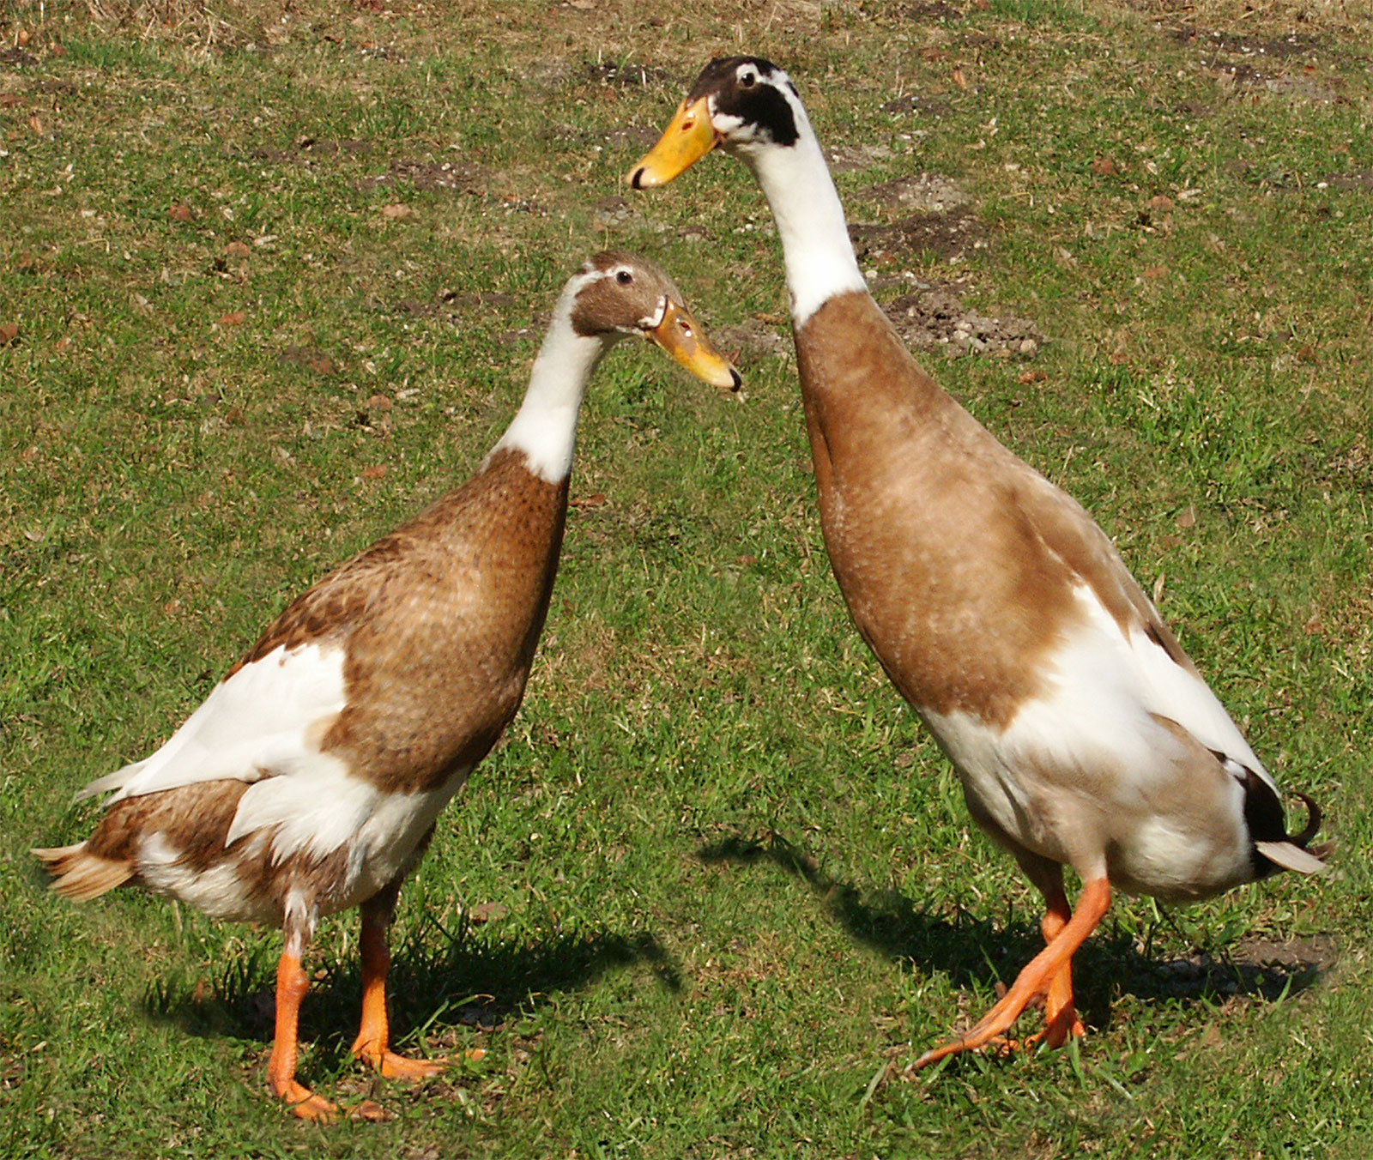
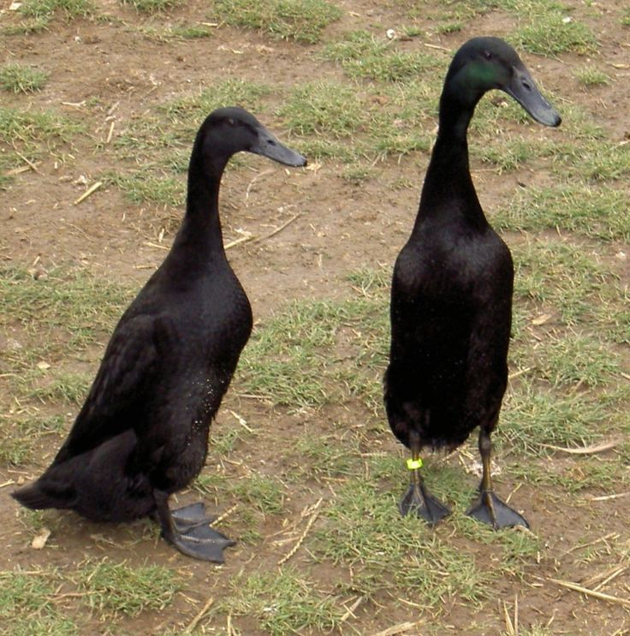
Indian Runner Duck
Upright Foraging Duck – Pest Control & Egg Production
Characteristics
Key Metrics
Distinctive upright posture – runs not waddles
200–300 eggs per year – outstanding layer
Excellent pest control in gardens & fields
Thrives without swimming water
Light body weight (1.4–2 kg) – lower feed cost
Available in Fawn & White, Black, Blue varieties
Body weight:
1.4–2 kg
Egg production:
200–300/year
Egg size:
65–80 g
Incubation:
28 days
Market age:
16–20 weeks

Slide 9
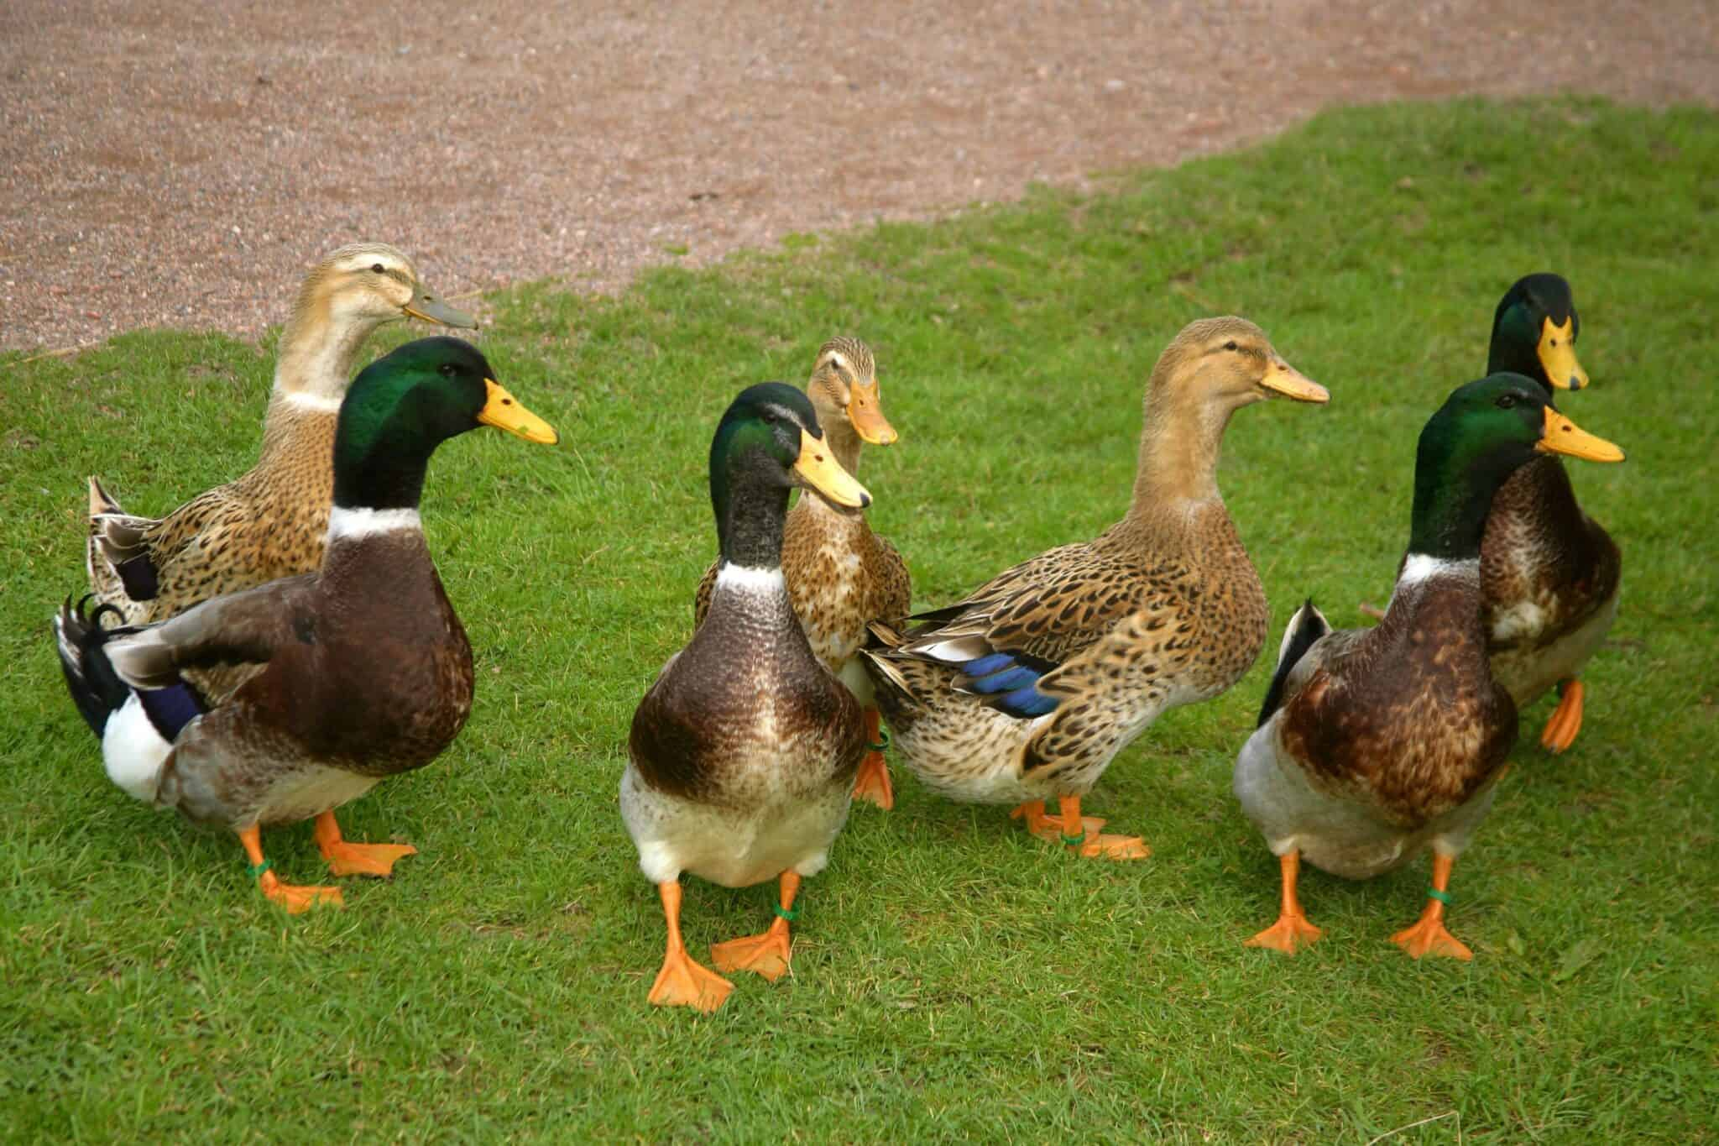
roRouen Duck
Ideal butchering weight at 10-12 weeks.
Calm and gentle ducks.
Lay 140-180 eggs a year.
Excellent foragers and adapt to various climates. butchering weight at 10-12 weeks

Slide 10
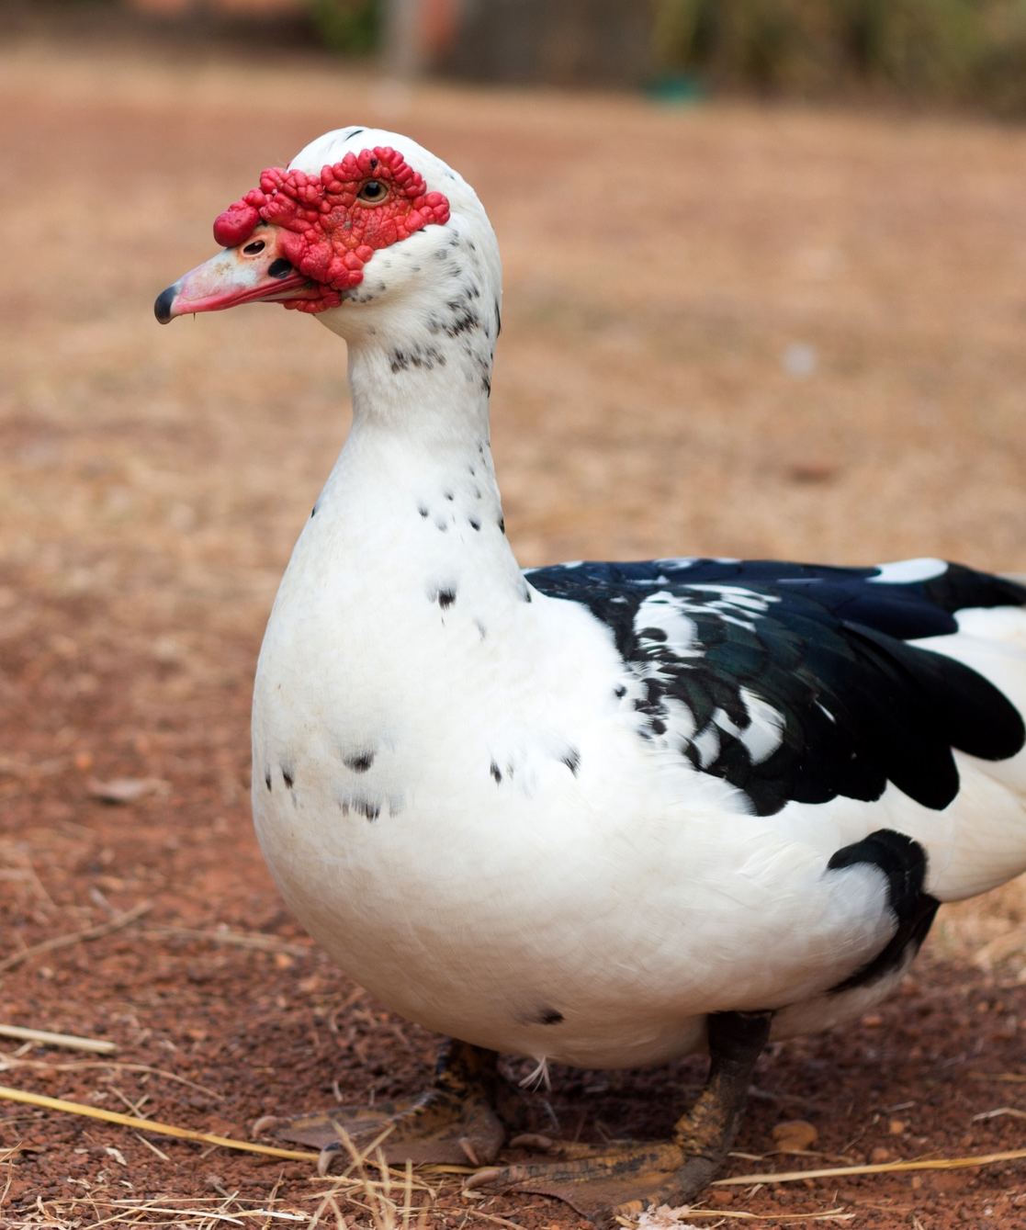
Why is duck farming on the rise
Muscovy
Duck meat is an excellent and affordable source of protein and duck eggs can be a good protein source
Starting a duck farm requires a small amount of capital
If you already have a crop farm you can rear your ducks in the same place because they do not destroy flowers or vegetables
Ducks live longer compared to chickens
Ducks can lay eggs for a longer period.

Slide 11
Duck Production Management
Key Husbandry Practices for Zambian Conditions
Housing & Water
Feeding
Health & Disease
Records
Single, low-cost housing – ducks are hardy
Provide shade and ventilation
Water available at all times
Shallow trays for bathing
Deep dry litter or concrete with good drainage
Starter crumbles 20–22% protein (ducklings)
Grower mash 16–18% protein (3–8 weeks)
Layer diet 16% + calcium for egg layers
Ducks eat 10–15% more feed than chickens
Green fodder supplements commercial feeds
Duck Plague – vaccinate in endemic areas
Duck Cholera – strict biosecurity
Internal parasites – deworm regularly
Botulism near stagnant water – clean supply
Generally more resistant than chickens to disease
Record egg production daily
Monitor feed and conversion
Track mortality and causes
Weigh birds monthly
Review economics every 2 months

Slide 12
Duck Breed Comparison
Breed | Primary Use | Adult Weight | Eggs/Year | Market Age | Key Features
Muscovy | Dual (meat/eggs) | ♂:2.7-4.5kg ♀:1.5-2.0kg | 60-125 | 10-14 wks | Hardy, quiet, excellent forager, lean meat
Pekin | Meat + eggs | 3.6-5.0kg | 200-250 | 7-8 wks | Fast growth, white plumage, commercial
Khaki Campbell | Eggs | 1.8-2.0kg | 300-340 | N/A | Top egg layer, active forager, hardy
Indian Runner | Eggs | 1.6-2.3kg | 200-300 | N/A | Upright posture, excellent layers
Swedish Blue | Dual purpose | 2.7-3.6kg | 150-200 | 10-12 wks | Calm, good meat and egg production
Breed Selection Recommendations for Zambia:
Meat production: Muscovy (most popular) or Pekin (fastest growth)
Egg production: Khaki Campbell or Indian Runner
Small farms/backyard: Muscovy (lowest input, dual purpose)
Notes:
Breed selection should consider: 1) Production goals (meat vs. eggs vs. dual-purpose), 2) Available resources (housing, feed, water), 3) Climate and management capacity, 4) Market preferences (duck meat is premium product in Ghana), 5) Cultural acceptance. Muscovy remains the top choice in Ghana for its adaptability, low inputs, and multi-purpose use. For commercial operations focused on rapid meat production, Pekin is superior. For egg-focused operations, Khaki Campbell offers unmatched productivity.

Slide 13
Duck Farming Business
Business Opportunities
Overcoming Challenges
Low start-up capital (minimum 12 ducks)
Duck meat is premium product (higher prices)
Duck eggs larger, richer than chicken eggs
Growing market from Asian communities
Hotels and restaurants seeking duck meat
Ducks live longer than chickens
Can integrate with crop farming
Ducks provide pest control services
Duck manure excellent fertilizer
Challenge: Cultural myths about ducks
Solution: Education on duck benefits
Challenge: Limited technical knowledge
Solution: Training programs, extension services
Challenge: Lack of processing facilities
Solution: Partner with restaurants, direct sales
Challenge: Feed costs
Solution: Maximize foraging, local grains
Challenge: Market development
Solution: Target hotels, Chinese restaurants
Notes:
Duck farming is emerging as a profitable livestock business in Ghana despite historical cultural barriers. The minimum investment is lower than chicken farming - you can start with 12 ducks. Duck meat commands premium prices (often 50-100% higher than chicken). The growing Asian population in Ghana provides a ready market for duck products. Duck eggs are prized by bakers and chefs for superior quality in pastries and baked goods. Ducks are more disease-resistant than chickens and require less veterinary care. Average egg production: 100 eggs/duck/year (minimum). Duck eggs are bigger than chicken eggs. Adult duck weight ranges 1-3 kg depending on breed and sex. Production purposes: egg production, duckling production for sales, meat production.

Slide 14
Duck Production Systems
Small Home Flock (12-50 ducks)
Free-Range with Water Access
Simple shelter, yard space, basic fencing
Feed hopper, waterers
Foraging supplemented with grains
Nearby dry sheltered area for night/nesting
Can combine with fish farming (tilapia)
Duck manure feeds fish
Semi-Intensive (50-500 ducks)
Commercial Intensive (500+ ducks)
Improved housing with ventilation
Day foraging, night confinement
Supplemental commercial feed
Controlled environment housing
Commercial duck feeds (starter, grower, layer)
Biosecurity, vaccination programs
Essential Requirements for All Systems:
Clean water for drinking (ducks drink more than chickens)
Dry sheltered sleeping area with good drainage
Predator protection (especially at night)
Adequate ventilation to prevent respiratory issues
Notes:
Duck housing does not need to be expensive or elaborate. Ducks are adaptable and can thrive in simple structures. They collect eggs in morning/night making daily collection convenient. Space requirements: Brooding (0-4 weeks): 0.1 m²/duckling; Growing (4-8 weeks): 0.2 m²/duck; Adult: 0.3-0.5 m²/duck. Feed consumption: Ducklings 25-50g/day; Adults 150-200g/day. Water: Adults need 0.5-1.0 liter/day. Ducks can control pests in gardens. They eat rice, corn, cassava, and forage on algae, aquatic weeds, insects, snails, and small fish. The duck-fish integration system is particularly efficient for small farms.

Slide 15
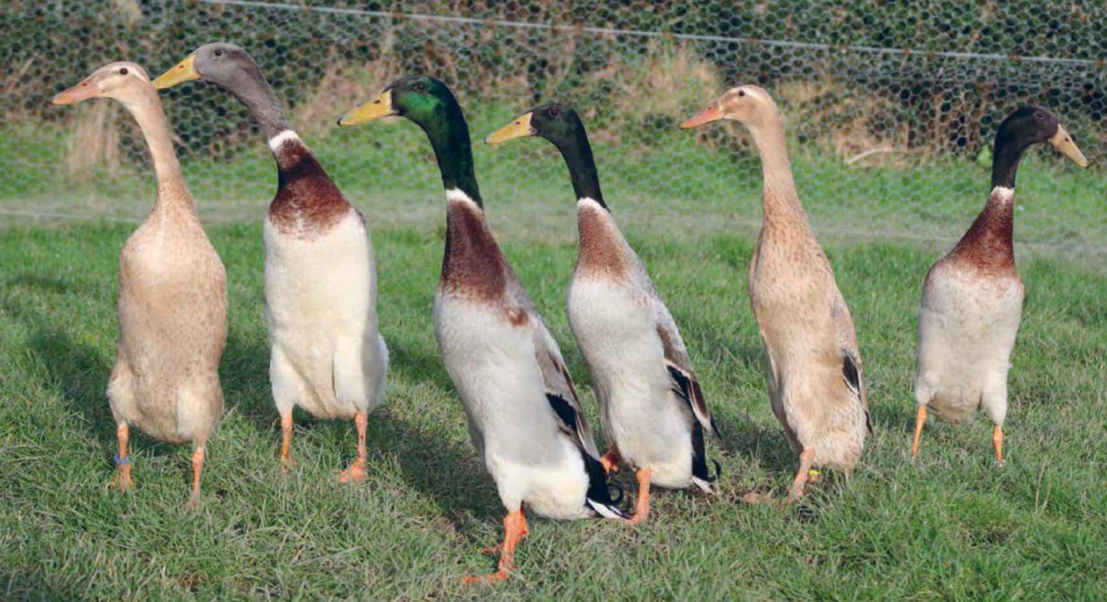
Duck Farming Resources in Zambia
Ministry of Food and Agriculture - Livestock Division
Local veterinary services and extension officers
Poultry hatcheries (some supply duck breeding stock)
Agricultural training centers and universities
Duck farming associations (emerging)
Markets: Chinese/Asian restaurants, hotels, supermarkets
Starting small with 12-20 ducks allows you to learn while minimizing risk
Notes:
Duck farming in Ghana is still developing compared to chicken production, but opportunities are significant. The key to success is starting small, learning the basics of duck management, and gradually scaling up as you gain experience and identify reliable markets. Focus on the Muscovy breed initially due to its hardiness and low input requirements. As the industry develops, processing facilities, specialized hatcheries, and feed suppliers will emerge to support commercial duck farming.

Slide 16
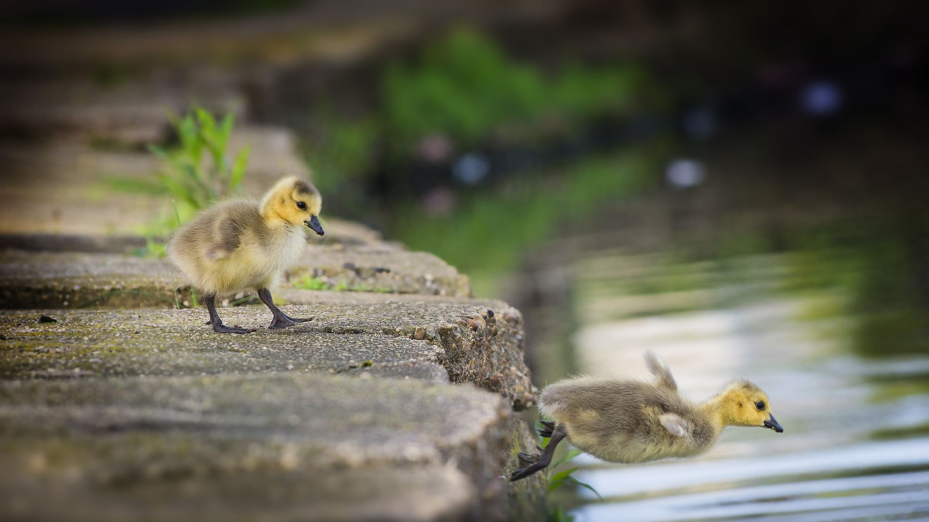
Starting a duck farming business
Minimum of 12 ducks
Do not require large housing and expensive feeds
Not easily affected by avian diseases that affect other poultry birds
You can leave them unsupervised because they can fend for themselves
Ducks can eat insects like termites, cockroaches and grasshoppers, fish eggs and snails.
Don’t necessarily need a pond to be able to rear your ducks but if you want fertile eggs you should consider it.

Slide 17
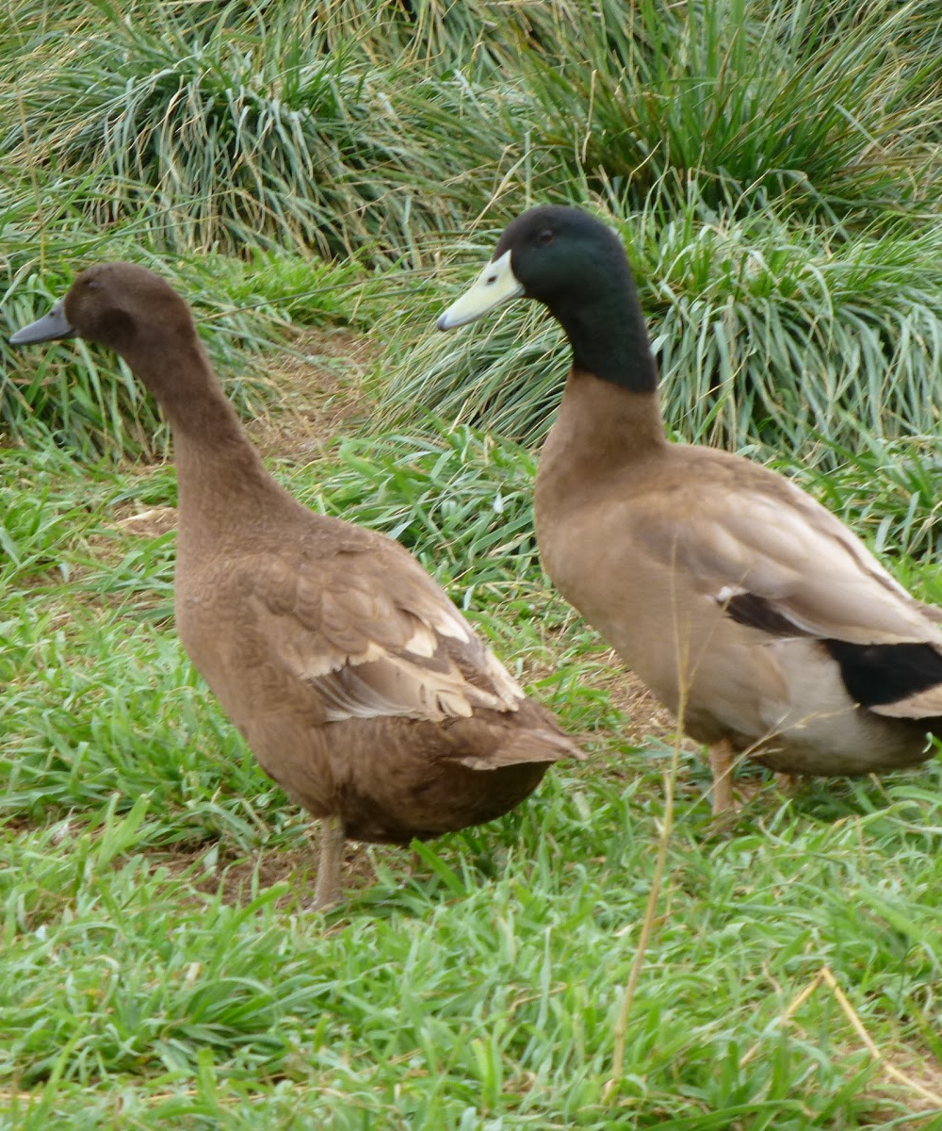
Advantages of duck farming
Khaki Campbell
Duck houses facility does not have to be expensive and elaborate
Ducks can easily adapt to any new environment
They lay eggs in the morning or at night which means that you can collect fresh eggs every morning
You can use your ducks for pest control.
Not a lot of money on duck feed- normally eat rice, corn, cassava and other easily available food. Ducks then to forage on algae, aquatic weeks, fungi, snails, insects etc

Slide 18

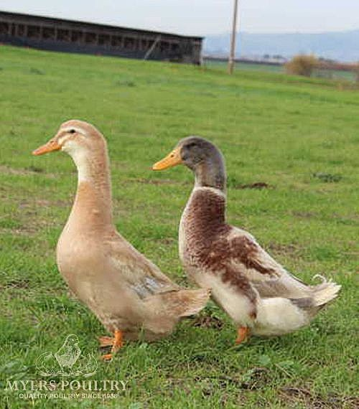
Choosing your duck
  What to look for
    From eight-week stock
    Movement should be normal and balanced
    Good eyesight
    Healthy feathers
    No obvious defects

Slide 19
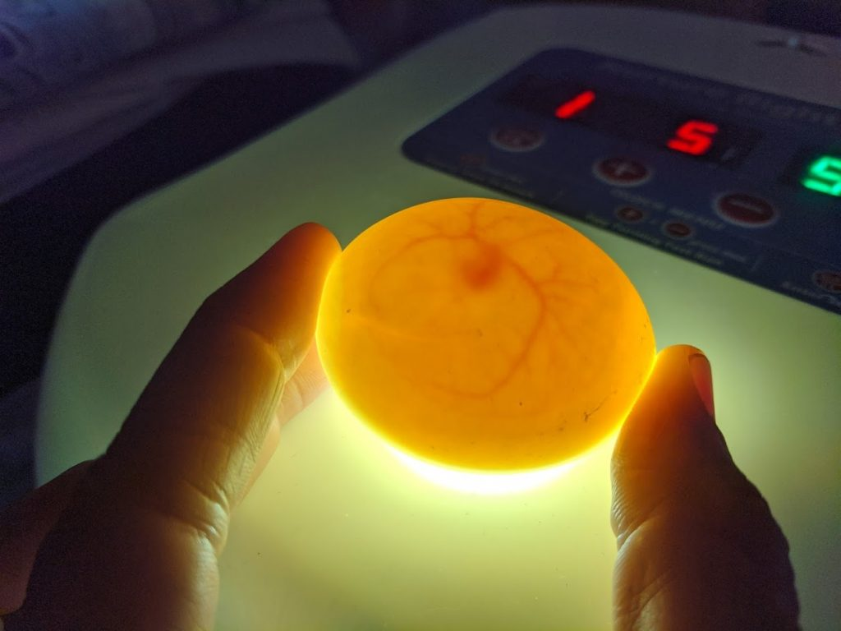
Duck Eggs and rearing ducks
When you are collecting the duck eggs, you must check for the fertilized eggs. The fertilized eggs will be left to be hatched by the female ducks, while the unfertilized eggs will be taken for commercial purposes.
How will you check for fertilized eggs? Remember chicken information.
For your ducks to thrive, it is advisable to keep them in a place with ponds of water. If you rear ducks on dry land, they will still be fine, but they will produce unfertilized eggs that will not hatch into ducklings. Ducks require water to be able to mate.

Slide 20
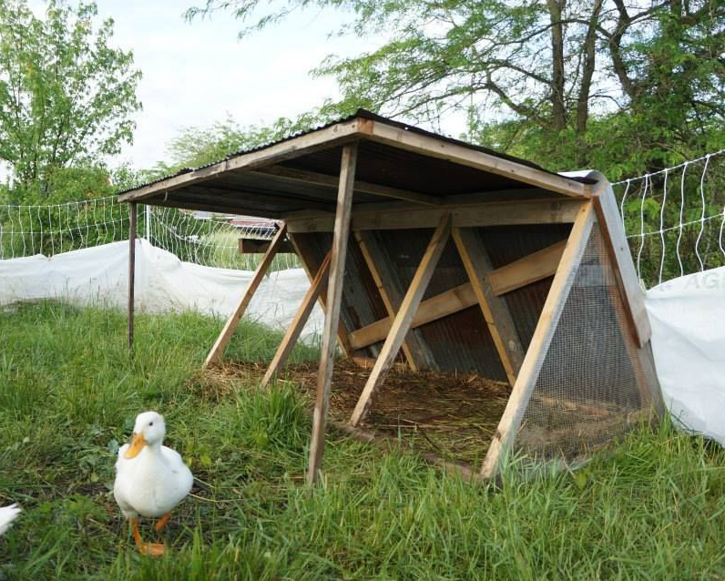
Duck housing and management
Ducks adapt well to a wide range of management systems provided they receive essential basic care.
Protection from predators and extremes in weather
A clean, dry, sheltered area- although they spend most of their time outdoors on ponds or in wet areas, they require a clean, dry area to retreat, rest, clean, and preen their feathers, which allows them to waterproof their plumage, which protects their skin from injury and helps keep their body warm
Clean water for drinking- free from germs and toxins
A diet that provides all of the duck’s daily nutritional needs
Adequate light stimulation, especially for layers
Protection from disease-Biosecurity and vaccinations

Slide 21
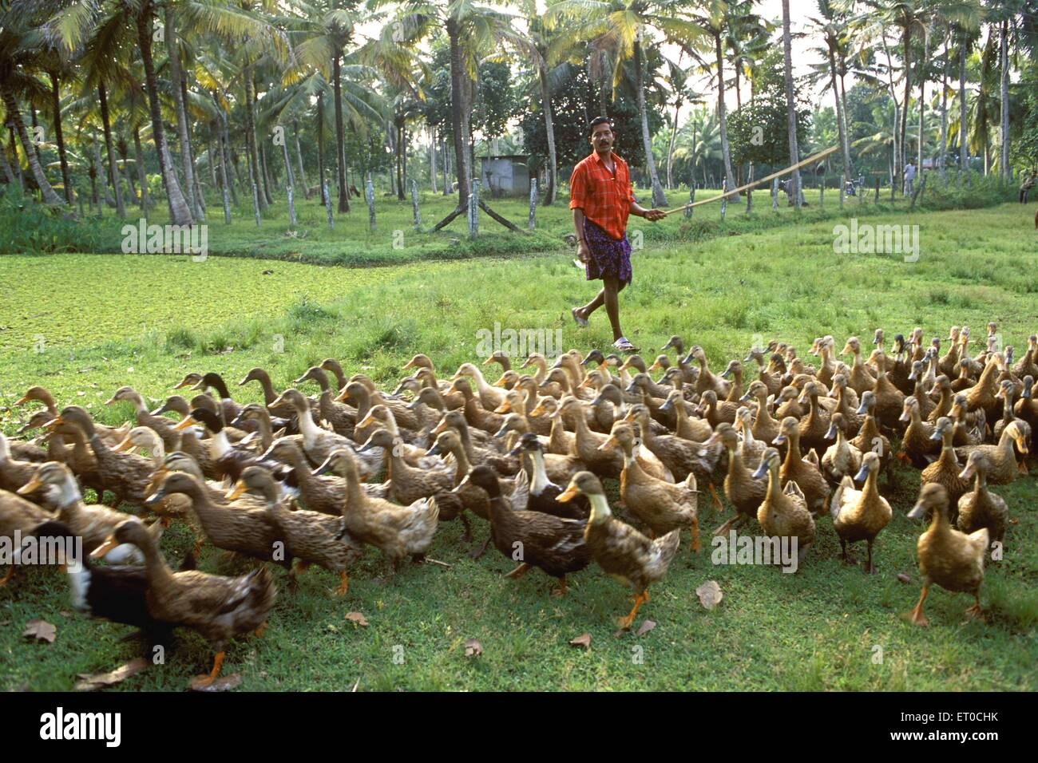
Methods of raising ducks
Small home flock
Raising ducks on open ponds
Herding
Brooding

Slide 22
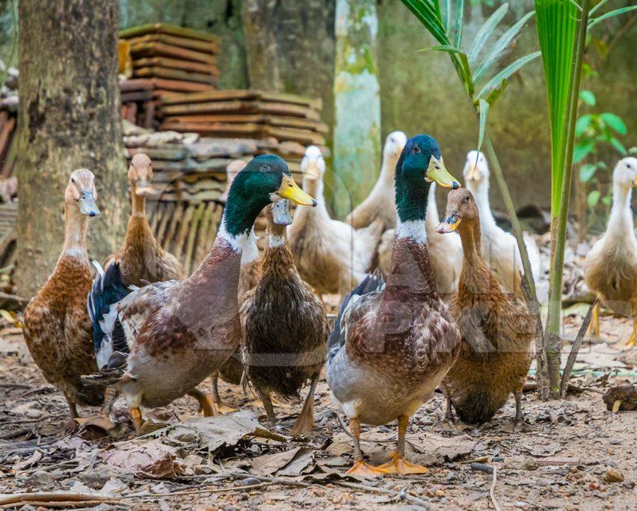
Small home flock
Typical requirements
A brooder for first week or so, to get ducklings started without stress
Yard space
A simple structure, such as a shed, should be bedded with straw shavings or dry absorbent material
Inexpensive fencing
A feed hopper
Well-drained area of yard, so it will drain quickly if it rains

Slide 23
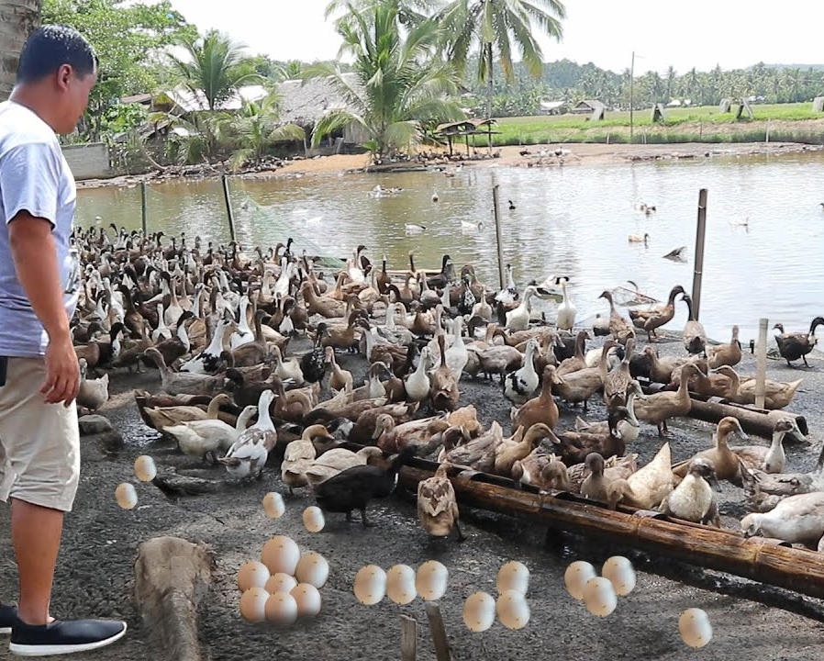
Open ponds
Requirements
Nearby dry sheltered area
Can combine with raising fish for human needs such as tilapia
  Duck manure can be used by fish for food
  May need to supplement food for ducks
  Try to keep wild waterfowl away for biosecurity

Slide 24
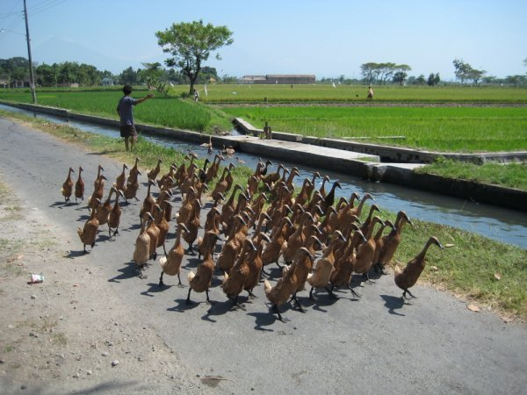
HERDING duck management
Typical for Indonesia herds of 90 to 130
During the day, the flock usually, mature females are allowed to search for food in areas where plentiful
At night, the flock is returned to confinement, usually a bamboo pen, where eggs are laid during the night, which are collected or sold
Major parts of the diet are whole grains, snails, insects, leaf material, crabs, and frogs. Herder's job is to move to a new source of food.
Portable fencing and other equipment are moved with the flock and set up as a base camp.

Slide 25
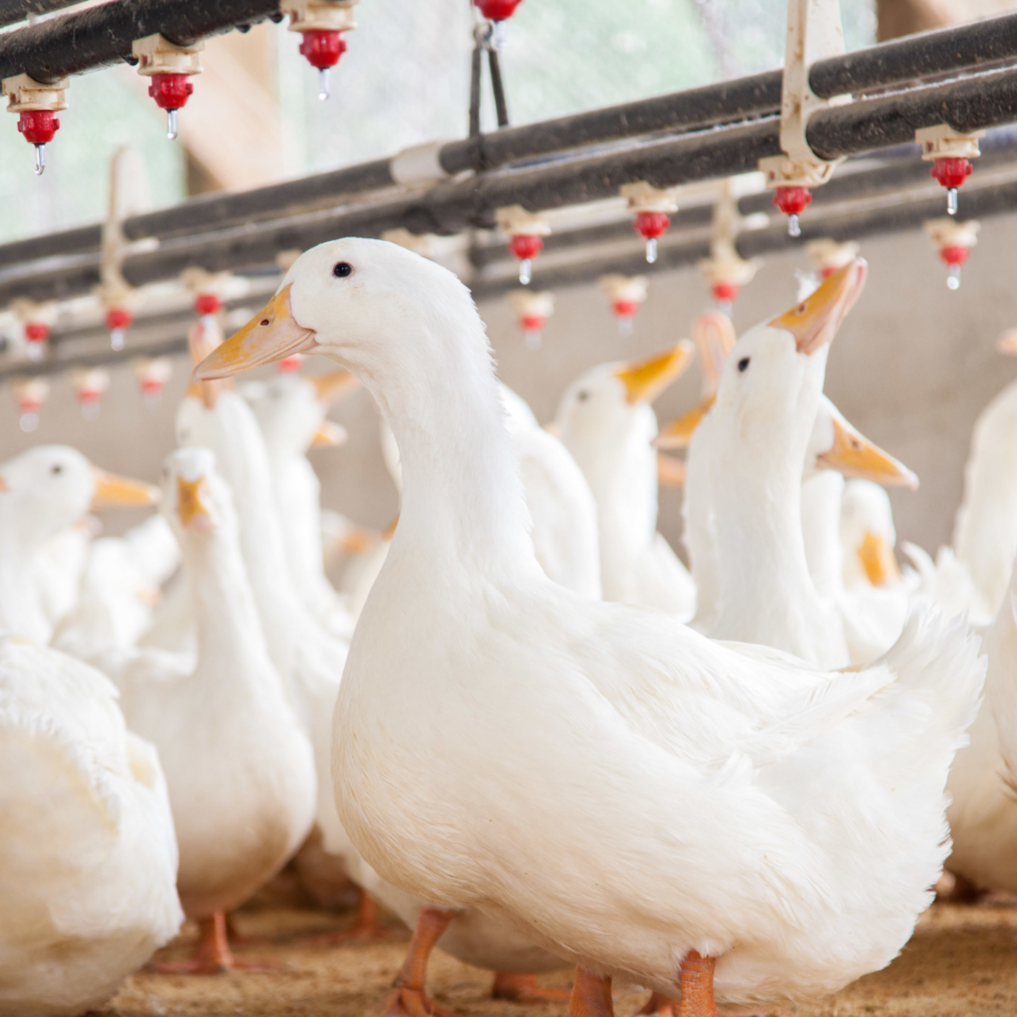
Brooding- commercial
Sources of information
Orr, H.L., 1969. Duck and Goose Raising. Publication 532. Ontario
Department of Agric. and Food, Parliament Building, Toronto, Canada.
j. Scott, M.L., and Dean, W.F., 1991. Nutrition and Management of
Ducks. M.L. Scott, Ithaca, NY 14853.

Slide 26
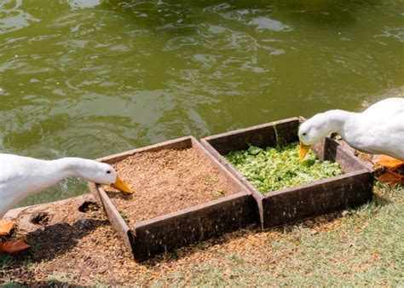
Duck nutrition
Require the same nutrients as chickens, but in slightly different amounts
For small flock owners who have less than 15 ducks and are not able to obtain complete duck feeds or the ingredients to make complete feeds, the following suggestions are offered. (1) If possible, allow ducks access to areas where the flock can forage for green plants, seeds, insects, insect larvae, earthworms, snails, crabs, mollusks, shrimp, crayfish, small frogs, eels, and other material with some nutritive content.
(2) Feed ducks unused garden vegetables, table scraps (bones must be ground), and other food leftovers. (3) If affordable, supplement the flock’s diet with any locally available foodstuffs such as bakery waste, rice bran (if not rancid), wheat bran, brewers' yeast, distillers' grains, broken rice, trash fish (cooked and not putrefied), prawn meal, tapioca chips, palm oil, and similar products.

Slide 27
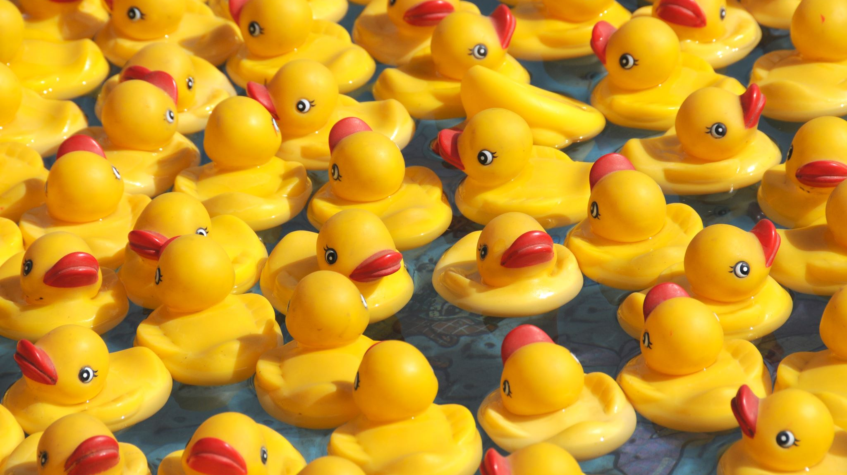
Duck Nutrition
If available and affordable, purchase nutritionally complete commercially prepared duck feeds. If duck rations are not available, and chicken feeds are, they will serve as a satisfactory substitute.
If poultry feed concentrates, which, when fed with grain, constitute a nutritionally complete diet, are available at a reasonable price, this may be a good option. The grain can sometimes be purchased from local farmers at a favorable price.
If feeding chicken feed, use non-medicated feed with 20% protein for about 10 weeks, then 15% protein ration.
Consider adding brewers’ yeast.
Give ducklings water within an hour before feeding to help digestion and keep beak clean.
Ducks are very good at grazing and foraging, even in gardens.

Slide 28
Duck Diseases

Slide 29
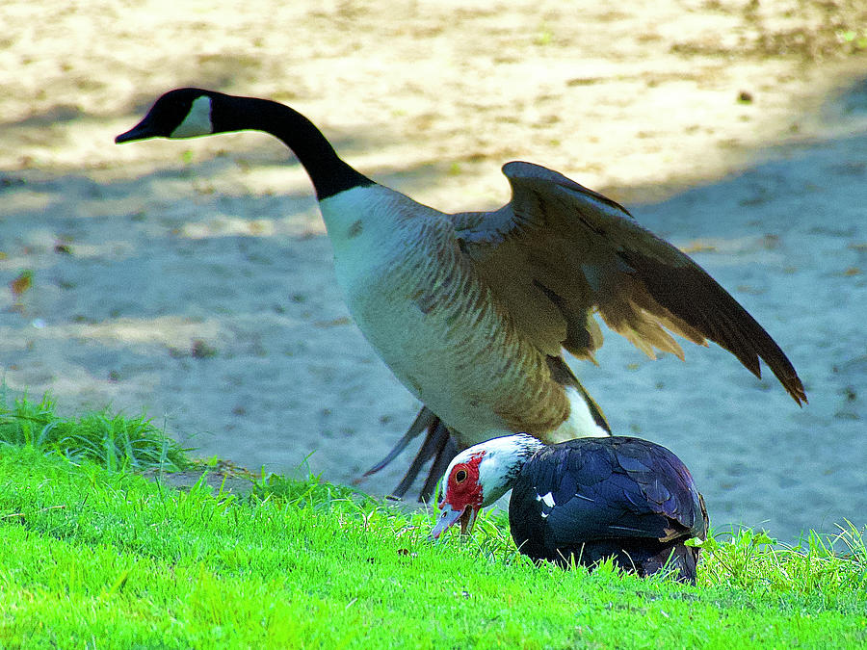
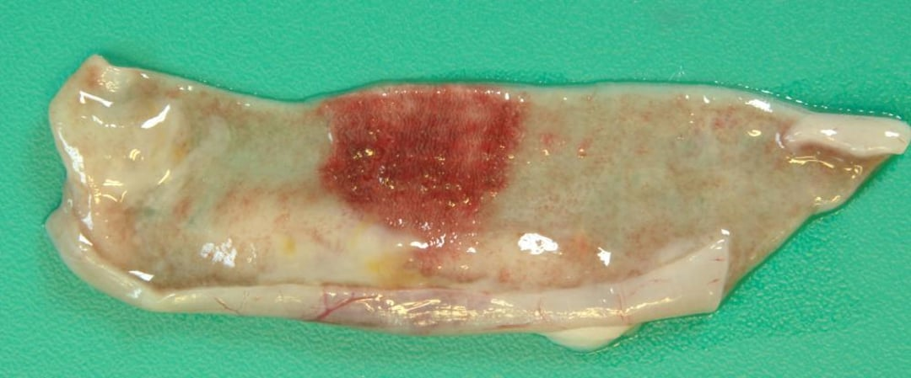
Duck Viral Enteritis
(Duck Plague)
Duck Plague
Etiological agent: Herpes virus
Zoonotic: No
Treatment: None-
Prevention: Biosecurity, clean water, and vaccination of breeders
Signs:
  Sluggishness, ruffled feathers, greenish-yellow diarrhea, blood dripping form nostrils
Highly contagious among waterfowl-wild and domestic
Sudden death, bloody diarrhea, and hemorrhages, Muscovy ducks are more susceptible
Prevention-Biosecurity and vaccinate breeding stock

Slide 30
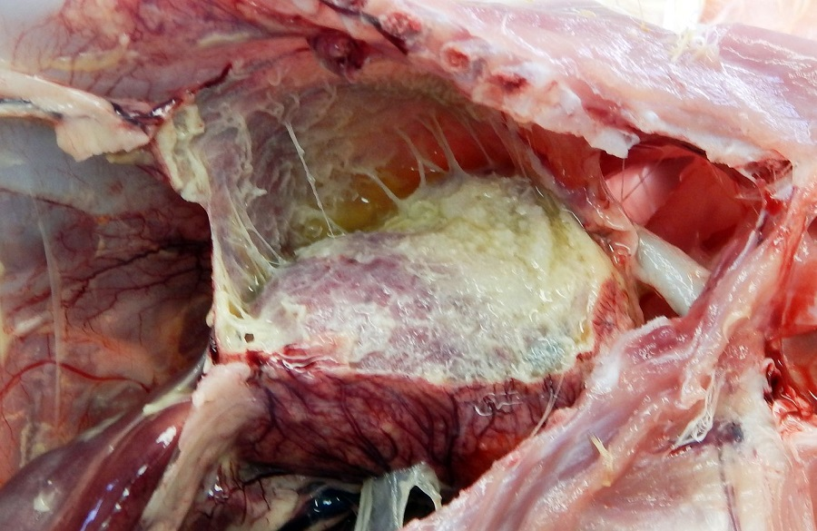
Riemerella anatipestifer Infection
Also called New Duck Disease or Infectious Serositis
Affected ducklings, usually under 7 weeks, may have eye/nasal discharge, coughing/sneezing progressing to tremors of the head and neck, and incoordination, leading to high mortality. Ducklings can be upside down and paddling just before death.
Many will have a fibrinous whitish covering in the chest and abdomen.
Survivors should not be kept for breeding, as it can affect the reproductive system.
Treatment: None-
Prevention: Biosecurity and cleaning between batches of birds. Bacterins

Slide 31
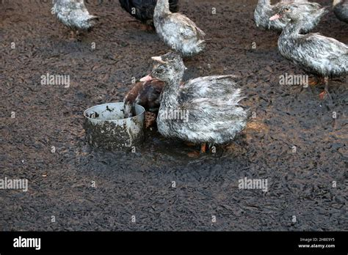
FOWL Cholera
Etiological agent: Pasteurella multocida
Prevention: Biosecurity and avoiding dirty stagnant water
Signs: loss of appetite, mucous discharge from the mouth, diarrhea, and labored breathing.- Liver is enlarged and copper colored after death
Treatment: antibiotics, removal of dead birds, and cleaning. De-population

Slide 32
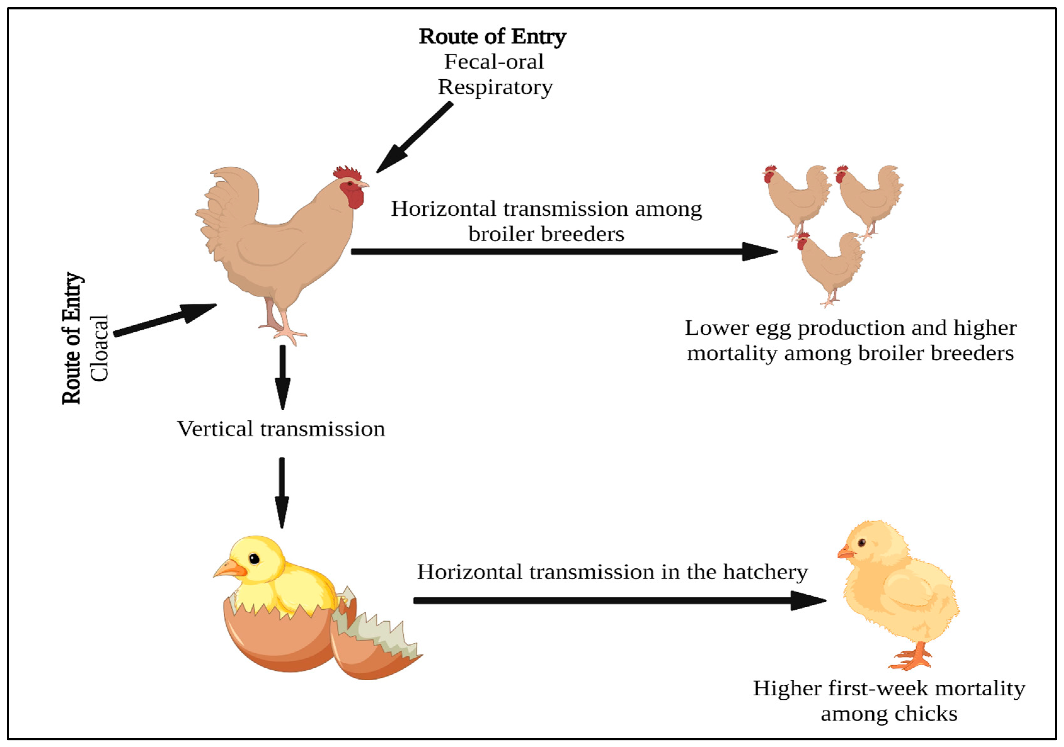
Colibacillosis
(E. coli)
Signs: reduced hatchability, infection of the yolk sac, and a septicemia
Age 2-8 weeks of age
Prevention: good sanitation, especially of water sources
Treatment: sulfdimethoxine ormetoprin

Slide 33
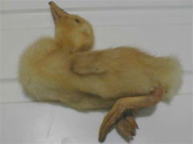
Duck Viral hepatitis
DUCK VIRAL HEPATITIS
Age 1-28 days of age
Prevention: Biosecurity and vaccination of breeding ducks
Keep ducklings away from wild waterfowl and rats
Not ZOONOTIC
Signs- 90% mortality
-becomes lethargic, loses balance
  Spasmodic contractions of legs and die within an hour in a typical arched-backward position.
  Liver enlarged

Slide 34
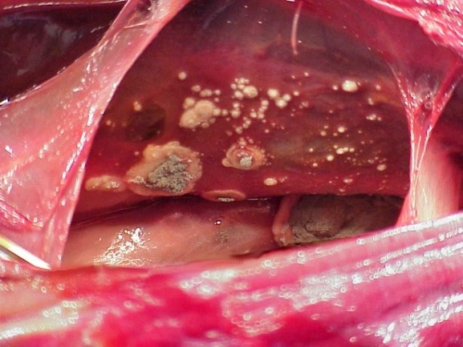
Aspergillosis
Etiological agent: Aspergillus fumigatus spores that grow on straw or damp feed
Signs: death- gasping, listlessness, dehydration
Prevention: avoid moldy straw and preventing feed from getting wet and moldy.

Slide 35
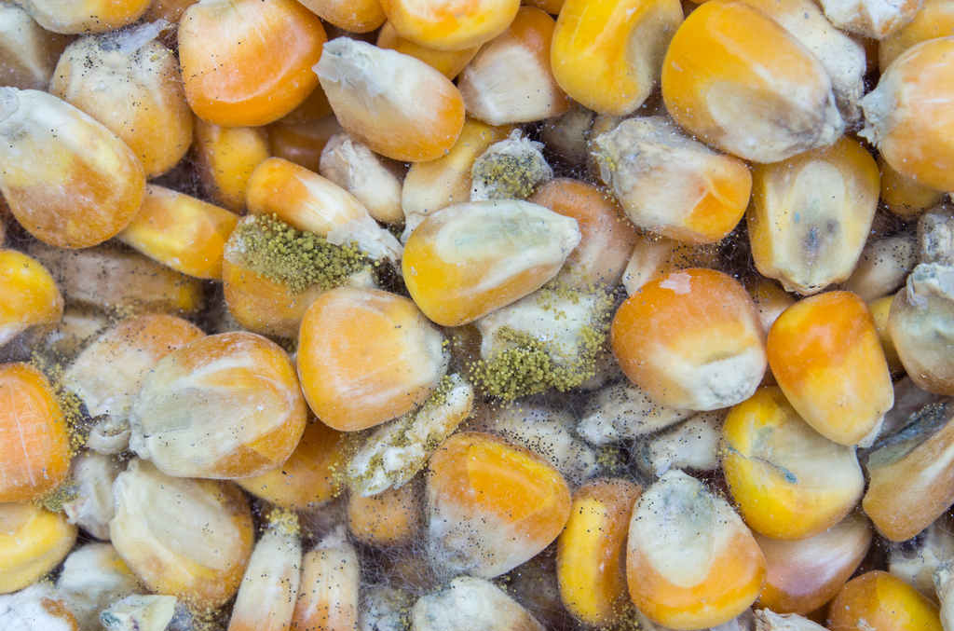
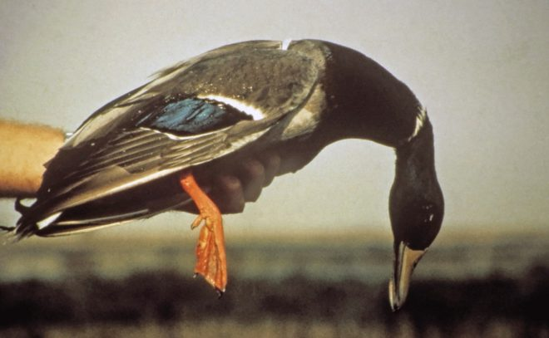
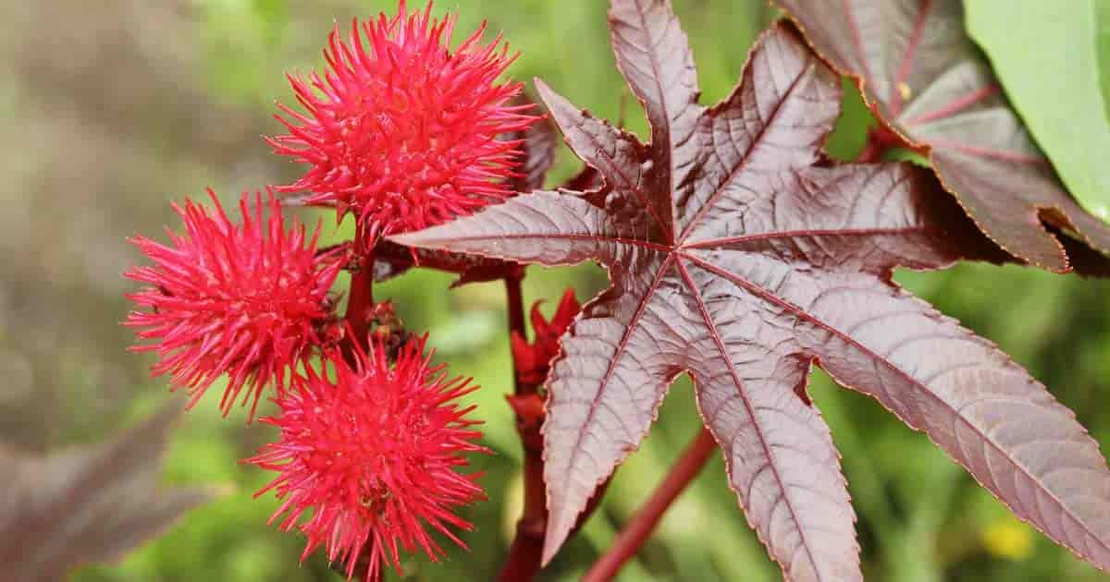
Toxins
  Aflatoxin- mold
  Botulism-stagnant pools
  Castor bean poisoning
  Insecticides rodenticides

Slide 36
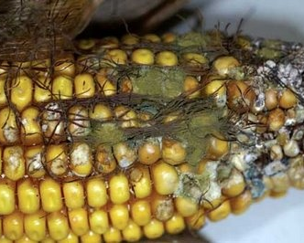
Toxins
Aflatoxin poisoning
Etiological agent- aspergillus flavus and aspergillus parasiticus
Molds that grow on cereal grains and oilseeds
Affects the liver primarily, but can also affect the immune system

Slide 37
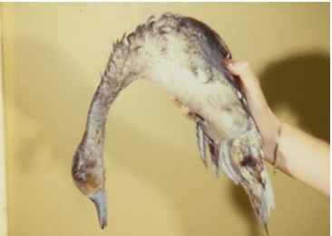
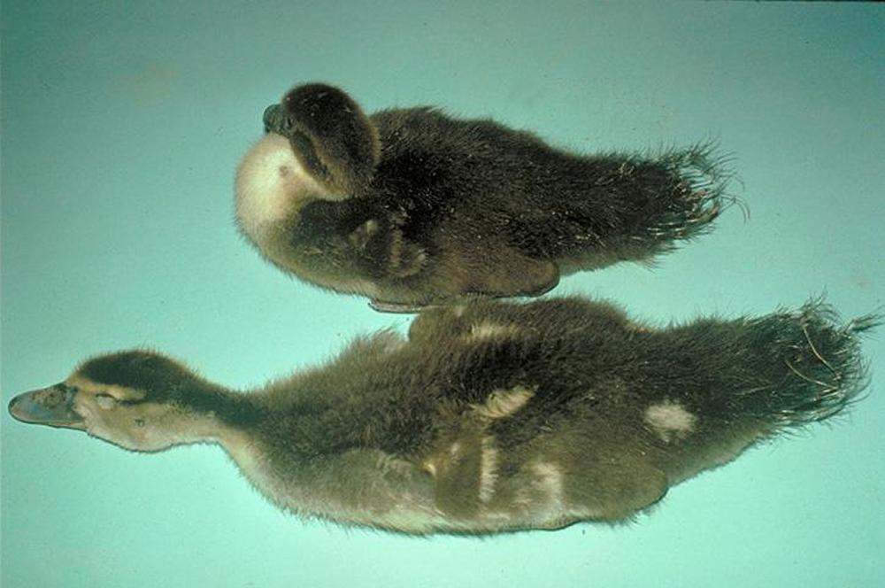
Toxins
Botulism
A toxin produced by a Clostridium bacteria that produces gradual paralysis. Also called limberneck.
Progressive and fatal.
Usually from rotting plants or animals found in stagnant water.

Slide 38
Turkey Production in Zambia
Breeds, Husbandry & Disease Management for Zambian Farmers

Slide 39
Turkey Breeds in Zambia
Commercial & Heritage Turkey Breeds for Zambian Smallholders
Broad Breasted White
Broad Breasted Bronze
Dominant commercial turkey worldwide
Toms: 16–20 kg; Hens: 8–10 kg at maturity
Market age: 16–20 weeks
Excellent FCR – 2.5:1 to 3.0:1
White feathers – clean carcass appearance
Requires confinement & commercial feed
Cannot breed naturally – AI required
Best for peri-urban commercial operations
Traditional heritage-commercial breed
Toms: 13–16 kg; Hens: 7–9 kg
Market age: 18–24 weeks
Distinctive bronze-black plumage
Slightly more disease tolerant than BBW
Generally requires AI for breeding
Premium niche market – visible at holidays
Popular in Zambia for Christmas & Easter

Slide 40
Heritage Turkey Breeds
Naturally Breeding, Hardy Breeds Suited to Zambia's Village Systems
Narragansett
Royal Palm
Bourbon Red
Grey-black plumage; calm nature
Toms 11–15 kg; Hens 6–7 kg
Breeds naturally – no AI needed
Good disease resistance
Thrives in free-range systems
Market age: 24–28 weeks
White with black markings; ornamental
Toms 7–9 kg; Hens 4–5 kg
Excellent foragers; active and alert
Naturally breeds; good brooding hens
Smaller – suits home/village scale
Market age: 28–32 weeks
Rich chestnut-red plumage
Toms 10–12 kg; Hens 5–6 kg
Naturally breeds; mild temperament
Outstanding flavour – premium niche
Hardy; adapts to semi-extensive systems
Market age: 28–30 weeks

Slide 41
Turkey Production Management
Key Husbandry Practices for Zambian Conditions
Housing
Feeding
Brooding Poults
Health & Biosecurity
3–4 sq m per adult turkey
Roosts at 0.5 m height; 50 cm per bird
Ventilated, shaded, waterproof
Deep litter (10 cm): straw or shavings
Keep dry – wet litter causes disease
Separate from chickens always
Predator-proof fencing essential
Poults starter: 28% protein (0–8 wks)
Grower: 20–22% protein (8–16 wks)
Finisher: 16–18% protein (16+ wks)
Turkeys eat 2–3x more than chickens
Fresh water available at all times
Supplement with moringa, termites, insects
Avoid salty or mouldy feeds
Incubation: 28 days
Brooder temp: 35°C week 1, reduce 3°C/week
Poults are fragile – keep warm and dry
Dip beaks in water on day one
Avoid chilling and wet bedding
Brood for 4–6 weeks before outdoor access
Turkey hen lays 80–100 eggs/yr
NEVER mix with chickens
Vaccinate: ND, Fowl Pox, Erysipelas
Deworm every 3 months
Strict all-in / all-out batching
Quarantine new birds 2–3 weeks
Avoid stagnant water near pens
Record deaths, weights, feed monthly

Slide 42
Turkey Diseases
Priority Diseases Affecting Turkeys in Zambia

Slide 43
Critical Turkey Diseases
Priority Disease Screening for Zambian Turkey Flocks
Blackhead (Histomoniasis)
Newcastle & Fowl Cholera
Erysipelas & Mycoplasma
#1 TURKEY KILLER in Zambia
Agent: Histomonas meleagridis protozoan
Signs:
Sulfur-yellow diarrhea
Dark discolouration of head skin
Drooping wings, lethargy
Liver & caecal lesions at necropsy
Prevention:
NEVER house with chickens
Deworm to control Heterakis worm
Rotate pasture; avoid earthworm areas
No treatment available; cull sick birds
Newcastle Disease (ND)
Respiratory distress, green diarrhoea
Twisted neck, paralysis, sudden death
Vaccinate every 2–3 months (ND vaccine)
Fowl Cholera (Pasteurella)
Mucous discharge, laboured breathing
Copper-coloured, enlarged liver
Treat: antibiotics; avoid dirty water
Both: Biosecurity + vaccination essential
Erysipelas (Erysipelothrix)
Sudden death in toms; snood discolouration
Red-purple skin lesions on head/wattles
Treat: penicillin; vaccinate breeder flocks
Mycoplasma (CRD)
Nasal discharge, swollen sinuses
Wheezing, reduced growth and production
No cure; depopulate & restock clean

Slide 44
Turkey Breed Comparison & Recommendations
Breed Selection Guide for Zambian Turkey Farmers
Breed Tom Weight Hen Weight Market Age Breeding Best Use in Zambia
Broad Breasted White 16–20 kg 8–10 kg 16–20 wks AI only Commercial peri-urban production
Broad Breasted Bronze 13–16 kg 7–9 kg 18–24 wks AI only Premium market, Christmas/Easter
Narragansett 11–15 kg 6–7 kg 24–28 wks Natural Semi-extensive smallholder farms
Bourbon Red 10–12 kg 5–6 kg 28–30 wks Natural Village/pastoral premium flavour market
Royal Palm 7–9 kg 4–5 kg 28–32 wks Natural Home/backyard flocks, pest control
ELGF Breed Selection Recommendations for Zambia
Commercial production: Broad Breasted White (fastest growth, highest yield)
Smallholder/pastoral farmers: Narragansett or Bourbon Red (natural breeding, disease-hardy)
Holiday & premium market: Broad Breasted Bronze (premium Christmas/Easter pricing)
CRITICAL REMINDER: Always house turkeys SEPARATE from chickens to prevent Blackhead disease (Histomoniasis)

Slide 45
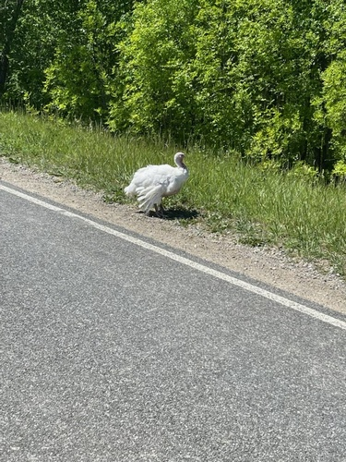
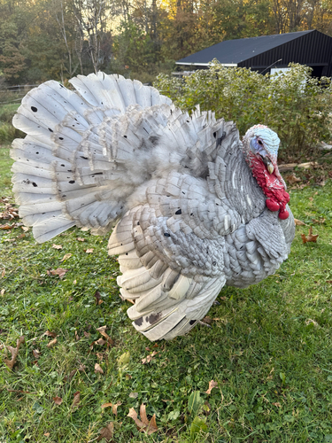
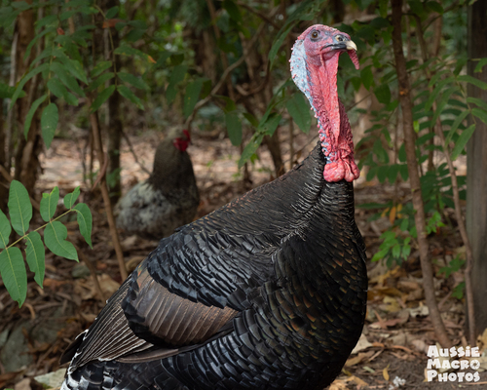
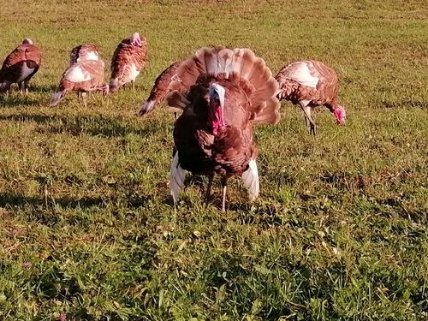
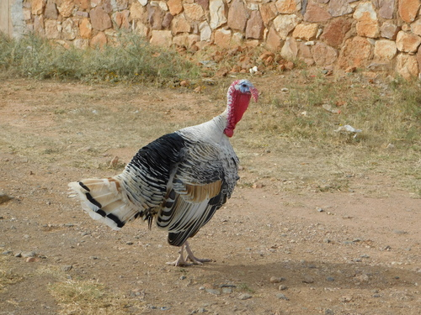
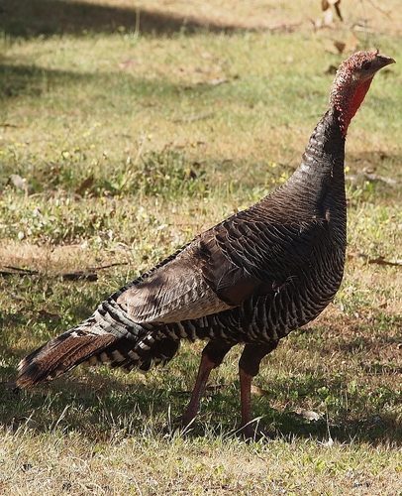
Turkey Breeds – Photo Gallery
Commercial & Heritage Breeds Used in Zambia
Broad Breasted White
BB White – Tom Displaying
Bronze-type Heritage Tom
Heritage Flock – Free Range
Narragansett-type Tom
Bourbon Red-type

Slide 46
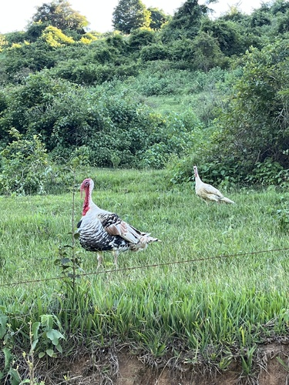
Turkey Housing
Design, Space Requirements & Examples for Zambian Farms
Space Requirements
Minimum 3–4 m² per adult turkey indoors
8–10 m² per bird for outdoor run/range
Overcrowding causes stress, fighting & disease
Roosts at 0.5 m height – 50 cm perch/bird
Housing Design
Orient house E–W to reduce midday sun
Open ridge ventilation to prevent heat stress
Deep litter: 10 cm straw, sawdust or maize husks
Replace litter when wet to prevent Blackhead
Raised mesh floor ideal for disease control
Nesting boxes for breeding hens
Biosecurity
SEPARATE completely from chickens at all times
Footbath at entrance; all-in / all-out batching
Wire mesh to exclude rats, snakes & predators
Free-range heritage turkeys on tropical smallholding

Slide 47
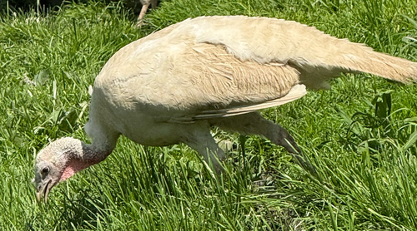
Turkey Feeding & Nutrition
Starter, Grower & Finisher Phases with Zambian Local Feed Sources
STARTER – 0 to 8 weeks
28–30% protein required – highest of all phases
Commercial turkey starter crumble (if available)
If unavailable: high-protein chicken starter + fish meal
Key sources: soybeans (44%), fish meal (60%), blood meal
Feed 24 hours – full ad-lib feeding at all times
GROWER – 8 to 16 weeks
20–22% protein; maize-soy-fishmeal ration
Maize can form 60–65% of ration at this stage
Add: groundnut cake, sunflower cake, moringa leaves
Supplement vitamin E & selenium for muscle health
FINISHER – 16+ weeks to slaughter
16–18% protein; can increase energy (maize, cassava)
Withdraw any medicated feeds 7 days pre-slaughter
Turkeys drink 2–3x more water than chickens daily
LOCAL FEED SOURCES (Zambia)
Maize: 60–70% of ration for energy
Soybeans / groundnut meal: primary protein source
Fish meal / dried kapenta: excellent protein + minerals
Moringa leaves: vitamins A, E, K – add 5% to ration
Termites & insects: high protein, excellent for poults
Cassava: up to 25% for energy (finisher only)
Turkeys foraging – free range reduces feed costs
Heritage flock on open pasture – supplement with grain

Slide 48
Water Management for Turkeys
Clean Water Is the #1 Health Requirement – Turkeys Drink More Than Chickens
Daily Water Requirements
Adult turkey: 0.5–1.0 litre/day (double chickens)
Poults: check every 15–20 minutes for first week
In Zambian heat: water needs increase 30–50%
Provide shade near waterers to reduce evaporation
Waterer Types
Bell drinkers: best for chicks/poults (low, accessible)
Nipple drinkers: hygienic, minimal contamination
Trough waterers: cheap but need daily cleaning
Avoid metal troughs – taste deters drinking
Water Quality Rules
Change water at least twice daily in heat
Clean and disinfect waterers weekly
Never use stagnant or mud-contaminated water
Stagnant water = Botulism risk (limberneck)
Test water pH – ideal 6.0–8.0 for turkeys
Space Requirements
1 bell drinker per 50 poults (0–4 weeks)
1 bell drinker per 30 growers (4–16 weeks)
No bird should be more than 3 m from a waterer
Provide electrolytes in water during heat stress
Turkeys require continuous access to clean, cool water

Slide 49
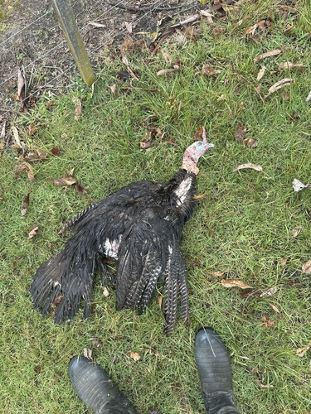
Blackhead Disease (Histomoniasis)
The #1 Turkey Killer in Zambia – Caused by Histomonas meleagridis Protozoan
Clinical Signs
Sulfur-yellow diarrhea (distinctive colour)
Drooping wings, extreme lethargy
Dark bluish-black discolouration of head skin
Loss of appetite, rapid weight loss
Liver: circular, button-like lesions (necrosis)
Caecum: cheesy 'core' of necrotic debris
Mortality up to 100% in naive flocks
Poults 3–12 weeks most susceptible
Prevention & Control
NEVER house turkeys with chickens or ducks
Chickens are asymptomatic carriers – transmit to turkeys
Deworm regularly – targets Heterakis gallinarum worm (vector)
Rotate grazing areas – earthworms also carry parasite
All-in / all-out management; clean litter between flocks
No approved treatment – cull all infected birds
Thorough liming of soil between flocks
Diagnose: post-mortem liver & caecal lesions
Sick turkey: drooping wings, ruffled feathers, lethargy

Slide 50
Other Critical Turkey Diseases
Disease Recognition, Prevention & Response for Zambian Turkey Flocks
Newcastle Disease
Erysipelas
Fowl Cholera
Respiratory & Gut Parasites
Twisted neck (torticollis), paralysis
Respiratory distress, open-mouth breathing
Green-yellow watery diarrhea
Sudden high mortality – 80–100%
Vaccinate: ND thermostable vaccine
Boost every 2–3 months
No treatment – biosecurity critical
Sudden death in toms (breeding age)
Red-purple plaques on snood/wattles
Caused by Erysipelothrix rhusiopathiae
Toms most susceptible at mating
Treat: penicillin G (if caught early)
Vaccinate breeder flocks (bacterin)
Remove dead birds immediately
Mucous discharge from mouth/nostrils
Green diarrhea, swollen wattles/snood
Laboured breathing, sudden death
Enlarged, copper-coloured liver at PM
Caused by Pasteurella multocida
Treat: sulfonamides or tetracycline
Prevention: biosecurity, clean water
Mycoplasma: swollen sinuses, wheezing
No cure – depopulate infected flocks
Caecal worms (Heterakis): carry Blackhead
Deworm: fenbendazole every 3 months
Roundworms: weight loss, poor FCR
External: lice & mites – treat with dust
Record all treatments for traceability

Slide 51
Turkey Health Calendar
Vaccination, Deworming & Management Schedule for Zambian Turkey Flocks
Day 1 (Hatch)
Dip beak in water – ensure all poults drink
Start brooder at 35°C; provide 28% protein starter
Week 1–2
Newcastle Disease vaccine (eye/nose drop method)
Vitamin/electrolyte supplement in water
Week 3–4
ND booster vaccine
Fowl Pox vaccination (wing-web method)
Begin reducing brooder temperature 3°C/week
Week 6–8
First deworming – fenbendazole in feed/water
Erysipelas bacterin (for breeding toms & hens)
Transition to 20–22% protein grower ration
Every 3 Months (ongoing)
ND booster vaccination – critical in Zambia
Deworming – especially free-range birds
Ectoparasite check (lice, mites) & treatment
7 Days Before Slaughter
Withdraw all medicated feeds
Clean waterers and feeders; record final weights
Critical Reminder
ALWAYS keep turkeys AWAY from chickens
Blackhead (Histomoniasis) kills turkeys – not chickens
Regular health monitoring is key to flock productivity

