Slide 1

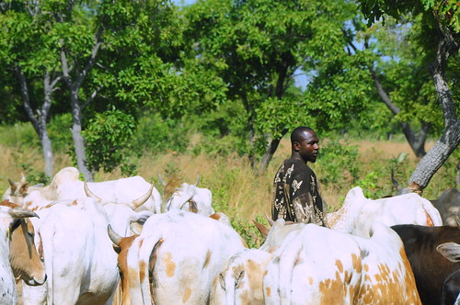
Bovine Training
Dr. Allen Wachter

Slide 2

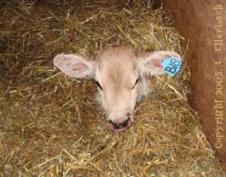
Welcome
Sure is warm in here isn’t it

Slide 3
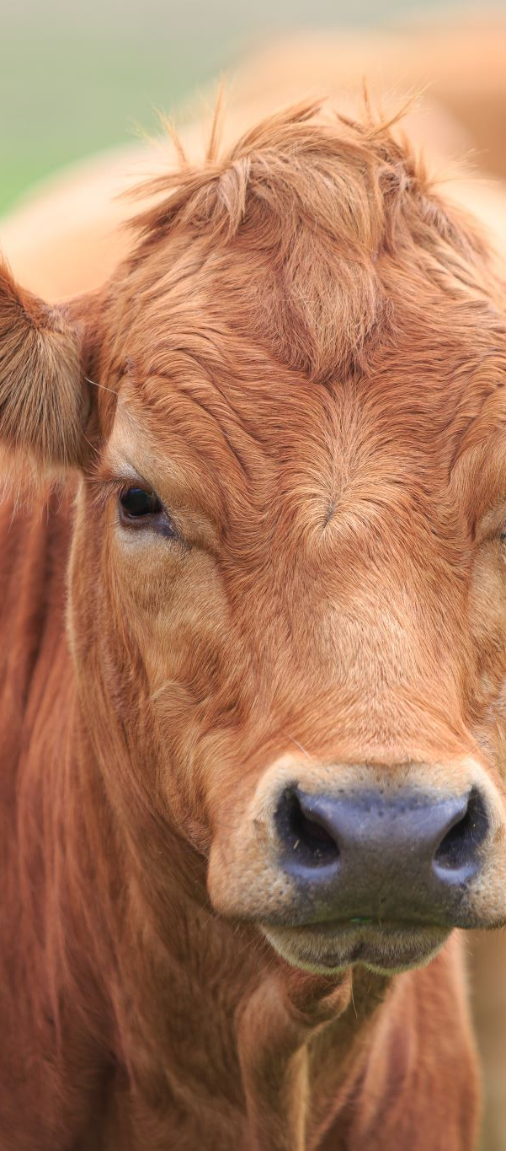
Introduction
Point: Most of the livestock losses that result from poor health can be prevented by proper management.

Slide 4
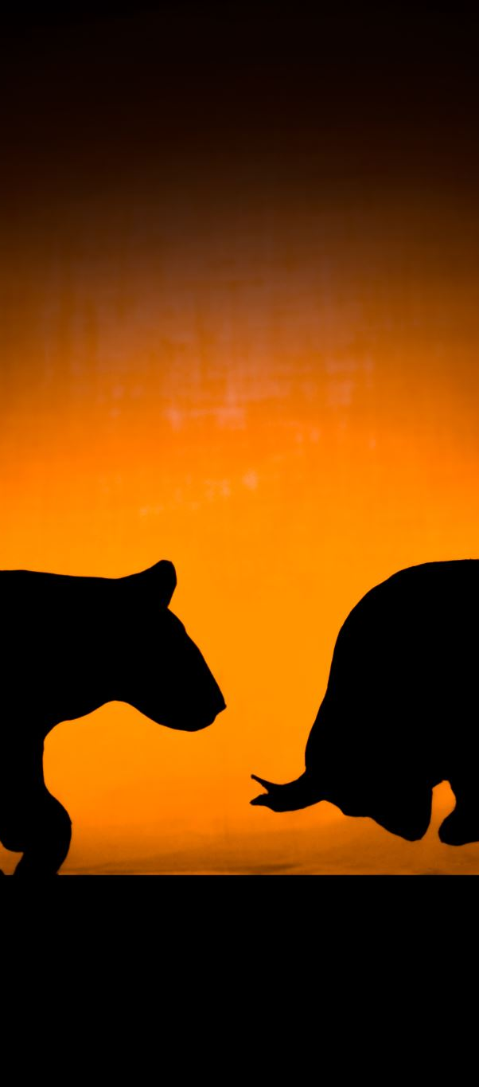
Health
Definition: state of the individual living in complete harmony with his or her environment
A healthy animal may appear healthy but still undergo physiological, anatomical, and chemical changes in response to stress from environment
Difference between healthy and diseased animal is fact that healthy animal hasn’t exhausted its normal adaptive powers

Slide 5
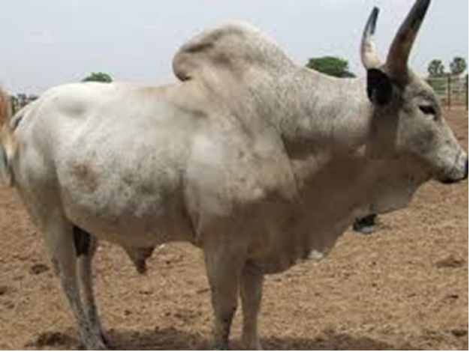
Sokoto Gudali
The Gudalis are principally found in Nigeria, Cameroon and Central African Republic, but a small population also inhabits Ghana. They are known for their hardiness to the arid northerly environments. The Sokoto Gudali cattle are considered as meat and milk animals. Mature weights for bulls averages 550 kg and cows 300 kg. Milk yield is about 4.5 litres per day. Breeding stock can be obtained from some farmers in the Northern part of Ghana and in Nigeria

Slide 6

Disease
Definition: a condition in which the individual overtly shows physiological, anatomical, or chemical changes from the normal.
Two types of diseases
  Non infectious- results from injury, improper nutrition, genetic abnormality, uncomfortable environmental conditions, or exposure to toxic materials.
    Toxic or poisonous
      bacterial toxins
      metallic and chemical poisons (lead, arsenic, copper)
      phytotoxins (from plants)
      zootoxins (snake and insect bites)
      mycotoxins (mold or fungi)

Slide 7
Disease
  Infectious- produced by microorganisms that gain entrance to the body in sufficient numbers and virulence to result in symptoms and changes in body fluids and cells.
    Some examples?- brucellosis, swine erysipelas
  Contagious diseases- term used to describe an infectious agent that is transmitted from animal to animal
    Contagious diseases are all infectious, but not all infectious diseases are contagious
    e.g. tetanus vs. pseudorabies

Slide 8
Disease Transmission
Shedding Route How shed Types of diseases
Body surface Pus, hair, scabs Abscesses, ringworm, cowpox
Mouth Saliva, phlegm Foot and mouth disease, rabies Tuberculosis, erysipelas
Nose Snot, blood Influenza, strangles, anthrax
Eyes Tears Pink eye
Anus Feces Johne’s disease, enteritis, Septicemia
Mammary Gland Milk Mastitis
Urinary and Repro tracts Urine, semen, egg Leptosporosis, pullorum
Wounds Blood Q-fever

Slide 9
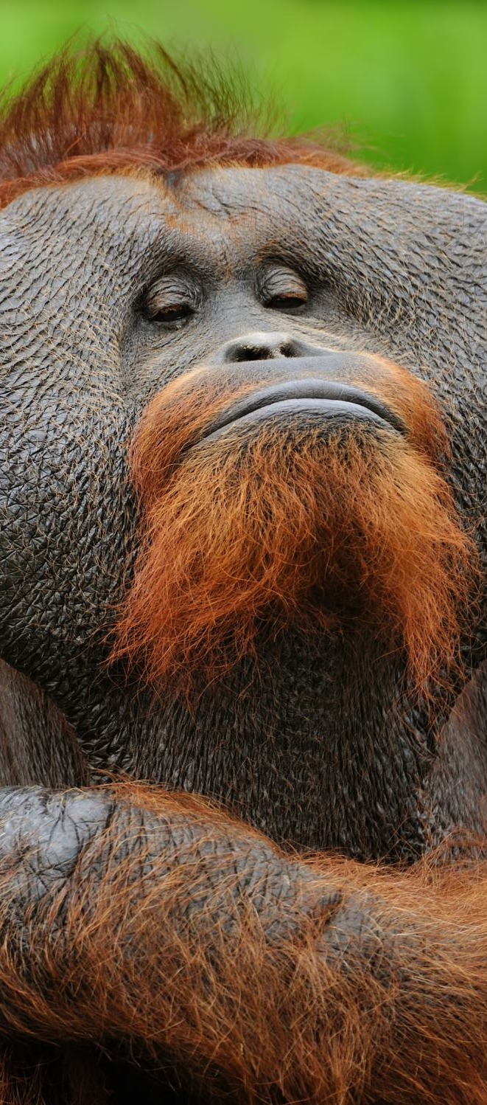
Specificity and our friends
Most organisms like specific tissue
  Eg. Rabies likes ??
  Eg. Pasturella likes ??
What are an animals friends
  Skin, hair, feathers
  Mucous membranes
  Eyelashes, eyelids, tears
  Hair wax, structure

Slide 10
Immunity
Definition: Immunity is an animal’s resistance to the effects of a foreign substance
Antigens are the substances that are recognized as foreign to the body
  Proteins, venom, etc
Antibodies are proteins that are produced in plasma cells in response to a specific antigen
  Bind with specific antigens
  For each antibody produced there is an individual plasma cell line that produces that antibody

Slide 11
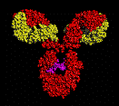
Human IG1 antibody

Slide 12
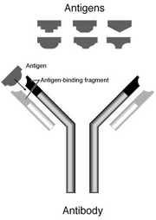
Antigen antibody complexes

Slide 13
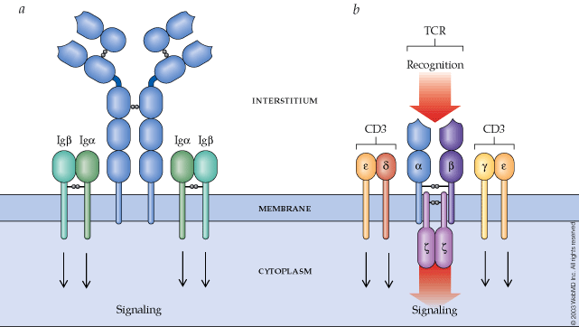
Cell Surface immunoglobulins

Slide 14
Types of Immunity
  Have it for one of three reasons
    Natural
    Passive- From one animal to another
      Placenta. Milk
      Colostrum
        Absorb antibodies via intestinal wall-
        Lost after 3- 48 hours post birth
        Lost over time
    Actively developed- exposure to antigen
        natural infection- disease then healing
        Vaccination- length it lasts varies on vaccine and disease and animals response to vaccine

Slide 15
Resistance
Natural immunity
  Species dependent
  Age, environment, nutrition, fatigue, and genetic makeup

Slide 16
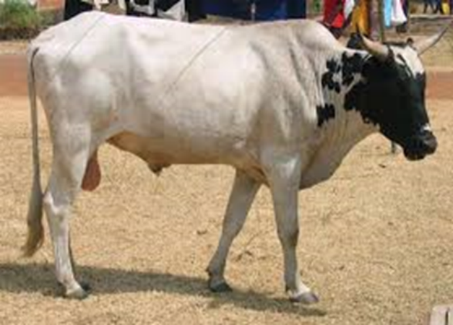
Sanga
Is a cross breed between White Fulani and West Africa Short Horn. The breed is basically a beef animal but in Ghana it is considered as a dual (both beef and milk) purpose animal. It is relatively small in body size with a short and sturdy neck. The hump is rudimentary and usually inconspicuous. It has a short and concave back with an elevated rump. Milk yield is about 2 litres per day and the live weight at maturity, averages 300kg. They constitute 76% of the cattle used for milk production in the smallholder dairy herds of the Accra Plains (Obese et al., 1999).

Slide 17
Immune response
Immune response: the process of recognizing and destroying antigen
  Humoral immune response- production of an antibody in response to exposure to an antigen
  Anamnestic response-exposure to same antigen result in more rapid and stronger response than the first
  Negative phase-If second exposure to antigen is too close to the first, there is actually a drop in the amount of antibodies in the blood for a few days until secondary immune response is under way
  Cell-mediated response: is similar to humoral in that second gives higher response but it cannot be transferred with serum
    Only transferred via cells (lymphocytes)
  Tolerance: Immune system does not recognize the substance as foreign and therefore does not try to get rid of the antigen
    Allergy shots

Slide 18
Sanitation Steps
  The number of organisms in the environment and the incidence of disease outbreaks can be reduced by the implementation of sanitation practices.
  Step # 1- thorough cleaning, including the mechanical removal of waste, manure, and organic material.
    Organic material provides nutrients and provides protection
    Adding soaps will help remove organic material
  Step # 2-Intelligent and application of antiseptics and disinfectants is the second step

Slide 19
Antiseptic
  Substances that kill or prevent the growth of microorganisms- applied to living tissue
    Characteristics of ideal antiseptic
      high degree of germicidal potency
      broad antimicrobial spectrum
      low surface tension
      long-lasting germicidal activity
      rapid and sustained action
      not be harmful or toxic to animal tissue

Slide 20
Disinfectants
  Products that prevent infection by the destruction of pathogenic microorganisms- usually to inanimate objects
    Characteristics of ideal disinfectant
      stable and does not loose effectiveness when in contact with organic material
      dissolves readily in water
      readily destroys many forms of microorganisms
      minimal toxicity and capable of killing lower forms of life with little or no effect on man and animal
      noncorrosive
      minimal odor which will not contaminate products intended for human consumption
      power of penetrating cell walls
      economical
      compatible with and effective in the presence of soaps and other chemical substances

Slide 21
Other terms
  sanitizer- special form of disinfectant that is capable of reducing the numbers of microbial contaminants to levels considered safe by public health requirements
  Sterilization refers to the complete destruction of all forms of life, especially microorganisms, by some chemical or physical means
  Germicide is an agent that destroys microorganisms
    Amebicide, bactericide, fungicide, and viricide

Slide 22
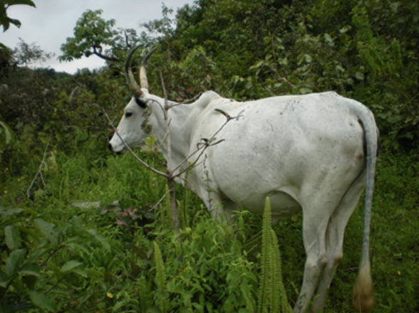
WHITE FUlani
This cattle breed has great potential as dual-use (milk and beef). Average daily milk yield per cow across breeds was 2.0 litres. Average body weight of the mature bulls is about 350 to 665 kg. And the cows on average weight about 250 to 380 kg. White Fulani cattle are very hardy and strong animals. They are well adapted to long distance trekking in the pastoral management. They can survive and perform well in hot weather

Slide 23
Types of disinfectants
  Alkalies- ph > 9, very irritating
    Sodium hydroxide most common- milking equipment
    Unslaked lime added to water
    Acids- vinegar
  Phenols and Related compounds
    Carbolic acid-most efficient disinfectant- expensive
    Cresol- trucks, pens, railway cars
    Orthophenylphenol- odorless in barns usually
  Halogens
    Chlorine- excellent disinfectant but is readily destroyed by organic material, corrosive to metals
    Iodine- most effective for use on skin 2-7% solutions-stains skin
  Alcohols
    Require prolonged contact 22 min for killing bacteria
    Ethanol Rubbing alcohol not good
    Isopropanol- not effective, causes dilatation of surface blood vessels

Slide 24
Types of disinfectants
  Oxidizing Agents
    Hydrogen Peroxide-washing and cleansing wounds
    Permanganates- antiseptic and antifungal
  Other disinfectants
    Quaternary ammonium compounds- good, inactivated by organic matter and soaps
    Detergents, wetting agents, emulsifiers- non toxic to living things
    Soaps- remove oily compounds
    Chlorhexidine- general disinfectant- used mostly for utensils

Slide 25
Other means of sanitizing
Fumigation- most effective-
  Airtight for 8 hours, and need thorough cleaning and allowed to air out for 48 hours before occupation.
  2 people
  Usually use potassium permanganate or formaldehyde powder
Miscellaneous sanitation measures
  Get rid of dead animals
  Mud holes filled
  Adequate supply of clean, cool, fresh water
  Clean, clean, clean to interrupt parasite development

Slide 26
Drugs
Types of drugs used by veterinarians
Pharmaceuticals-treatment
Biologicals-prevention

Slide 27
Pharmaceuticals
  Diagnosis first
  How to achieve and maintain adequate levels of active drug
    Route of administration
    Dosage
    Frequency of dosage
  The ideal chemotherapeutic agent
    Selective and effective antimicrobial activity
    Bactericidal and not merely bacteriostatic
    Not result in buildup of resistance in target microorganisms
    Capable of providing adequate tissue levels quickly and maintaining these levels over time

Slide 28
  WITHDRAWAL TIMES
    Milk and meat
    Know them- read the manufacturer’s product label
    You can become culpable
    FDA is increasing amount of chemicals, drugs, and feed additives for certain categories of animals or for all animals
under certain conditions.
    Labeled vs unlabeled use
    PUBLIC SAFETY
      e.g. child with penicillin allergy
    http://sulaco.oes.orst.edu:70/1/ext/farad
      updated data base available for pharmaceuticals and withdrawal periods
    Your responsibility- tell the farmer/ warn him
    Be careful of mixing and giving combinations
      organophosphate-cholinesterase inhibitor- don’t use with another cholinesterase inhibitor

Slide 29
Antibiotics
    Broad spectrum
      bacitracin- commonly used skin and wound
      dihydrosptrptomycin- pneumonia every 8 hours
      penicillin- resistances
      tetracyclines- bacteriostatic
      neomycin-broad spectrum
      sulfas-bacteriostatic *** adequate withdrawal***
      nitrofurans-broad-spectrum drugs-only topically

Slide 30
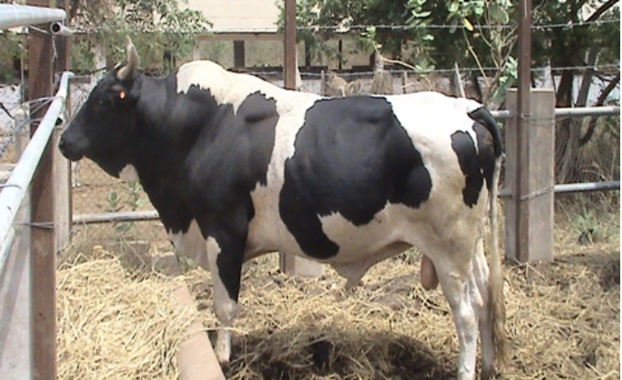
Friesian Sanga
The Friesian-Sanga and Sanga are two breed groups of cattle raised by the Animal Research Institute of the Council for Scientific and Industrial Research (CSIR-ARI). Ghana with the objective of evolving a dual-purpose cattle breed for use on the Accra Plains. Total milk is 305-day milk yield/day and lactation length. This is a crossbred between the Sanga and Friesian, does very well and can produce about 8-10 litres of milk/day and live weight of about 450 kg. The breeding stock can be obtained from Amrahia Dairy Farm in Gt. Accra Region and some farmers in the Accra Plains or the Northern part of Ghana.

Slide 31
Miscellaneous pharmaceuticals
  Steroids-< inflammation
  Hormones- produced by endocrine glands
    Oxytocin

Slide 32
Biologicals
Biologics
  Biologicals are effective in preventing disease because they elicit the antigen-antibody reaction in the animals body
  ANTIGEN for disease ---administer---ANTIBODY---formed

Slide 33
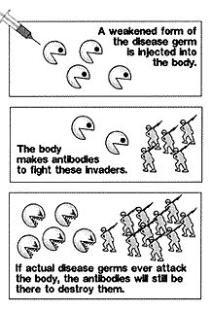
How vaccines work

Slide 34
Guidelines for Biologics
      Keep biologicals refrigerated but not frozen
      Reconstitute vaccines at time used-no sunlight
      Never use needles or syringes that have been sterilized by chemical disinfectants
      Never mix a biological with other substances
      Never use after expiration date
      Reputable manufacturer and distributor

Slide 35
Vaccines
Term that implies or is used to mean all types of biological agents that produce active immunity
Types of Vaccines
  Bacterin- killed culture of bacteria
    Blackleg, leptospirosis, streptococcus, salmonella, pasteurella, bordetella, and staphylococcus
    Mixed bacterin- more than one type of organism
    Autogenous bacerin- made from an organism isolated from an infection in animals on a given premise
    Stock bacterin- used from a bacterial culture
    Live bacterial spore vaccines-effective against bacteri that have the ability to form spores that are very resistant to environmental conditions. Bacillus anthracis
    Live bacterial vaccines of reduced virulence- made from strains less virulent- Bruscella abortus strain 19 vaccine

Slide 36
Types of vaccines
    Killed virus- organisms killed and are then used as antigens
    Modified live virus vaccines- grow live virus on culture and then modify
      Virus has to multiply in the body
    Antiserum-blood serum containing specific antibodies against a disease
    Antitoxins- antiserums that contain antibodies to bacterial toxics- tetanus antitoxin
    Toxoids-detoxified toxins that are used as antigens to stimulate production af an antibody against the toxin
    Adjuvants- substances added to a biological that enhances the antigen’s ability to stimulate antibody production.- they delay absorption of the antigen and by themselves stimulating the immune system to some extent.

Slide 37
Type and route of Vaccines
      killed safer than modified
      modified provide better stimulation
        esp. ibr and bovine parainfluenza intranasal provide better immunity

Slide 38
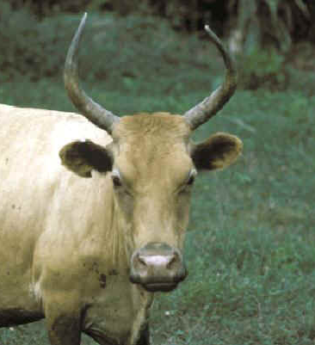
N’DAMA
The N'Dama is a hardy breed, medium size type (100 cm at shoulder height for cows; 120 cm for bulls) with a large and strong head and with lyre-shaped horns. Cows produce only 2 to 3 liters milk per day during 7 to 8 months. Average liveweight for a mature steer varies between 250 to 300 kg.

Slide 39
Administering Pharmaceuticals and Biologics
General ideas:
Approach with caution
  If administered topically- if animal has sensitive lesion that will hurt
  If administered orally-may resist the drenching bottle, dose syringe, or balling gun.
  If by injection there may be a strong, quick reaction from the animal
  POSITION/ RESTRAINT
  Check out the anatomy

Slide 40
Topical route
  Def- a topical application is one in which the medicine is applied to the skin or to the mucous membranes of the eye, ear, or nasal passages.
    Ointments, aqueous solutions, powders, and aerosols
      Be careful- gloves to apply

Slide 41
Oral route
  Dependent upon the condition of the digestive system at the time of administration and tolerance of the animal’s system to the product.
  Types
    Tablet, pill, capsule, and liquid form.
  Means
    Feeding of drugs- must make sure eats the drug
      Drug must be palatable to them
    Balling guns- blousing

Slide 42
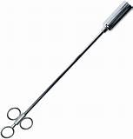
Balling Guns
    Balling guns- blousing
      used to give boluses, capsules, and tablets
      Placed on back of the tongue
      Equipment necessary:
        Squeeze chute, head gate, stanchion or halter
        Bolus(balling) gun
        Bolus (Tablet, capsule, or magnet)

Slide 43
Step by Step procedure
        Assemble necessary equipment- use the right size equipment
        Restrain the animal
        Load the bolus gun by inserting bolus into the head of bolus gun- hold it upright
        Open the animals mouth- stand near animal’s head and face same direction as animal
        Place nearest arm over animal- and place thumb into animals mouth
        Apply downward pressure as you squeeze jaw between thumb and four fingers
        Insert bolus gun into the animals’ open mouth, along the side of the mouth and tongue to the base of the tongue. Gently push the gun back into the animal’s mouth and allow the animal to swallow the head of the bolus gun.- Don’t force it
        After the animal has swallowed the head of the bolus gun, depress the plunger to dispense the bolus and pull out the gun
        Observe animal for a few seconds to make sure it doesn’t spit it out.
        Release the animal

Slide 44
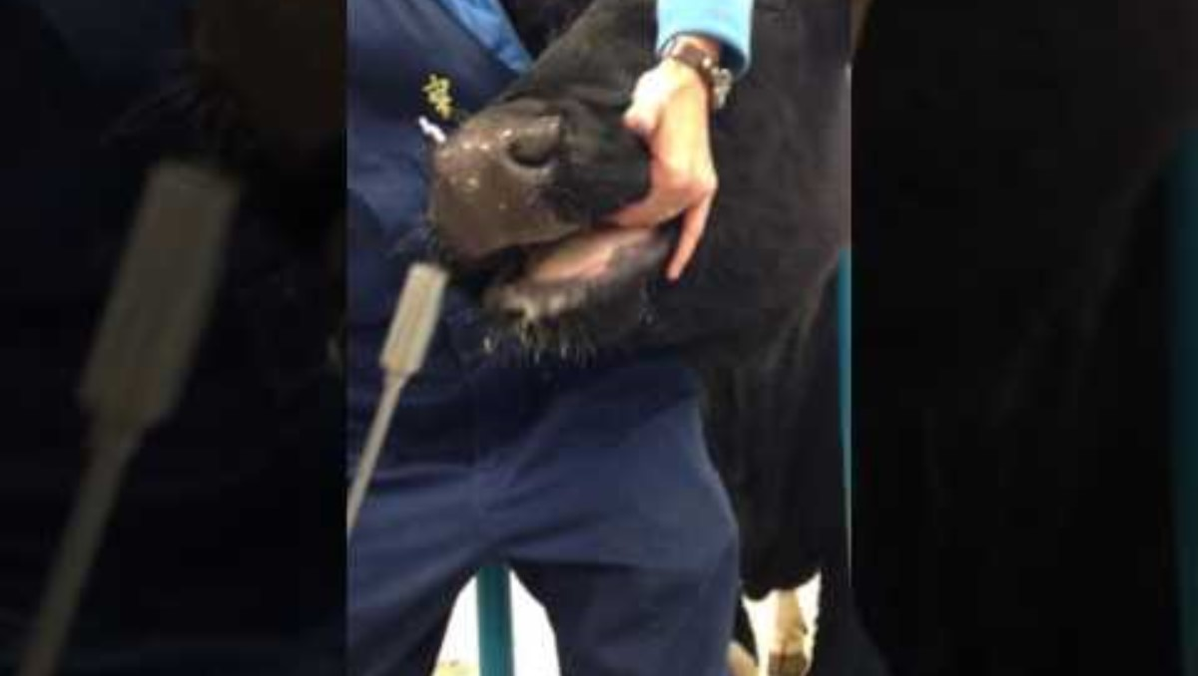

Slide 45
Drenching
      Give liquid up to 1 quart of liquids or suspensions to cattle, sheep, and goats.
      Proper restraint
      Equipment needed
        Squeeze chute, head gate, stanchion, or halter
        Drenching syringe or long-necked bottle
        Drench

Slide 46
Drenching
      Procedure
        Assemble the necessary equipment- drenching syringe must be soaked
        If meds are powder – make the solution
        Restrain the animal
        Load the drenching syringe or bottle.
        Open the animal’s mouth
        Open the animals mouth- stand near animal’s head and face same direction as animal- put leg under the animals neck
        Place nearest arm over animal- and place thumb into animals mouth
        Apply downward pressure as you squeeze jaw between thumb and four fingers
        Raise animals head and insert the drenching syringe or bottle into the animal’s mouth. Along side of mouth and tongue.
        Observe the animal for a few seconds before releasing it. Watch for signs of inhalation pneumonia

Slide 47
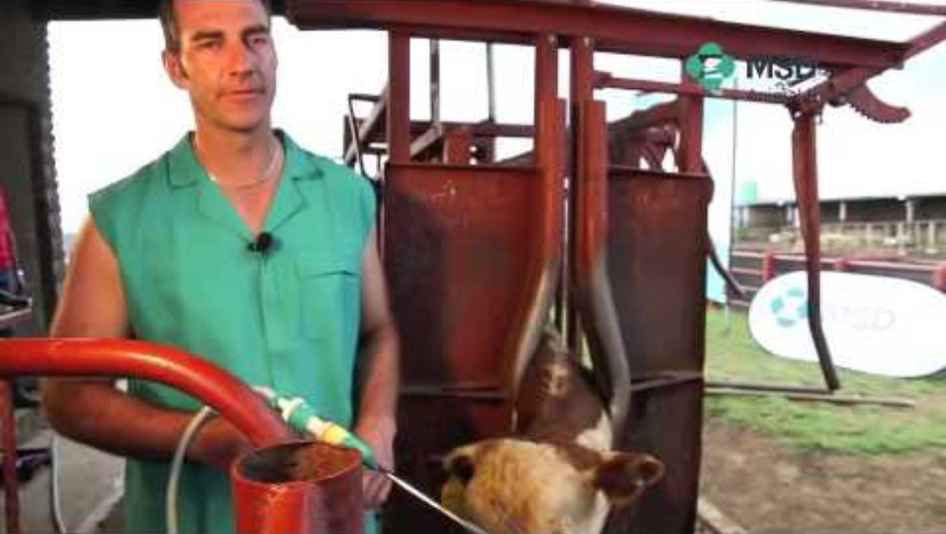
Drenching

Slide 48
Dose syringe
      Used to administer small amo9unts of liquids and suspensions, especially to horses and hogs.
      4-6 ounce syringe
      Procedure:
        Place animals head parallel to ground if possible
        Nozzle placed into the corner of the mouth, oriented over the base of the tongue, and plunger slowly depressed to deposit the drug into the back of the mouth.

Slide 49
Injectable (Parenteral) Route
  Definition: the administration of a drug directly into an animal’s body by the use of a needle and syringe
  Why?
    Act rapidly
    Utilized more efficiently
    Act longer than when they are given orally or applied topically
    Prevent GI irritation
  Disadvantages
    More expensive
    Requires sterile technique
    Local irritations
    Greater chance of systemic allergic reaction

Slide 50
Needles
    IV Bovine 14 gauge
    IM/SQ
      Bovine, Equine 18 gauge 1 ½ Inch
      Ovine, Porcine, Caprine 20 gauge 1 inch

Slide 51
Filling syringe
    Pull back on plunger and fill the syringe with amount of air equal to the amount of the medication to be placed in the syringe
    Pass the needle through the cleansed rubber stopper which has been cleaned with alcohol- slowly inject air
    Make certain only bevel through the end of the bottle
    Remove all air bubbles from the syringe by holding it upright, tapping on it with your finger- push air bubbles back into bottles
    Pull the needle straight out to remove it from the stopper
    Should you cap the syringe at this point?????
    Tricks for given Large animal injections
      Pinch the skin 2-3 “ from the injection site
      Slap firmly two or three times on the injections site, then insert the needle with a quick thrust
      Pull loose skin down over the needle when making a sq injection.

Slide 52
Types of injections:
    Subcutaneous- beneath the skin but on top of the muscle layer.
      Location-
        equine, bovine-side of the neck
        ovine, porcine, caprine- axillary space area
      Tips
        Can give 2-30 cc
        Massage area
        18-20 gauge 1to 1 ½ “ needles
        Lambs, pigs, kids. 20-22 gauge ¾” to 1”

Slide 53
Subque injection
      Technique;
        Lift the skin away from the underlying tissue with the thumb and index finger of your free hand.
        Into raised area- insert the needle with a sharp, quick, yet controlled jab.
        Push needle into until you are holding a fold of skin over the hub of the needles.
        Lightly pull out plunger and observe for blood.
        Administer injection
        Massage area

Slide 54
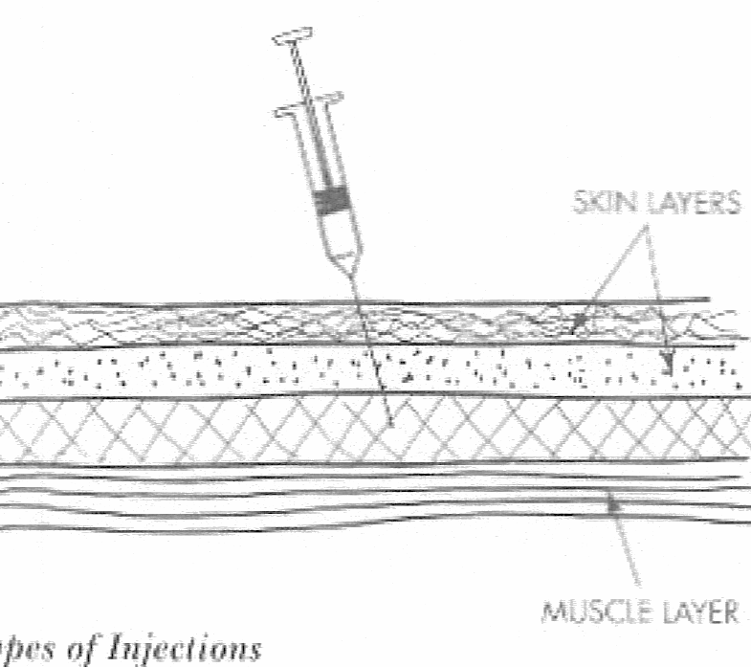
Subcutaneous injection

Slide 55
Intramuscular
      Made directly into a major muscle mass with 18-20 gauge needle that is 1- 1 ½ inches long
      Find the proper species location
      Technique
        After site is determined distract the animal’s attention by pinching the skin next to the intended injection site or by slapping the injection site firmly
        Immediately after slap or pinching-insert the needle with a sharp, quick thrust.- always go inward.
        After inserting, pull back to see if you have any blood

Slide 56
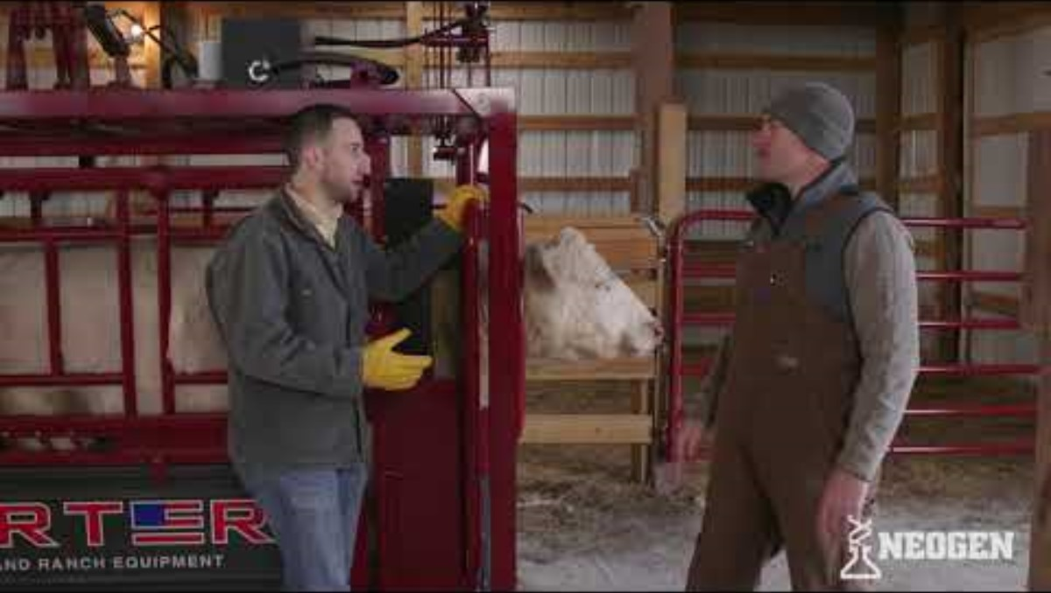

Slide 57
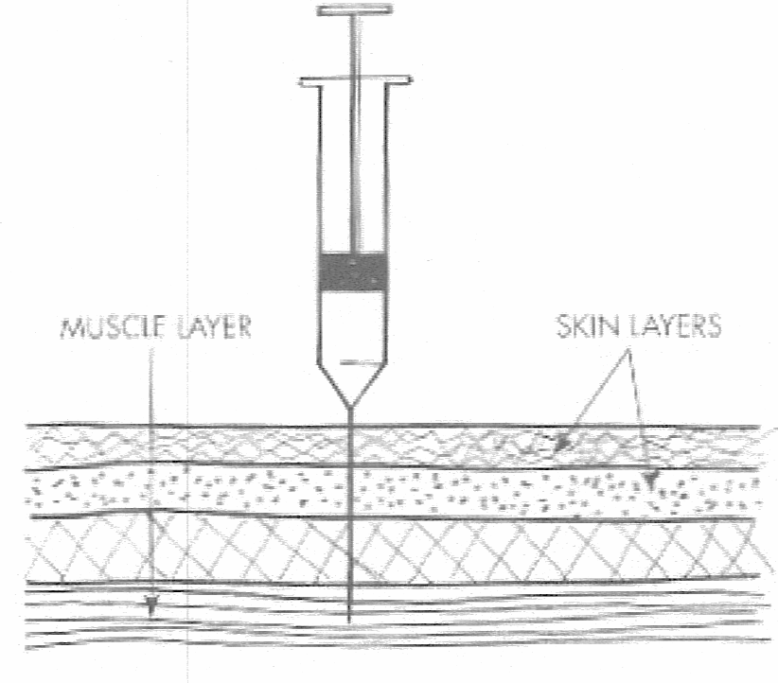
Intramuscular

Slide 58
Miscellaneous Parenteral methods
    Intraperiotneal- most common in ruminant- do not use in equine
    Intramammary- Made by inserting a cannula into the teat canal and injecting the drug into the milk cistern
      CLEAN the teat end before inserting a sterile teat cannula-
      Massage the gland well
    Base of Ear- unless doing beef operations- read in Battaglia

Slide 59
Other miscellaneous
    Nebulizing and inhalation
      rarely used, maybe small ruminants
      needs a nebulizing machine

Slide 60
Examination of Animals
The Vital signs
  Definition: The body temperature, pulse rate, and respiratory rate of an animal are called its vital signs.

Slide 61
Body temperature-
  Reflection of the balance between the production and the dissipation of heat by the body
    Usually little fluctuation except
      camel- can vary up to 11 degrees
      Very small animals – change can be 5-10 degrees
    Fever- increase in body temperature
      causes- infection or overheating
    Subnormal- bad prognostic sign
      Body is no longer able to function adequately
    Taking temperature
      Restraint- maybe none
      Shake down the thermometer-
      Moisten end of thermometer- water, Vaseline, spit
      Insert ¾ of length into animal- attach clip to end-3 minutes
      remove, clean, read

Slide 62
Pulse-
  Surge of blood through the arteries following contraction of ventricles
    Bovine-middle coccygeal artery (under tail)
    Equine- Facial artery (under jaw)
    Ovine/Caprine- side of chest or femoral artery
    Porcine- Young ones-femoral Can’t on old ones

Slide 63
Respirations-
  Act of breathing
    Note the rate and actions associated with breathing
      wheezing, sneezing, groaning, rattling, head extensions, and the expansion and relaxation of the rib cage and abdominal wall.

Slide 64
Temperatures
 | Rectal Temperature
Animal | Degrees F
Cattle | 101.5 (100.5-102.8)
Goat | 102.3 (101.3-103.5)
Sheep | 102.3 (100.9-103.8)
Horse | 100 (99.1-100.8)
Swine | 102.5 (101.6-103.6)
Chicken | 107.1 (101.6-103.6)
Turkey | 105 (105-109.4)

Slide 65
Respiration rates
Cattle 30
Goat 15
Sheep 19
Horse 12
Swine 16
Chicken 12-36
Turkey 28-49

Slide 66
Heart Rate (per minute)
Cattle 50 (40-70)
Goat 90 (70-135)
Sheep 75 (60-120)
Horse 45 (25-70)
Swine 60 (55-85)
Chicken 275 (250-300)
Turkey 165 (160-175)

Slide 67
Recognizing the Healthy Animal
Recognizing the Healthy Animal
You need to know the normal before you can understand or appreciate or see the abnormal. You also need to understand animal behavior. This is known as “livestock sense.”

Slide 68
Physical Observation
In all cases physical observation is performed under the supervision of a veterinarian and the veterinarian alone is informed of the findings so that s/he can make the diagnosis, evaluate progress and prescribe treatment.
Your observations and history taking ARE important.
Use your eyes, your hands, your ears and your nose

Slide 69
Instruments Used in Physical Observation Typically done by your local veterinarian
Otoscope
Ophthalmoscope
Rectal Thermometer
Note: All diagnostic equipment should be cleaned and disinfected by the Animal Health Technician before and after each use.

Slide 70
Manual Procedures Used
Auscultation
  HR, Respirations and rumen movements
Palpation
  Touch and feel
Percussion
  Procedure of striking or tapping the thorax and abdomen with the fingertips to determine from the sound produced the condition, to a degree, of internal organs

Slide 71
Medical History
First Step
85% of diagnosis are made here
General information
Age/sex/heat cycle/vaccines/sick or injured/treatment
Weight- any change/ Appetite
Consumption of Water
Activity
V/D
Lameness
Skin disease
Swelling

Slide 72
Observation of Unrestrained Animal
From a distance
Swelling, hair loss, atrophy, cuts, bruises, laceration, alertness, walking and running pattern, rate and nature of breathing, attitude, behavior, voice.

Slide 73
Physical Examination
TPR
Observe Eye-size/shape/staining of eye area/conjunctiva/third eyelid, cornea, pupils, light response
  Veterinarian may ask for ophthalmoscope or fluoresene dye
Muzzle/Nostrils- discharge/ swelling
Mouth-size, color, shape, any obvious abnormalities- teeth

Slide 74
PE Continued
Skin of head-growth, condition, cuts etc
Ears-outside (lacerations, swelling, redness, discharges) inside (swelling, fluid)
Veterinarian may ask for otoscope here- looking for bacteria and ectoparasites
Neck-inspection and then palpation- looking for physical abnormality, dermatitis, swelling
Front legs-compare the two-size, shape, lymph nodes

Slide 75
PE cont.
Thorax- size/conformation/compare sides
  Auscultation done by veterinarian
Abdomen and Back- skin checked for ectoparasites-abdominal palpation??
Hind Limbs and Pelvis-symmetry, muscle mass, wounds
Anal region-swelling, tumors
External genitalia of Male- scrotum/penis
  Is smegma normal?

Slide 76
PE Continued
External Genitalia of the Female- vulva/discharge
Tail-injury, location, tone, parasites
Joints- swelling/palpation for swelling, heat, color, discharges
NOTE: IN ALL CASES THE VETERINARINAN AND ONLY THE VETERINARIAN IS INFORMED OF THE FINDINGS SO S/HE CAN MAKE THE DIAGNOSIS

Slide 77
Livestock Restraint Techniques
Some degree of control over an animal’s movement and activity is required for every technique that the livestock producer performs.

Slide 78
Types
Psychological
  E.g. don’t run blindly into sheep herd
  Pig snare- will pull back- so use it to back into corner
  Human voice- authority, fear
    Be confident but not foolish
Sensory diminishment
  Blindfolding
Use of confining chutes, alleys, and barriers
  Cattle and sheep- funnel concept
  Pig board
Use of tools and physical force
  Ropes, snares, leg hooks, nose tongs, nose rings etc
Chemical sedation or immobilization
  Tranquilizers
  Anesthetics
  Advantages and disadvantages
    Advantage-strongest
    Disadvantage- size of animal, bloat, recovery time, induction time

Slide 79
Why we restrain
To prevent injury to us and animal
Decrease pain
We want to perform the tasks necessary with the least amount of pain inflicted and least amount of psychological upset (fright)

Slide 80
Questions to consider when choosing type of restraint
Will the restraint method minimize the danger to the handler?
Will the restraint method minimize the danger to the animal?
Will the method cause unnecessary pain or fright?
Will the retrain method allow the management technique to be completed as necessary?

Slide 81
Cattle restraint:
Important
Know the mechanics of the restraint method so that you have them well practiced and you don’t have to stop and think what the next step is.
Study and understand the behavior so can anticipate next step- in tie stall will pull head back and over to side-Anticipate
have strong, appropriate sized, well-cared-for equipment that you thoroughly understand how to use.

Slide 82
Working Chute-
Usually V-Shaped, funnel shaped- move slowly into working alley- remember the flight response will be as you move toward back and side the cow will move forward. If you move toward front, will move backwards.
WARNING- Don’t get squeezed or stepped on

Slide 83
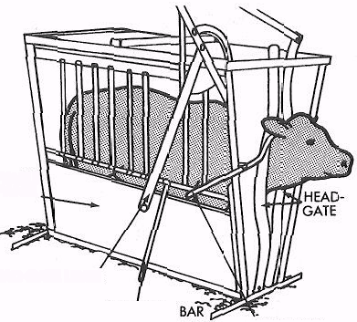
Squeeze Chute
Need to adjust head gate so it is the right height for the animal you are using.-don’t want choking

Slide 84
Tilt Tables
Halter and lead animal into position next to the vertical tilt table.
Restrain head when animal parallel to the table
Restrain animal’s midsection and rear end using canvas
Tilt the table using levers and gears
Restrain each leg with padding as necessary

Slide 85
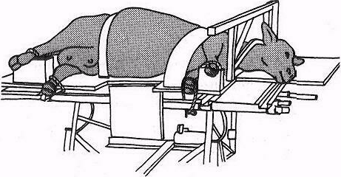

Slide 86
Casting- Half-Hitch Method
Halter the animal and lead it to the lay-down area
Secure the lead rope to the post 12 to 18” from the ground
Tie the end of casting rope 35-40 foot rope loosely around the animal-using the bowline knot to form the loop-Don’t want any choking-6” below the ridge of the spine to one side or the other
Place a wrap of rope immediately behind the animal’s forelegs. And then reach under and form a half hitch about 12 inches behind the bowline knot.
Wrap a second wrap of rope in the flank area just in front of the udder if it is a cow, by repeating step 4
Begin pulling on the working end of the casting rope. As pressure is exerted on the nerves and muscles the animal will lie down. Keep pressure on the rope and have an assistant tie the animal’s legs before beginning the management procedure.
Constant steady pull should be maintained on the working end of the casting rope.
After technique has been completed release the legs, loosen the casting rope and allow the animal to regain its feet. – Release the halter also.

Slide 87
Step-by-Step Procedure
1. Halter the animal and lead it to the lay-down area. Secure the lead rope to a post or ring approx­imately 12" to 18" from the ground.
2. Tie the end of a 35- to 40-foot, "A- to K-inrh, three-strand, loose-weave cotton rope loosely around the animal's neck, using a bowline knot to form the loop. Position the knot approximately 6 inches below the ridge of the spine to one side or the other.

Slide 88
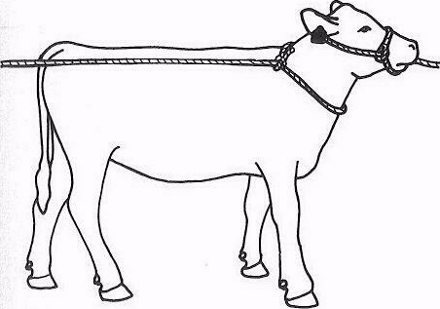

Slide 89
3. Place a wrap of rope immediately behind the animal's forelegs. Form this wrap by dropping the whole coil of the rope over the animal's back to the side opposite the bowline knot. Reach under the animal (carefully, to avoid being kicked), grasp the rope, and bring it out from under its body. Note: the use of a show stick here is helpful. Run the working end of the rope under the itaud-ing part connected to the bowline knot. This will form a half hitch about 12 inches behind the bow­line knot.

Slide 90
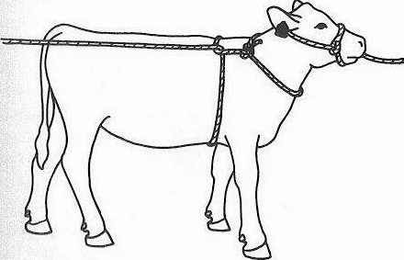

Slide 91
4. Place a second wrap of rope in the flank area, just in front of the udder if it is a cow, by repeating the processes in step 3.

Slide 92
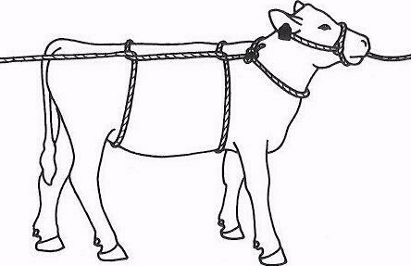

Slide 93
5. Begin pulling on the working end of the cast­ing rope. As pressure is exerted on the nerves and muscles, the animal will lie down. Keep pressure on the rope and have an assistant tie the animal's legs before beginning the management practice. A con­stant, steady pull should be maintained on the working end of the casting rope.

Slide 94
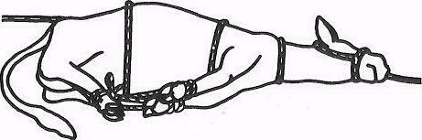

Slide 95
6. After the management technique has been completed, release the legs, loosen the casting rope, and allow the animal to regain its feet.
The halter rope may need to be released from the post or tie-ring so that the animal can rock itself to gain the necessary momentum to rise.

Slide 96
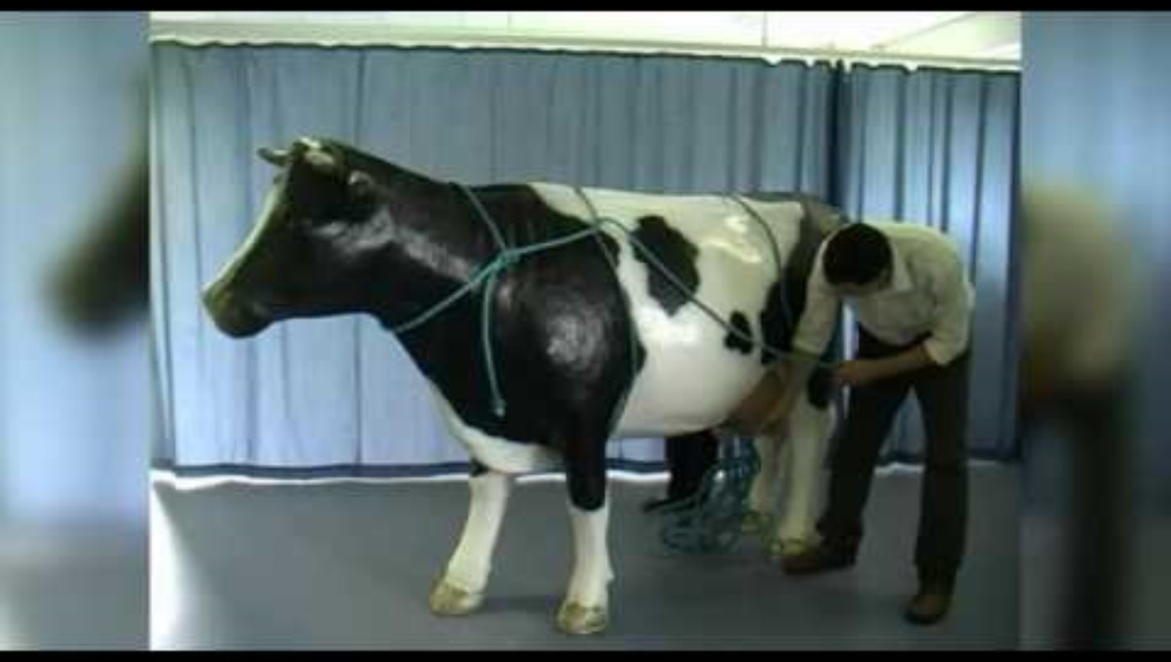

Slide 97
Halters-Least harsh of the restraint methods
Apply bowline around neck
Apply half hitch over the nose
Manly trick- run the line through the bowline knot area to prevent choking

Slide 98
Nose Lead- YOUR FRIEND
Invaluable tool for restraining cattle-but it can be severe if used improperly
Placing nose lead:

Slide 99
Nose Lead Placement
      Move animal into head gate or stanchion
      Grasp the nose by tightly clamping your index finger in one nostril and your thumb in the other nostril. This may be all you need to do.
      If not, quickly place the nose lead into position with other hand and squeeze it shut.
      Proper way is to use a rotating motion. Place one side of the tongs into one side for the nose, then rotate the tongs across the end of the nose and place it into the other side.
      Pull head to side, take a double wrap around a pipe or post with the nose lead rope, and then have an assistant hold the end of the rope. DO not tie it. Animal can go down and tear nose before you can undo even a quick-release knot.

Slide 100
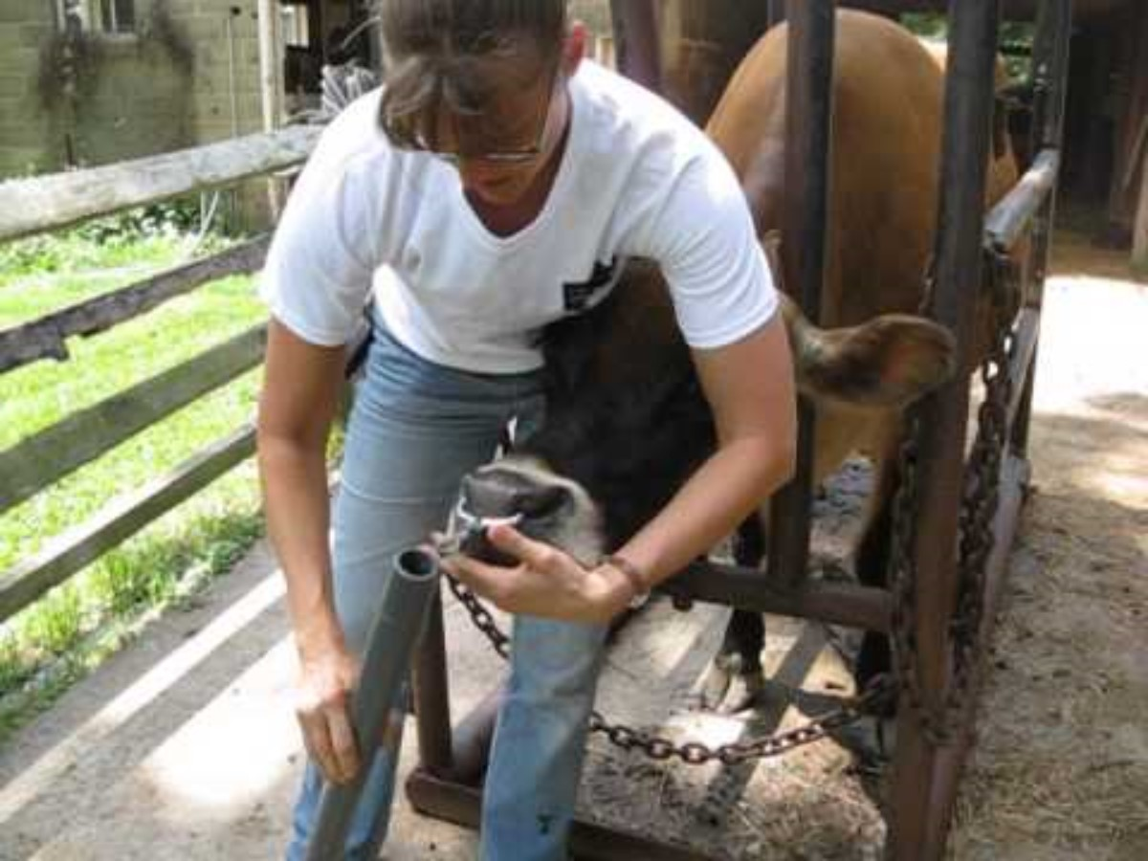

Slide 101
Flanking a calf
1. Approach, corner if necessary, and catch or rope the calf. Minimize stress.
2. Catch the calf as quietly and as efficiently as you are able.- shepherds crook.
3. Stand beside the calf, grasp its neck with one hand to keep the calf from moving forward, and grasp the opposite flank with the other hand
4. Bend your knees slightly for leverage, lift and pull the calf toward you, and allow the calf to gently slide to the ground on its side.
5. Restrain the calf on the ground. Place one knee on the calf’s neck and one on the calf’s side
6. Release pressure on the calf when the management technique is finished to allow the calf to get up.

Slide 102
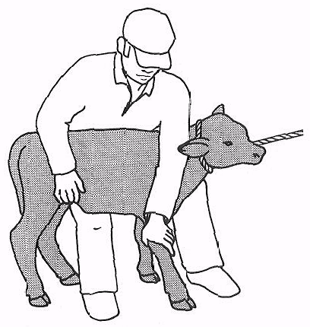

Slide 103
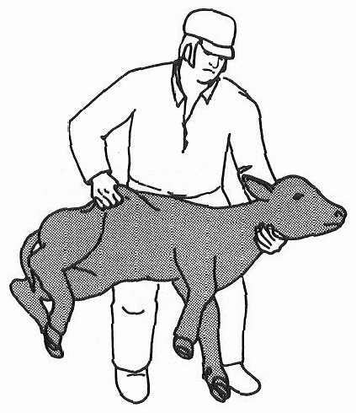

Slide 104
Tail Twist
Two methods
      Curling the tail into a loop.
      Grasping the tail and pushing it up to form a lazy S curve.- stand on the side to minimize the risk of injury

Slide 105
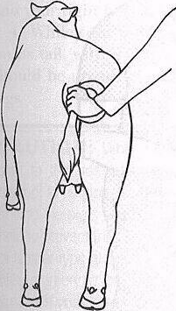
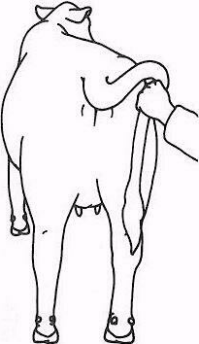

Slide 106
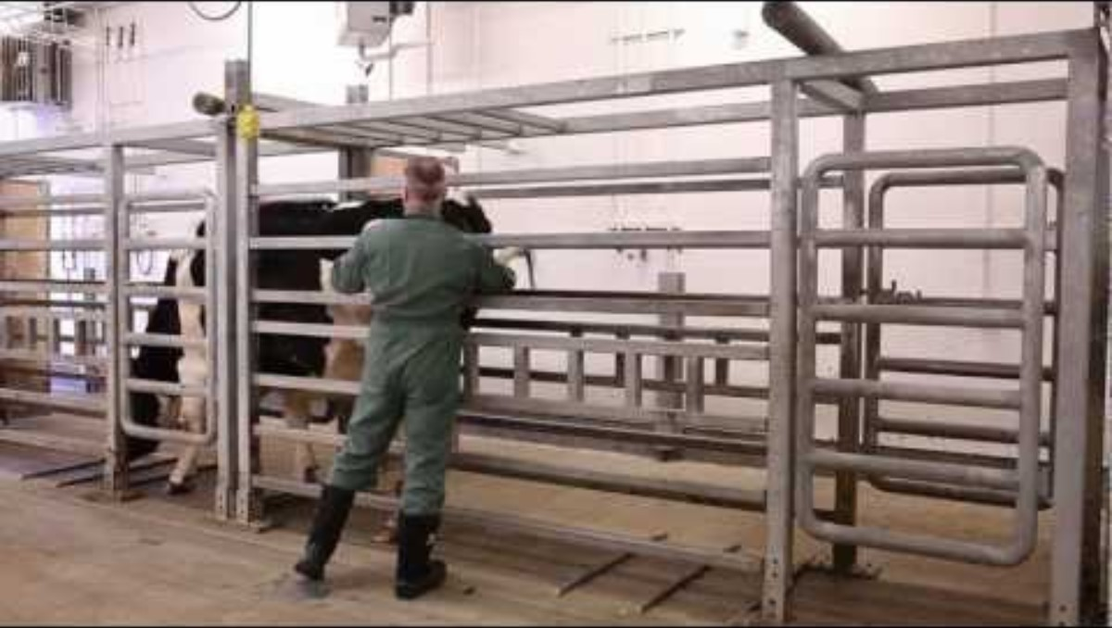

Slide 107
Tail hold
        Stand beside the animal, grasp the tail near its base, and pull it straight up and over the animals back

Slide 108
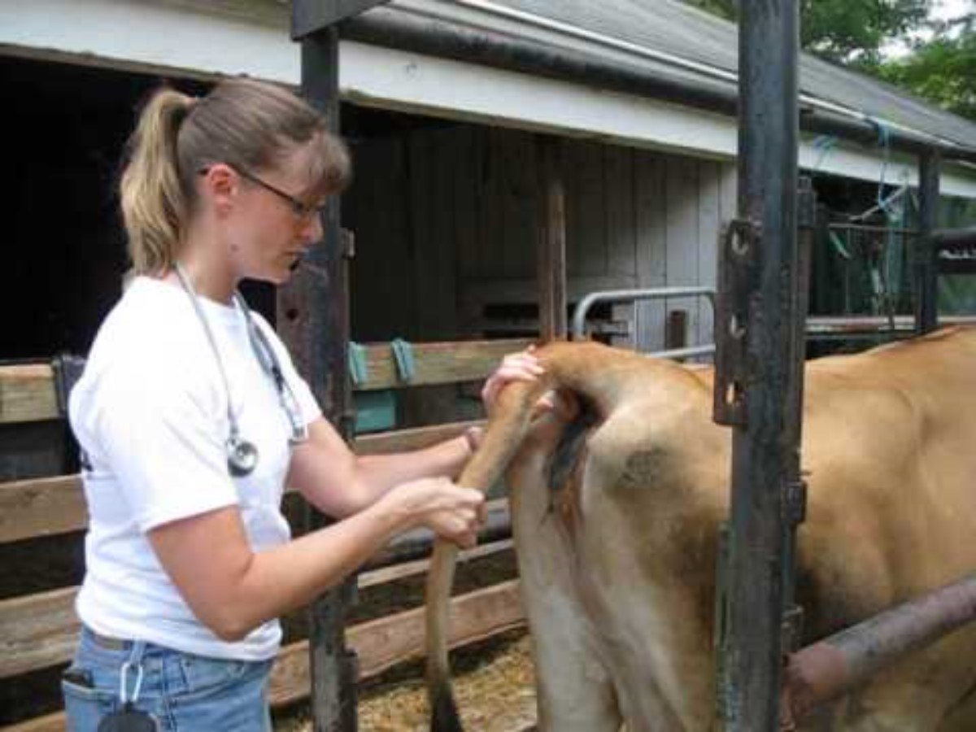

Slide 109
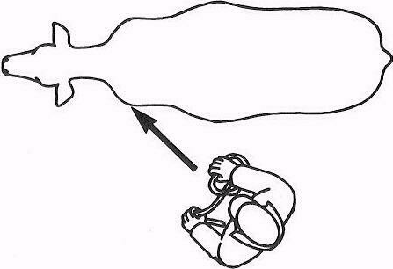
Approach from back 45 degree angle

Slide 110
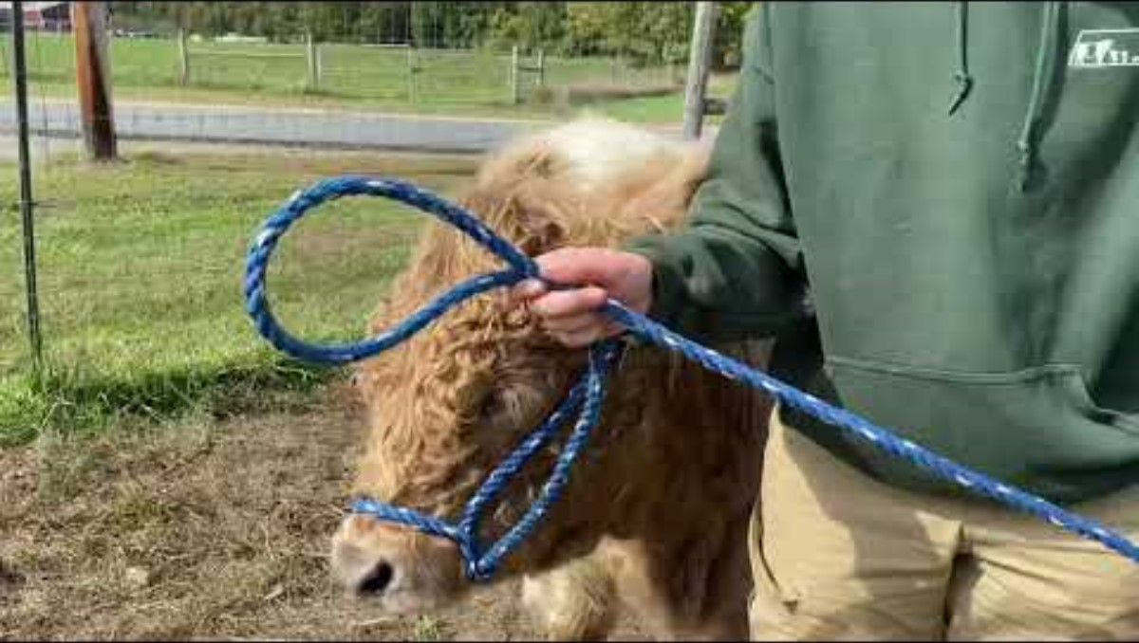

Slide 111
Characteristics of cattle
Some characteristics of cattle
      32 teeth
        8 Incisors bottom jaw only
        6 molars
Ruminant digestive system- 4 compartments
  Rumen
  Reticulum
  Omasum
  Abomasum

Slide 112
Eat Beef
Tasty, rich in nutrients as protein, iron and B vitamins
  5.2 billion burgers a year
  Provides 186,000 jobs with 1.4 million in supporting roles

Slide 113
Vision
Have panoramic vision which allows them to see almost 360 degrees with no movement of head
  Like looking through a wide-angle lens- things on edges are distorted.
  Easily spooked
Blind spot
  Color-blind with poor depth perception
  Don’t like to step on anything with grid pattern or hole
  React to loud, abrupt noises

Slide 114
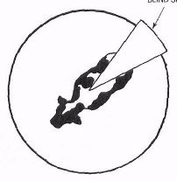

Slide 115
Strong sense of smell
  Calves
  Sexual signals in cows in heat
gregarious-thrive best in groups
Like to follow the leader

Slide 116
Identification
Animal ID is a must in a beef herd
A numbering system must be developed to give each and every animal in the herd some type of identification.

Slide 117
3 Ways to ID
1. Tattooing
a. Permanent but not easily identified
b. Use tattoo instrument
1. Indelible ink
2. Clean ear
c. Procedure
1. Restrain
2. Locate ear- top third of ear
3. Wipe with alcohol
4. Rub on paste
5. Use tattoo equipment to apply tattoo
6. Rub in more paste

Slide 118
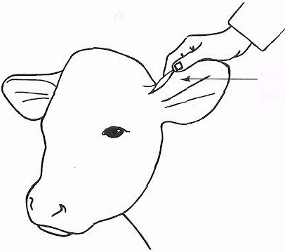

Slide 119
2. Ear tagging
a. Economical /read at distance
b. Breakage and loss of tag
c. Usually 4 numbers.
1. First-year of birth
2. Second-optional and code for ` who to breed with
3. 3rd and 4th for order in which born
d. Insecticide ear tags can be applied as well.
e. Can apply metal tags- apply to top of ear usually

Slide 120
3. Branding
a. Permanent and readable at a distance

Slide 121
Pasture Breeding
Pasture (natural) mating is the process of allowing bulls and cows to be together during the breeding season, and mating occurs without the herdsman’s supervision.

Slide 122
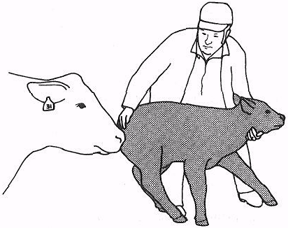
Weighing

Slide 123
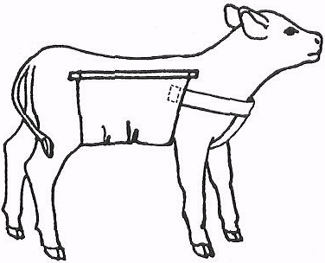
After separating apply canvas sling to calf

Slide 124
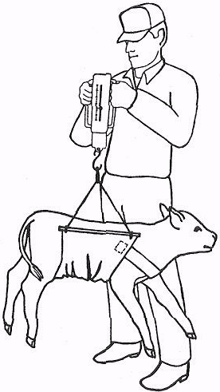
Weigh with scale

Slide 125
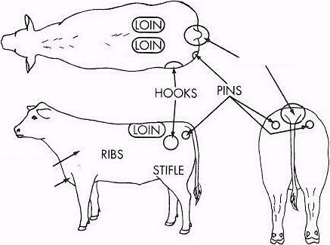
Areas to focus on

Slide 126
BCS 1: Severely Emaciated.
No fat detectable, by sight or touch, over the spinous processes of the backbone, edge of the loin (transverse processes), edges of the hipbones, or ribs. There is visible and palpable space be ween the spinous process of the vertebra of the back. Tailhead is quite prominent. All ribs and entire bone structure are easily visible. There is severe muscle loss (atrophy) in the shoul­ders, loins, and hindquarters. All ribs are highly vis­ible and hard (lacking any fat cover) to the touch. Animal appears lethargic and weak.

Slide 127
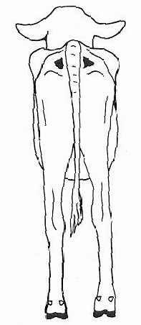
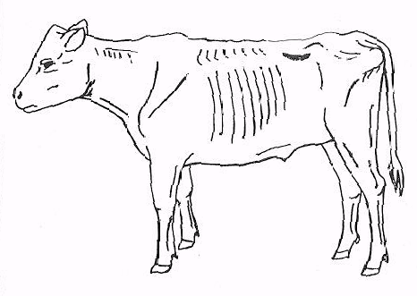

Slide 128
BCS 2: Poor or Very Thin.
Slightly more tissue is palpable over the spinous processes of the back­bone, but the processes still appear to have space between them, as in the BCS 1. Tailhead is slightly less prominent to the eye than the BCS 1. Ribs are slightly less visible to the eye, but still lacking in fat cover. There is still muscle loss (atrophy) in the shoulders, loins, and hindquarters. Nearly as ema­ciated as the BCS 1, but animal does not appear as weak.

Slide 129
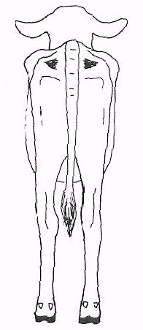

Slide 130
BCS 3: Thin.
There is a slight fat cover beginning to appear over the spinous processes of the back­bone. Spinous processes of the backbone are still highly visible, hut the spaces between them are less pronounced. Each rib is still visible, but upon palpation, they are less hard {have some fat cover) than the BCS 2. Slight fat cover beginning to appear over the tailhead. There is still some slight muscle loss (atrophy) in the shoulders, loins, and hindquarters.

Slide 131
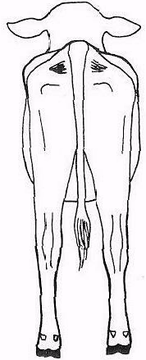
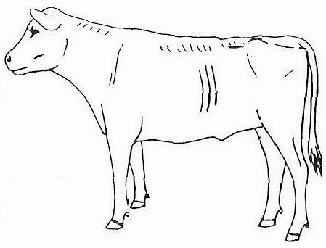

Slide 132
BCS 4:
Borderline or Slightly Thin. Individual spinous processes are no longer visible, nor are the spaces between them. The individual spinous processes can still be palpated. Only the rear ribs (2 to 4) can be seen. Hipbones are still obvious to the eye. There is fat cover over the edges of the loins and shoulders. There is no visible muscle atrophy, and the muscling appears full, but flat (not bulging) in die hindquarter.

Slide 133
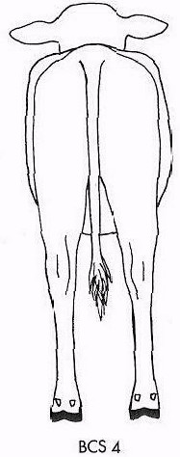
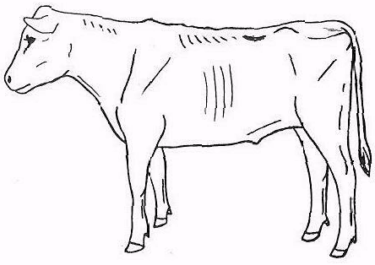

Slide 134
BCS 5: Moderate.
The cow looks good, healthy, and finished "just right." Only the last two rihs are obvious to the eye. There is fat cover over the shoulders, foreribs, and loins. Fat cover is "springy" over the ribs. The tailhead has fat cover on each side, but the fat is not mounded an each side. Spinous processes are palpable only with pressure. There is no fat in the brisket and very lit-de fat over the hooks and pins.

Slide 135
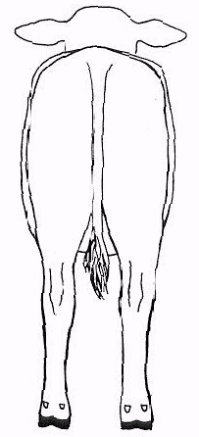


Slide 136
BCS 6: High Moderate or Slightly Fleshy (Some­times Termed "Good").
All ribs are fat covered, and none are visible to the eye, Spinous processes palpable only with firm pressure. Hindquarters are becoming plump and full and slightly rounded in profile. There is considerable fat cover around the tailhead, and it is spongy when palpated. There is some fat in the brisket. Obvious fat is covering the loins, shoulders, and foreribs

Slide 137



Slide 138
BCS 7: Good or Fleshy.
Cow appears smooth due to tat processes. Tailhead has "pones" of fat on each side. Fat is filling the brisket and flanks. There is considerable fat covering the shoulder, loins, and foreribs. It is still possible to feel the ends of the spinous processes, but only with a good deal of pressure.

Slide 139



Slide 140
BCS 8: Fat or Obese.
Cow is carrying too much condition. She will appear square in profile when viewed from behind. Tail head is lost in pones of fat. Fat deposits will be seen below vulva. Flanks appear deep due to fat fill, and brisket will be full of fat.

Slide 141



Slide 142
BCS 9: Extremely Fat or Very Obese.
Bone struc­ture is no longer visible from any aspect All defi­nition is lost. Brisket entirely distended with fat and neck appears short due to this. Pones of fat are obvious at many places on body. Loin, hip, and tailhead take on a "rippled" look due to excess fat.

Slide 143



Slide 144


How to body score

Slide 145


What is this bcs?

Slide 146
KEY Husbandry Factors
Basics

Slide 147
Selection of breeding stock
Breeding stock ratio is 1 Bull – 25 Cows
Cows: Should have the following body characteristics:
  Well-developed udder and teats,
  Large hind quarters,
  Docile with good mothering ability,
  Good body conformation.
Bulls: Should have the following body characteristics;
  Well developed 2 testes of equal size
  Very strong hind legs
  Very active and not shy (neither allow any bull to cross a cow nor cross itself)
  Well built with good body conformation.

Slide 148
Bull must be capable of
      Producing fertile sperm
      Mounting
      Erection
      Ejaculation
      Settling a cow
      Siring efficient, fast-growing calves.

Slide 149
Land acquisition
Factors to consider in selecting a site for cattle production include the following:
  Distance to neighboring residences – 1-2 km.
  Nearness to a regular water source.
  The land should have a slope of about 2 to 5 percent (gradient) for good drainage.
  Soil type should be sandy loam.
  Should be easily accessible.

Slide 150
Housing and equipment
Basic requirements for a standard housing:
  Positioning of the housing should be oriented length wise in the East to West direction (ie. against the direction of the sun rise and set) to allow for good shade, ventilation and air circulation within the house.
  Provide dip for control of ecto-parasites.
  Provide foot-baths and changing rooms for workers and visitors. (Bio-security)
  Provide different sections/compartments within the structure (to house the breeding stock, growing animals and sick animals separately).
  The house must be structured in a form that movement of humans as well as animals is from the section of young animals to older ones and not the other way round.
  The house must be well secured to prevent undesirable elements such as vectors (pests, rodents and insects) and robbers from entering.
  Floor should neither be smooth nor very rough to harbour pathogens or hamper cleaning
  Floor must slope towards the drainage outlet of the pen for easy flow of liquid substances.

Slide 151
Housing and equipment
Facilities required in a Standard Housing:
  Delivery area (calving )
  Nursing area (Cow/Dam and calve/young one)
  Weaner/Grower/Fattener area
  Bull/Sire area (bulls)
  Dam area (dry/breeding cow)
  Isolation pen
  Water and feed troughs
  Store house

Slide 152
Construction of cattle housing (KRAAL)
Suitable materials for construction of Cattle housing (Kraal)
  Blocks (concrete/lancrete/sancrete)
  Cement
  Sand and stones
  Welded mesh
  Roofing sheet
  Iron rods
  Wood

Slide 153

Example of Krall

Slide 154
Space requirement
Table 1. Space requirement
Class, Age and Size of Animal | Barn/Shed/Kraal
 | Floor Area per Animal | Height of Wall | Height of Ceiling (from ground)
Cows or Steer, 2 years or over | 40 - 50 ft2 (3.7 - 4.6 m2) | 4 ft (1.2 m) | 8 - 10 ft (2.4 - 3.0 m)
Yearlings | 30 - 40 ft2 (0.8 - 3.7 m2) | 4 ft (1.2 m) | 8 - 10 ft (2.4 - 3.0 m)
Calves, 150 to 200 | 20 - 30 ft2 (1.9 - 2.8 m2) | 4 ft (1.2 m) | 8 - 10 ft (2.4 - 3.0 m)
Cows in maternity stall | 100 - 150 ft2 (9.3 - 14 m2) | 4 ft (1.2 m) | 8 - 10 ft (2.4 - 3.0 m)
Head Bulls | 100 - 150 ft2 (9.3 - 14 m2) | 4 ft (1.2 m) | 8 - 10 ft (2.4 - 3.0 m)

Slide 155
Type of Feed
Pasture
A good pasture id made up of Grasses and Legumes
Example of Grasses
  Panicum maximum (guinea grass)
  Penisetum pepurium (elephant grass),
  Cynodon nlemfuensis (giant star grass)
  Cenchrus ciliaris (buffel grass)
  Brachiaria decumbens (signal grass)
Example of Legumes:
  Leucaena leucocephala (Ipi-Ipil)
  Centrosema pubescence (centro)
  Dolichos lablab (lalab beans)
  Gliricidia sepium (quickstick)
  Stylosanthes hamate (stylo)
These pasture species can be planted as pure stand or mixture (grass x legume) and harvested/cut for animals under intensive rearing of grazed directly by animals under semi intensive system.

Slide 156



MATCHING
STYLO
GUINEA GRASS
ELEPHANT GRASS

Slide 157
Type of Feed
Agro by products:
  Wheat bran
  Spent malt
  Rice straw
  Maize/sorghum stover
  Groundnut/cowpea vines
  Cassava peels
Concentrate:
Calve starter concentrate is made up of the following ingredients
  Sorghum – 35 kg
  Cotton seed – 5 kg
  Wheat bran – 30 kg
  Maize – 10 kg
  Groundnut cake – 20 kg

Slide 158
Feeding schedule for calves
Table 2. Feeding schedule for calves up to 6 months
Age of calf | Approx. body weight (kg) | Quantity of milk (kg) | Quantity of calf starter (g)
4 days to 4 weeks | 25 | 2.5 | Small qty.
4 - 6 weeks | 30 | 3.0 | 50 - 100
6 - 8 weeks | 35 | 2.5 | 100 - 250
8 - 10 weeks | 40 | 2.0 | 250 - 350
10 - 12 weeks | 45 | 1.5 | 350 - 500
12 - 16 weeks | 55 | - | 500 - 750
16 - 20 weeks | 65 | - | 750 - 1,000
20 - 24 weeks | 75 | - | 1,000 - 1,500

Slide 159
Concentrate for 6 mos and beyond
Concentrate mixture for 6 months onwards:
  Copra cake – 30 kg
  Cotton seed cake – 10 kg
  Rice bran – 30 kg
  Yellow maize 27 kg
  Mineral mixture – 2 kg
  Salt – 1 kg

Slide 160
Table 3. Concentrate mixture for 6 months and above
Age (months) | Approx. Body Wt. (kg) | Concentrate mixture (kg) | Grass (kg)
6 - 9 | 70 - 100 | 1.5 -1.75 | 5 - 10
9 - 15 | 100 - 150 | 1.75 – 2.25 | 10 – 15
15 - 20 | 150 - 200 | 2.25 - 2.50 | 15 – 20
Above 20 | 200 - 300 | 2.50 – 2.75 | 15 – 20
Bulls | 400 - 500 | 2.5 – 3 | 20 – 25

Slide 161
Dry matter requirement
The total dry matter requirement of cattle is around 2-3 % of their body weight
It is recommended to give minerals block or urea molasses block always when animals are fed on only fodder.
Hay refers to a grass that is cut and dried to use as animal fodder. Feeding hay is a fact of life in cattle production. It is usually fed as a supplement for cattle in dry seasons when feed is scarce in Ghana. Hay such as rice straw can be treated with urea at a rate of 1kg urea to 10 litres of water applied to 20 kg of straw.

Slide 162
Health Management/ Medication/ vaccination Regime
Improved health management requires regular cleaning of kraals and vaccination of the animals against scheduled diseases such as Foot & mouth, Anthrax, Brucellosis, Lumpy skin and Rinderpest.
Some cattle medication:: Antibiotics, Sulphadimidine, Dewormer, Acaricide , Vitamins etc
Vaccination Schedule for Cattle

Slide 163
Vaccination schedule
SN | Disease | Age | When to vaccinate
1 | Foot and Mouth Disease (FMD) | 4 months and above | Every six months
2 | Haemorrhagic Septicaemia (HS) | 4 months and above | Biannually in endemic areas
3 | Black Quarter (BQ) | 4 months and above | Annually in endemic areas
4 | Brucellosis | 4 -8 months of age (only in female calves) | Once in a lifetime
5 | Theileriosis | 4 months and above | Once in a lifetime.
6 | Anthrax | 4 months and above | Annually in endemic are

Slide 164
Breeding cattle
Mating takes place when the cow is on heat every 21 days. Heat last for 3 days
Sign of heat:
The female mounts other cows
It allows others in the flock to mount it.
It becomes restless and
Its vulva becomes red

Slide 165
Heat detection-
An experienced observer with a well-trained eye can do a good job by observing the herd for ½ to 1 hour early in the morning and ½ to 1 hour in the evening. 25% of cows exhibit signs of estrus between 6 PM and midnight. 40% between midnight and 6 Am

Slide 166
Estrus
Estrus (heat) is a fairly well-defined period that occurs in nonpregnanct cows once each 19-23 days. This period is characterized by increased sexual activity and acceptance of the bull by the post-pubertal heifer or cow. I t begins with the first acceptance of the bull and ends with the last acceptance. Anywhere from 3-6 hours (Brahman) to 12-18 hours (European cattle)

Slide 167
Heat detection aids
Heat patches,
Grease marks
Teaser or marker bulls
Wax marker sticks
Chin ball marker

Slide 168
Visual heat detection
Usually occurs between 2-6 in the morning

Slide 169
Behavioral changes
  Restless
  Females isolate, twitch their tails
  Clear, thick mucous discharge- if cloudy, milky-white or pussy then may have a vaginal or uterine infection
  Mounting- A cow in heart will follow others, stand beside them, and put her head on their rumps or backs. When cows being mounted does not attempt to escape, she usually is in standing heat
    Can be the mounter or the mountee
  tail raised-mucous
  Roughened tail head or mud on back indicating cow trying to ride her.
  If you see blood then in heat 2-3 days ago.
  If heat activity in morning- breed at night
  If heat activity at night-then breed in morning

Slide 170
Behavioral changes
2. The most obvious behavioral estrous activity is mounting. Wren a cow in heat tries to mount another not in heat, the mounted cow will not stand quietly and allow the other cow to mount. A cow in heat, may also follow others, stand beside them, and put her head on their rumps or backs. She may throw her head as if to mount, wrinkle her nose, and snort. If you are unsure which cow is in heat, be patient and continue to observe the herd. If the suspected cow continues in this activity, more
than likely she is in heat and should be watched until she allows other cows to mount and ride her.
The time interval between a cow's attempts to mount may be as long as 20 minutes and can depend somewhat on the lot surface. If the lot is concrete, it can become slick and reduce visual activity, and a casual look at the herd will not reveal the number of cows in heat.
Two cows may be in heat at the same time. When the cow being mounted does not attempt, to escape, she usually is in standing heat.

Slide 171
Mounting Behavior in cows
cow mounting behavior

Slide 172

Mounting Behavior in COws

Slide 173



Slide 174
Heat detection aids
Heat patch- plastic heat-detecting device (patch) is glued to the top of the sacrum (back) between the tail head and the hooks (hipbones)
  Once ridden clear fluid in patch is ruptured and red dye makes whole fluid area red
  E.G. kamar patch and Bovine Beacon Patch

Slide 175
Colored Wax Marker- Tail head marking- thick deposit of wax on very top of tail head- when ridden the wax is spread down the sides of the tail head onto the rump.

Slide 176

Anatomy of the area

Slide 177


Slide 178


Slide 179


Slide 180
Normal calving
Up to several days before calving, some cows have increased distension of udder. Distention of abdomen. Ligaments around tail head and in pelvic area relax and sink to increase the size of the birth canal.

Slide 181
Stage 1-Preparatory
2-6 priors to expulsion
Normal- calf is rotated into position of least resistance
Cows become antsy and nervous
Labor begins- cervix dilates, and rhythmic contractions of the uterus begins.
Contractions start at every 15 minutes.
At end of predatory stage, cervix expands to create a continuous canal.

Slide 182
Stage 2-Delivery.
Uterine contractions increase in frequency about 2 minutes apart, duration, and intensity once the water sac is broken- followed by voluntary contractions of the diaphragm and abdominal muscles. I
In normal delivery, the calf’s forelegs and head, surrounded by membranes, are forced through the canal and protrude from the vulva. All this in about 15-30 minutes.
The delivery stage is normally completed in less that one hour. If delivery is normal, proceed to stage 3. Delivery should be accomplished within 1 ½ to 2 hours after the water sac ruptures. Calf normally born without membranes.

Slide 183


Slide 184
Calf should be breathing within 10-60 seconds after expulsion.
Tickle calf’s nose
The calf can be rubbed vigorously with an old gunnysack or coarse towel.
Can grasp back legs and vigorously shake the calf up and down to stimulate breathing.

Slide 185
Stage 3- Cleaning
Cow normally will lick the calf immediately after birth and remove any remaining membranes.
Treat the calf’s umbilical cord with strong tincture of iodine
Calf usually stands within 30 minutes post calving.
Calf should receive colostrums (cow’s first milk as soon as possible after birth to provide mild laxative effect.
Placenta is usually expelled within 2-12 hours.

Slide 186

Normal Calving

Slide 187



Newborn
3 to 4 mo.
Mature
Newborn

Slide 188
Neonatal Care of Calves
Basic Calf Care
      Post partum- need to soak a navel with a dip
      Equipment required:
        Navel dip solution
        Shallow container
  Action required:
  Fill container with dip solution
  Cover umbilical cord and its base with dip before they come in contact with adult cow manure or any other objects highly contaminated with bacteria.
  Repeat dipping after the dam has licked off the calf.

Slide 189
Facts
  Iodine concentration in dip gives good bacterial kill
  Alcohol in dip solution has drying effect on umbilical cord
  Repeated dipping ensures good bacterial control and cord closure
  Urgency of dipping is due to direct connection of umbilical cord to liver. An open cord is a direct route for bacteria into the blood stream.

Slide 190
Scours:
Physical appearance:
      0-48 hours old- normal feces may be any consistency and color- yellow, black, green, brown
      Calves eating mostly milk-
        Normal feces have one color and consistency when the calf defecates. When exposed to air the feces turn darker and become more solid.
        Normal feces at defecation have a dark yellow color but a lot of variation from this is normal, also.
        Normal feces at defecation have a consistency much like fresh pudding before it is refrigerated.
        At 7-14 days of age, calves with cryptosporidiosis will have looser feces of a lighter color.
        Calves with bacteria scours will have very loose feces, often gray, may contain blood.
        Calves with both cryptosporidiosis and bacterial enteritis will have watery feces, often a mix of white, gray and yellow fluids.
        Calves being fed more milk than they can digest may have normal colored feces but excessively loose.

Slide 191
Calves Eating Milk and Starter Grain
        Normal feces will be browner than milk-only calves and slightly more solid.
        Calves with coccidiosis will have looser feces; often feces contain traces of blood and may be gray.
        Calves with bacteria enteritis will have loose feces, sometimes gray in color.
        Claves consuming in excess of two quarts daily of starter grain containing a high level of molasses will normally have feces more brown than expected.

Slide 192
SAFETY ISSUE: Examination of calves and especially fecal materials may expose calf care persons to pathogens that can cause illness (primarily transient diarrhea) in humans. For example, salmonella, E.Coli, campylobacter, cryptosporidium.

Slide 193


Slide 194


Slide 195
What is salmonellosis?
Salmonellosis is an infection with a bacteria called Salmonella. Most persons infected with Salmonella develop diarrhea, fever, and abdominal cramps 12 to 72 hours after infection. The illness usually lasts 4 to 7 days, and most persons recover without treatment. However, in some persons the diarrhea may be so severe that the patient needs to be hospitalized. In these patients, the Salmonella infection may spread from the intestines to the blood stream, and then to other body sites and can cause death unless the person is treated promptly with antibiotics. The elderly, infants, and those with impaired immune systems are more likely to have a severe illness.

Slide 196
Campylobacter jejuni
Campylobacter jejuni is a bacterium commonly found in the intestines of poultry, cattle, swine, rodents, wild birds and such household pets as cats and dogs. It has also been known to be found in untreated surface water (caused by fecal material moving through the environment) and manure.
Humans may develop an illness called campylobacteriosis if infected by Campylobacter jejuni bacteria.
What are the symptoms?
Symptoms may include fever, headache and muscle pain, followed by diarrhea, stomach pain, cramps, nausea and vomiting.
Further complications include Guillain-Barré Syndrome, meningitis, septicemia, urinary tract infections and, in very rare cases, reactive arthritis (this arthritis is almost always short term).
Symptoms of infection usually occur within 2 to 5 days after the bacteria have been ingested and usually do not last longer than 10 days.
It takes most people anywhere from a few days to a few weeks to recover

Slide 197
Treatment of Scours:
      The best way to treat is to prevent
      Good colostrum management program
      Good environmental sanitation program
      Provide enough good quality feed in order to build strong immune systems
      Reduce manageable stress as much as practical

Slide 198
Homemade formula
        White corn syrup 8 tbsp
        Salt 2 tsp
        Baking soda 1 tsp
        Warm water to make 1.25 gallon
Or
a. Beef consommé 1can
b. Jam and jelly pectin 1 pkg
c. Low sodium salt- 2 tsp
d. Baking soda 2 tsp
e. Warm water to 2 qts.

Slide 199

Symptoms
Control and management
Vesicles occur on the teat and mammary gland and in the rumen Vesicle formation on the tongue, in the mouth and on the feet, particularly at the margin of the hoof. Degenerative changes occur in muscle, and extensive involvement of the cardiac muscle can result in death | Control in areas suffering sporadic infection is best achieved by slaughter, destruction of infected carcases and disinfection. Where the disease is endemic, vaccination campaigns reduce the incidence and, in the absence of re-importation of virus, can lead to eradication
Foot and Mouth Disease

Slide 200

Symptoms
Control and management
Necrotic lesions in the mouth and gastrointestinal tract and destruction of lymphocytes | Systematic vaccination with tissue culture propagated virus.
Rinderpest

Slide 201

Symptoms
Control and management
Fever, the development of multiple, painful skin nodules and lymphadenitis As lesions progress the center of the cutaneous lesions becomes hard, necrotic, and difficult to remove | Administration of sulfonamides to prevent the secondary infection Good nursing care are recommended Vaccination with attenuated virus offers the most promising method of control. Euthanasia may be necessary sometime
Lumpy Skin Disease

Slide 202

Symptoms
Control and management
Diarrhea, necrosis, and erosions of the alimentary tract. | Control is based on use of modified live virus vaccines
Bovine Viral Diarrhea

Slide 203

Symptoms
Control and management
Fever Bone and joint pain Paralysis Testicular swelling | Control is by Vaccinal immunity by use of attenuated living strain 19 or by the rough killed strain 45120. For the tropics, control to reduce prevalence by large-scale application of whole herd vaccination, with or without serological testing is advocated as the most cost-effective programme.
Brucellosis

Slide 204

Symptoms
Control and management
Infection usually gives rise to either rapid death (peracute anthrax) Extreme dullness, high fever, widespread hemorrhages, dysentery and usually death within 48 hours. | Prompt diagnosis, prevention of contamination, preferably by the deep burial of unopened carcases and disinfection of the immediate environment. Carry out annual vaccination.
Anthrax

Slide 205

Symptoms
Control and management
It is transmitted by Ticks. Nervous, intestinal, and pulmonary disorders, caused by the rickettsia Cowdria ruminantium | Acaricidal control of the vectors (tick) must be frequent and efficient if heartwater transmission is to be prevented.
Heartwater

Slide 206
Pinkeye
Treatment of pinkeye
Causative agent- Moraxella bovis
Def- an infectious disease of cattle characterized by inflammation and watering of the eye.
Most common during warm weather- when flies, bright sunlight, dust, wind pollen, and unclipped pastures can contribute to eye irritation.

Slide 207


Slide 208


Slide 209


Slide 210
Ringworm
Ringworm “ barn itch “is a contagious disease of the outer layers of the skin caused by a fungus.- contagious to humans also
Easily identified by circular patch of roughened, scaly skin devoid of hair- become gray and crusty in appearance and increase in size if not treated. Can occur anywhere on the animal-usually in area of head, neck and root of the tail.

Slide 211
Ringworm is a transmissible infectious skin disease caused most often by Trichophyton verrucosum, a spore forming fungi. The spores can remain alive for years in a dry environment. It occurs in all species of mammals including cattle and man. Although unsightly, fungal infections cause little permanent damage or economic loss. Direct contact with infected animals is the most common method of spreading the infection.
Spores germinate and attack the shafts of the hair and the surface layers of the skin. Exudates ooze from the damaged skin and mix with debris from skin and hair forming a crusty scab. The grayish-white scab is noticeably higher than the surrounding skin. Ringworm is most frequent on the head and neck, but it may be found over the entire body in severe cases. Infection spreads from the center outwards and resulting in a circular lesion. Scabs fall from older lesions leaving a ring with a hairless area in the center. Hence, the name ringworm.
Ringworm will usually cure itself without treatment. Common treatments include topical application of a 2% solution of iodine, thiabendazole paste or any fungicide used to treat athlete's foot in man.

Slide 212
Treatment
  Identify the affected animals
  Restrain the animal
  Put on rubber gloves.
  Scrape the are either with a pocket knife or corn cob till reddened area
  Place on fungicide
  Zoonotic infection
  Repeat treatment every 2-4 days until the infection is cleared up.
  UV light helps
  Some vets with give vit D injection

Slide 213
Treatment
Restrain
Examine eye
Subconjunctival injection of antibiotic and cortisone
Apply special patch
Release

Slide 214
Dehorning Animals:
Timing
Dehorning when the calves are very young is less traumatic for the calves and less work for the calf care person than sawing horns off fresh heifers
Dehorning cannot be done until horn buds can be located well enough to insure accurate removal.

Slide 215
Equipment
Means of restraining the heifer/bull
Dehorning tool(s) in good working order
  Barnes
  Keystone
  Burning tool
  Gigli wire

Slide 216
Action required
Restrain the animal
Check to be sure that horn buds are of sufficient size to insure accurate dehorning
Administer local anesthetic
Clip hair if appropriate
If using cautery- apply dehorning tool until a solid copper-colored band appears around the horn bud.
If a caustic paste is used, apply evenly over the entire horn bud
If gouging, remove a full circle around the center of the horn bud, pull arteries as needed, and apply antiseptic powder or spray

Slide 217

Chemical pasting

Slide 218

Burning

Slide 219

Tube dehorner

Slide 220

Barnes Dehorner

Slide 221


Slide 222

Pulling the artery

Slide 223
Dehorning warnings
Warning
Delayed bleeding
Fly control

Slide 224

DEHORNING AND DISBUDDING CALVEAS

Slide 225
Other cattle procedures
Stomach tubing- this job involves passing a flexible tube into the mouth, down the esophagus, and into the reticulum or rumen.
Uses- bloat relief, and fluid therapy
Equipment necessary
  Squeeze chute, stanchion, headgate, halter
  Plastic or rubber stomach tube 1/2” by 4 ‘ adult, ¼”x 2 ‘ newborn
Restraint needed- depends on animal

Slide 226
Procedure:
  Assemble equipment and necessary treatment fluids
  Restrain animal
  Prepare the tube- rounding edges, lube it
  Open animals mouth
    Calves- insert fingers into mouth, apply pressure to calf’s palate and open
    Mature- pass frick speculum after reaching over the cow’s head and opening lower jaw.

Slide 227
Def. A non-infectious disease of ruminants that is caused by high-concentrate diets, grazing on legume pastures, peritonitis, and genetic abnormalities such as dwarfism.
Signs; Severe distention of the left side of the animal- may have some right sided as well.

Slide 228

Bloat

Slide 229
Pasture bloat- don’t leave on legume hay for the first time without filling up on grass hay first. Don’t put on a frost killed legume field until turns dormant.

Slide 230
Treatment- relieve the gas
Stomach tube
Trocar or pocket knife

Slide 231
Post procedural management
place in pen or stall
recheck every 30 minutes
change ration to high fiber

Slide 232

Stomach tubing a calve

Slide 233


Passing a stomach tube

Slide 234

Passing a stomach tube in a cow

Slide 235
Milking
Number 1: milk with holding times must be followed on lactating dairy cows treated with antibiotics. Only drugs approved by the FDA for use in lactating cows can be used without a prescription from a veterinarian.

Slide 236
Milking
Physiology-Washing and drying of the udder and teats, the nerves in the teats send a message to the pituitary gland located at the base of the brain. The milk letdown hormone, oxytocin, is released into the bloodstream= reaching the udder in about 1 minute. This hormone causes the muscle fibers surrounding the alveoli to contract and force the milk out into the ducts and udder cistern, making milking possible. Alveoli are the very tiney milk-secreting cells in the udder. The effect of oxytoin is diminished in about 7 minutes, so rapid milking is necessary if one is to obtain a complete emptying of the udder.

Slide 237


First steps of milking

Slide 238
Mastitis- inflammation or swelling in the udder caused by an infection. It can be in one quarter or all four and is caused by many different bacteria.

Slide 239
Causes of mastitis
Poor milking procedures
Over milking
Improperly functioning milking machines,
Poor housing conditions
Injuries caused by poor surroundings

Slide 240
Checking for mastitis
Check usually with CMT test (California Mastitis Test.- checks for high level of somatic cells

Slide 241
Heifers freshening for the first time may have some blood for a few days post freshening- normal

Slide 242
Intramammary infusions
Step by step procedure
The cow may be treated in the milking parlor or in another treatment area. Milk out the udder completely into a bucket and discard the milk- completely milk out the quarter- trying to prevent dilution of the drug in a milk filled udder.
Clean the end of the teat.
Grasp the teat to be treated with the thumb and forefinger of one hand. Use your other hand to insert the antibiotic treatment tube into the teat canal. Only put the end of the tube in 2-3 mm.
Once the tube is inserted inject the drug slowly into the teat.. Each tube contains one treatment for one quarter.
Dip the teat with a post dip after the treatment is complete.
Massage the udder.
ID the cow treated

Slide 243

Intramammary infusion

Slide 244
Downer cows-
Down cows cannot get up and stand by themselves-
Causes
  Slipping on floor
  Post partum paresis

Slide 245

Cow lift

Slide 246
Treatment
Keep comfortable
Keep in eternal recumbency
Bedding/ hay
Bring water and fluids to animal

Slide 247

Removal of supernumerary teats

Slide 248
Supernumerary teats
Many calves are born with supernumerary teats- they can develop and grow just like a normal teat- problems if develop mastitis=
Usually remove when calves or if adult remove when dryed off

Slide 249
In calves- pick up rear leg and cut with a scissors as ar you can to the udder.- cut and close after removed place antiseptic on the wound.

Slide 250



Slide 251
Hoof trimming-
Why?
Extends life of animal
Prepare animals for show
Correct he hoof problems of young splayfooted animals
Most common defect
Excessive toe length
Leg lifting
1 Safest method is manual leg lift

Slide 252
Method
Stand in front of the front leg toward the rear of the animal
Clasp the hands around the front leg at the fetlock joint, with the thumbs placed under the dewclaws.
Pull upward on the leg and dewclaws to pick up the foot.
Flex the leg at the, elbow and the shoulder, positioning the foot so that the trimmer can proceed.

Slide 253



Slide 254
Hind leg
Can be lifted manually by one person
The procedure is to stand alongside the leg, facing the rear of the animal
Place your thigh just below the stifle, grasp the foot below the dewclaws at the fetlock joint, and pull upward in the same manner as with the front foot.
With one motion, pull the leg up while flexing the fetlock.

Slide 255

Lifting up rear leg

Slide 256




Slide 257

Treatment of hoof rot

Slide 258
Key risks along the value chain and mitigation
Value Chain Actions | Key Risks and Challenges | Mitigation Measures
Input Supply | Inadequate quality breeding stock | Resource MoFA Cattle breeding stations to produce more breeding stock. Encourage private sector to set up breeder farms. Encourage the use of Artificial Insemination.
 | Limited access to prepared feed (concentrate) | Provide required feed formula for Feed Millers. Train farmers on the use of cattle feed (concentrate) Facilitate development of entrepreneurs in input sector
 | Limited access to Veterinary drugs and services | Private Veterinary services clinics and laboratories should be encouraged License Veterinary technicians to operate drug shops in various communities Farmers could form cooperatives to buy inputs in bulk to store for regular supply to members.
Finance | Inadequate capital | Provide easy access to finance to farmers for purchase of inputs and other related services. Encourage farmers to use Equity capital instead of credit.

Slide 259
Production | Inadequate access to production and dairy technologies. | Dissemination of production technologies through electronic means
 | Inadequate grazing land and unavailability of pastures during dry season | Train farmers on conservation, preservation and utilization of agro-by-products for dry season feeding. Establish fodder banks with leguminous trees such as Gliricidia, Leucaena etc. for dry season feeding.
 | Low productivity (milk and beef) | Introduce and facilitate adoption of high yielding crossbred cattle for both milk and beef production.
 | High diseases incidence. | Train farmers on good animal husbandry practices/ health management and ensure strict adherence to biosecurity measures. Encourage and support research in the use of ethno veterinary medici

Slide 260
Marketing | Poor access to market information and transportation. | Promote market information through MoFA E-agriculture and other electronic media sources.
 | Consumers not willing to pay for quality beef and dairy milk | Create awareness among customer on safe and quality beef and dairy milk.
 | Inadequate hygienic milk and beef retail points. | Develop hygienic retail shops for milk and beef Promote investment into dairy milk, meat processing and packaging.
 | Lack of appropriate transport facilities for carting live animals and meat/milk. | Encourage transporters to invest in appropriate transport facilities for carting live animals, beef and fresh milk.
 | Limited enforcement of standard prizing system for live animals and fresh milk. | Encourage selling of live animals and fresh

Slide 261
Processing | Outdate technology at Abattoirs | Re-tool and modernized Abattoirs
 | Inadequate number of abattoirs. | Provide financial incentives for entrepreneurs to set-up abattoirs.
Consumption | Low quality meat and dairy milk | Sensitize consumers on meat and dairy milk safety. Ensure supply of quality dairy milk and beef by enforcing meat and milk quality standards. Promotion of consumerism.
 | High price of meat | Promote the use of less expensive feed to reduce production cost.
 | Sophisticated consumer taste | Train farmers and processors on consumer preference

