Slide 1
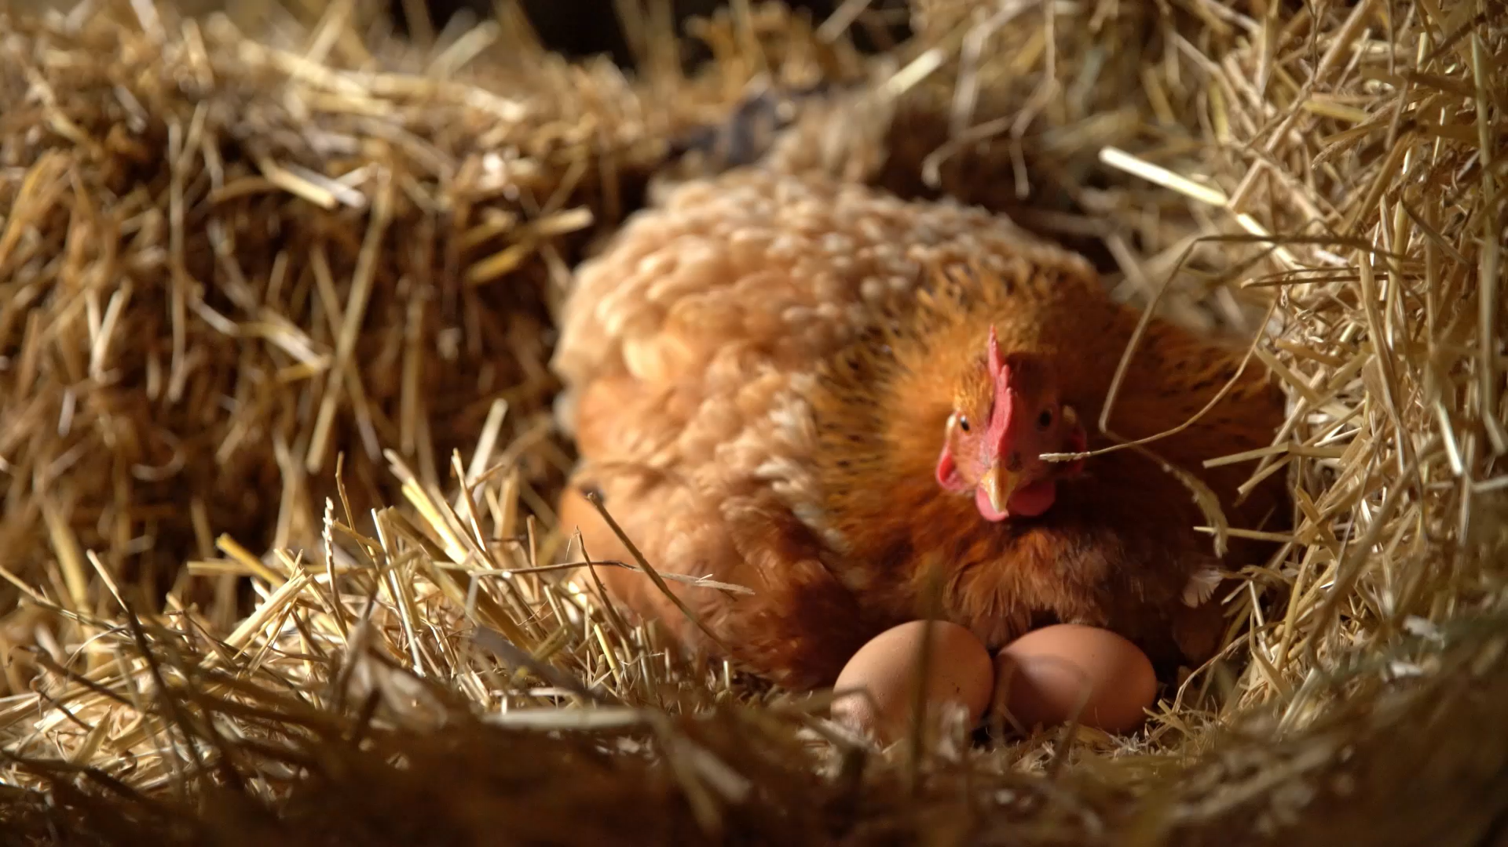
Raising healthy poultry

Slide 2
Common Chicken Breeds in Ghana
Layer, Broiler, Dual-Purpose & Indigenous Breeds

Slide 3
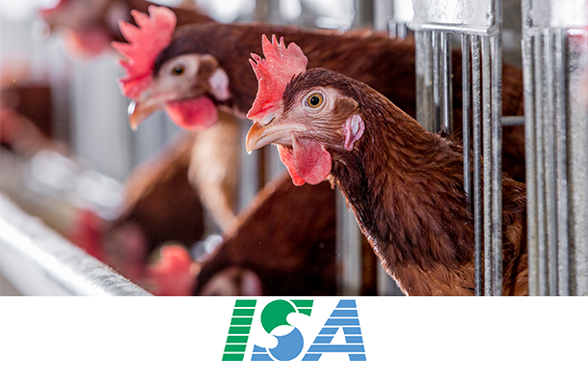
Layer Breeds in Ghana
Commercial Egg Production Breeds
ISA Brown
Most popular brown egg layer globally
Up to 500 eggs per production cycle
Excellent feed conversion efficiency
Adapts well to different climates
Eggs: 60-65g, golden brown shells
Widely distributed in Ghana by multiple suppliers
Notes:
Layer breeds are selected specifically for high egg production. In Ghana, ISA Brown is the most common, followed by Lohmann Brown. These breeds require proper feeding, housing, and management to achieve their genetic potential. Commercial hatcheries like Darko Farms, St. Charles Farms, and Kuipers Breeders supply day-old layer chicks with vaccinations for Marek's, Newcastle Disease, and IBD. Layers typically start production at 18-19 weeks and maintain peak laying until 72-78 weeks of age.

Slide 4
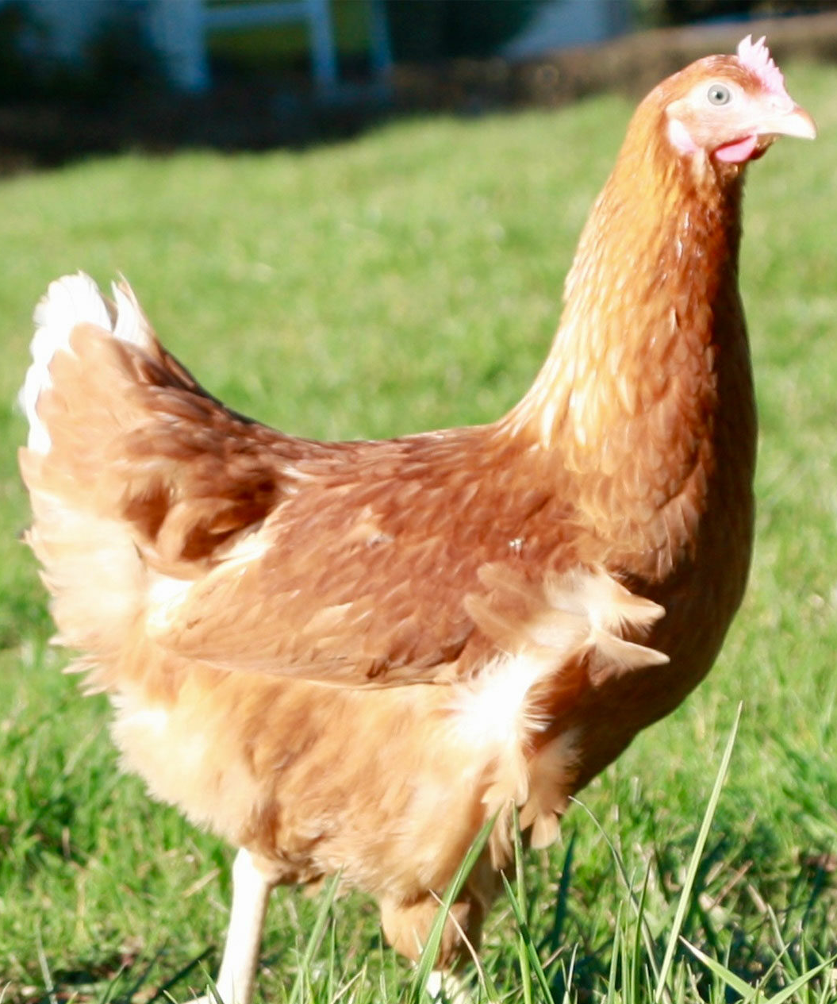
Lohmann Brown Classic
Cross: Rhode Island Red × White Rock
Up to 320 eggs per year
Eggs: 60-65g, brown shells
Calm, friendly temperament
Performs well in various housing systems
Available through Kuipers Breeders in Ghana

Slide 5
Layer Breeds in Ghana (Continued)
Lohmann LSL Classic
Hy-Line Brown
White egg production specialist
Cross: White Leghorn × White Plymouth Rock
High egg numbers with excellent shell quality
Lighter body weight, lower feed consumption
Well-suited for cage and free-range systems
Calm, well-balanced behavior
Over 480 brown eggs and can produce 100 weeks of age
Early maturity - starts laying early
Excellent feed efficiency
Large brown egg production
Robust and adaptable to Ghanaian conditions
Available from select hatcheries in Ghana
Note: Brown egg layers are preferred in Ghana over white egg layers
Notes:
White egg layers like Lohmann LSL are less common in Ghana as consumer preference strongly favors brown eggs. The golden-brown eggs from ISA Brown hens are particularly popular in hotels, restaurants, and homes. Hy-Line Brown is gaining popularity for its exceptional egg production longevity. These breeds require starter feed (22% protein), grower feed, and layer feed (16-18% protein with calcium supplementation).

Slide 6
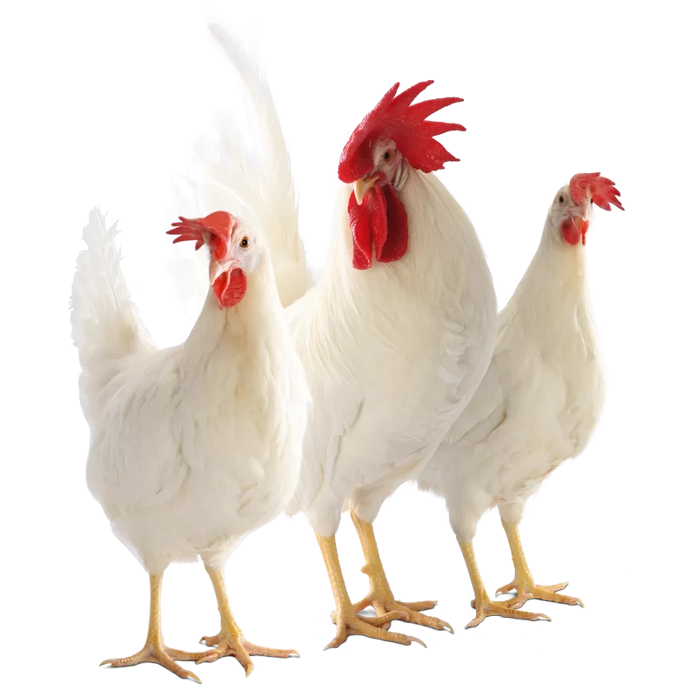
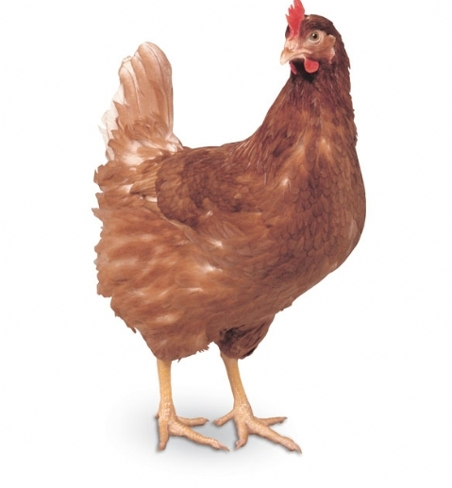
Lohlman Classic hy-line Brown

Slide 7
Broiler Breeds in Ghana
Fast-Growing Meat Production Breeds
Cobb 500
Reaches 2kg in 42 days under optimal conditions
Excellent feed conversion ratio (FCR)
Superior body weight, carcass quality, and breast meat yield
Most profitable broiler strain in multiple comparative studies
Ross 308 / Ross 708
Rapid growth rate with high meat yield
High meat-to-bone ratio, excellent breast meat production
Efficient feed conversion
Preferred for frozen chicken processing and barbecue (lean meat)
Hubbard
Medium to large size, round plump body
Reaches 1.8-4.5kg at maturity (7-14 weeks)
Adaptable to various climates and conditions
Good disease resistance, docile temperament
Notes:
Ghana's domestic broiler production meets only about 2% of total demand, with 95% supplemented by imports. The 'Rearing for Food and Jobs' program aims to increase local broiler production. Broilers grow from 40g hatch weight to 1.5-2kg in just 6 weeks. They must be kept indoors on deep litter or in cages with well-formulated diets. Feed represents 50-70% of production costs, making feed conversion ratio critical for profitability.

Slide 8
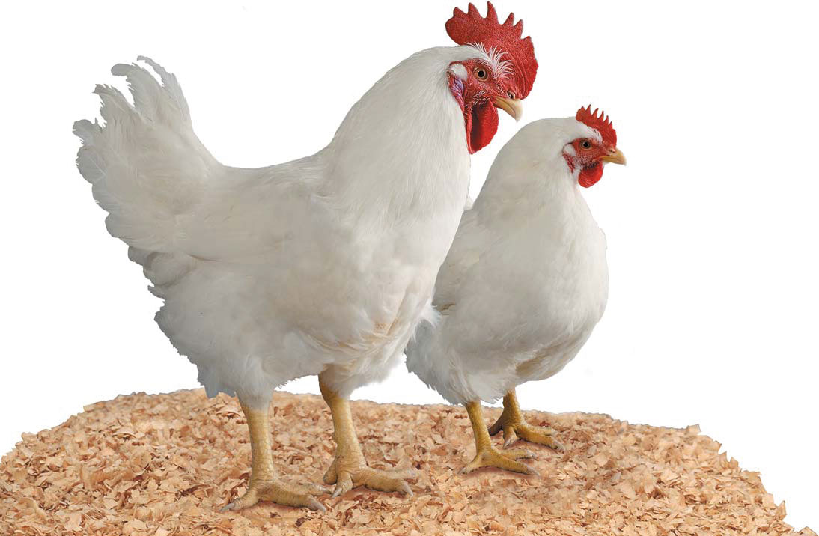
Cobb 500
Reaches 2kg in 42 days under optimal conditions
Excellent feed conversion ratio (FCR)
Superior body weight, carcass quality, and breast meat yield
Most profitable broiler strain in multiple comparative studies

Slide 9
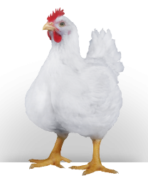
Ross 708/308
Rapid growth rate with high meat yield
High meat-to-bone ratio, excellent breast meat production
Efficient feed conversion
Preferred for frozen chicken processing and barbecue (lean meat)

Slide 10
Hubbard
Medium to large size, round plump body
Reaches 1.8-4.5kg at maturity (7-14 weeks)
Adaptable to various climates and conditions
Good disease resistance, docile temperament

Slide 11

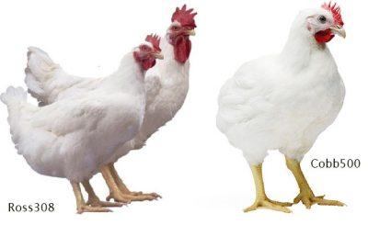
Comparison of Robb 500 and 308

Slide 12
Broiler Production in Ghana
Performance Characteristics & Management
Production Statistics
Management Requirements
Market age: 6-7 weeks
Market weight: 1.5-2.0 kg
Feed conversion ratio: 1.8-2.0:1
Feed required: 3-4kg per bird
Starter feed: 22-24% protein (0-3 weeks)
Grower feed: 20-22% protein (3-6 weeks)
Finisher feed: 18-20% protein (6+ weeks)
Indoor confinement essential
Deep litter or cage systems
Strict biosecurity measures
Temperature control critical
Adequate ventilation required
Disease prevention program
Daily monitoring essential
Notes:
Broiler production in Ghana faces challenges including high feed costs (maize and soybean shortages), competition from cheaper imported frozen chicken, and limited processing infrastructure. Only one commercial poultry abattoir exists in Ghana, slaughtering 9,000 birds per day. Small-scale farmers (under 5,000 birds) primarily focus on meat production. Medium-scale farmers (5,000-10,000 birds) represent 80% of the sector. Despite challenges, local fresh chicken commands premium prices over frozen imports.

Slide 13
SASSO Breeds - Dual Purpose
Improved Colored Chickens for African Conditions
SASSO (Selection Avicole de la Sarthe et du Sud-Ouest)
Performance
Origin: France (Hendrix Genetics)
Dual purpose: Both meat and egg production
Colored birds (multi-colored plumage)
Slower growing than commercial broilers
Better suited for free-range systems
Disease resistant and climate adaptable
Traditional appearance, superior taste
Lower feed requirements than broilers
Popular varieties: T44, T451A, Ruby, Rainbow
Market weight:
2.0-2.5 kg
Market age:
10-14 weeks
Egg production:
150-200/year
Feed efficiency:
Better than local breeds
Notes:
SASSO breeds are being promoted in Ghana through the 'Better Chicken for a Better Future' project, a collaboration between Dutch and Ghanaian partners including Solidaridad West Africa. These birds bridge the gap between commercial broilers (too fast-growing, expensive to feed) and local chickens (too slow-growing). The SAPPSA project (Sustainable Access to Poultry Parental Stock to Africa), funded by the Bill & Melinda Gates Foundation, aims to secure supply of parent stock genetics to Africa and develop breeds specifically for smallholder farmers. SASSO chicks are distributed by Hatch Africa in Ghana and five other African countries.

Slide 14
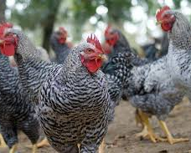
Sasso Breed
Origin: France (Hendrix Genetics)
Dual purpose: Both meat and egg production
Colored birds (multi-colored plumage)
Slower growing than commercial broilers
Better suited for free-range systems
Disease resistant and climate adaptable
Traditional appearance, superior taste
Lower feed requirements than broilers
Popular varieties: T44, T451A, Ruby, Rainbow

Slide 15
Indigenous Ghanaian Chickens
Local Breeds and Ecotypes
Interior Savannah Ecotype
Forest Ecotype
Coastal Savannah
Heaviest ecotype
Females: 1.23 kg
Males: 1.40 kg
High genetic diversity
Varied plumage colors
Adapted to savannah climate
Medium-sized birds
Closely related to Coastal ecotype
Adapted to forest zones
Cultural significance
Slower growth than Savannah
Similar to Forest ecotype
Heat tolerant
Good foragers
Coastal adaptation
Notes:
Ghana has three main indigenous chicken ecotypes corresponding to the country's agro-ecological zones: Interior Savannah (Guinea and Sudan Savannah), Forest (Semi-deciduous Rainforest), and Coastal Savannah. These birds represent 36.9% of Ghana's 82.5 million poultry population. Indigenous chickens are reared in backyard, free-range systems and rely on scavenging for nutrition. They show high genetic diversity with variations in plumage color, body size, feather patterns (including naked neck, frizzle, silky), comb types, and shank color. While egg production is lower than commercial breeds (60-100 eggs/year vs 300+), indigenous chickens are valued for disease resistance, heat tolerance, excellent feed conversion on minimal inputs, and superior meat flavor that commands premium prices.

Slide 16
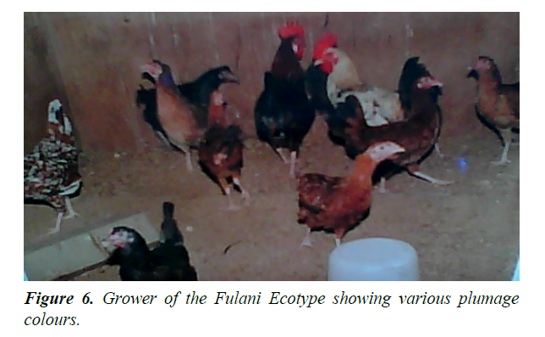
Representative ecotypes

Slide 17
Indigenous Chicken Characteristics
Advantages
Limitations
Excellent foraging ability - minimal feed costs
Natural disease resistance
Heat tolerance and climate adaptability
Natural breeding and brooding ability
Superior meat flavor (commands premium prices)
Low input requirements
Cultural and social significance
Survival during food scarcity
Low egg production (60-100 eggs/year)
Slow growth rate (5-6 months to maturity)
Small body size (1.0-1.4 kg)
Smaller eggs than commercial breeds
High chick mortality without intervention
Susceptible to predation in free-range
Inconsistent productivity
Notes:
Indigenous chickens play a vital role in rural Ghana, providing subsidiary income and nutritious food for marginalized communities. They can survive on table scraps, green fodder, insects, and other scavenged materials. Improvement programs focus on crossbreeding with improved breeds (like crossing local males with Lohmann females) to create birds with better productivity while retaining local adaptation. Some farmers prefer pure indigenous breeds for their cultural value and consumer preference for their meat and eggs. Common mutant traits include naked neck (heat tolerance), frizzle feathers, polydactyl (extra toes), and silky feathering. These traits have varying cultural significance across regions.

Slide 18
Breed Comparison Summary
Breed Type | Examples | Market Age | Market Weight | Best Use
Commercial Layers | ISA Brown, Lohmann Brown, Hy-Line | 18-19 weeks | 1.5-2.0 kg | Egg production (300+ eggs/year)
Commercial Broilers | Cobb 500, Ross 308, Hubbard | 6-7 weeks | 1.5-2.0 kg | Fast meat production
Dual Purpose | SASSO (T44, Ruby, Rainbow) | 10-14 weeks | 2.0-2.5 kg | Meat + eggs, free-range, small farms
Indigenous | Savannah, Forest, Coastal ecotypes | 20-24 weeks | 1.0-1.4 kg | Subsistence, premium meat, cultural
Breed Selection Recommendations for Ghana:
Commercial egg production: ISA Brown or Lohmann Brown
Commercial meat production: Cobb 500 or Ross 308
Small-scale farmers: SASSO breeds (lower input, free-range suitable)
Subsistence/cultural use: Indigenous ecotypes with improved management
Notes:
Breed selection should be based on: 1) Production goals (eggs vs. meat vs. dual-purpose), 2) Scale of operation (commercial vs. small-scale), 3) Available resources (feed, housing, capital), 4) Market preferences (brown eggs preferred, fresh vs. frozen chicken), 5) Management capacity (intensive vs. extensive). Large commercial operations typically use specialized breeds (layers or broilers). Small to medium farmers increasingly adopting SASSO or improved indigenous breeds as middle ground between commercial and local chickens. Government's 'Rearing for Food and Jobs' program promotes cockerel and improved breed adoption to reduce import dependence.

Slide 19
Methods for Starting a Poultry Operation
Practical Options for Establishing Your Flock

Slide 20
Starting Methods Overview
🐣
🥚
🐔
🐤
🐓
Day-Old
Chicks
Hatching
Eggs
Natural
Incubation
Started
Chicks
Point-of-Lay
Pullets
Each method offers distinct advantages depending on your resources, experience, and operation goals

Slide 21
Method 1: Day-Old Baby Chicks
Most Common Method
✓ Advantages
⚠ Considerations
Stored yolk provides nutrition
No food or water needed for 2-3 days of shipping
Temperature resilience
Groups of 25 provide adequate body heat
Cost-effective
Lower initial investment per bird
Temperature sensitivity
Risk of smothering if overheated
Risk of chilling in freezing weather
Shipping delays
Watering and feeding necessary if delayed >3 days
Ventilation critical
Proper air holes essential for groups

Slide 22
Method 2: Hatching Eggs
Key Considerations
Storage Requirements
Temperature tolerance
Less critical than with live chicks during shipping
Breakage risk
Easily broken if insecurely packed
Proper packaging essential
Immediate action required
Incubation must begin upon receipt
10°C
Optimum Storage Temperature
7 Days Maximum
Storage limitation even at optimum temperature

Slide 23
Method 3: Natural Incubation
Using a Broody Hen, Turkey, Duck, or Other Bird
12-14
Success Depends On:
Egg fertility
Typical Egg Capacity
Hen nutrition
Eggshell condition
Genetic constitution of parents
Pre-incubation storage time
Pre-incubation temperature

Slide 24
Method 4: Started Chicks
3+ Weeks of Age
Primary Advantages
⚙️
💉
⏱️
No Brooding Equipment
Vaccination Complete
Time Savings
Eliminates need for specialized early-stage equipment and infrastructure
Early vaccinations already administered by the seller
Skip critical early weeks requiring intensive management

Slide 25
Method 5: Point-of-Lay Pullets
Ready to Lay at ~20 Weeks
✓ Advantages
⚠ Disadvantages
Pre-selected flock
Males and inferior females already eliminated
Complete vaccination
Full vaccination program already administered
Immediate production
Ready to begin laying within days of purchase
Higher per-bird cost
Costs added on a per-bird basis for:
• Growing period management
• Feed costs (5 months)
• Vaccination programs
• Culling and selection
• Labor and facilities
Requires larger initial capital investment

Slide 26
Selecting the Right Method
Consider These Key Factors
Lower →
Medium →
Higher →
Budget
Day-old chicks
Started chicks
Point-of-lay pullets
Experience Level
Started chicks
Day-old chicks
Natural incubation
Equipment Available
Point-of-lay
Started chicks
Day-old chicks
Time to Production
Point-of-lay
Started chicks
Day-old chicks
Risk Tolerance
Started/POL
Hatching eggs
Day-old chicks
Match your resources and goals to the most appropriate starting method

Slide 27
Housing and equipment

Slide 28
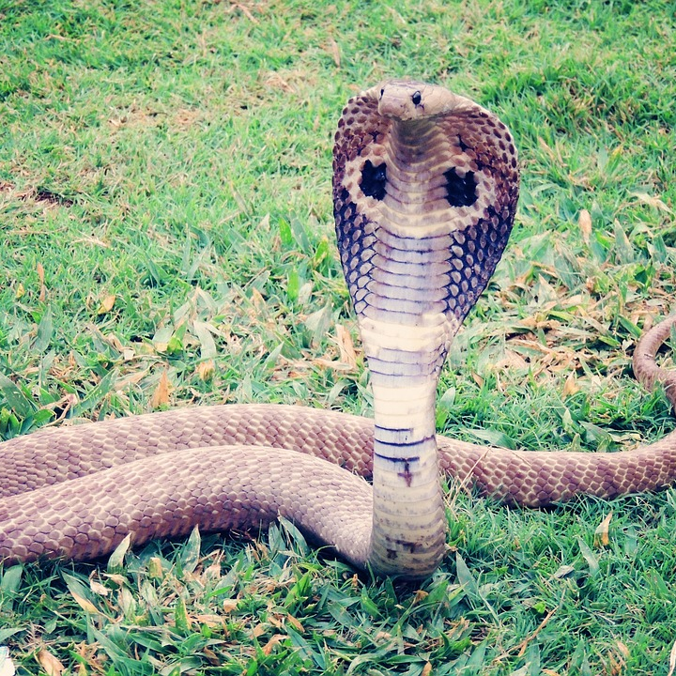
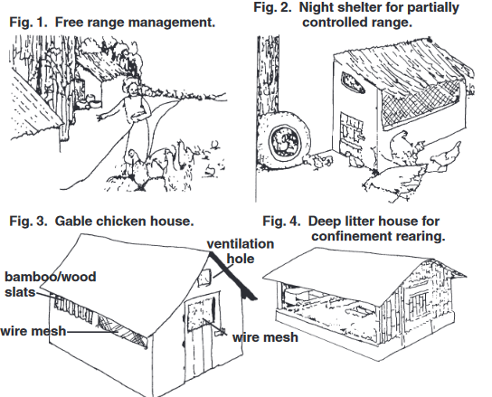
Housing
Considered essential for protection against predators.

Slide 29

Housing
Considered essential for protection against predators.
Location: Properly oriented to 1) Protect against wind but permit some air movement, 2) prevent too much heat from the sun, and 3) to ensure sufficient drainage to prevent wet floors. 4. shade and overhang may also be important.
Temperature Control- Temperature extremes in hot and cold weather create stressful conditions in poultry houses.
Ventilation: Air movement within the house is essential to prevent smothering. Chickens need more fresh air per unit of body weight than any other class of livestock.
This Photo by Unknown Author is licensed under CC BY-SA

Slide 30

Housing
5. Insulation- Health of poultry is often promoted by insulating roofs and sidewalls against both hot and cold weather
6. Moisture Control: Large quantities of water are consumed by chickens. Layers require more than 1 liter per day. High humidity can result in wet droppings which cause disease problems.
7. Space: Minimum requirements for birds are 15 birds per square meter up to 6 weeks of age, 5 birds per square meter up to 16 weeks, and 3-4 birds per square meter for older birds.
8. Framing: Roof support is critical
9. Roof: Entirely rainproof, Overhang of at least one meter on the south side to permit shade in summer but permit sun to enter the house during winter.

Slide 31
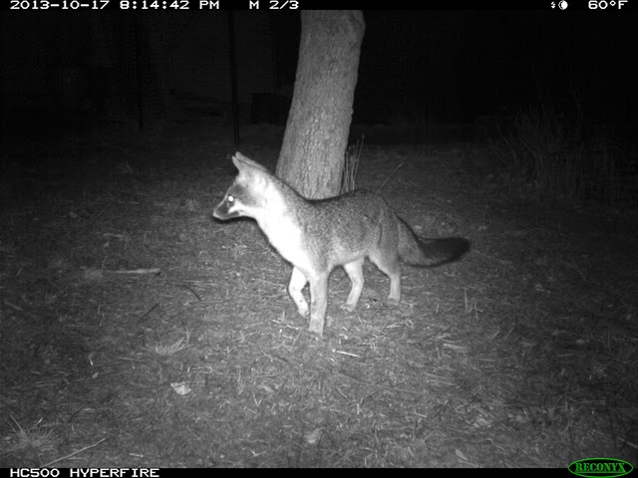
Housing
10. Floor- Cement with embedded wire mesh to keep rats our is desirable. Most places have dirt or heavy clay floors. Adequate drainage should be planned. Convenient clean-out systems for manure need to be considered. Deep litter is an option as well.
11. Animal and bird protection. Nighttime protects should be planned. Wire mesh is often used.
This Photo by Unknown Author is licensed under CC BY-SA-NC

Slide 32
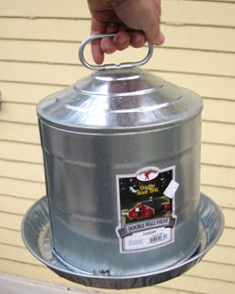
Waterers
Considered essential for protection against predators.
Chickens of any age should never be left without clean, cool water! Chickens need water every 15 to 20 minutes. Making certain that water supplies are adequate is one of the most important jobs of the caretaker. Waterers adapted for various ages of chickens are illustrated
This Photo by Unknown Author is licensed under CC BY-NC

Slide 33
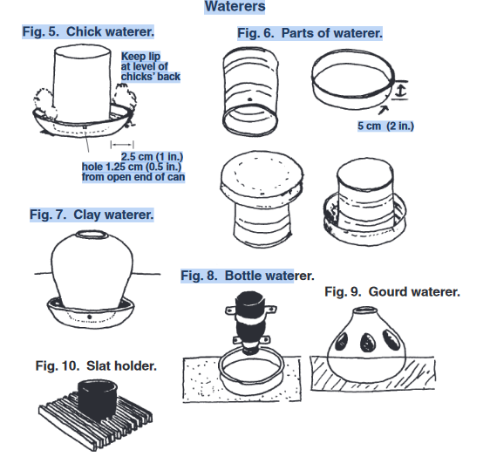
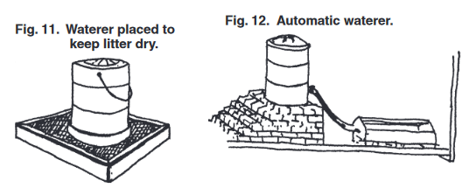
Waterers

Slide 34
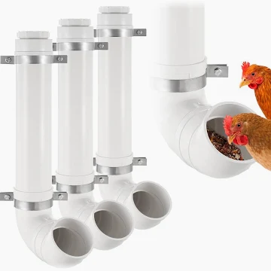
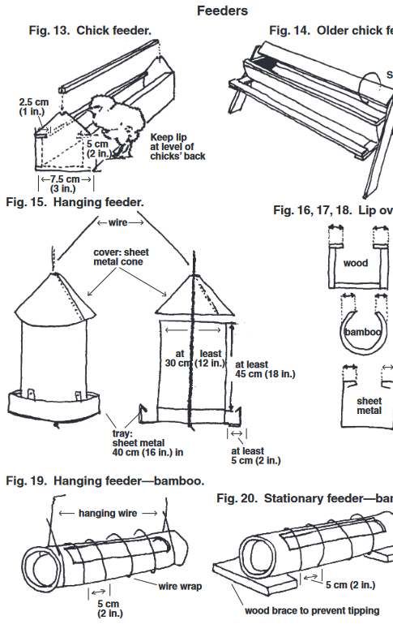
Feeders

Slide 35
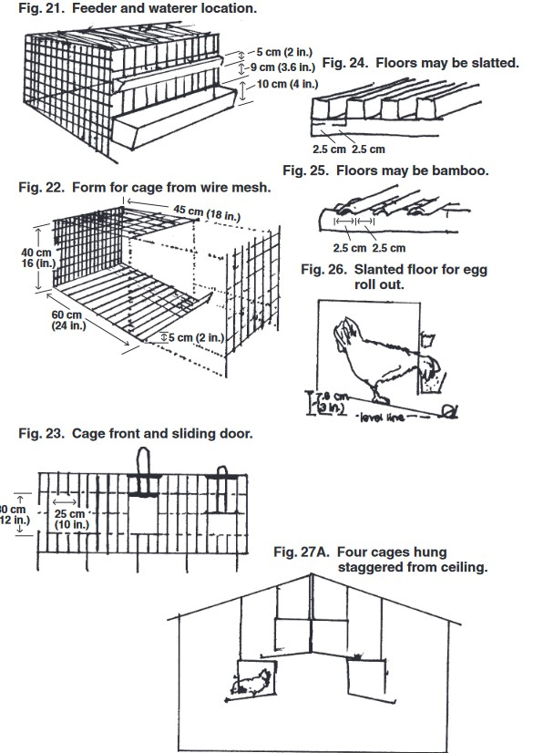
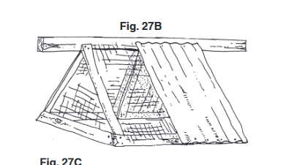
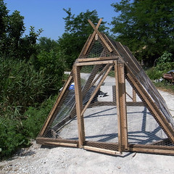
CAGES
This Photo by Unknown Author is licensed under CC BY-NC

Slide 36
Increasing your flock

Slide 37
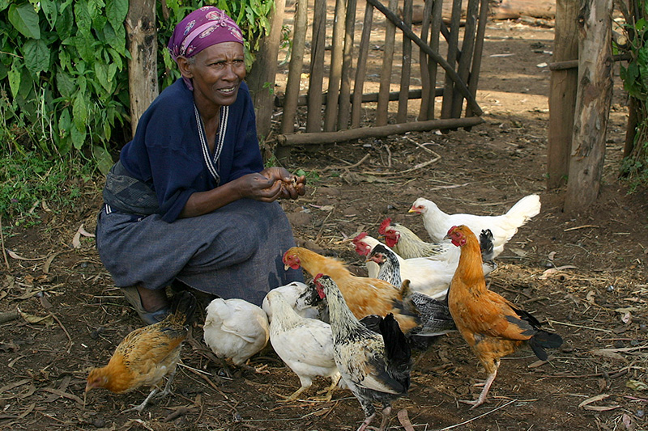
Incubation and Hatching
A. Incubation and Hatching
First choice-natural brooding or incubator
Incubators
  Commercial or home-constructed
  With constant supply of electricity, kerosene can purchase inexpensive incubator.
  Need a thermostat for optimal temp of 37.5 C
  Need to rotate eggs several times a day
Commercial hatchery- can also do beak trimming , vaccination and sexing
Brooding- relies on brooding hens
  Decreases amount of chickens
  Possibility of disease introduction

Slide 38
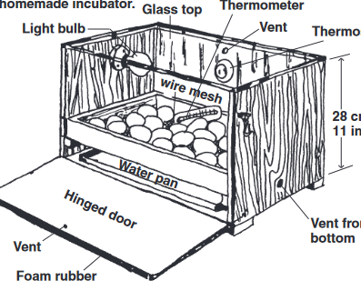
Home made incubator

Slide 39
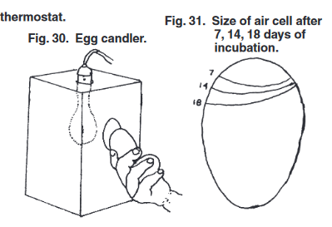
Management
Candling Eggs- progress in the developing embryo during incubation can be observed by rotating an egg in a beam of light.
If the air sac is more than 4/11 cm (1/2 in.) deep, the egg is probably spoiled
Infertile eggs (white shells only) can be detected after 4-5 days of incubation. Two or three days longer may be required for tinted or brown eggs. If thin blood vessels may be seen as emerging from a dark red spot, the egg is fertile and the chick developing
Boschweld

Slide 40
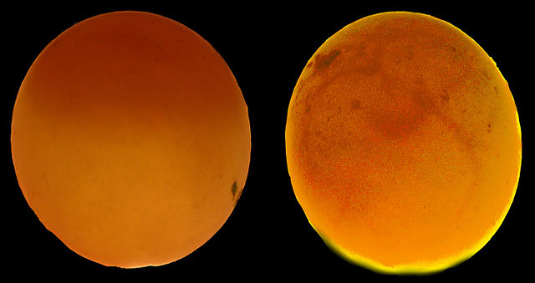
EGG CANDLING
This Photo by Unknown Author is licensed under CC BY

Slide 41
Next steps brooding
Three necessities: Heat, feed, and water
Heat
Heat for a brooder may be provided by electricity (Fig. 32-33), gas (Fig. 34),kerosene (Fig. 37), charcoal (Fig. 35) wood, coal, straw, or solar heat.
Preparations include testing and adjusting the heat source 24 hours before the chicks arrive. The old rule of thumb for maximum brooder temperature has been 35°C (95°F) for the first week, and a decrease of 2.8°C (5°F) for each succeeding week until 21°C (70°F) is reached.

Slide 42
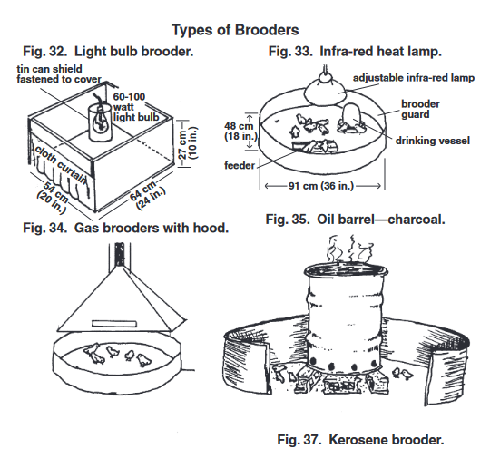
Brooders

Slide 43
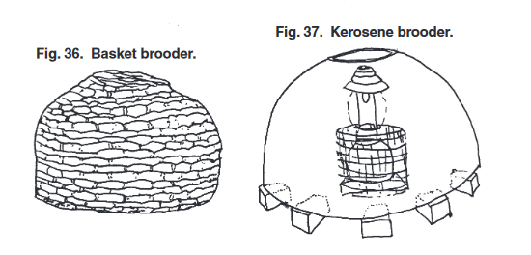
Brooders

Slide 44
Chick Guard
For the first week a ring known as a “chick guard” (it may be card-board, metal, bricks, wood or any material that is clean and will keep the chicks close to heat source) or “brooder guard” is often placed beyond the rim of the brooder to prevent chicks from wandering too far from the heat source An experienced observer will be guided by temperature regulation by the chick behavior

Slide 45
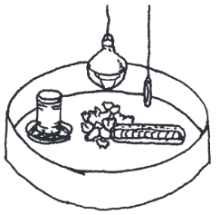
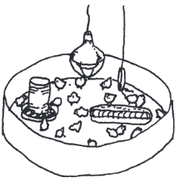
What is Going on in each of these

Slide 46
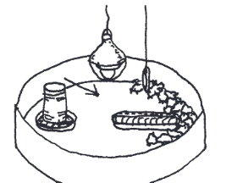
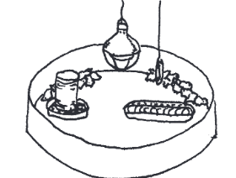
What is Going on in each of these

Slide 47
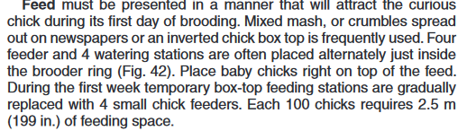
Feeding baby chicks
Potchefstroom Koekoek

Slide 48
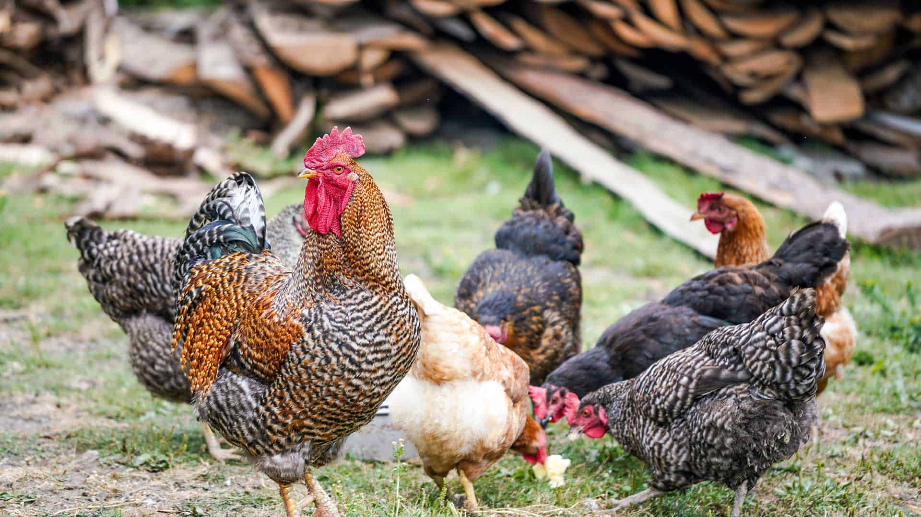
Management
Water-must be found by each chick during the first day even if some must be picked up by hand and their beaks inserted in the water
During first 2 weeks no chick should be more than 1 m from the waterer and thereafter not more than 3.5 m. Daily requirement for 100 chicks 2 liter .
Size of waterers should be increased as the chickens grow
One hundred hens may require 36 liters per day.
No spillage in litter

Slide 49
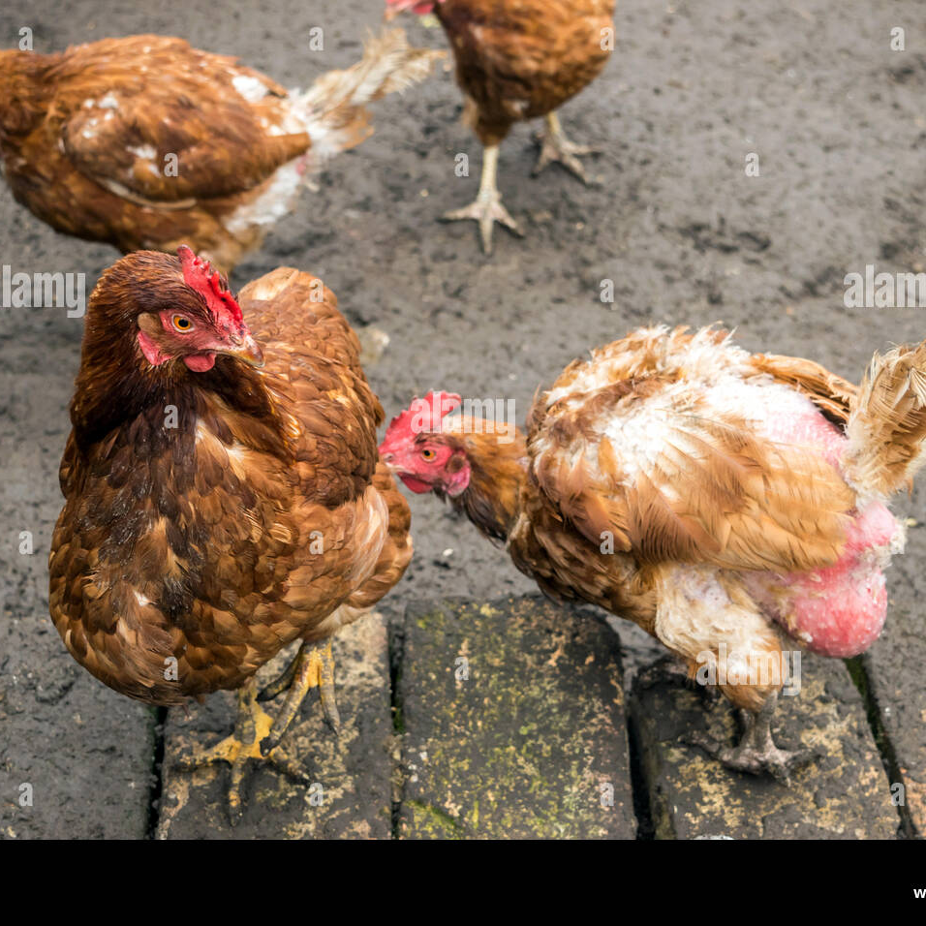
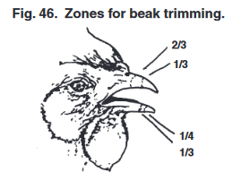
Next steps Beak Trimming
Beak trimming is a method of cutting or burning off the tip of the upper and lower beaks. If properly done the minor operation prevents cannibalism which is a bad habit of pecking at feathers or injured areas of the other birds.
> For broilers only about 1/3 of the top beak is removed
For layers 1/3 to 2/3rds of the upper and ¼ to 1/3 of the lower beak
Scissors or a sharp knife may be used if a debeaking machine is not available.

Slide 50
Next steps rearing
> Extra heat can be discontinued after 3 weeks.
Types of systems of management
Free Range
Limited range
Confinement within houses

Slide 51
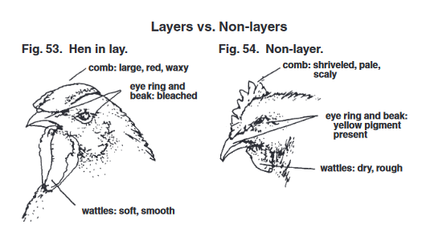
Culling – removing non layers from a flock

Slide 52
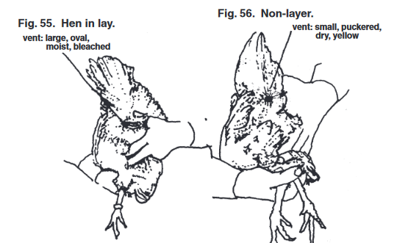
Culling – removing non layers from a flock

Slide 53
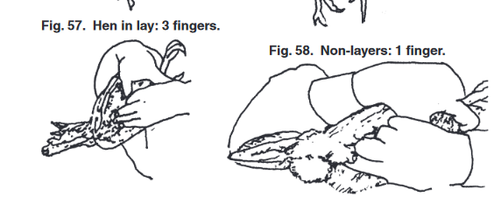
Culling – removing non layers from a flock

Slide 54
Management housing
Advantages and disadvantages of different types of rearing
Free Range
Adv. reduced feed costs as bids find source of food, reduced housing costs.
Disadv. Loss from predators and close flock shepherding
Limited Range
Adv less flock supervision, hen will take care of chicks with natural brooding
Disadv. Predators can be a problem anytime
Confinement/Pen rearing
Adv More protection from weather and predators
Disadv.- cost and responsibility for furnishing all essential nutrients in the feed and cost of complete feeding, fencing, and problems arising from wet pens

Slide 55
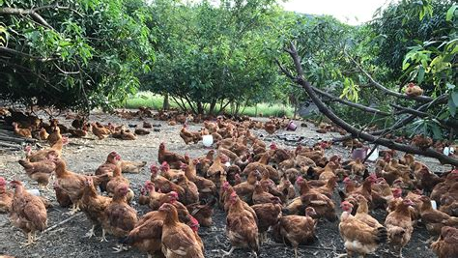
Free Range

Slide 56
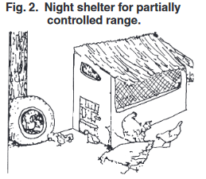
Free Range

Slide 57
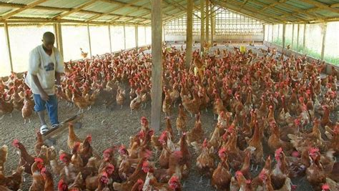
Confinement housing

Slide 58
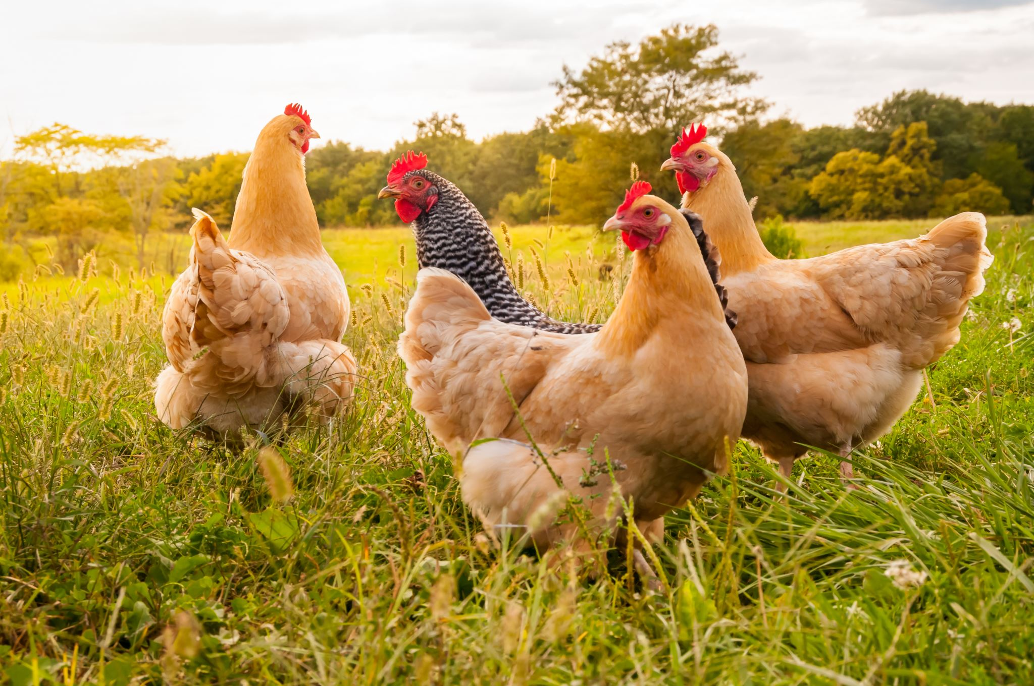
Confinement rearing
Permits greater protection from predators
May prevent disease if exclude visitors, older chickens , pets or fomites
Space per bird 650 sq cm for the first 5 weeks, and increase to 2750 sq cm until reaches maturity.
Floor covered with 5-10 cm of litter.
If litter becomes wet- replace it.
Fine grass, straw or hard particles of incompletely ground feedstuffs may cause a blockage known as crop-bound- need to sacrifice these birds.

Slide 59
Special consideration for layer operations

Slide 60
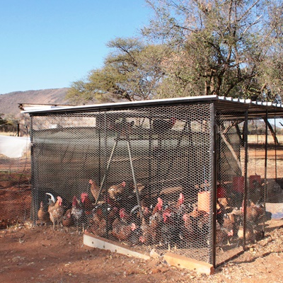
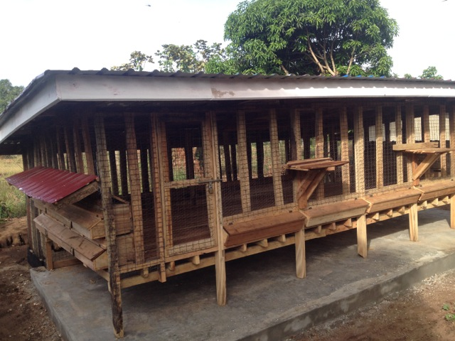
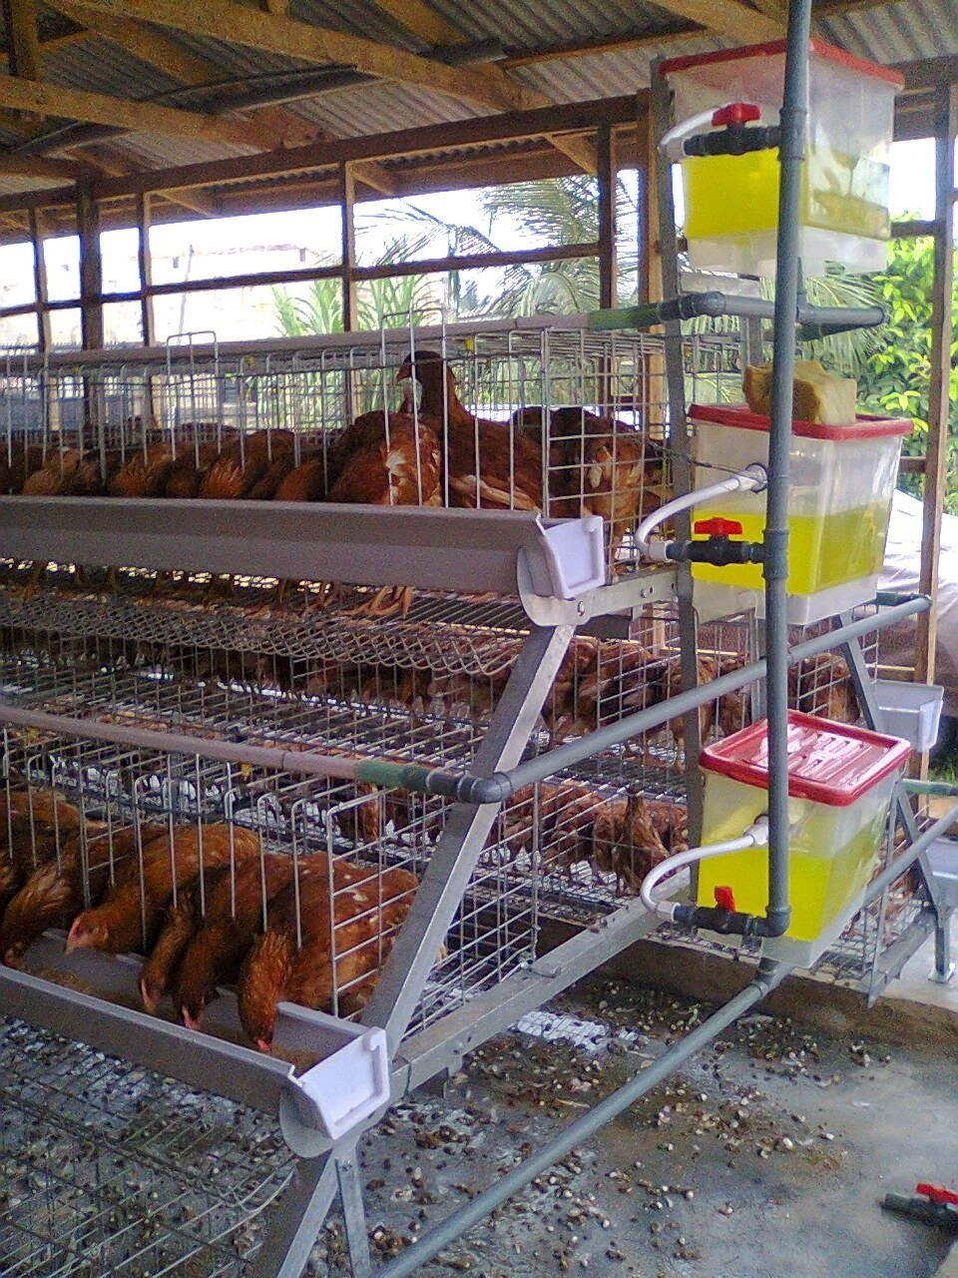
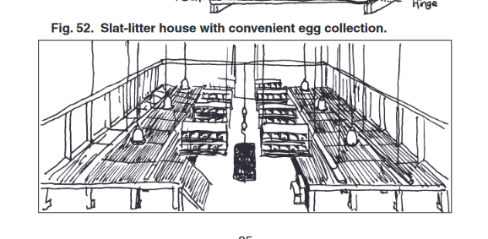
LAYErs
Free range vs confinement housing are two types typically used.
Confinement rearing on litter in floor pens , on elevated slatted floors or in cages is now widely practiced.

Slide 61
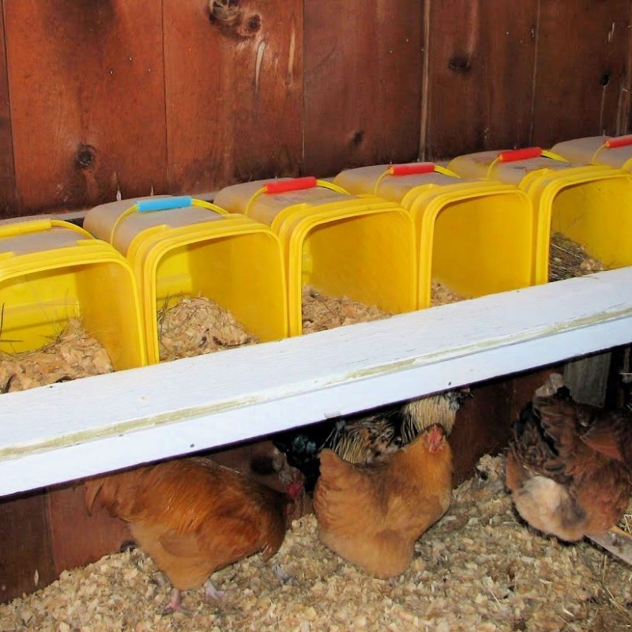
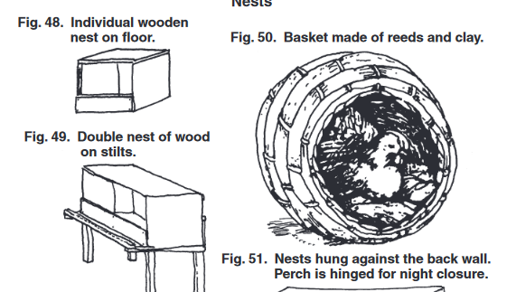
Layer tricks
Increasing light may increase egg production
Eggs laid as free range have darker yolks and can be sold as premium
Daily collection 3-4 times a day important unless hen permitted to naturally brood
Eggs should be stored in cool place
Roosts are important to provide
Nesting boxes are helpful

Slide 62
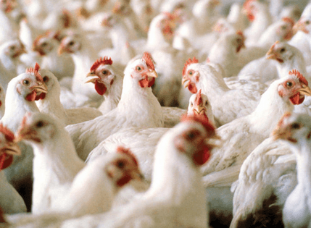
MEAT BIRD TRICKS
Commercial producers calculate that 50-70 percent of the expense of producing chickens is due to the cost of feedstuffs.
“Full feeding” keeping feed in front of the birds always is often recommended.
Weight of feed required will be at least 2 or more times the expected market weight of fast-growing meat birds.
  Feed conversion ration (Feed wight divided by market weight of the birds) requires
    A good broiler breeder stock
    A nutritious and well-balanced diet
    Good management
    Disease control

Slide 63
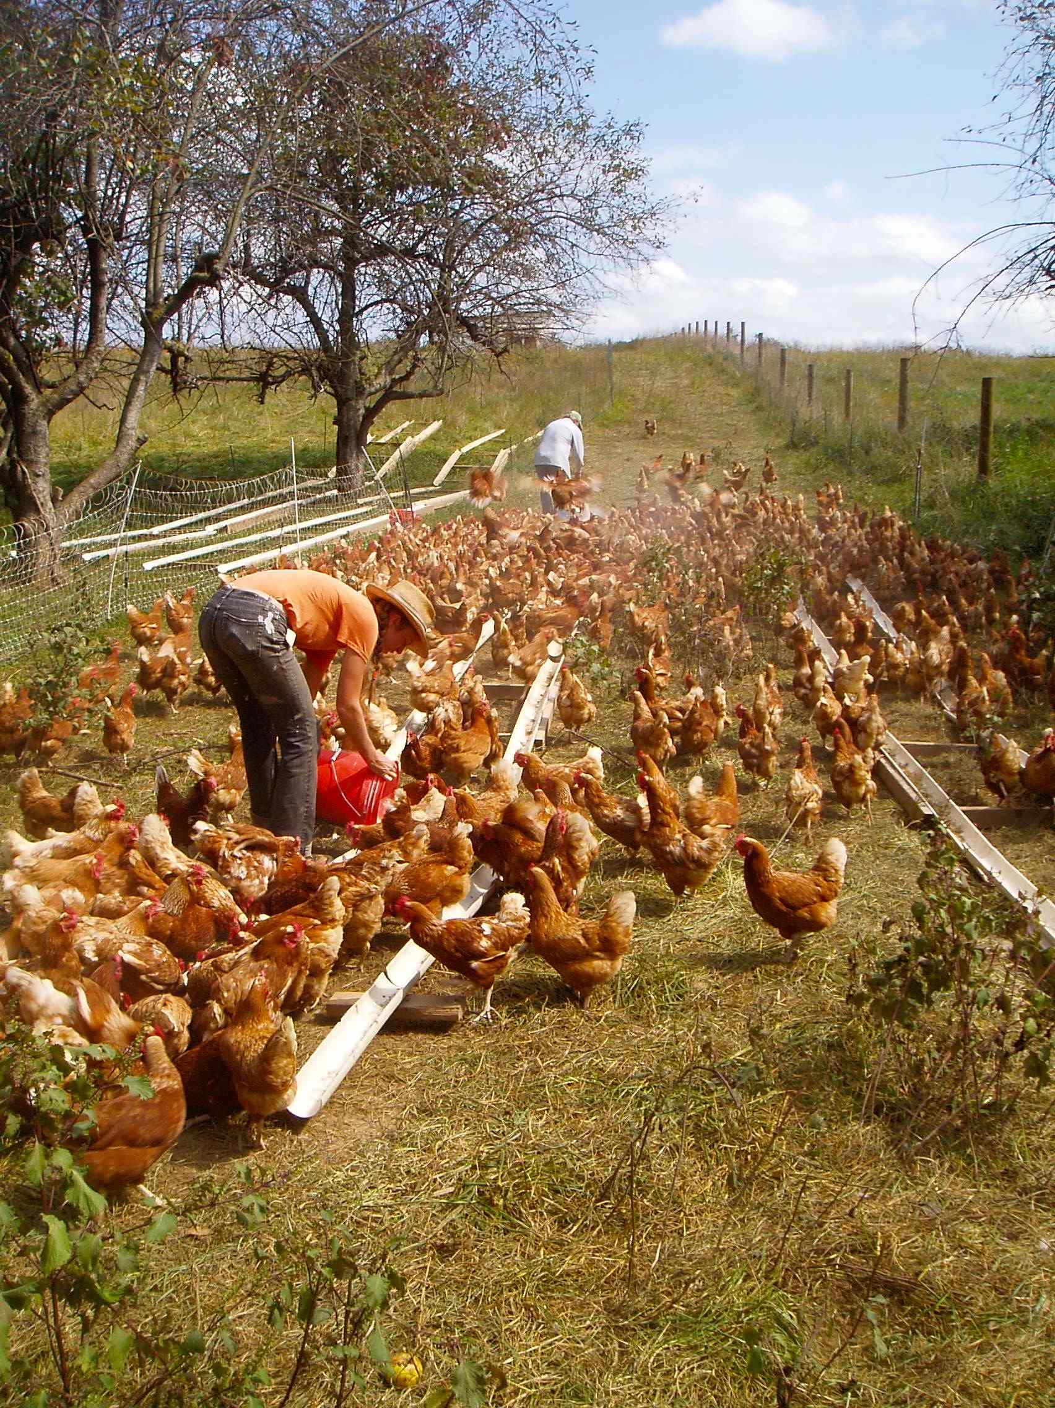
Poultry nutrition
If poultry are permitted to forage in open fields or barnyards, birds usually mange to obtain enough of a balanced diet to survive. A household flock of 10-20 birds may require no feed in addition to table scraps, green fodder and insects from nearby gardens
Slightly larger flocks survive better if fed a few handfuls of corn or other grain.
If get a lot larger then may need to supplement feed, cutting into profits.

Slide 64
Poultry nutrition
For optimal performance, some 40 different chemical substances, or nutrients, have been identified as essential in the diet.
Carbohydrates
Fats
Proteins
Vitamins
Minerals
Water
Nonnutritive additives

Slide 65
Poultry nutrition
Feedstuffs Rich in Energy
Hunger is the driving force which stimulates a chicken to eat and satisfy its energy requirement. Energy is required for muscular activity to carry on chemical processes like and digestion and for producing heat
Feedstuffs that contribute to energy needs
  Corn- 60-70 % of the ration
  Wheat- can be 70% of ration
  Other grains
  Rice
  Cassava- up to 25% of ratio
  Potatoes and yams
  Molasses up to 5%
  Cane Juice- for broilers
  Fats – oil and tallow- up to 3-6% of diet

Slide 66
Poultry nutrition
Feedstuffs rich in proteins and amino acids
Amino acids are building blocks of proteins. Some are essential and cannot be synthesized by chicks and must be present in diet (arginine, lysine, histidine, leucine, isoleucine, valine, methionine, phenylalanine, tryptophan, and threonine)
Feedstuffs which contribute to protein needs
Soybeans and soybean oil 44-49% protein
Peanut meal- may contain 47% protein
Cottonseed meal- 43% protein
Meals from sunflower, safflower, sesame, tung nut, kapok oil etc
Animal sources- fish, meat, blood, offal, and feathers
Synthetic amino acids- feed supplements lysine and methionine

Slide 67

Poultry nutrition
Vitamin Supplements
13 different ones required. , Vit A, E,D,K,B1, B2, Pantothenic acid, nicotinic acid, niacin, B6, Biotin, folacin, folic acid, choline, B 12
Vitamin A Deficiency- rough, dry skin, eye inflammation, ruffled feather, white-yellowish mouth sores, pale comb and wattles, decrease egg production, blood spots in eggs.

Slide 68

Natural Vitamin Sources
for Healthy Chickens in Ghana
Empowered by Livestock, Guided by Faith

Slide 69


Vitamin A
Natural Sources
Needed For
Yellow maize
Palm oil
Moringa leaves
Pawpaw (papaya)
Carrots
Sweet potato leaves
Vision and eye health
Strong immune function
Growth and development
Reproduction
Healthy mucous membranes

Slide 70


Vitamin D
Natural Sources
Needed For
Sunlight exposure
(30-60 minutes daily)
Fish meal
Dried fish waste
Calcium absorption
Strong bones
Eggshell quality
Skeletal development

Slide 71


Vitamin E
Natural Sources
Needed For
Palm kernel cake
Groundnut (peanut) leaves
Wheat bran
Moringa leaves
Fresh green forages
Antioxidant protection
Fertility and reproduction
Immune function
Muscle development

Slide 72

Vitamin K
Natural Sources
Needed For
Fresh green leaves:
• Cassava leaves
• Sweet potato leaves
Alfalfa
Cabbage
Moringa
Blood clotting
Bone metabolism
Wound healing

Slide 73

B-Complex Vitamins
Natural Sources
Needed For
Brewer's yeast
Termites
Fish meal
Fermented feeds
Rice bran
Dried fish
Energy metabolism
Nerve function
Growth
Feather quality
Egg production

Slide 74

Vitamin C
Natural Sources
Needed For
Citrus fruits
Guava leaves
Moringa
Green vegetables
Note: Usually synthesized by
chickens, but beneficial during
heat stress
Stress resistance
Immune support
Heat tolerance
Antioxidant function

Slide 75
Key Takeaways
Moringa is a powerhouse - provides Vitamins A, E, K, and C
Daily sunlight exposure is essential for Vitamin D production
Local ingredients like palm oil, groundnut leaves, and yellow maize are excellent sources
Fish meal and dried fish waste provide multiple B-vitamins and Vitamin D
Empowered by Livestock, Guided by Faith

Slide 76
Essential Mineral Supplements
for Healthy Chickens in Ghana
Nine Essential Elements
Empowered by Livestock, Guided by Faith

Slide 77
Calcium (Ca)
Natural Sources
Requirements & Functions
Limestone (calcium carbonate)
Oyster shells
Bone meal
Eggshells (crushed)
Fish bones
Moringa leaves
Requirements:
• Pullets/Broilers: 0.9-1.0%
• Layers: 3%
Essential for:
• Eggshell formation
• Bone development
• Blood clotting
• Muscle function

Slide 78
Phosphorus (P)
Natural Sources
Requirements & Functions
Bone meal
Fish meal
Rice bran
Wheat bran
Dicalcium phosphate
Groundnut cake
Requirements:
• Minimum: 0.32%
• Ca:P ratio: 2:1
Essential for:
• Bone formation
• Energy metabolism
• DNA/RNA synthesis
• Cell membrane structure

Slide 79


Sodium (Na) & Chloride (Cl)
Natural Sources
Functions
Table salt (NaCl)
Sea salt
Rock salt
Fish meal
Dried fish
Note: Usually added as 0.3-0.5%
sodium chloride in feed
Essential for:
• Fluid balance
• Acid-base balance
• Nerve impulse transmission
• Nutrient absorption
• Digestive enzyme activation
• Water intake regulation

Slide 80
Potassium (K)
Natural Sources
Functions
Green leafy vegetables
Moringa leaves
Cassava leaves
Molasses
Rice bran
Potassium chloride
Note: Usually adequate in
plant-based feed ingredients
Essential for:
• Muscle contraction
• Heart function
• Nerve transmission
• Enzyme activation
• Protein synthesis
• Electrolyte balance

Slide 81
Iron (Fe)
Natural Sources
Functions
Fish meal
Blood meal
Moringa leaves
Dark green leafy vegetables
Ferrous sulfate
Iron oxide (red soil)
Essential for:
• Hemoglobin formation
• Oxygen transport in blood
• Energy metabolism
• Immune function
• Prevention of anemia

Slide 82

Manganese (Mn)
Natural Sources
Functions
Wheat bran
Rice bran
Groundnut cake
Green leafy vegetables
Manganese sulfate
Manganese oxide
Essential for:
• Bone formation
• Eggshell quality
• Reproduction
• Enzyme activation
• Prevention of perosis
(slipped tendon)

Slide 83
Selenium (Se)
Natural Sources
Functions
Fish meal
Sunflower seeds
Groundnuts
Selenium-enriched yeast
Sodium selenite
Note: Required in very small
amounts (0.1-0.3 ppm)
Essential for:
• Antioxidant protection
• Works with Vitamin E
• Immune system support
• Muscle health
• Prevention of muscular
dystrophy

Slide 84
Iodine (I)
Natural Sources
Functions
Fish meal
Sea salt
Iodized salt
Kelp/seaweed meal
Calcium iodate
Potassium iodide
Essential for:
• Thyroid hormone production
• Metabolic regulation
• Growth and development
• Egg production
• Feather development

Slide 85
Key Takeaways
Calcium and phosphorus must be balanced (Ca:P ratio 2:1) for optimal bone health
Layers require 3x more calcium (3%) than pullets/broilers (0.9-1.0%) for eggshell formation
Common salt (0.3-0.5%) provides essential sodium and chloride for fluid balance
Moringa leaves provide multiple minerals: calcium, iron, potassium, and manganese
Empowered by Livestock, Guided by Faith

Slide 86
Water
Chickens require free access to clean, preferably cool drinking waters at all times
Water makes up 85% of the body weight of a hick.
Water deprivation can end up in death within one day in hot environments.
Be careful of salt poisoning if accidently added to water

Slide 87

Feeding systems
Producers with a few scavenging birds my first want to supplement their bird’s diet.
Green feeds may be grown in seasons for birds to range
Can cut and dry and store them
Green pastures are excellent source of high protein, high vitamin feeds.
Can give scavenging or free0-range birds grain or concentrate pre mixes.

Slide 88

Anatomy of the digestive system

Slide 89

External anatomy

Slide 90

Combined anatomy

Slide 91
VETERINARY CHECKLIST
West African Context
Chicken Evaluation for Soundness & Quality
Comprehensive Field Assessment Guide

Slide 92
General Information & Documentation
Basic Details to Record:
Date of examination
Location/Farm identification
Breed type
Age and sex
Purpose: Meat, Eggs, Breeding, or Dual-purpose
Why Documentation Matters:
Tracks health trends over time
Supports breeding decisions
Facilitates disease surveillance
Ensures traceability for sales
Provides legal documentation

Slide 93
1. Behavioral Assessment
Observable Signs of Health
Alert & Responsive
Active Movement
Aware of surroundings
Reacts to movement/sound
Bright, attentive eyes
Foraging behavior present
Walks without limping
Balanced gait
Normal Vocalization
Social Interaction
Appropriate calling
Not excessively quiet
No distress sounds
Engages with flock
Normal pecking order
Not isolated/withdrawn

Slide 94
2. Body Condition & Conformation
Body Condition Score (BCS)
Physical Conformation Checks
Score 1-2: Thin
Prominent keel bone, little muscle
Score 3: Ideal
Moderate muscle, keel slightly felt
Score 4-5: Overweight
Heavy muscle, keel difficult to palpate
Breast muscle development (palpate keel)
Symmetrical body structure
Appropriate weight for age/breed
Good posture when standing
Balanced stance and movement

Slide 95
3. Integument: Skin & Feathers
Feather Quality Indicators
Skin & Parasite Check
Complete coverage for age
Clean, smooth, and glossy
No excessive loss or bare patches
Vent area clean (no fecal staining)
No signs of vent pecking
Appropriate skin color for breed
No wounds, abscesses, or lesions
Check for ectoparasites:
  Lice (base of feathers)
  Mites (legs, vent area)
  Ticks and fleas
⚠ West Africa Note: High humidity increases fungal skin infections and mite infestations

Slide 96
4. Head & Sensory Organs
Eyes
Comb & Wattles
Both eyes open and clear
No discharge or cloudiness
No Marek's disease signs
Alert expression
Bright red color (healthy)
Firm, warm texture
No lesions or pox nodules
Symmetrical shape
Beak & Nostrils
Ears
Properly aligned upper/lower
No overgrowth or deformity
Nostrils clear and dry
No nasal discharge
Earlobes appropriate color
Clean, no discharge
No foul odor
No swelling present

Slide 97
5. Respiratory System Assessment
Normal Indicators
Common Diseases to Rule Out
Respiratory rate: 15-30 breaths/min at rest
No open-mouth breathing
Clear, dry nostrils
No abnormal sounds (rattling, wheezing)
No facial/sinus swelling
Newcastle disease
Infectious bronchitis
Fowl cholera
Chronic Respiratory Disease (CRD/Mycoplasma)
Avian influenza (reportable)
CRITICAL: Newcastle disease is the #1 viral threat in West Africa. Look for greenish diarrhea, neurological signs (head twisting, paralysis), and sudden flock deaths. Vaccination status is essential.

Slide 98
6. Digestive System Evaluation
Crop Examination
Abdominal Palpation
Droppings Analysis
Normal size/consistency
Empties overnight
No impaction
No sour smell
Soft and pliable
No fluid buildup
No masses
Not distended
Formed with white urates
Brown/green normal
No blood (coccidiosis)
No visible worms
Common Digestive Issues in West Africa
Coccidiosis: Bloody diarrhea, especially during rainy season. Young birds most susceptible.
Internal Parasites: Common in free-range systems. Regular deworming essential.

Slide 99
7. Musculoskeletal System
Legs & Feet Assessment
Wings Examination
Stands and walks normally
No lameness or reluctance to bear weight
Legs straight, properly aligned
No swollen joints
Footpads intact (no bumblefoot)
Check for scaly leg mites
Toenails and spurs appropriate length
Both wings held symmetrically
Full range of motion
No drooping or deformity
Flight feathers intact
Common Issues:
Bumblefoot, scaly leg mites, and nutritional leg deformities

Slide 100
8. Critical West African Diseases
Priority Disease Screening
Newcastle Disease
Infectious Bursal Disease
Head twisting, paralysis, greenish diarrhea, sudden death
Sudden deaths in young birds (3-6 weeks), watery diarrhea
Fowl Pox
Fowl Typhoid/Pullorum
Wart-like nodules on comb, wattles, unfeathered areas
Pale comb, droopiness, chronic diarrhea, liver damage
Coccidiosis
Avian Influenza
Bloody diarrhea, ruffled feathers, huddling, dehydration
Sudden death, respiratory distress, facial swelling (REPORTABLE)

Slide 101
9. Vaccination & Health History
Essential Vaccinations
Treatment History to Record
Newcastle disease (CRITICAL)
  Primary vaccination at 1-2 weeks
  Booster every 2-3 months
Fowl pox vaccination
Infectious bursal disease (Gumboro)
Marek's disease (day-old chicks)
Deworming history and schedule
Recent antibiotic use
Anti-coccidial treatments
Ectoparasite treatments
Vitamin/mineral supplements
Withdrawal periods (for meat/eggs)

Slide 102
10. Environmental Considerations
West African Climate Challenges
Housing Quality:
Adequate ventilation for heat
Protection from heavy rains
Shade availability
Predator protection
Appropriate stocking density
Nutrition & Biosecurity:
Clean, accessible water
Appropriate feed quality/quantity
Biosecurity measures in place
Quarantine for new birds
Foot baths and visitor controls
Heat stress is common: Ensure adequate shade, water, and ventilation. Rainy season increases disease pressure.

Slide 103
Overall Quality Assessment
Quality Grading System
EXCELLENT
No abnormalities detected, optimal body condition, complete vaccination record, ideal for breeding/sale
GOOD
Minor issues that don't affect overall health, suitable for production, may need monitoring
FAIR
Moderate issues requiring attention or treatment, suitable for home consumption after treatment
POOR
Significant health concerns, not suitable for sale/breeding, requires immediate treatment or culling

Slide 104
Key Reminders for Field Use
Newcastle disease is the #1 threat - always check vaccination status
Heat stress common - look for panting, wing spreading, reduced feed intake
Rainy season increases coccidiosis and respiratory disease pressure
Local/indigenous breeds often more heat-tolerant and disease-resistant
Regular deworming essential in free-range systems
Always document findings for disease surveillance and traceability

Slide 105
Comprehensive Field Assessment
Ensures Quality, Protects Livelihoods
✓ Systematic evaluation protocol
✓ West African disease awareness
✓ Climate-appropriate considerations
✓ Grading system for informed decisions
Healthy Chickens = Healthy Communities

Slide 106
POULTRY DISEASES

Slide 107
Rule Number Zero- increase the animals resistance
Vaccination
Rule Number One- remember that there are non-infectious causes of disease
For example- vitamin deficiencies
Environmental problems- lack of water
Rule Number Two-Dilution is the solution to pollution
For most diseases caused by infectious disease-causing agents (pathogens), the bird must be exposed to a relatively large number of organisms( pathogens) for infection to occur.
This number of pathogens is known as the “minimum infectious dose.”
Notes:
If we can dilute the number of pathogens by sanitation then disease won’t occur.
Some techniques to do this include
Rotating the number of animals in an area
Replacing and changing bedding

Slide 108
3 Considerations for the prevention of infectious disease in poultry
1. Proper nutrition and management to minimize stress
2. Reduce exposure to disease causing agents
3. Specific appropriate vaccines can increase the resistance to challenge by a specific disease-causing agent.
In healthy poultry, infectious disease can be prevented by maintaining resistance above the level of challenge, or by reducing challenge below the level of resistance (immunity)

Slide 109

Sanitation and Biosecurity
Two distinct sanitary principles that allow for maintaining large numbers of poultry for food production
1. Strict Isolation
  All in and all out
  Control vectors
2. Reduction of pathogen numbers
  Sanitation- reducing the number of infectious or potentially infectious agents in the environment
  In addition to sanitation- time also helps to decrease number of pathogens
Notes:
Show the biosecurity video

Slide 110

Coccidiosis
Bloody diarrhea, ruffled feathers, huddling, dehydration

Slide 111

Crop bound and euthanasia of chickens

Slide 112
Types of disease
1. Bacterial pathogens
Obligate normal pathogens
Produce toxins
2. Viral pathogens
3. Fungal pathogens
Mycotoxins- preformed toxins generally produced by fungal species that are non-pathogenic for poultry

Slide 113
Protection by Vaccination
Vaccination is the process by which specfici immunity can be induced by exposing the host to a weakened or killed organism that has the same external “appearance” as the field pathogen to the immune system.
Prior to the contact with the pathogens
Notes:
Importance of serotypes-in some cases a single disease agent can have alternative “appearances” to the birds immune system (serotypes) In this case I is essential that the vaccine chosen appears the same to the immune system as the actual disease-causing agent to which the birds are likely to be exposed in order to induce protective immunity.
Relationship of the vaccination to the infectious dose: It is very important to remember that protection by vaccination is also related to the concept of infectious dose. With exposure to higher infectious doses, immunity can often be overcome.

Slide 114
General Vaccination Considerations
1. Need to be specific
2. Minimal vaccination strategy for protection
3. Appropriate for the environment

Slide 115
Typical vaccination schedule
18 days- intra egg- Marek’s
Day of Hatch- Newcastle dx and infectious bronchitis via nasal spray
Pullets
Maybe laryngotracheitis, avian encephalomyelitis, infectious coryza, fowl cholera, and fowl pox.

Slide 116
Diseases affecting the nervous system
1. Marek’s Disease
2. Botulism
3. Epidemic Tremor
4. Vitamin E/Selenium Deficiency
5. Aspergillosis
6. Fowl CHolorea

Slide 117
Diseases causing tumors
1. Marek’s Disease
2. Avian Leukosis Virus

Slide 118

Marek’s Disease
System: generalize, neurological
Etiologic Agent: herpes virus
Signs: depression, unilateral leg paresis, ataxic
Diagnosis: based on enlarged nerves and lymphoid tumors in various viscera
Treatment: depopulation
Prevention/Control: vaccinate
Zoonotic: No

Slide 119

Avian Leukosis
System: tumors of lymphoid
Etiologic Agent: avian leukosis virus
Signs:inappetence, weakness, diarrhea, dehydration, and emaciation, non lymphoid tumors
Diagnosis: tumors
Treatment: Depopulate
Prevention/Control: viral antigens in eggs
Zoonotic

Slide 120
Diseases Affecting the Musculoskeletal System
1. Nutritional
2. Mycoplasma Infection
3. Viral Arthritis
4. Bacterial Arthritis
5. Chronic Fowl Cholera

Slide 121

Mycoplasmosis
System: Respiratory/joints
Etiologic Agent: Mycoplasma gallisepticum
Signs: varying respiratory distress, sneezing
Diagnosis: Agglutination reactions and ELISA are commonly used for diagnosis
Treatment: chloamphenicol
Prevention/ControlP: serum agglutination/elisa
Zoonotic: No

Slide 122
Diseases Causing immunosuppression and General Conditions
1. Marek’s Disease
2. Infectious Bursal disease
3. Mycotoxicosis
4. Pullorum disease

Slide 123

Infectious Bursal Disease
System: Bursa
Etiologic Agent: birnavirus (IBDV)
Signs:severe prostration, incoordination, watery diarrhea, soiled vent feathers, vent picking, and inflammation of the cloaca.
Diagnosis: quantitative serologic test such as virus neutralization or ELISA
Treatment: Depopulation
Prevention/Control: Vaccination
Zoonotic: NO

Slide 124
Pullorum Disease
System:GI
Etiologic Agent: Salmonella pullorum
Signs:anorectic, appear weak, and have whitish fecal pasting around the vent (diarrhea)
Diagnosis: Pullorum testing
Treatment: Depopulatoin
Prevention/Control: Screening
Zoonotic: Yes

Slide 125
Pullorum disease
Acute or chronic, salmonella pullorum
Egg transmitted
Resp or gi
Young birds, mortality 90%
Pullorum testing- blood
Eradication/depopulation

Slide 126

Pullorum Disease

Slide 127
Diseases Affecting the respiratory system
Infections involving the eyes and Face
1. Fowl Pox
2. Infectious Coryza
3. Fowl Cholera
4. Avian influenza

Slide 128

Fowl Pox
System: Integument
Etiologic Agent:large DNA virus (an avipoxvirus, family Poxviridae)
Signs: scabs
Diagnosis:PCR
Treatment: self limiting/ ELISA/ Virus neutralization
Prevention/Control: Vaccination
Zoonotic: Yes

Slide 129
Avian Influenza
System: Respirator
Etiologic Agent:Avian influenza (AI) viruses
Signs: cyanosis and edema of the head, comb, and wattle; edema and discoloration of the shanks and feet due to subcutaneous ecchymotic hemorrhages; petechial hemorrhages on visceral organs and in muscles; and blood-tinged oral and nasal discharges
Zoonotic

Slide 130
Avian Inluenza
Diagnosis: hemagglutination/ viral RNA RT-PCR
Treatment: Depopulate
Prevention/Control: Vaccine

Slide 131


Avian influenza

Slide 132

Avian influenza viruses do not normally infect species other than birds and pigs. The first documented infection of humans with an avian influenza virus occurred in Hong Kong in 1997, when the H5N1 strain caused severe respiratory disease in 18 humans, of whom 6 died. The infection of humans coincided with an epidemic of highly pathogenic avian influenza, caused by the same strain, in Hong Kong’s poultry population.
Extensive investigation of that outbreak determined that close contact with live infected poultry was the source of human infection. Studies at the genetic level further determined that the virus had jumped directly from birds to humans. Limited transmission to health care workers occurred, but did not cause severe disease.

Slide 133
Diseases affecting the respiratory tract
Limited to the Upper Respiratory Tract
1. Infectious Bronchitis
2. Laryngotracheitis
3. Bordetellosis (turkeys)
4. Mycoplasmosis

Slide 134
Laryngotracheitis
System:
Etiologic Agent:herpesvirus infection
Signs: blood, mucus, and yellow caseous exudate or a hollow caseous cast in the trachea.
Diagnosis PCR/ isolation
Treatment Quiet, cough suppression
Prevention/Control Vaccination
ZoonoticNo

Slide 135

laryngotracheitis

Slide 136
Generalized Respiratory Diseases
Avian Influenza
Newcastle disease
Mycoplasmosis
Fowl cholera
Chlamydiosis
Avian tuberculosis
Aspergillosis

Slide 137

Avian Tuberculosis
System: GI, musculoskeletal
Etiologic Agent: Mycobacterium avium var avium
Signs:thin and sluggish, and lameness may be seen. In chickens, granulomatous nodules of varying size are usually found in the liver, spleen, bone marrow, and intestine.
Diagnosis: Live birds may be tested with avian tuberculins, although these are of little value in birds that do not have wattles. Large numbers of acid-fast bacteria in smears from lesions provide a tentative diagnosis.
Treatment: Chemotherapy is ineffective
Prevention/Control: New additions to the aviary should be quarantined for 2-3 mo
Zoonotic: NO

Slide 138
Diseases affecting the Gastrointestinal Tract
Esophagus/Gizard
1. Fowl Pox
2. Crop mycosis
3. Capillariasis
4. Gizzard/proventricular erosions/dialation

Slide 139
Cecal Worms
Heterakis gallinae
Small, white ½ inch in length
Vector of Histomonas meleagridis, which is the agent of blackhead
Life cycle- eggs produced in the ceca and pass in the feces- infective form in about 2 weeks
Tx- febendazole

Slide 140



Slide 141
Diseases affecting the Gastrointestinal Tract
Small Intestine
1. Coccidiosis
2. Necrotic enteritis
3. Colibacillosis
4. Roundworms
5. Tapeworms

Slide 142
Diseases affecting the Gastrointestinal Tract
Ceca and Large Intestines
1. Salmonellosis
2. Histomoniasis
3. Coccidiosis

Slide 143

Histomoniasis
System: Gastrointestinal
Etiologic Agent:protozoan parasite Histomonas meleagridis is transmitted most often in embryonated eggs of the cecal nematode Heterakis gallinarum , and sometimes directly by contact with infected birds
Signs: listlessness, drooping wings, unkempt feathers, and yellow droppings.
Diagnosis: Histopathology
Treatment: none
Prevention/Control contact between chickens and turkeys should be avoided nitarsone at 0.01875% of feed until 5 days before marketing
Zoonotic: NO

Slide 144

Diseases affecting both the respiratory tract and gastrointestinal tract
1. Newcastles Disease
2. Avian Influenza
3. Fowl Cholera

Slide 145
Diseases Affecting the renal system
1. Ochratoxin
2. Infectious Bronchitis

Slide 146
Diseases causing systemic generalized disease
1. Fowl cholera
2. Coccidiosis
3. Mycotoxicosis (Aflatoxicosis)
4. Ascites syndrome

Slide 147

Diseases affecting the Skin and feathers
1. Molt
2. External parasites
3. Wear on feathers
4. Gangrenous dermatitis
5. Cannibalism, scratches and scabs
6. Tumor causing disease

Slide 148

Poultry lice
Effects are via irritation
Become restless and don’t sleep well
Incubation period is four to seven days
Head, body and shaft louse

Slide 149


Poultry lice
Effects are via irritation
Become restless and don’t sleep well
Incubation period is four to seven days
Head, body and shaft louse

Slide 150

Fowl tick
Argas pesicus- can become serious parasite
Blood sucker
Spend most of time in cracks and hiding places- emerging at night

Slide 151
Common Duck Breeds in Ghana
Meat, Egg & Dual-Purpose Breeds

Slide 152
Muscovy Duck
Most Popular Duck Breed in Ghana
Characteristics
Production Performance
Origin: Central/South America
Large size - significant sexual dimorphism
Drakes: 2.7-4.5 kg (6-10 lbs)
Ducks: 1.5-2.0 kg (3.5-4.5 lbs)
Red caruncles (facial warts) on face
Variable plumage: white, black, mixed
Quiet - do not quack like other ducks
Strong flyers, can perch in trees
Egg production: 60-80 eggs/year (scavenging)
100-125 eggs/year (improved management)
Egg weight: 72-75g (larger than chicken eggs)
Dressing percentage: 70-71% (males)
Lean meat: 98% fat-free
Meat similar to steak/ham in taste
Excellent brooders - 2-3 broods/year
Market age: 10-14 weeks
Notes:
Muscovy ducks are the most popular breed in Ghana due to their hardiness, low maintenance requirements, and dual-purpose capabilities. Unlike true ducks (which belong to Anas species), Muscovies are actually a separate species (Cairina moschata) and do not quack. They are quieter than other ducks, making them suitable for urban/suburban settings. In West Africa, Muscovies are valued for their lean, high-quality breast meat that commands premium prices. They adapt well to various climates from tropical heat to -12°C, making them ideal for Ghana's conditions. Muscovies are excellent foragers and can thrive on minimal supplementation, eating insects, snails, grass, and kitchen scraps.

Slide 153
Muscovy Duck Management in Ghana
Advantages
Management Tips
Not picky about housing - simple shelter sufficient
Disease resistant - minimal health problems
Excellent foragers - low feed costs
Natural brooding and mothering ability
Live longer than chickens (8-12 years)
Effective pest control (insects, snails, termites)
Can be left unsupervised
Adapt to presence/absence of water
Quiet - minimal noise disturbance
Housing: Simple, dry shelter with good ventilation
Do not require pond but benefit from water access
Need water for mating to produce fertile eggs
Incubation: 35 days (longer than other ducks)
Feed: Rice, corn, cassava + foraging
Space: Can coexist with crop farms
Drakes can be aggressive during breeding
Regular deworming recommended
Notes:
Muscovy ducks require minimal management compared to other poultry. They do not destroy flowers or vegetables, making them ideal for integrated crop-duck farming systems. While they don't require a pond, providing access to water significantly improves fertility rates and egg production. Muscovies are excellent mothers and will naturally incubate eggs and raise ducklings. However, they can be territorial, and drakes may become aggressive during breeding season. Starting with a minimum of 12 ducks is recommended for a viable flock. Cultural myths about ducks being 'dirty birds' have limited duck farming uptake in Ghana, but these misconceptions are gradually being overcome.

Slide 154
Pekin Duck
Commercial Meat Production Breed
Breed Characteristics
Production
Origin: China (imported to West 1873)
Most popular commercial duck breed worldwide
White plumage with orange/pink bill and legs
Upright posture (similar to Indian Runner)
Docile, calm temperament
Fast growth - ready for processing at 7 weeks
Market weight: 2.5 kg at 49 days
Adult weight: 3.6-5.0 kg
Dual purpose: Excellent for both meat and eggs
Egg production:
200+ eggs/year
Egg weight:
75-90g
Market age:
7-8 weeks
Adaptability:
Confinement or free-range
Notes:
Pekin ducks are the dominant breed for commercial meat production globally. In Ghana and East Africa, they are gaining popularity for their rapid growth and high meat yield. China produces 60% of the world's duck meat, primarily using Pekin ducks. The breed's white plumage results in a clean-looking carcass preferred by consumers. Pekins are less broody than other ducks, requiring incubation or broody chickens to hatch eggs. They are hardy, fertile, and one of the largest duck breeds. Duck meat sells for GH₵450+ per kg in Ghana. Pekins are particularly popular with Asian restaurants, hotels, and food processors. They require commercial duck feed for optimal growth but can supplement with locally available grains (rice bran, broken rice, cassava).

Slide 155
Khaki Campbell Duck
Superior Egg Production Breed
Breed Characteristics
Exceptional Egg Production
Origin: England (late 1800s)
Cross: Rouen × Runner × Mallard
Light breed: 4-4.5 lbs (1.8-2.0 kg)
Khaki brown plumage
Drakes: darker head with green sheen
Active, energetic temperament
Excellent foragers
Hardy in hot and cold climates
300-340 eggs per year
World record: 365 eggs in 365 days!
Egg color: White/cream/green-tinted
Egg weight: 75-85g
Start laying: 5-7 months
Lay throughout the year
Rarely go broody (continuous laying)
Superior to chickens in egg production
Notes:
Khaki Campbell ducks are renowned as one of the best egg-laying duck breeds in the world, exceeding even the most productive chicken breeds. They were developed by Mrs. Adele Campbell specifically for high egg production and are ideal for commercial egg operations or homesteads focused on egg production. Campbells are excellent foragers, helping with pest control (slugs, snails, insects). They don't require a pond but need access to water for drinking and bill cleaning. Duck eggs are larger than chicken eggs, richer in flavor, and superior for baking (give more lift to pastries). Campbells adapt well to various climates and are suitable for Ghana's conditions. They require less care than chickens and are relatively quiet compared to other duck breeds.

Slide 156
Indian Runner & Other Breeds
Indian Runner Duck
Swedish Blue Duck
Distinctive upright posture (penguin-like)
Excellent egg layers: 200-300 eggs/year
Light breed: 1.6-2.3 kg
Active runners, not waddlers
Good for pest control in gardens
Dual purpose: meat and eggs
Medium-heavy breed: 2.7-3.6 kg
Egg production: 150-200 eggs/year
Blue/grey plumage with white bib
Calm, docile temperament
Saxony Duck
Mallard (Local/Wild Type)
Large dual purpose breed: 3.2-4.1 kg
Egg production: 190-240 eggs/year
Excellent meat quality
Attractive buff and blue plumage
Ancestor of most domestic ducks
Smaller size: 0.9-1.6 kg
Variable egg production: 60-150 eggs/year
Excellent foragers, very hardy
Notes:
These breeds are less common in Ghana but may be available through specialized hatcheries or imports. Indian Runners are excellent for small farms focused on egg production and are entertaining to watch. Swedish Blue and Saxony are good all-around breeds for farmers wanting both meat and eggs. Mallards or local duck types may be kept in village settings and are extremely hardy but have lower production than improved breeds. When selecting breeds, consider: purpose (eggs vs. meat vs. dual), climate adaptability, feed availability, and market demand.

Slide 157
Duck Breed Comparison for Ghana
Breed | Primary Use | Adult Weight | Eggs/Year | Market Age | Key Features
Muscovy | Dual (meat/eggs) | ♂:2.7-4.5kg ♀:1.5-2.0kg | 60-125 | 10-14 wks | Hardy, quiet, excellent forager, lean meat
Pekin | Meat + eggs | 3.6-5.0kg | 200-250 | 7-8 wks | Fast growth, white plumage, commercial
Khaki Campbell | Eggs | 1.8-2.0kg | 300-340 | N/A | Top egg layer, active forager, hardy
Indian Runner | Eggs | 1.6-2.3kg | 200-300 | N/A | Upright posture, excellent layers
Swedish Blue | Dual purpose | 2.7-3.6kg | 150-200 | 10-12 wks | Calm, good meat and egg production
Breed Selection Recommendations for Ghana:
Meat production: Muscovy (most popular) or Pekin (fastest growth)
Egg production: Khaki Campbell or Indian Runner
Small farms/backyard: Muscovy (lowest input, dual purpose)
Notes:
Breed selection should consider: 1) Production goals (meat vs. eggs vs. dual-purpose), 2) Available resources (housing, feed, water), 3) Climate and management capacity, 4) Market preferences (duck meat is premium product in Ghana), 5) Cultural acceptance. Muscovy remains the top choice in Ghana for its adaptability, low inputs, and multi-purpose use. For commercial operations focused on rapid meat production, Pekin is superior. For egg-focused operations, Khaki Campbell offers unmatched productivity.

Slide 158
Duck Farming Business in Ghana
Business Opportunities
Overcoming Challenges
Low start-up capital (minimum 12 ducks)
Duck meat is premium product (higher prices)
Duck eggs larger, richer than chicken eggs
Growing market from Asian communities
Hotels and restaurants seeking duck meat
Ducks live longer than chickens
Can integrate with crop farming
Ducks provide pest control services
Duck manure excellent fertilizer
Challenge: Cultural myths about ducks
Solution: Education on duck benefits
Challenge: Limited technical knowledge
Solution: Training programs, extension services
Challenge: Lack of processing facilities
Solution: Partner with restaurants, direct sales
Challenge: Feed costs
Solution: Maximize foraging, local grains
Challenge: Market development
Solution: Target hotels, Chinese restaurants
Notes:
Duck farming is emerging as a profitable livestock business in Ghana despite historical cultural barriers. The minimum investment is lower than chicken farming - you can start with 12 ducks. Duck meat commands premium prices (often 50-100% higher than chicken). The growing Asian population in Ghana provides a ready market for duck products. Duck eggs are prized by bakers and chefs for superior quality in pastries and baked goods. Ducks are more disease-resistant than chickens and require less veterinary care. Average egg production: 100 eggs/duck/year (minimum). Duck eggs are bigger than chicken eggs. Adult duck weight ranges 1-3 kg depending on breed and sex. Production purposes: egg production, duckling production for sales, meat production.

Slide 159
Duck Production Systems in Ghana
Small Home Flock (12-50 ducks)
Free-Range with Water Access
Simple shelter, yard space, basic fencing
Feed hopper, waterers
Foraging supplemented with grains
Nearby dry sheltered area for night/nesting
Can combine with fish farming (tilapia)
Duck manure feeds fish
Semi-Intensive (50-500 ducks)
Commercial Intensive (500+ ducks)
Improved housing with ventilation
Day foraging, night confinement
Supplemental commercial feed
Controlled environment housing
Commercial duck feeds (starter, grower, layer)
Biosecurity, vaccination programs
Essential Requirements for All Systems:
Clean water for drinking (ducks drink more than chickens)
Dry sheltered sleeping area with good drainage
Predator protection (especially at night)
Adequate ventilation to prevent respiratory issues
Notes:
Duck housing does not need to be expensive or elaborate. Ducks are adaptable and can thrive in simple structures. They collect eggs in morning/night making daily collection convenient. Space requirements: Brooding (0-4 weeks): 0.1 m²/duckling; Growing (4-8 weeks): 0.2 m²/duck; Adult: 0.3-0.5 m²/duck. Feed consumption: Ducklings 25-50g/day; Adults 150-200g/day. Water: Adults need 0.5-1.0 liter/day. Ducks can control pests in gardens. They eat rice, corn, cassava, and forage on algae, aquatic weeds, insects, snails, and small fish. The duck-fish integration system is particularly efficient for small farms.

Slide 160
Duck Farming Resources in Ghana
Ministry of Food and Agriculture - Livestock Division
Local veterinary services and extension officers
Poultry hatcheries (some supply duck breeding stock)
Agricultural training centers and universities
Duck farming associations (emerging)
Markets: Chinese/Asian restaurants, hotels, supermarkets
Starting small with 12-20 ducks allows you to learn while minimizing risk
Notes:
Duck farming in Ghana is still developing compared to chicken production, but opportunities are significant. The key to success is starting small, learning the basics of duck management, and gradually scaling up as you gain experience and identify reliable markets. Focus on the Muscovy breed initially due to its hardiness and low input requirements. As the industry develops, processing facilities, specialized hatcheries, and feed suppliers will emerge to support commercial duck farming.

Slide 161

Duck Farming
One of the most profitable livestock farming businesses is duck farming in Ghana.
Duck farming is not very popular in Ghana because of the several myths associated with ducks. A lot of people consider ducks as dirty birds and hence not consumed in many parts of Ghana
Recently many people are seeing an opportunity to start a duck farming business.

Slide 162

Why is duck farming on the rise
Muscovy
Advantages
Duck meat is an excellent and affordable source of protein and duck eggs can be a good protein source
Starting a duck farm requires a small amount of capital
If you already have a crop farm you can rear your ducks in the same place because they do not destroy flowers or vegetables
Ducks live longer compared to chickens
Ducks can lay eggs for a longer period.

Slide 163

Starting a duck farming business
Minimum of 12 ducks
Do not require large housing and expensive feeds
Not easily affected by avian diseases that affect other poultry birds
You can leave them unsupervised because they can fend for themselves
Ducks can eat insects like termites, cockroaches and grasshoppers, fish eggs and snails.
Don’t necessarily need a pond to be able to rear your ducks but if you want fertile eggs you should consider it.

Slide 164
Starting a duck farming business
Minimum of 12 ducks
Do not require large housing and expensive feeds
Not easily affected by avian diseases that affect other poultry birds
You can leave them unsupervised because they can fend for themselves
Ducks can eat insects like termites, cockroaches and grasshoppers, fish eggs and snails.
Don’t necessarily need a pond to be able to rear your ducks but if you want fertile eggs you should consider it.

Slide 165

Advantages of duck farming
Khaki Campbell
Duck houses facility does not have to be expensive and elaborate
Ducks can easily adapt to any new environment
They lay eggs in the morning or at night which means that you can collect fresh eggs every morning
You can use your ducks for pest control.
Not a lot of money on duck feed- normally eat rice, corn, cassava and other easily available food. Ducks then to forage on algae, aquatic weeks, fungi, snails, insects etc

Slide 166

Duck production in Ghana
The minimum average amount of eggs a duck can produce in a year is 100 eggs and if well fed can do 200 eggs and eggs usually are big.
The weight of an adult duck depends on the sex. The average weight of most duck's ranges between 1 kg and 3 kg.
Muscovy are most popular duck breed
  Large
  Not picky where they stay
  If shelter is clean safe and comfortable will be fine
  Don’t require lot of care and management
  Meat and eggs are valuable.
Indian Runner

Slide 167

Duck Business in Ghana
Pekin
While preparing to venture into the duck farming business, you must define your purpose for rearing ducks.
  Egg production-can be used for a meal and as medicine
  Duckling production for sales and supply
  Meat

Slide 168

Choosing your duck
Once decided on reason for duck farm then
  What to look for
    From eight-week stock
    Movement should be normal and balanced
    Good eyesight
    Healthy feathers
    No obvious defects

Slide 169

Duck Eggs and rearing ducks
When you are collecting the duck eggs, you must check for the fertilized eggs. The fertilized eggs will be left to be hatched by the female ducks, while the unfertilized eggs will be taken for commercial purposes.
How will you check for fertilized eggs? Remember chicken information.
For your ducks to thrive, it is advisable to keep them in a place with ponds of water. If you rear ducks on dry land, they will still be fine, but they will produce unfertilized eggs that will not hatch into ducklings. Ducks require water to be able to mate.

Slide 170

Duck housing and management
Ducks adapt well to a wide range of management systems provided they receive essential basic care.
Protection from predators and extremes in weathert
A clean dry sheltered area- although they spend most of their time outdoors on ponds or in wet areas, they require a clean dry area to retreat, rest, clean and preen their feathers- allows them to waterproof their plumage which protects their skin from injury and help keep their body warm
Clean water for drinking- free from germs and toxins
A diet that provides all of the duck’s daily nutritional needs
Adequate light stimulation especially for layers
Protection from disease

Slide 171

Methods of raising ducks
Small home flock
Raising ducks on open ponds
Herding
Brooding

Slide 172

Small home flock
Typical requirements
Brooder for first week or so,
Yard space
A simple structure such as shed- should be bedded with straw shavings or dry absorbent material
Inexpensive fencing
A feed hopper
Well drained area of yard so will drain quickly if rains

Slide 173

Open ponds
Requirements
Nearby dry sheltered area
Can combine with raising fish for human needs such as tilapia
  Duck manure can be used by fish for food
  May need to supplement food for ducks

Slide 174

HERDING duck management
Typical for Indonesia herds of 90 to 130
During the day flock usually, mature females are allowed to search for food in areas where plentiful
At night flock is returned to confinement usually a bamboo pen, where eggs are laid during the night which are collected or sold
Major parts of diet are whole grains and snails, insects, leaf material crabs and frogs. Herder's job is to move to new source of food.
Portable fencing and other equipment is moved with the flock and as set up as a base camp.

Slide 175

Brooding- commercial
Sources of information
Orr, H.L., 1969. Duck and Goose Raising. Publication 532. Ontario
Department of Agric. and Food, Parliament Building, Toronto, Canada.
j. Scott, M.L., and Dean, W.F., 1991. Nutrition and Management of
Ducks. M.L. Scott, Ithaca, NY 14853.

Slide 176

Duck nutrition
Nutrient requirements of ducks
Require the same nutrients as chickens but in slightly different amounts
For small flock owners who have less than 15 ducks and are not able to obtain complete duck feeds, or the ingredients to make complete feeds, the following suggestions are offered. (1) If possible, allow ducks access to areas where the flock can forage for green plants, seeds, insects, insect larvae, earthworms, snails, crabs, mollusks, shrimp, cray-fish, small frogs, eels, and other material with some nutritive content.
(2) Feed ducks unused garden vegetables, table scraps (bones must be ground), and other food leftovers. (3) If affordable, supplement the flock’s diet with any locally available foodstuffs such as bakery waste, rice bran (if not rancid), wheat bran, brewers' yeast, distillers' grains, broken rice, trash fish (cooked and not putrefied), prawn meal, tapioca chips, palm oil, and similar products.

Slide 177

Duck Nutrition
If available and affordable, purchase nutritionally complete commercially prepared duck feeds. If duck rations are not available, and chicken feeds are, they will serve as a satisfactory substitute.
If poultry feed concentrates, which when fed with grain constitute a nutritionally complete diet, are available at a reasonable price, this may be a good option. The grain can sometimes be purchased from local farmers at a favorable price.
For those with sufficient knowledge of nutrition and feed formulation, complete duck rations may be mixed on the farm. This approach is dependent upon the availability of feed ingredients and vitamin and mineral premixes at affordable prices. Small batches can be mixed by turning the feed on a clean floor with a shovel.

Slide 178
Duck Diseases

Slide 179

Duck Viral Enteritis
Duck Plaque
Etiological agent: Herpes virus
Zoonotic: No
Treatment: None-
Prevention: vaccination of breeders
Signs:
  Sluggishness, ruffled feathers, greenish-yellow diarrhea, blood dripping form nostirl.

Slide 180
Riemerella anatipestifer Infection
Etiological agent: Pasturella anatipestifer infestion
Signs: High mortality, weigh loss, listlessness, eye discharge and diarrhea, incoordination, shaking of head and twisted neck
Treatment: None-
Prevention: Bacterins
Preventative management

Slide 181

Cholera
Etiological agent: pastuerella multocida
Prevention: Mangement- no stangnent water
Signs: loss of appetite, muchous discharge from the mouth, diarrhea, and labored breathing.- PM liver is enlarged, copper colored,
Treatment: Antibiotics, good sanitation

Slide 182

Colibacillosis
Etiological agent: Eschericahia coli
Signs: reduced hatchability, infection of yolk sac, and a setpicemia
Age 2-8 weeks of age
Prevention: good sanitation
Treatment: sulfdimethoxine ormetoprin

Slide 183

Aspergillosis
Etiological agent: Aspergillus fumigatus spores that grow on straw or damp feed
Signs: death- gasping, listlessness, dehydration
Prevention: avoid moldy straw and preventing feed from getting wet and moldy.

Slide 184

Toxins
Aflatoxin poisoning
Etiological agent- aspergillus flavus and aspergillus parasiticus
Molds that grow on cereal grains and oilseeds

Slide 185


Duck Diseases
Toxins
  Aflatoxin- mold
  Botulism-stagnant pools
  Castor bean poisoning
  Insecticides rodenticides

Slide 186
Diseases of Ducks
Duck Virus Hepatitis
Etiological agent:
Zoonotic: NO
Age 1-28 days of age
Prevention: vaccination of breeding ducks
Signs- 90% mortality
  Spasmodic contractions of legs and die within an hour in a typical arched-backward position.
  Liver enlarged

Slide 187
Botulism
Etiological agent: Clostridium botulinum
Signs progressive flaccid (limp) paralysis of the neck, legs and winds
Death
Prevention: no stagnant waters

