Slide 1
Pig Production:
Zambia initiative for animal husbandry

Slide 2
Agenda
General Overview of Pig production
Pig production parameters
Advantages of producing pigs
Key Husbandry Practices and Their importance
Key Risks along the value chain and mitigation measures
Pests , Diseases, Symptoms and Control Measures
Market Information of Pigs
Enterprise Budget for A Five Sow Unit

Slide 3
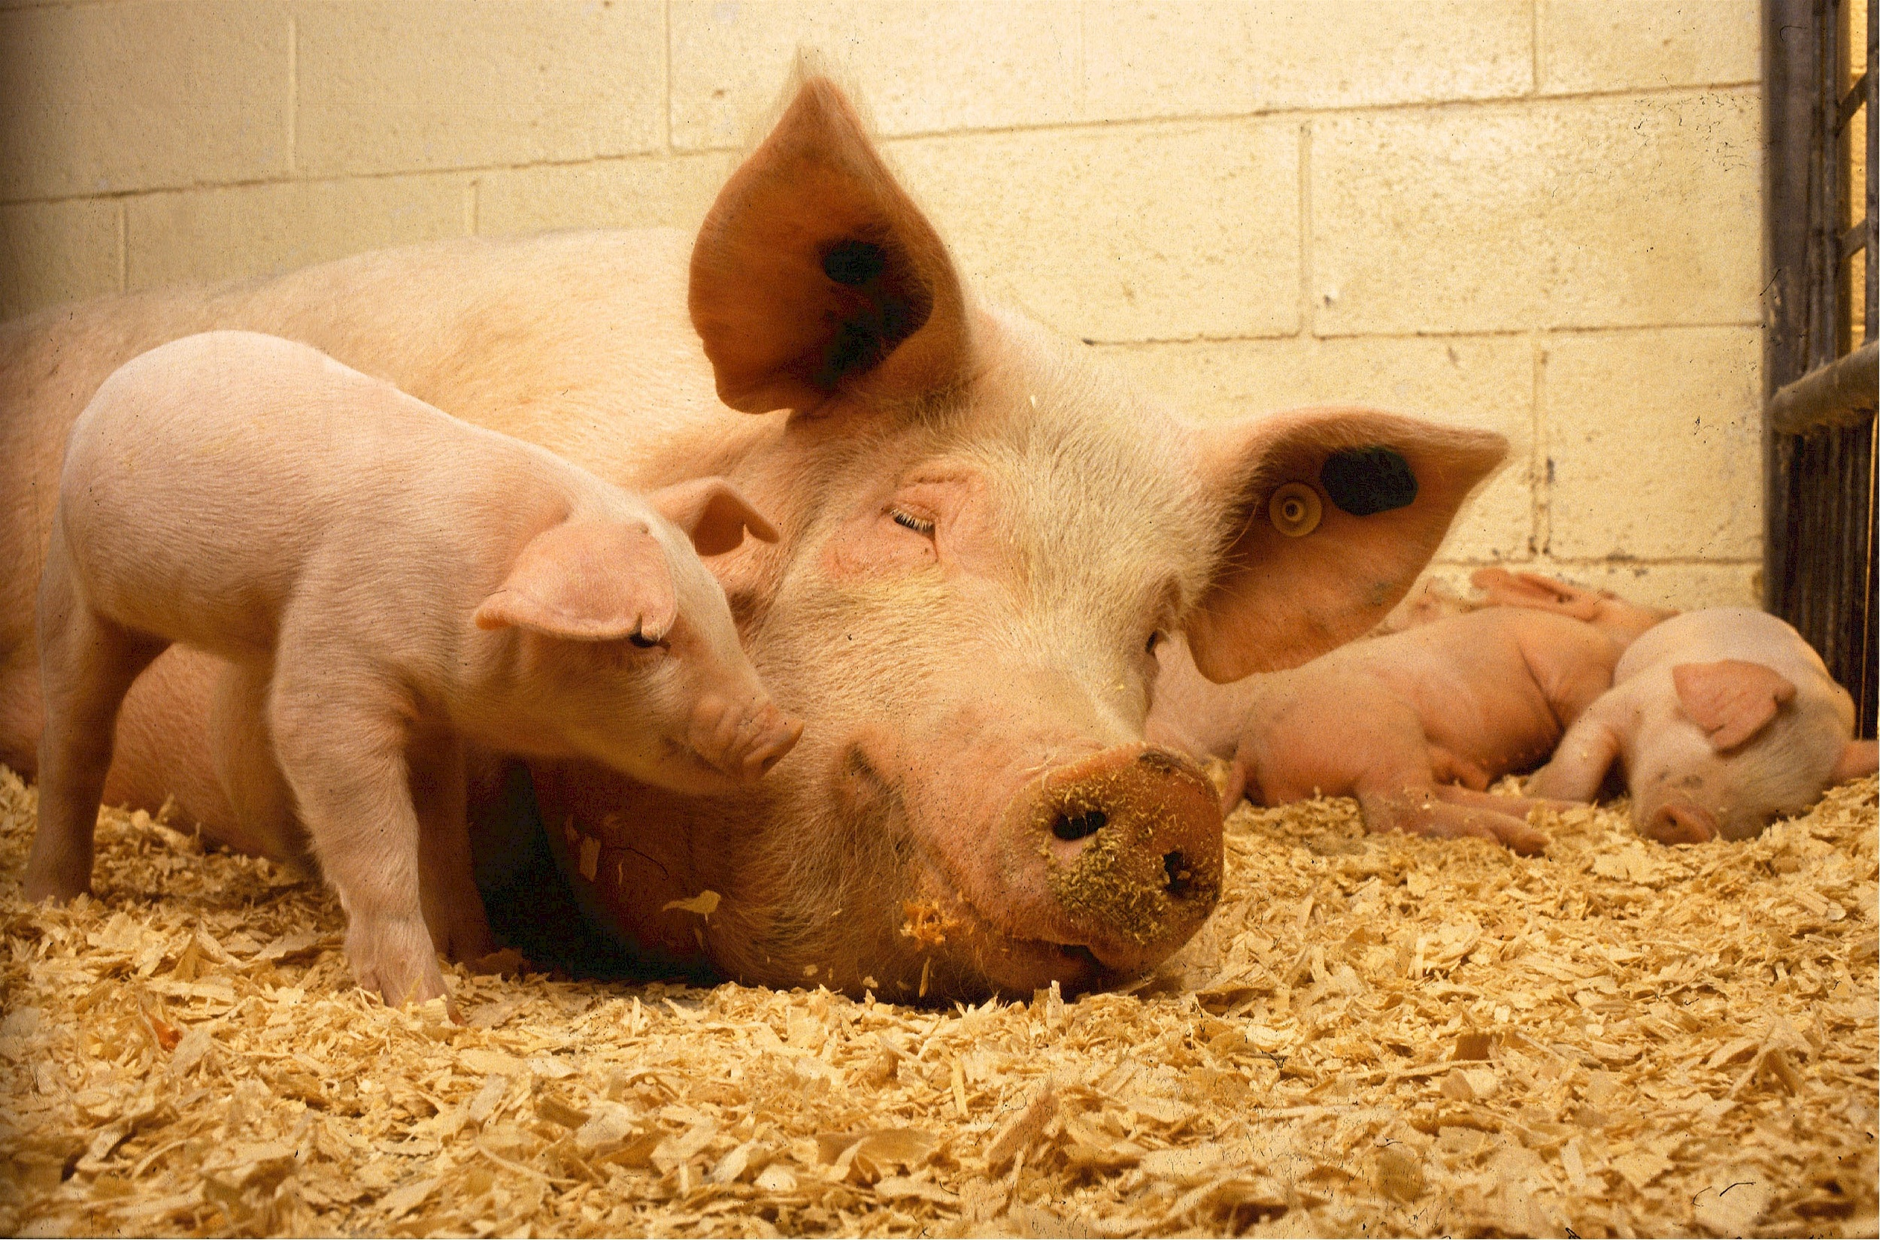
General Overview of Pig Production
Source of animal protein, vitamins, minerals, energy, employment and income for the various actors along the value chain
Short reproductive cycle, very prolific, and increase meat production within a short time
Rates of returns is relatively high
Growth rate is also high if given right feed ration and proper husbandry

Slide 4
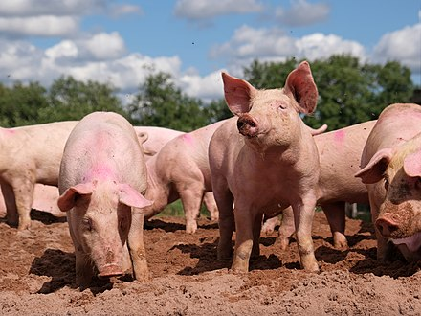
General Overview of Pig Production
Commonly used system of production is the intensive system where pigs are kept in pens throughout
Fed balanced ration
Can used semi-intensive and extensive system
Extensive practices by small holders using Ashanti Black Pig breed
This Photo by Unknown Author is licensed under CC BY-SA

Slide 5
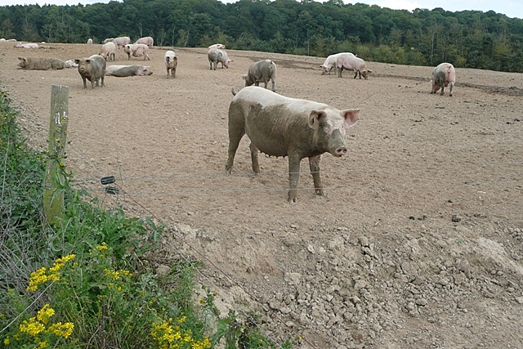
General overview of pig producton
Semi-intensive system: pigs are kept in pens and given boiled cassava and leftover meals and are sometimes opened to scavenge for food
Demand for pork and its products has been rising steadily over the past decade.
  White meat as opposed to red meat, demographic growth, economic and technological advancement.
This Photo by Unknown Author is licensed under CC BY-SA

Slide 6
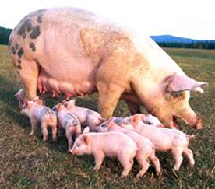
Pig Production parameters
Gestation: 113-115 days
Farrowing rate: 2 x a year
Average litter size: 8 per sow
Temperature of Farrowing environment: 26-30 Degrees C
Piglet access to colostrum
Weight of piglet: 1.2-1.8 kg

Slide 7
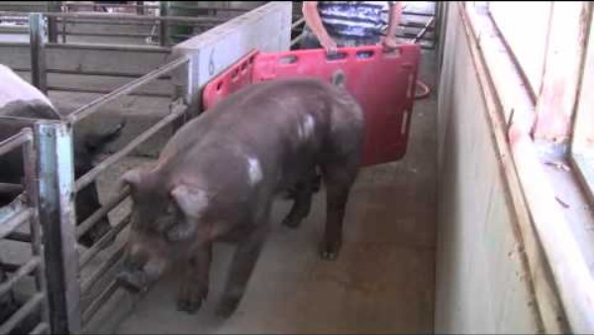
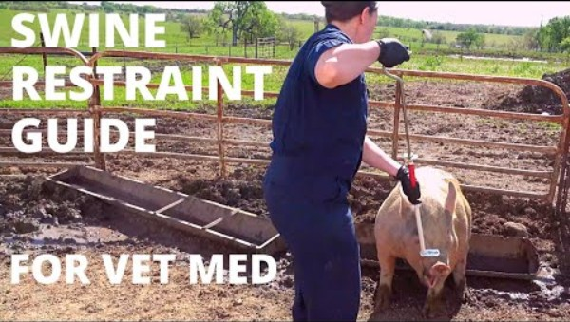
Pig handling

Slide 8
Pig Production parameters
Iron injection and removal of canine teeth – 3-4 days
Creep feeding (from 7 days)
Weaning: 6-8 wks with weight of 15.5-18 kg
Identification (ear tagging, tattooing)
Castration: 2-3 weeks

Slide 9
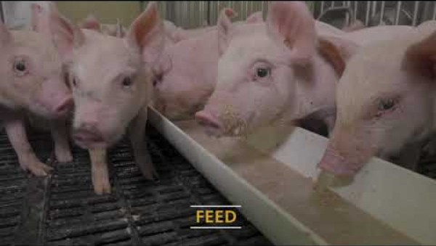
Video on Weaning management practices

Slide 10
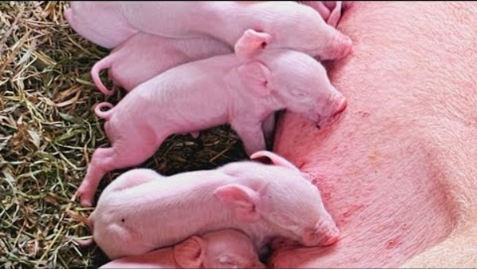
Video on clipping teeth and iron injections

Slide 11
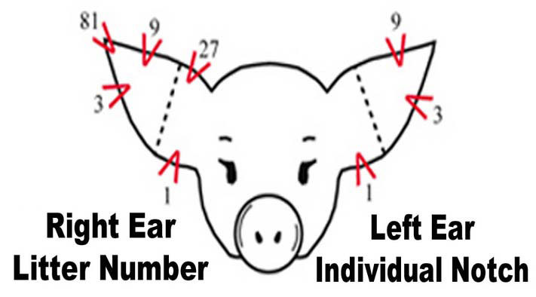
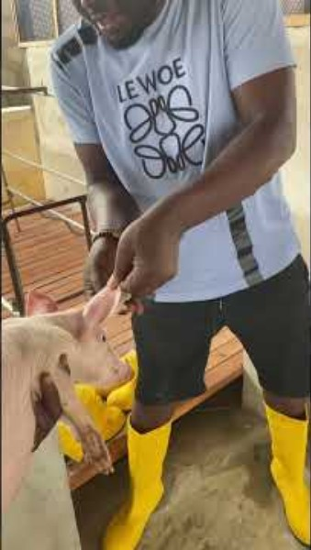
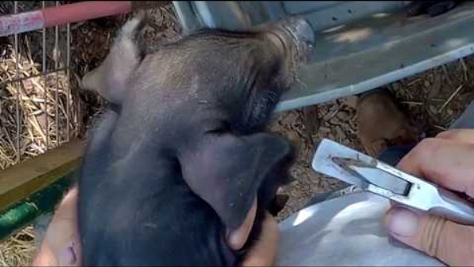
Video on ear identification

Slide 12
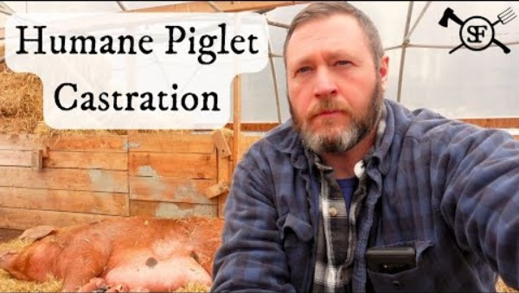
Video on castration of piglets

Slide 13
Advantages of producing pigs
Prolificacy and Short gestation period
Fast growth (90-100kg by 7-9 months)
Not much elaborate housing required
High dressing percentage (carcasss weight) Pig 75% ruminant (50%)
Manure and biogas

Slide 14
Value chain actors and linkages in zambia
Input suppliers
  Group sells feed, drugs, equipment and breeding stock to support process
Pig Farmers
  Most of these farmers practice intensive and semi-intensive system of production:
  They provide feed, water and cross the pigs for fattening and sales. Some farmers sell the live pigs to pig traders. Some provide slaughter facilities
Pig Traders
  Buy live pigs and send to slaughter salbs and those who sell fresh/processed meats
Processors
  Slaughter slab operators, cut into various parts, sausage, kebabs etc
Consumers
  Individual and institutional consumers/users

Slide 15
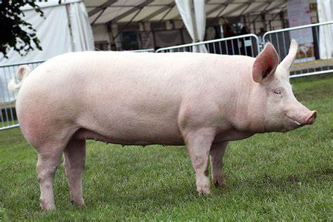
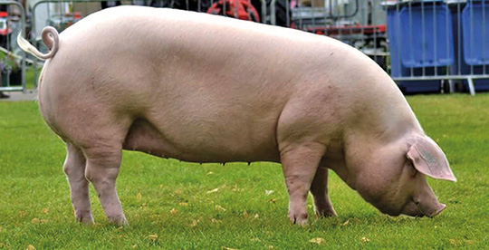
Key husbandry practices and their importance: Breeding stock
Common breeds in Ghana are large white, landrace and their crosses.
Large White: Large white pig is large in size and pure white coloration. It has white or pink skin, dished face and erect ears of pink color
Landrace: Have white skin and are free from black hair. They are lop-eared pig with a long middle, light forequarters and excellent ham development

Slide 16
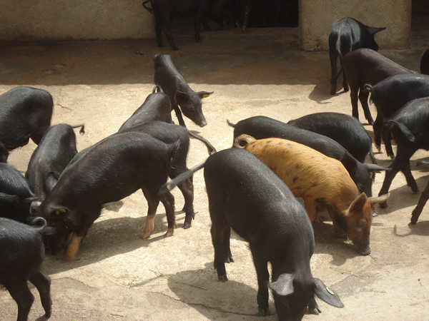
Key husbandry practices and their importance: Breeding stock
Ashanti Black Pig: It is a local breed. It is generally black, small, short-bodied animal with a relatively long and narrow head, and a prolonged snout.
The breeding stock can be purchased from reputable local farms or research stations. E. G. Animal Research institute farms, university farms or livestock breeding stations of the animal Production Directorate, Ministry of Food and Agriculture where good breeding systems are know to be practiced.

Slide 17
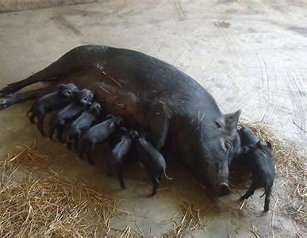
Key husbandry practices and their importance: Definitions
Name the two age groups of pigs
Boar: Mature male pig that can be used for breeding
Barrow or hog: male pig castrated before weaning
Farrowing: act of giving birth to pigs
Gilt: Female pig about 6 months of age: could be pregnant but never farrowed yet
Piglet: from day old to about 2 months
Sow: Mature female pig that has farrowed at least once.

Slide 18
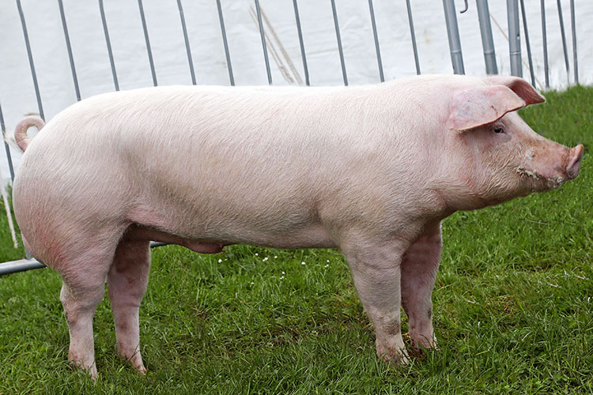
Key husbandry practices and their importance:
What is this breed? What is sex?
Selection of a breeding sow
Must have suitable body conformation
At least 7 pairs of uniform sized evenly spaced teats
The udder must be firm
The body must be fair haired and fine skinned
Must walk and carry the body well

Slide 19
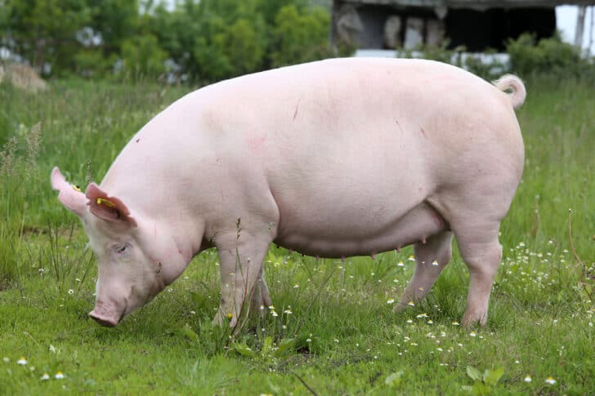
Key husbandry practices and their importance:
What is this breed? What is sex? Why does it have small litter size and what can you do about it?
Selection of a breeding boar
This is important since boars contribute about 50% of the quality of the herd.
Must have well developed testicles
Less restless and good tempered
Must walk and carry the body well
Must exhibit masculinity (vigorous and active)
Must have strong legs

Slide 20
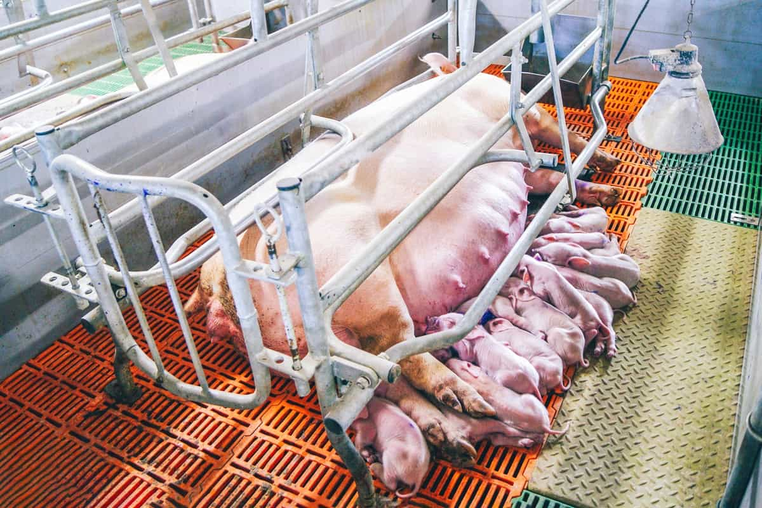
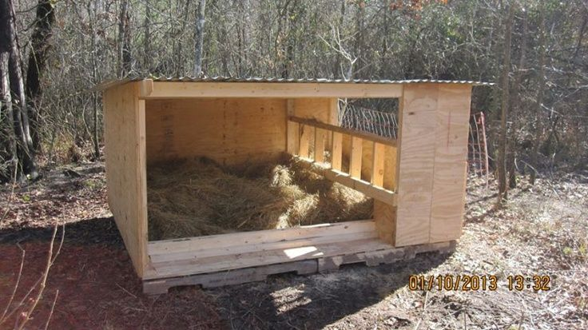
Key husbandry practices and their importance:
Preparation for farrowing
Farrowing crate
14 Days before farrowing, wash sow and spray with acaricide
10 days before farrowing give sow dewormer
7 days before farrowing wash sow again, spray with acaricide and send it to the farrowing pen which has been prepared
Provide farrowing crate / rail where possible
Stockman should be present during farrowing

Slide 21
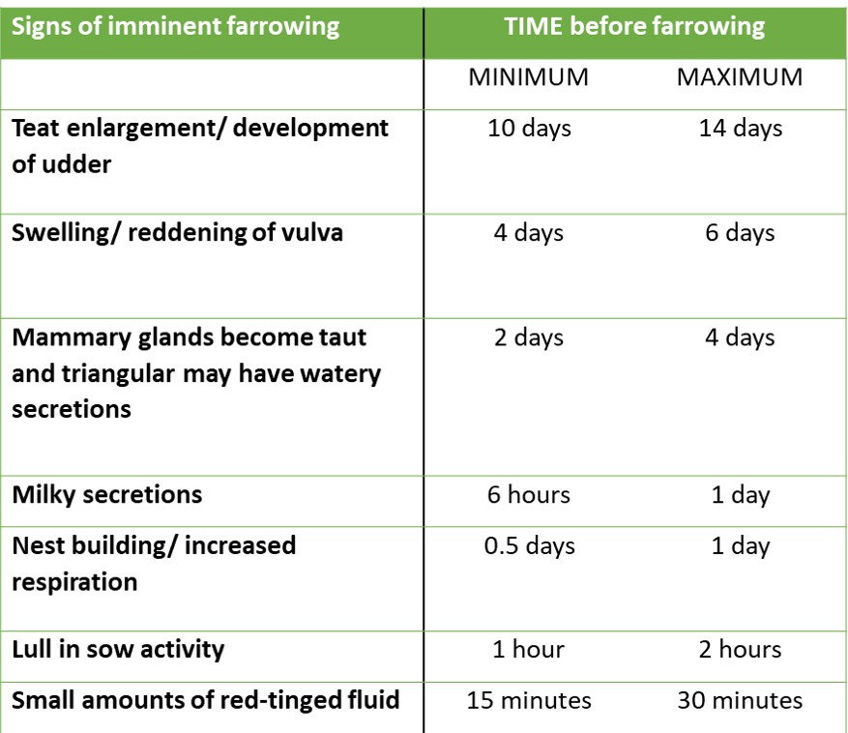
Key husbandry practices and their importance:
Signs of Farrowing

Slide 22
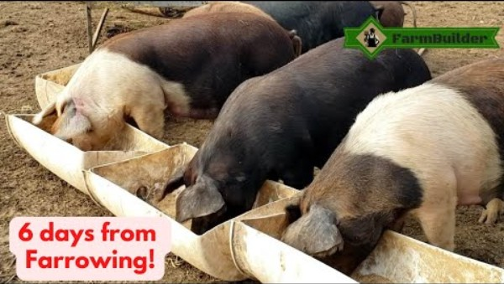
Leading up to farrowing

Slide 23
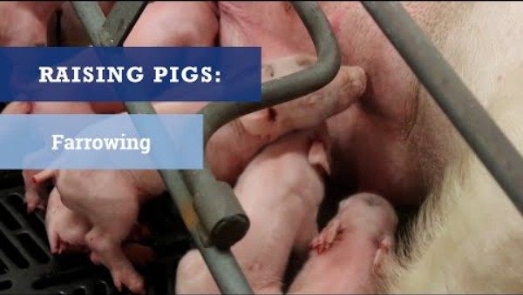
farrowing

Slide 24
Farrowing tips
Cut umbilical cord to a length of 5cm
Soak navel of each piglet in iodine to prevent inflammation
Assist piglets to suckle colostrum
Day1-3; give iron injection and clip needle teeth.
Day 4; provide clean water in a trough in creep area.
Day 7-10; introduce creep feed
Day 1-14; castrate males not for breeding and ear tag.
Day 35; start introducing weaning ration
Day 42; remove sow from litter (Weaning)
Piglets may remain there or be transferred to a weaner pool

Slide 25
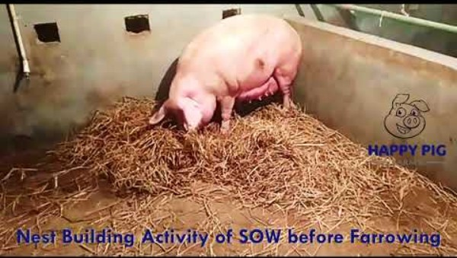
Key husbandry practices and their importance
Quality pig housing is a major contribution to profitability and pig health with lower mortality rates and better growth, increased feed efficiency and lower costs.
A good housing structure must offer the following benefits.
    Offer protection from extreme weather conditions and predators.
    Allows easy management of large numbers in relation to nutrition feeding and watering.
    Allows for high quality and consistent products to be produced.
    Allows for observation, handling and healthcare delivery.
    Facilitates harvest of manure for organic fertilizer and biogas.
    Must provide shelter for various classes of animals
Describe behavior and tell when will farrow

Slide 26
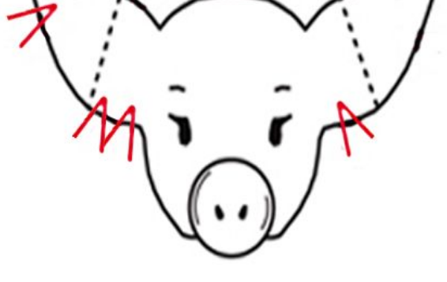
Key husbandry practices and their importance:Basic requirements for a standard housing
Positioning of the housing should be oriented length wise in the East to West direction (ie. against the direction of the sun rise and set) to allow for good shade, ventilation and air circulation within the house.
Provide foot-baths and changing rooms for workers and visitors (Bio-security).
Provide different sections/compartments within the structure (to house the breeding stock, growing animals and sick animals separately).
The house must be structured in a form that movement of humans as well as animals is from the section of young animals to older ones and not the other way round.
The house must be well secured to prevent undesirable elements such as vectors (pests, rodents and insects) and robbers from entering.
Floor should neither be smooth nor very rough to harbour pathogens or hamper cleaning.
Floor must slope towards the drainage outlet of the pen for easy flow of liquid substances.
What litter and number piglet

Slide 27
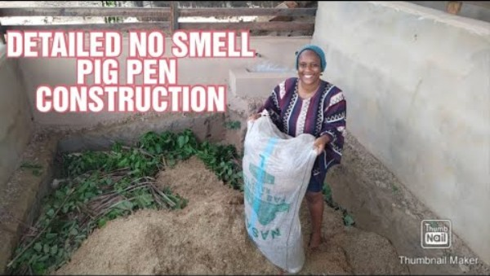
Key husbandry practices and their importance
Indigenous Micro Organism Techniques (IMO)
  Benefits
    Reduction of feed cost.
    Elimination of odour to some extent.
    Heating of the environment of the pigsty.
    Minimise use of water.

Slide 28
Key husbandry practices and their importance: vaccination
The Steps:
To IMO misxture
Cook a kilogram of corn, fancy rice, or sweet potatoes. Once it has cooled, place it in a wooden, earthen, or ceramic container; do not use metal or plastic.
Cover the mouth of the container completely with a cloth or paper, fixed in place with a rubber band to prevent water or small insects from getting in.
Place the covered container somewhere that is protected from potential rain, such as beneath a tree or on the ground covered in a thick layer of leaves, and leave it there for three days.
After whitish moldy filaments have formed, transfer the entire contents of the container to a larger glass or earthen jar and add one kilo of brown sugar or more molasses, preferably organic in nature.
Cover the jar with a clean cloth or paper, fixed with a rubber band. Keep it in a dark place and let it ferment for seven days until it appears muddy.
This is your IMO concoction.
Vaccination is not normally done in Ghana

Slide 29
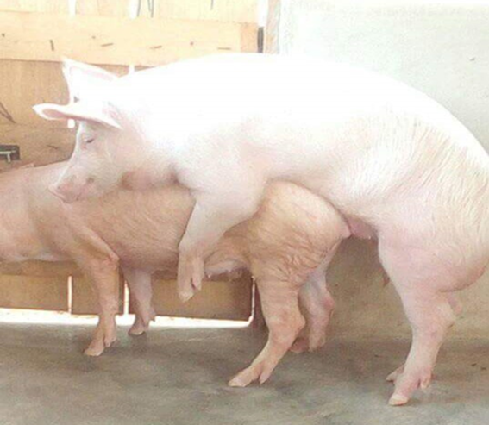
Key husbandry practices and their importance:servicing
Pigs can be bred throughout the year however very high temperatures can prevent or delay ovulation and in severe cases cause abortions. The boar reaches sexual maturity at 6 months with a weight of 60-110kg. At this age, use sparingly i.e. mating twice a week until 12 months old when it could be given 4-6 services per week. Serve twice per service at 12hrs intervals to ensure good fertilization Boar should be replaced after 20- 30 month One boar can serve 2-25 sows but it is often desirable to keep two boars even in smaller units. Young boars should be separated from gilts at 4 months old. Keep them in good lean condition to produce maximum amount of live sperm. Allow regular exercise and visual contact with sow.

Slide 30
Key husbandry practices and their importance: Servicing
Gilts reach sexual maturity at 6 months; however, mate them between 7-9 months i.e. after two to three heat periods (to take advantage of multiple ovulations) with a live weight of 90-100kg.
Sow comes on heat regularly every 18- 21 days and must be served within this period.
Ovulation occurs during this period and the heat lasts for 2-3 days.
During the 24 hour heat peak period, allow boar to service sow twice at 12-14hour intervals
After service remove sow to its original pen
Observe again if sow returns to heat the next 18- 21 days and serve again

Slide 31
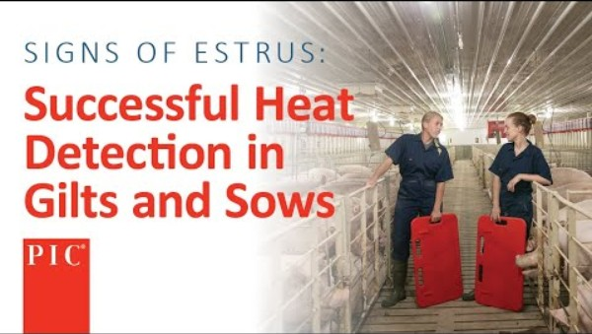
Key Management Practices and their importance:

Slide 32
Key husbandry practices and their importance: Signs of estrus
Signs of heat
General restlessness
Vulva turns red and is swollen
Slimy mucus discharge
Tendency to mount and be mounted by others.
Sow stands still when pressure is applied on its back
This is the ideal time to send the sow to the boar for mating

Slide 33
Key husbandry practices and their importance: Other reproductive parameters in pigs
Gestation period = 112-115 days
Weaning of piglets = 42-56 days
Period of rest for sow after weaning = 4 days
Litter size = between 8 -16
Reproductive rate (litter index) = 2 times in a year

Slide 34
Key husbandry practices and their importance: feed advice for sow before and after service
10 days before servicing, give the sow an extra 1-2kg of feed/day.
Continue for 1 week after servicing
During the last month of pregnancy feed sow an extra 0.5 kg per day

Slide 35
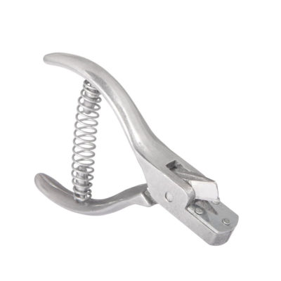
Key husbandry practices and their importance: management of weaned piglets
What is this tool?
Feed pigs twice daily
Provide water ad libitum (at all times)
Weighing should be done every month and recorded against pigs ear tag number

Slide 36
Key husbandry practices and their importance: culling
Reasons for culling a sow
Failure to conceive after service
Failure to come on heat
Small litter size
Old age, lameness or disease
Poor record of piglets born or reared
Reasons for culling a boar
Lack of virility and fertility
Lack of libido
Reluctance to service sow
Reduced performance
Lameness
Disposition ie dangerous and aggressive
Replacement stock can be selected from weaned piglets. Sows and Boars must be replaced after three years depending on their reproduction performance

Slide 37
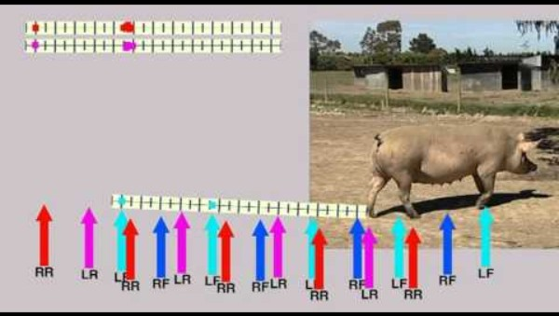
Normal walking: if not normal then lame

Slide 38
Key husbandry practices and their importance: Biosecurity measures
This is the set of practical measures taken to prevent the entrance of infection into a farm and control the spread of infection within that farm. The goal of a biosecurity programme is to keep out pathogens that the herd has not been exposed to and to minimize the impact of endemic pathogens.
Provide footbath at the entrance of the building.
Clean pen with water and disinfectant daily to prevent build-up of micro-organisms
Clean feed and water troughs daily
Ensure efficient disposal of manure and waste
Farm equipment and tools should always be washed and disinfected after use
Ensure control of rodents and birds
Always quarantine new stock for 14 days before they are added to the stock
Reduce visitors to the barest minimum
Isolate all sick animals and contact the nearest veterinary clinic to obtain accurate diagnosis and effective treatment of diseases.
Dispose of infected animals by slaughter, burial or burning

Slide 39
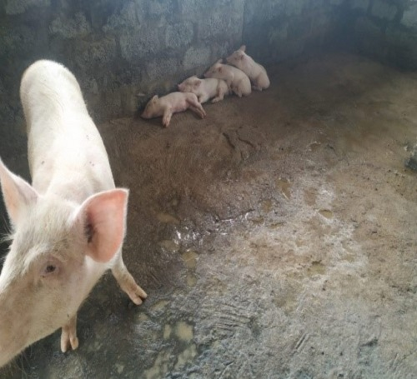
Key husbandry practices and their importance: Preparation for market/slaugheter eg fattening
In commercial production, the last phase may be divided into the grower (up to 55kg of animal live weight) and finisher stage (up to market weight) 90-100kg at 6-7 months
At the time of slaughter, animals should be healthy and physiologically normal. Slaughter animals should be adequately rested. They should be rested, preferably overnight, particularly if they have travelled for some times over long distances. However, pigs could be slaughtered on arrival if time and distances travelled are relatively short and holding in pens is stressful for them. Animals should be watered during holding and can be fed, if required. The holding period allows for injured and victimized animals to be identified and for sick animals to be quarantined.
What is wrong with this pig

Slide 40
Key husbandry practices and their importance: Parasitic diseases
These are caused by internal and external parasites
Internal Parasites
Common ones include roundworm and tape worm, adult worms live in the intestines of the pigs but immature ones may travel to the lungs and liver. Pigs become infected by eating eggs infected with the larvae. Due to competition between pigs and worms for nutrients derived from their feed the following signs may be observed.
Signs and symptoms
  Loss of appetite in advanced stages
  Anaemia
  Weight loss in latter stages
  Successful control of worms includes combination of strategic drug therapy and environmental clean-up.
Administer any broad-spectrum dewormer periodically either by injection or in feed.
Deworm pregnant sows 10 days before farrowing and lactating sows soon after weaning.
Deworm boars every 6 months
Fatteners one week after weaning and 3 months later
Piglets one week after weaning, 3months and 7months

Slide 41
Pests, diseases, symptoms and control measures
Pest-Parasitic Diseases | Symptoms | Control and management
Internal Parasites
Common ones include roundworm and tape worm, adult worms live in the intestines of the pigs but immature ones may travel to the lungs and liver. Pigs become infected by eating eggs infected with the larvae. The worms compete with pigs for nutrients derived from their feed, the following signs. | Loss of appetite in advanced stages Anaemia Weight loss in latter stages | Successful control of worms include combination of strategic drug therapy and environmental clean up Administer any broad-spectrum dewormer periodically either by injection, drench or in feed. Deworm pregnant sows 10 days before farrowing and lactating sows, soon after weaning. Deworm boars every 6 months Fatteners one week after weaning and 3 months later Piglets one week after weaning, 3months and 7 months

Slide 42
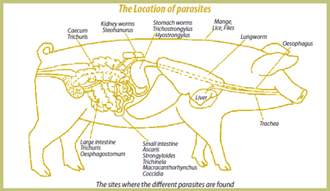
Pests,Diseases, symptoms and control measures
Location of worms in the Pig’s body

Slide 43
Pest-Parasitic Diseases | Symptoms | Control and management
External Parasites
Mange This is a dry scaly condition caused by mite. It affects the eyes, nose and skin and spreads to other parts of the body. This causes intense itching resulting in animals rubbing itself against objects in the pen. | The pig becomes itchy, and scratches and rubs against the walls of the sty and other objects with the skin between the legs, around the eyes, ears and neck being principally affected. The coat looks dull, and there are bare patches, heavy crusts, and lines on the body that look like ribs Restlessness and itching which can be very severe Red pimples on skin, which turn into crusts and scabs. Later the skin looks very rough, is thickened and covered with flakes scratching. Skin may show red spots or bite wounds Thick skin and rough hair coat Anaemia in severe cases especially in piglets Death in severe cases | Prevention Wash the sow before farrowing at least twice a one week interval. Boars should be washed at least four times a year. Treat gilts upon entering the farm and before serving. Wash all pigs at the beginning of fattening if mange is already a problem. Maintain proper animal nutrition and health programme to reduce severity and spread of mange. Recommended control products are: ivermectin (1% injectable), or malathion (1% spray). General cleanliness.

Slide 44
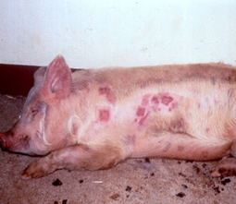
Pests,Diseases, symptoms and control measures
Pig infested with mites

Slide 45
Pest-Parasitic Diseases | Symptoms | Control and management
External Parasites
Mange This is a dry scaly condition caused by mite. It affects the eyes, nose and skin and spreads to other parts of the body. This causes intense itching resulting in animals rubbing itself against objects in the pen. | The pig becomes itchy, and scratches and rubs against the walls of the sty and other objects with the skin between the legs, around the eyes, ears and neck being principally affected. The coat looks dull, and there are bare patches, heavy crusts, and lines on the body that look like ribs Restlessness and itching which can be very severe Red pimples on skin, which turn into crusts and scabs. Later the skin looks very rough, is thickened and covered with flakes scratching. Skin may show red spots or bite wounds Thick skin and rough hair coat Anaemia in severe cases especially in piglets Death in severe cases | Treatment Remove scales and dirt with soap and water and a stiff brush. Afterwards the pig should be washed with organophosphate compounds. Repeat this treatment several times Ivermectin injection is a very effective treatment against mange and all other Spraying the animals or dipping also kills many parasites on the skin Herbal treatment: Smearing with coconut oil can be an effective control in cases of light contamination

Slide 46
Pest-Parasitic Diseases | Symptoms | Control and Management
External Parasites
Lice These are blood suckers that also cause irritation in the skin. It is mostly found in folds of skin behind the ears and between the legs. | Irritation and discomfort Red spots on bite wounds on skin Anaemia in severe cases Thick skin and rough hair coat for mange | Thorough cleaning of shelters, bedding and pens. Spraying walls/floors of pens with recommended acaricides or insecticides. Spray or dip animals periodically with appropriate insecticides or acaricides. Wash sow with acaricides before farrowing Wash piglets after weaning Boars should be washed at least 4 times in a year Maintain proper animal nutrition and health programme

Slide 47
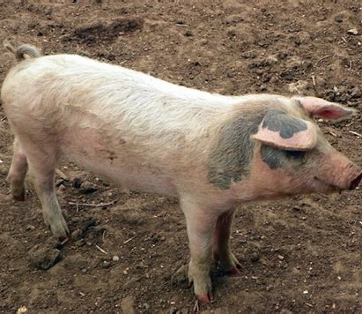
Pests,Diseases, symptoms and control measures
Pig infested with lice

Slide 48
Pest-Parasitic Diseases | Symptoms | Control and Management
Diseases | VETERINARIAN TO BE CALLED
African Swine Fever | Signs of fever beginning 4-5 days after infection and causing fever followed by dullness, breathing difficulty, vomiting, coughing, nasal and ocular discharge. Abortion in pregnant sows. | Culling animals on infected farms. Cleaning and disinfection, tracing possible contact farms. Followed by quarantine or preventive culling.

Slide 49
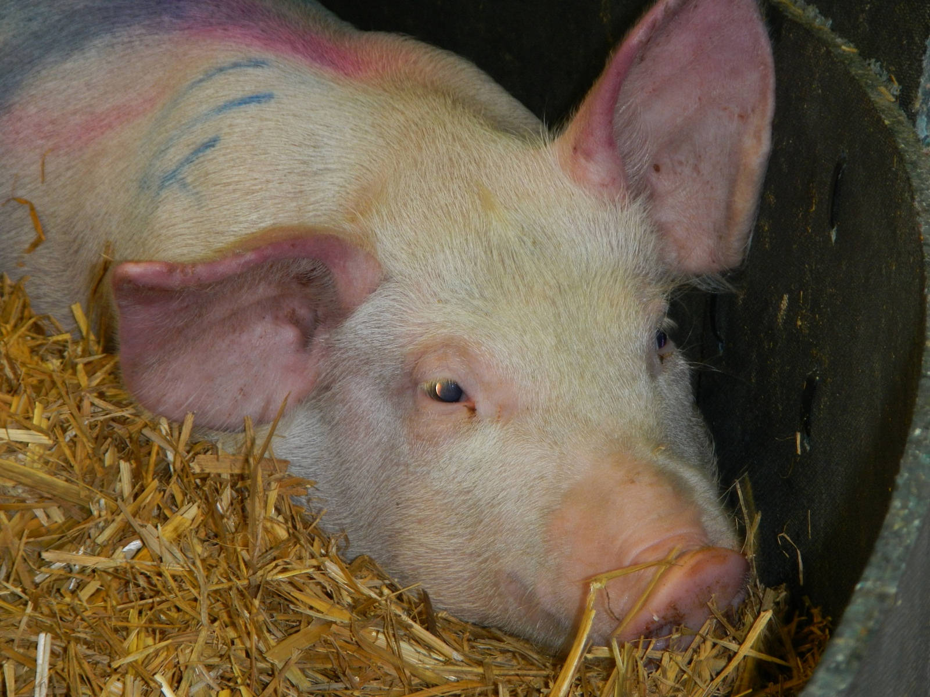
Pests,Diseases, symptoms and control measures
African swine fever

Slide 50
Pest-Parasitic Diseases | Symptoms | Control and Management
Diseases | VETERINARIAN TO BE CALLED
Mastitis | Swollen hot and painful udder. Absence or reduction of milk in the affected udder. Refusal of sow to suckle piglets. Depression and Fever. | Gently massage the affected udder with lukewarm water. Do not allow the young to suck milk from the infected sow. Remove the milk from the infected udder and discard. Separate sow from piglets and reduce access to teats (allow a few piglets to suckle at a time). If possible, foster piglets to lactating mothers. Use antibiotics. Inject penicillin-streptomycin into the muscle of hip or neck.

Slide 51
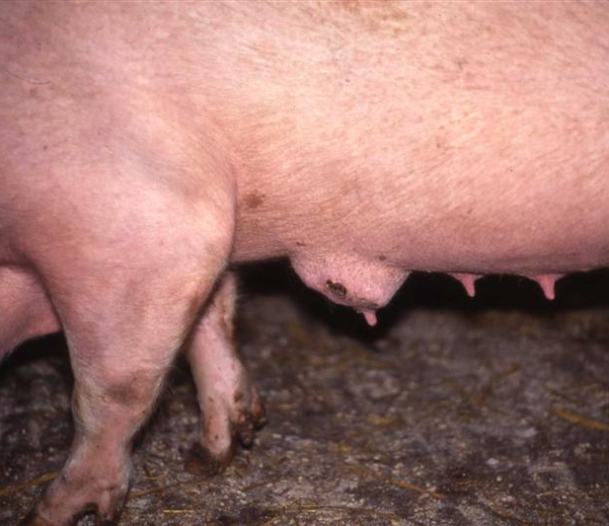
Pests,Diseases, symptoms and control measures
Mastitis

Slide 52
Pest-Parasitic Diseases | Symptoms | Control and Management
Diseases | VETERINARIAN TO BE CALLED
Foot and Mouth Disease | Sudden onset of severe lameness, fever, formation of vesicles on coronary bands. Blisters can be found on thin-skinned areas like udder, teats, anal area and eyelids. These blisters rapture within one day. There may be frothy saliva, anorexia, sometimes hooves become loose and fall off. Sows may abort. | Vaccination Quarantine Proper cooking of swill. Slaughter and burial

Slide 53
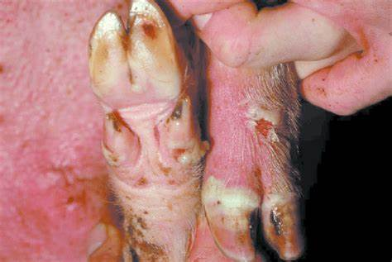
Pests,Diseases, symptoms and control measures
Foot-and-mouth disease

Slide 54
Pest-Parasitic Diseases | Symptoms | Control and Management
Diseases | VETERINARIAN TO BE CALLED
Leptospirosis | Fever, anorexia, diarrhea, bloody urine, nervous symptoms caused by Meningitis. Abortion in last trimester. In sows which are affected later, weak piglets are born. Mummified and macerated fetuses are common in the litters. Infertility associated with venereal spread may be responsible for repeat breeders. | Elimination of mice and rats and other rodents. Vaccination and hygienic measures. Vaccines are not available for all types of the diseases and vaccination may not prevent bloody urine. Treat all sows with injection or streptomycin before serving. Use antibiotics especially streptomycin for all ages.

Slide 55
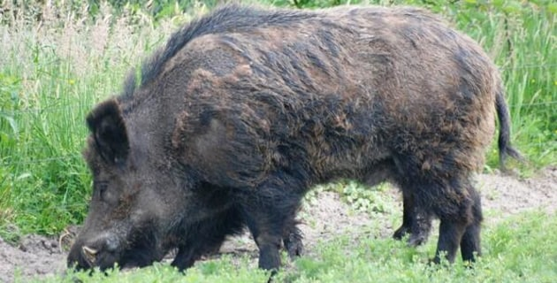
Pests,Diseases, symptoms and control measures
Leptospirosis
Leptospirosis

Slide 56
Pest-Parasitic Diseases | Symptoms | Control and Management
Diseases | VETERINARIAN TO BE CALLED
Scouring (diarrhea) |  | Hygienic measures should be taken to avoid or minimize scouring incidence. Regular deworming should also be done as a control measure to scouring Feed changes should be gradual and not drastic to avoid scouring.

Slide 57
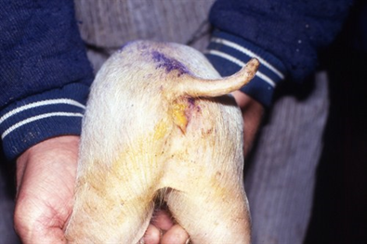
Pests,Diseases, symptoms and control measures
Foot-and-mouth disease
Diarrhea

Slide 58
Key Risks along the value chain and mitigation measures
Value Chain Actions | Key Risks and Challenges | Migation Measures
Input supply | Limited access to breeding stock | Establish breeder farms to supply breeding stock
 | Limited sources of pig feeds | Encourage feed millers to include pig fed formulations in their business Train farmers to prepare their own feed.
Finance | High cost of credit | Promote group formation to enhance financial resource mobilization
Production | Rudimentary breeding methods. | Train farmers in modern pig production techniques. Promote the use of Artificial Insemination

Slide 59
Key Risks along the value chain and mitigation measures
Value Chain Actions | Key Risks and Challenges | Migation Measures
Production | Low usage of formulated feed by farmers | Train/ sensitize farmers on benefits of formulated rations.
 | Poor housing | Promote intensive system of production Design and train farmers on simple housing and construction
Marketing | Non-existent market outlet | Set up specialized markets for pigs
Processing | Inadequate processing equipment | Encourage local fabrication of processing equipment to enhance meat processing
 | Limited slaughtering facilities for pigs | Set up specialized slaughter slabs for pigs

Slide 60
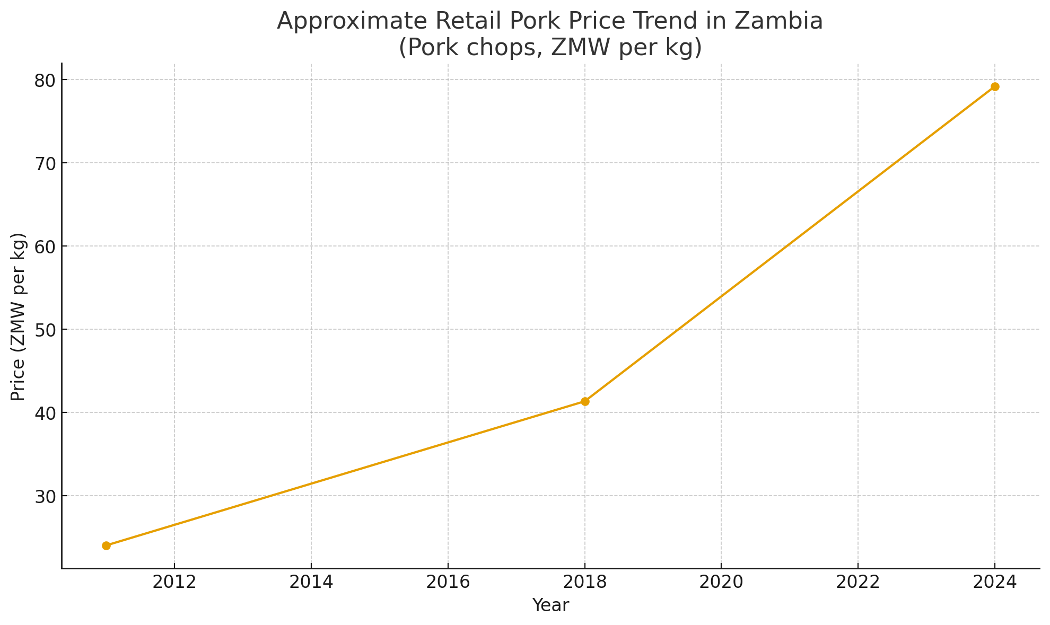
MARKET INFORMATION OF PIGS
Market Information
Some farmers sell live pigs to pig traders. Pig traders are made up of pig aggregators who buy live pigs and send to the slaughter slabs as well as those who sell fresh/processed meat.
A few farmers provide slaughter services and supply the meat directly to pork retailers, supermarkets, and other institutional consumers. Some of these retailer’s steam and fry the pork at drinking spots or at vantage points.

Slide 61
Enterprise Budget for 5 sow unit- in zmw
Period | A/C Heading | Y0 | Y1 | Y2 | Y3 | Y4 | Y5
 | Sale of pigs (Revenue) | 53,200 | 106,400 | 106,400 | 106,400 | 106,400 | 106,400
 | Expenditure
 | Fixed Cost
 | Depreciation (20%) | 9,065 | 9,065 | 9,065 | 9,065 | 9,065 | 9,065
 | Variable Cost | 50,851.20 | 73,195.20 | 73,195.20 | 73,195.20 | 73,195.20 | 73,195.20
 | Overhead Cost | 12,000 | 12,000 | 12,000 | 12,000 | 12,000 | 12,000
 | Total Cost | 71,916.20 | 94,260.20 | 94,260.20 | 94,260.20 | 94,260.20 | 94,260.20
 | Profit / Loss Before Tax | (18,716.20) | 12,139.80 | 12,139.80 | 12,139.80 | 12,139.80 | 12,139.80
 | Revenue / Total Cost Ratio | 0.73975 | 1.2879 | 1.2879 | 1.2879 | 1.2879 | 1.2879

Slide 62
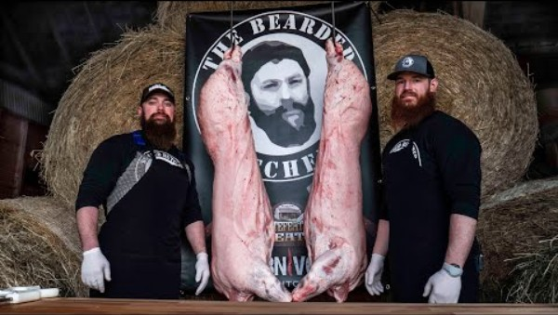
Butchering a pig NOT COmmercial

Slide 63
Thank you
---Dr. Allen Wachter--
01-845-701-0797
drallenwachter@protonmail.com

