Slide 1
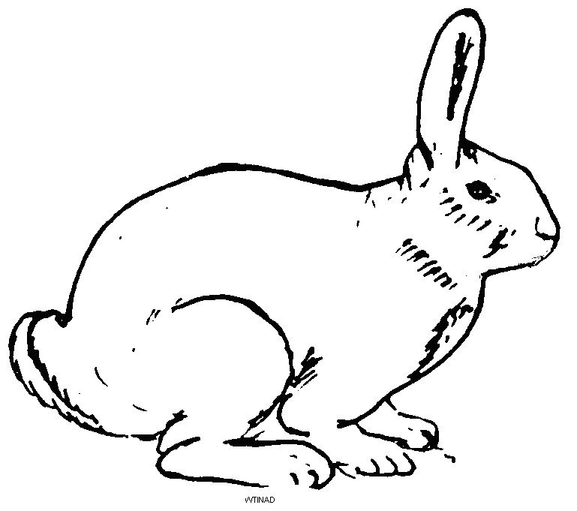

RABBIT KEEPER'S
GUIDE
Husbandry, Care & Disease Management
Dr. Daniel Graham | Christian Veterinary Mission

Slide 2
BIBLICAL STEWARDSHIP
What is a Steward?
Discussion Questions
A person who takes care of something that belongs to someone else.
Who do all animals belong to?
Who are the stewards of God's animals?
How do we see God caring for His animals?
In what ways are you currently a good steward?
How can you be an even better steward?
Key Scriptures:
Psalms 50:10-11 — All animals belong to God
Genesis 1:27-28 — Humans are stewards
Psalms 104:10-14 — God cares for animals
Exodus 23:4-5
Luke 15:3-6
John 10:2-5, 10:11-13

Slide 3



WHY KEEP RABBITS?
1 Corinthians 10:25-26 | Genesis 3:21
Small Space
Rapid Reproduction
Nutritious Meat
Minimal land — suitable for home gardens
2–10 kits per litter, 3-month cycle
High protein, easy to slaughter at home
Low Feed Cost
Fertilizer
Skins & Income
Eats grass & leaves — no competition
Manure & urine — direct to garden
Fur for crafts; live rabbits can be sold

Slide 4
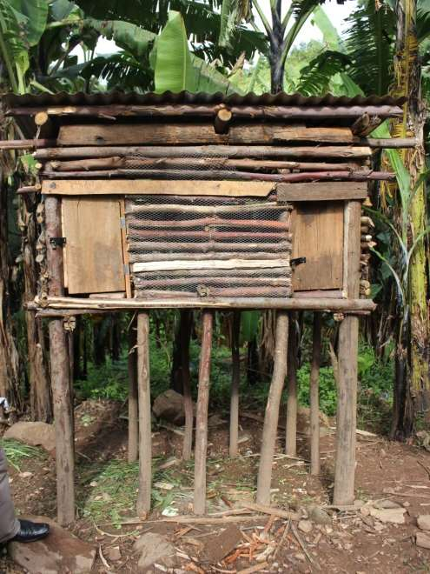
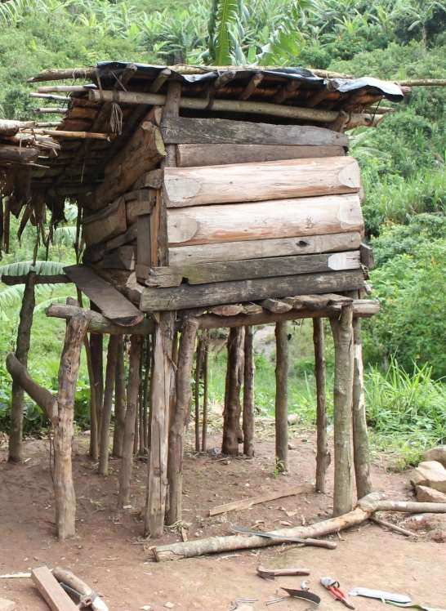
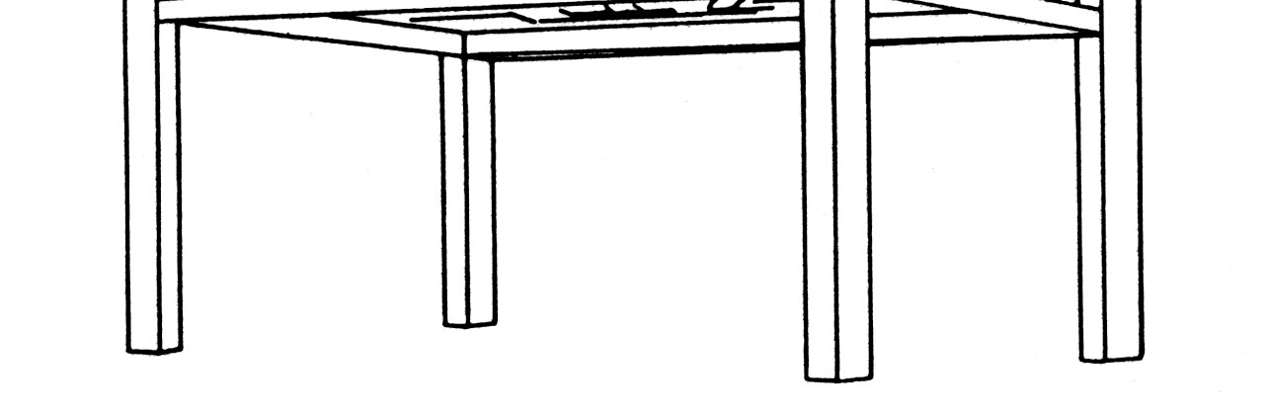
HOUSING
Genesis 33:17
✓ Benefits of Raised Housing
Protection from predators
Keeps rabbits out of gardens
Prevents diseases (coccidia, fleas, ticks)
Prevents theft
Easy to handle rabbits
Controlled, separate breeding
Minimum Cage Size
Height: 60 cm
Width: 60 cm
Length: 90–120 cm
⚠ Challenges
More expensive to build
Must provide food & water in house daily

Slide 5
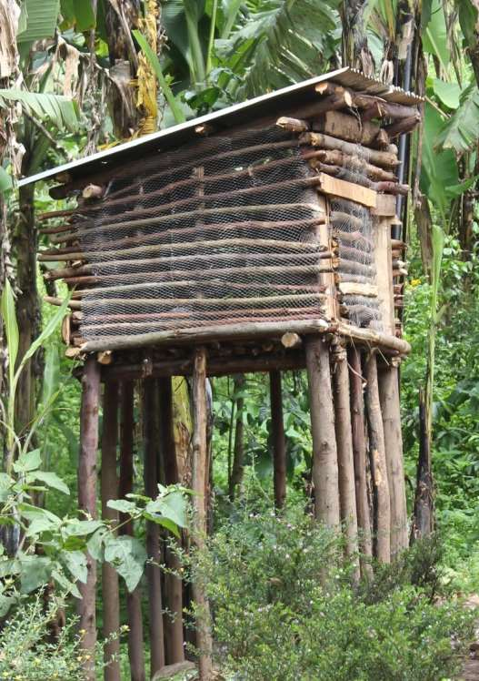
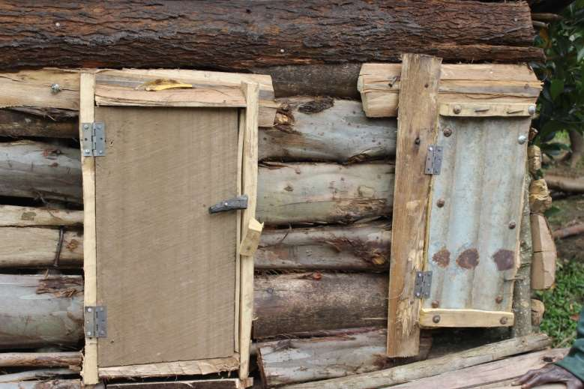
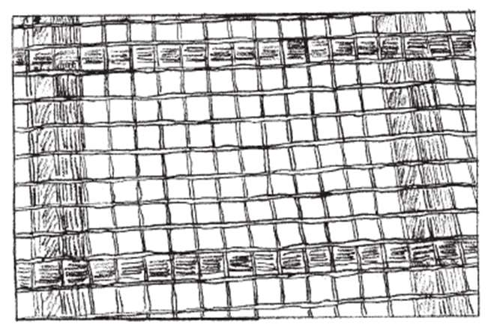
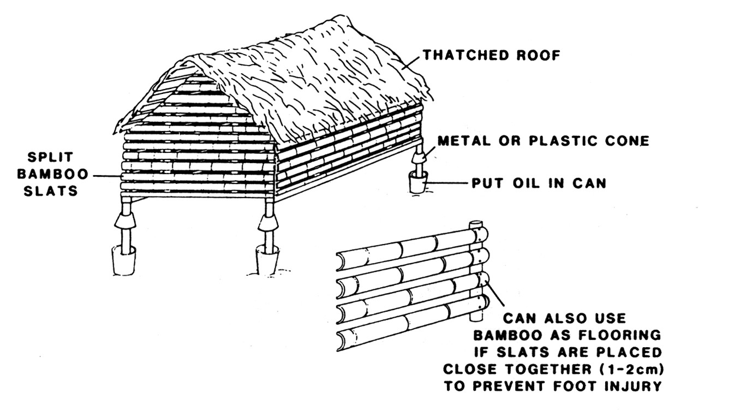
HOUSING — MATERIALS & PLACEMENT
Building Materials
Timbers, off-cuts
Wire mesh (coffee tray flooring)
Bamboo (slats 1–2 cm apart)
Grass thatch / iron sheets
Binding: rope, banana fiber, rubber, nails
🌿 Placement
Adequate shade — rabbits overheat easily
Protected from rain
🧹 Daily Cleaning:
Ventilation on 2+ sides · Remove food waste · Remove feces · Daily wash
Wire mesh (coffee tray) flooring
Thatched roof housing design

Slide 6
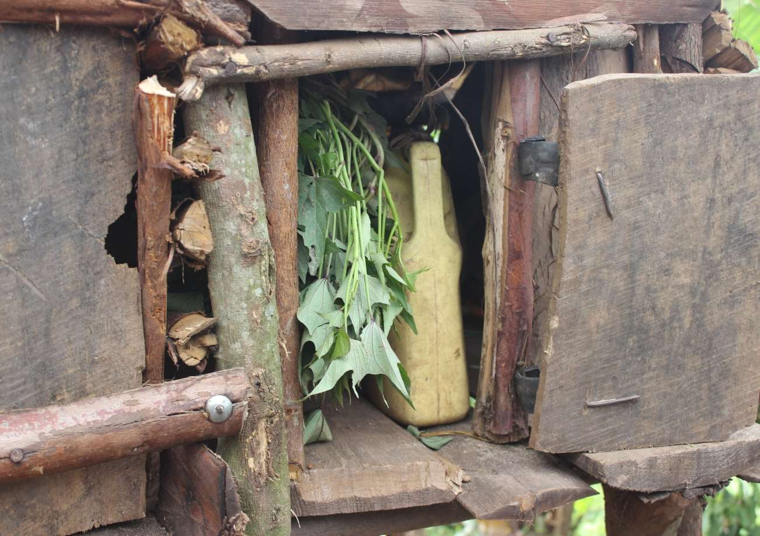

FEEDING
Genesis 1:30 | Psalms 147:8-9 — Rabbits thrive on high-fiber foods: grass & leaves
✓ Good Foods
✗ Foods to AVOID
Elephant grass, Guinea grass
Banana leaves, Sweet potato vines
Cabbage, Blackjack
Cowpea & soybean leaves
Groundnut, sunflower, maize
Sugar cane stalks, dry cassava
Kitchen waste: carrots, bananas, mango
High-protein: Calliandra, Leucaena, Lablab
Raw cassava
Irish potato leaves, Tomatoes
Eggplants, Onions, Soybeans
Cabbage in large quantities
Feeder Options
Grass hanging inside house
Hang food by rope or wire · Wooden feeder · Metallic feeder · Clay or ceramic bowl · Split bamboo trough
Grass holding rack diagram

Slide 7
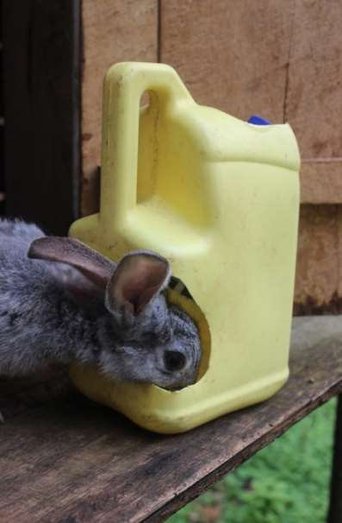
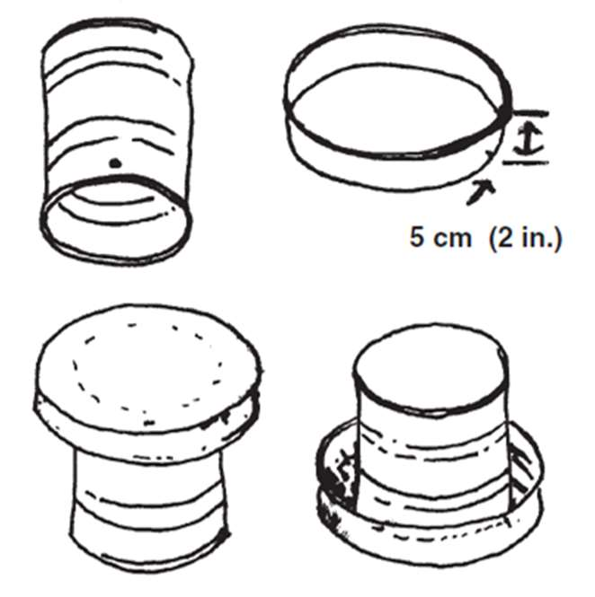
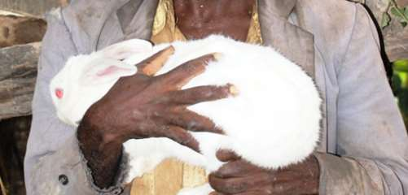
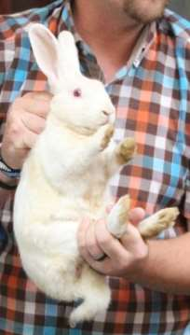
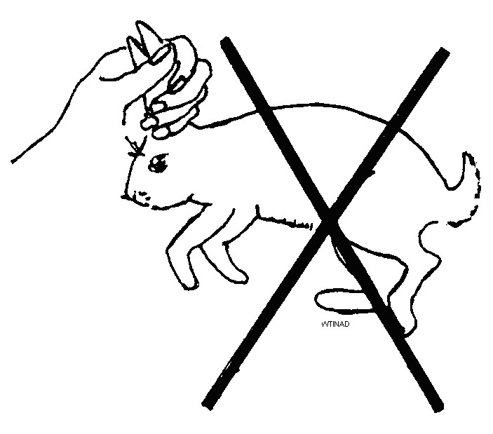
WATER & HANDLING
💧 Water | Genesis 29:1-3 | Psalms 42:1
🤲 Handling
Rabbit drinking from jerrican drinker
Container options
✓ Good:
Always available, clean & fresh
Change water every day
Options: mugs, jerricans, gourds, clay pots, glass-bottle drinkers
Loose neck skin — support body weight
Hands around the body
Always hold feet to prevent kicking
✗ NEVER by ears

Slide 8
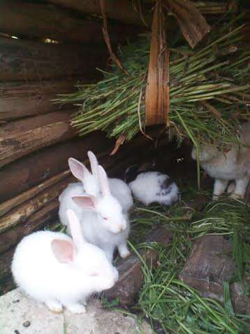

REPRODUCTION & BREEDING
Genesis 8:17 | Genesis 33:13
Ready at
Gestation
Litter Size
Weaning
3 kg
30–32
2–10
2 months
body weight
days
kits (max 8 ideal)
with mother
3-Month Breeding Cycle
Month 1: Breeding → pregnancy
Month 2: Birth → babies with mother
Month 3: Wean babies → breed again
Causes of Failed Pregnancy:
Disease · Too thin · Poor food · No water · High heat
Newborn kits in nest box

Slide 9



NEST BOXES & CARING FOR KITS
Development Timeline
Day 25 of pregnancy
Add nest box (5 days before birth)
Day 30–32
Birth — 2 to 10 kits
Day 10
Kits open their eyes
Mud nest box
Rabbit with nest box
Weeks 2–3
Kits walk and seek food
Week 3
Remove nest box
2 months
Wean kits — remove from mother
Nest materials: fur pulled from abdomen · soft dry grass · shredded newsprint
Wooden nest box design (with resting board)

Slide 10


HEALTH MANAGEMENT
Job 12:10 | Proverbs 12:10 | Genesis 1:27-28
Disease Prevention
Signs of Illness
Preventing disease is EASIER & CHEAPER than treating it.
Not eating well
Inactive / not moving
Losing weight
Dull or rough fur
Diarrhea
Abscesses / swellings
Wounds
Sneezing / coughing
Nasal discharge
Provide enough clean & nutritious food
Provide sufficient clean water daily
Clean, safe, well-ventilated housing
Keep rabbits cool in the shade
Give each rabbit adequate space
Handle gently and correctly
Observe rabbits daily for problems

Slide 11

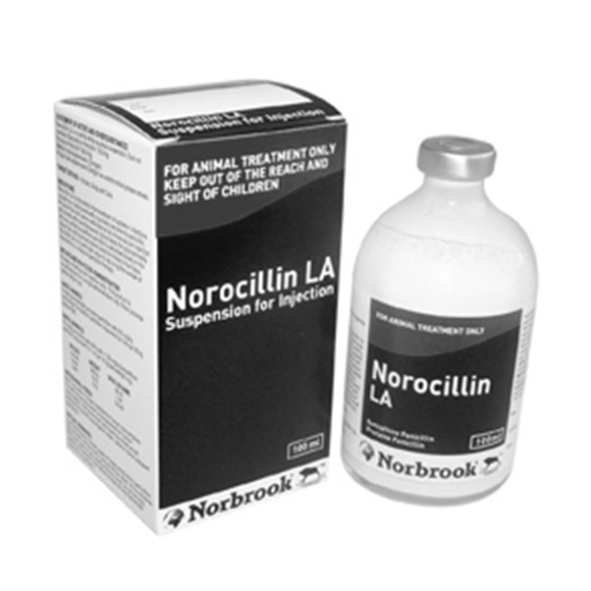

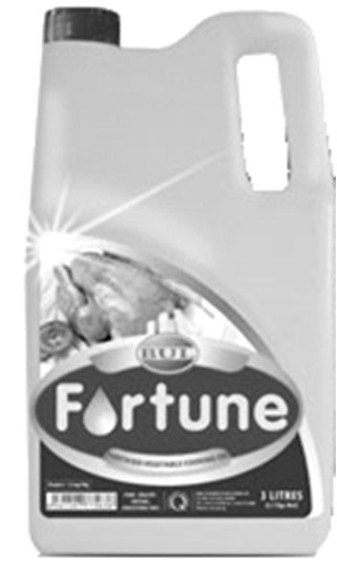

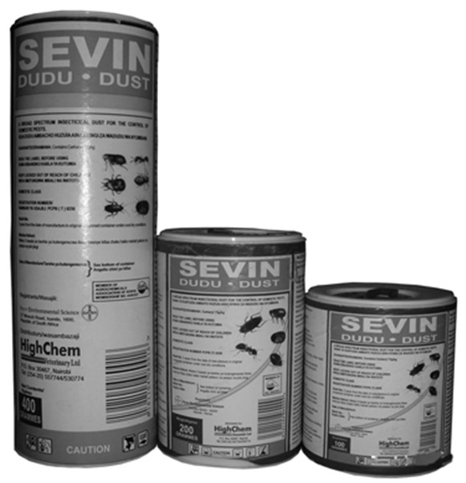
DISEASE GUIDE — Respiratory & Parasites
Pasteurella (Snuffles)
Cause:
Signs:
Contagious:
Treatment:
Pasteurella bacteria; stress, poor hygiene, poor ventilation
Nasal discharge, sneezing, breathing trouble, blue lips/ears, abscesses, twisted neck
Very contagious
No cure. Drain abscesses + 1 dose LA Penicillin
Ear Mites (Ear Canker)
Cause:
Signs:
Contagious:
Treatment:
Mites in the ear canal
Itchiness, crusts or scabs on ears
Very contagious
Drops of cooking oil in ear weekly until clear. If severe: 0.1 ml Ivermectin SQ
Fleas
Cause:
Signs:
Contagious:
Treatment:
Fleas on skin; only if rabbits are kept on ground
Itchiness, visible fleas on skin
Very contagious
Raise cages off ground + Dudu dust on fur weekly

Slide 12
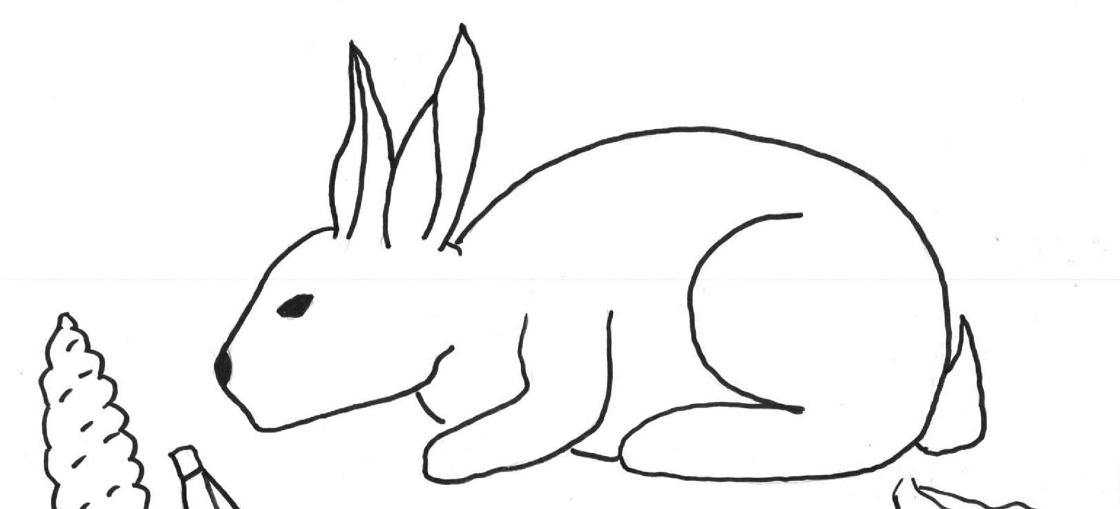

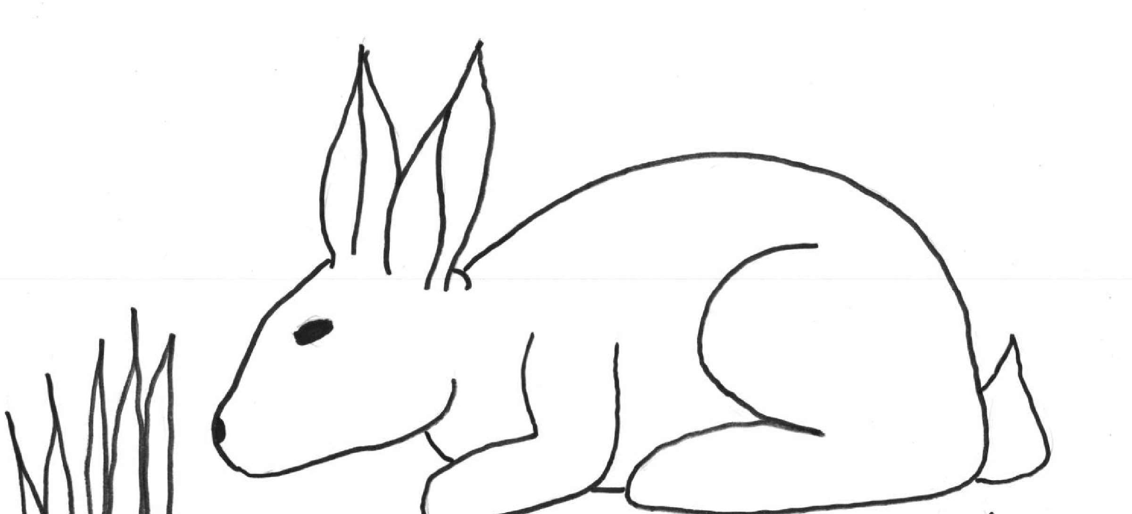
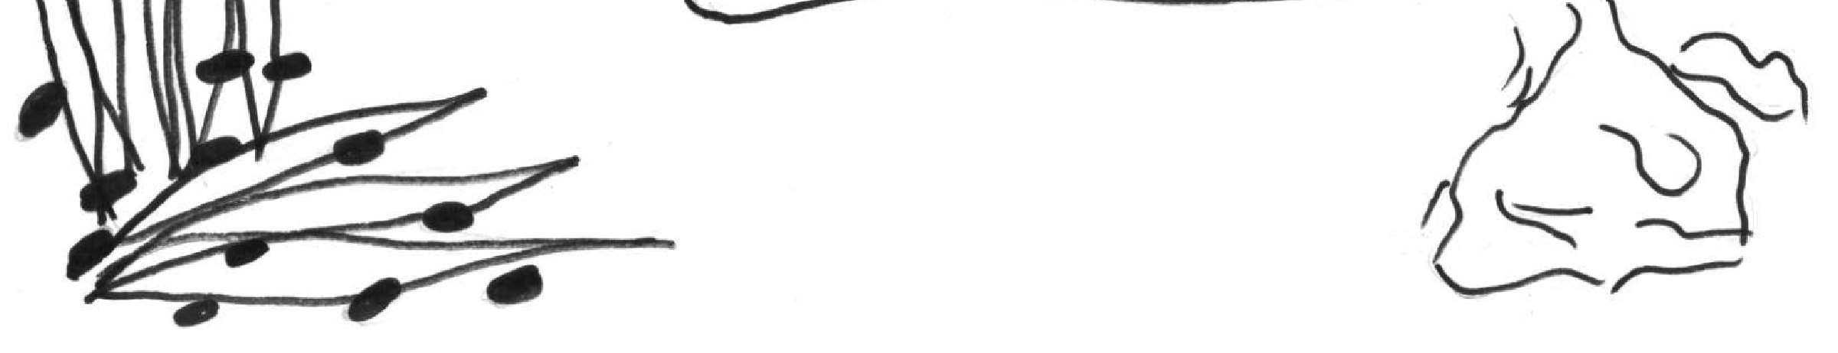

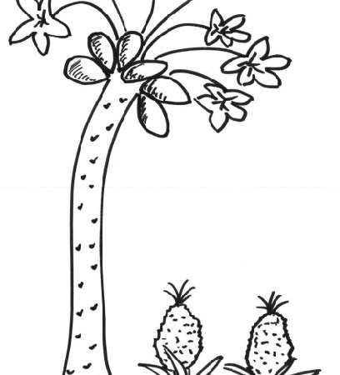
DISEASE GUIDE — Digestive Conditions
Diarrhea (Diet-Related)
Cause:
Signs:
Contagious:
Treatment:
Too much energy food (maize, rice); not enough fiber
Diarrhea, weight loss, low appetite
No
High-fiber diet + extra water
Diarrhea — Coccidia
Cause:
Signs:
Contagious:
Treatment:
Coccidia parasite; feces left >1 day (poor hygiene)
Diarrhea, weight loss, white spots on liver
Yes — fecal-oral
Remove feces, extra water, Amprolium
Blocked Stomach (GI Stasis)
Cause:
Signs:
Contagious:
Treatment:
Hair or food blockage in gut
Bloating, firm stomach, low appetite, no feces
No
Pineapple or pawpaw juice by syringe; high-fiber diet; extra water

Slide 13


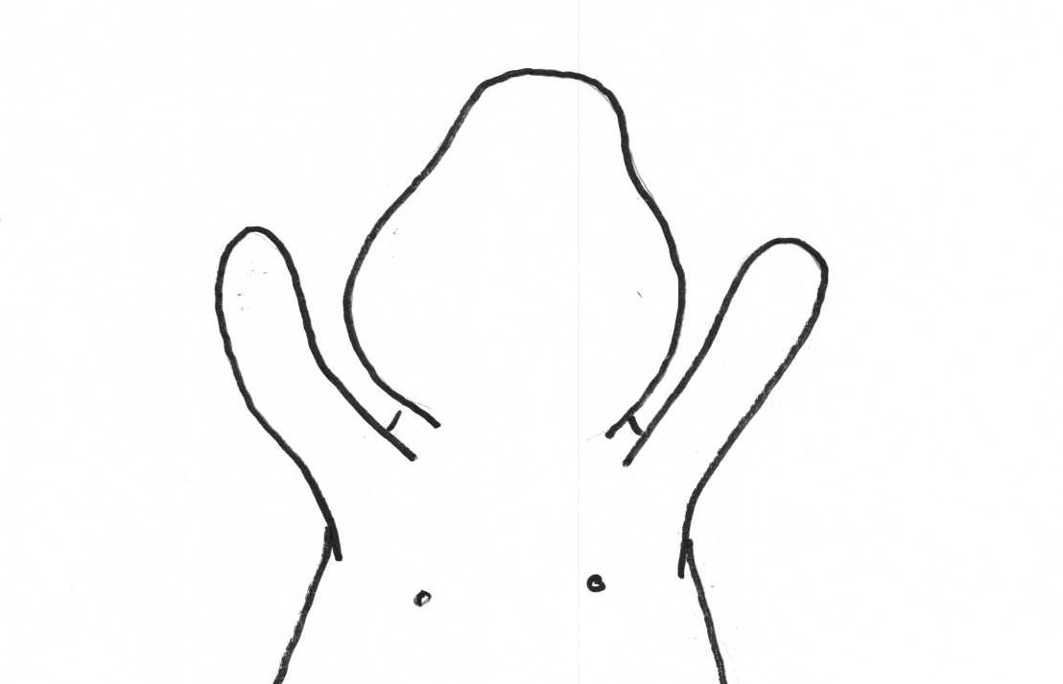

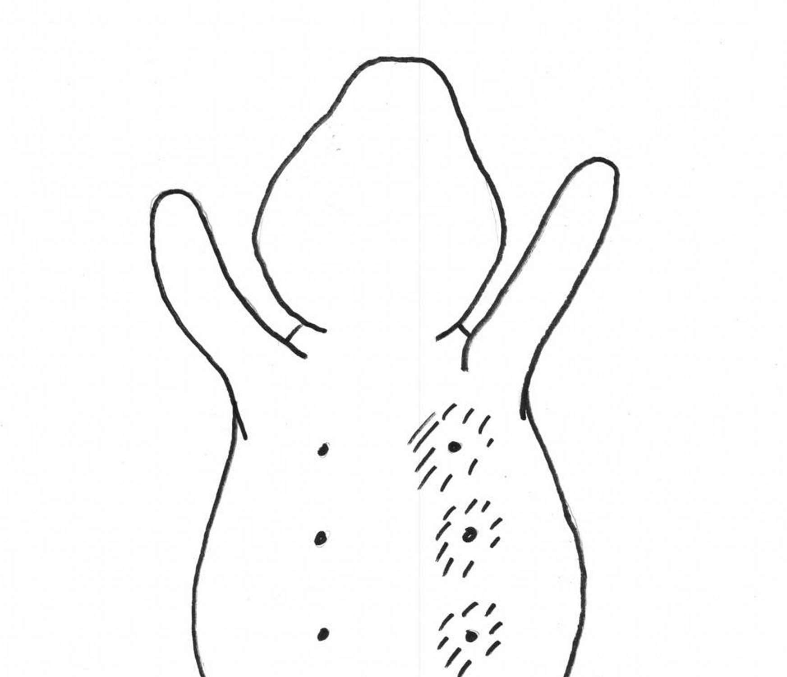

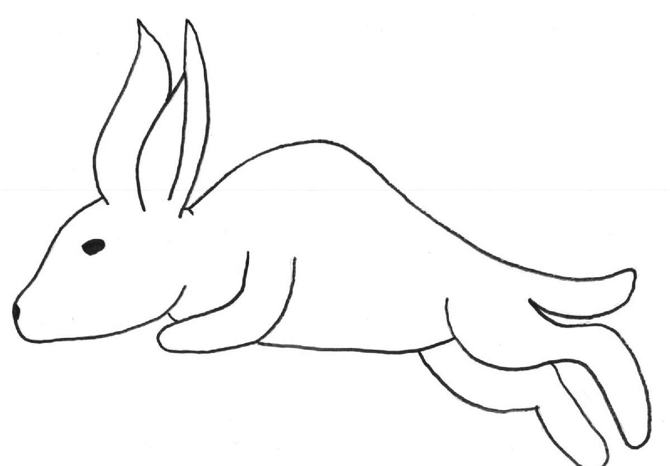
DISEASE GUIDE — Reproductive & Trauma
Sore Hocks
Cause: Rough/dirty wire flooring causing wounds on feet
Signs: Wounds on feet, inactivity, weight loss
Contagious: No
Treatment: Resting board, clean floors; if pus: 1 dose LA Penicillin
Syphilis (Vent Disease)
Cause: Bacterial infection spread during mating
Signs: Redness/scabs/blisters on genitals, abortions, swollen testicles
Contagious: Very contagious (mating)
Treatment: 1 dose LA Penicillin injection
Mastitis
Cause: Udder infection from dirty floor or nest box
Signs: Swollen, hot, painful udder; pus; weight loss
Contagious: No
Treatment: Clean cage/nest box + 1 dose LA Penicillin; repeat in 3 days if needed
Broken Back
Cause: Broken spine from falling or improper handling (uncontrolled kicking)
Signs: Cannot walk or move hind legs
Contagious: No
Treatment: No treatment — must be humanely killed immediately

Slide 14

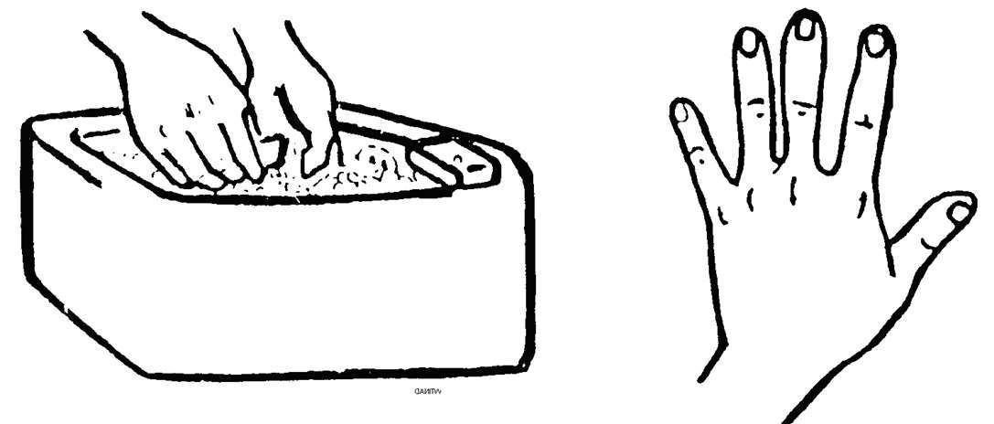
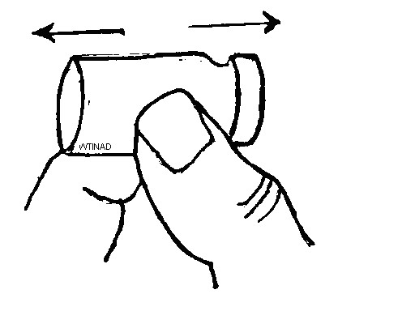
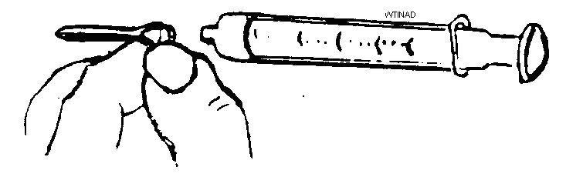
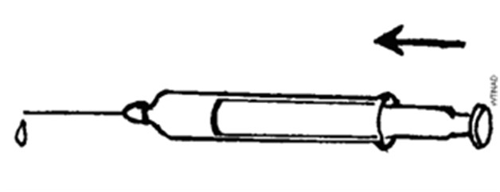
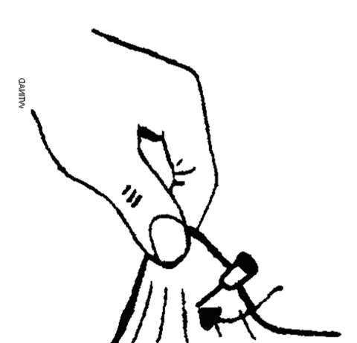
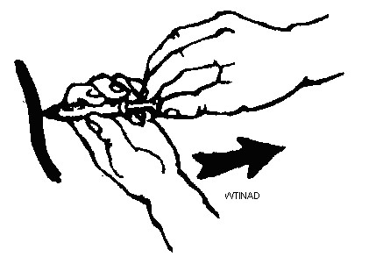
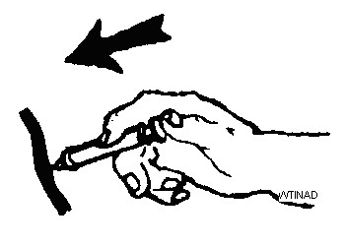
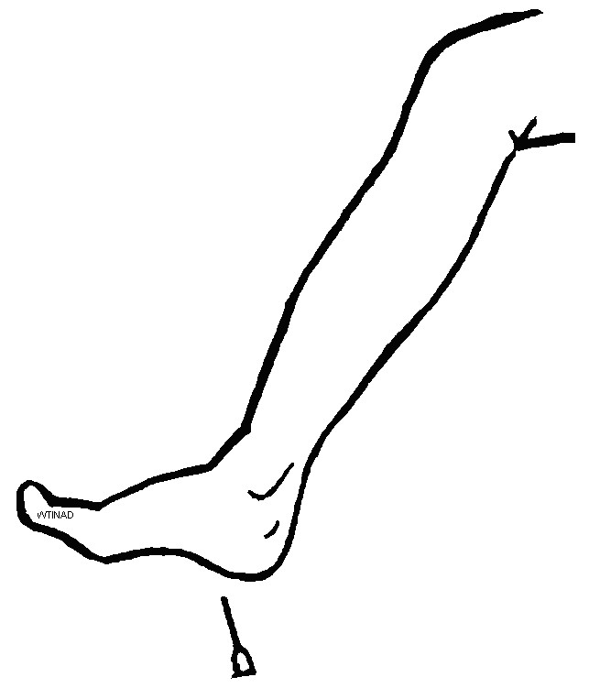
LA PENICILLIN — DOSING & INJECTION GUIDE
What Is It?
Dose by Weight
Injection Steps (Sub-Q)
1 kg
0.15 ml
1. Wash hands
2. Shake bottle
2 kg
0.30 ml
3 kg
0.40 ml
3. Needle on syringe
4. Remove air
4 kg
0.50 ml
LA = Long-Acting antibiotic. Usually ONE dose. Second dose after 3 days if needed.
Use for:
• Pasteurella abscesses
• Sore Hocks (infected)
• Syphilis • Mastitis
Sold as Norocillin LA
5 kg
0.70 ml
6 kg
0.80 ml
5. Lift skin, insert
6. Check — pull back
7 kg
1.00 ml
7. Push plunger
8. Dispose needle safely

Slide 15
"A righteous man cares for the needs of his animal."
Proverbs 12:10
Key Takeaways
Good housing, food & water are the foundation of rabbit health
Prevention is always better — and cheaper — than treatment
Handle rabbits gently to protect them and yourself
Observe daily — early signs save lives
As stewards of God's creation, excellence in care honors Him
Dr. Daniel Graham | Christian Veterinary Mission

