Slide 1
Raising healthy poultry

Slide 2
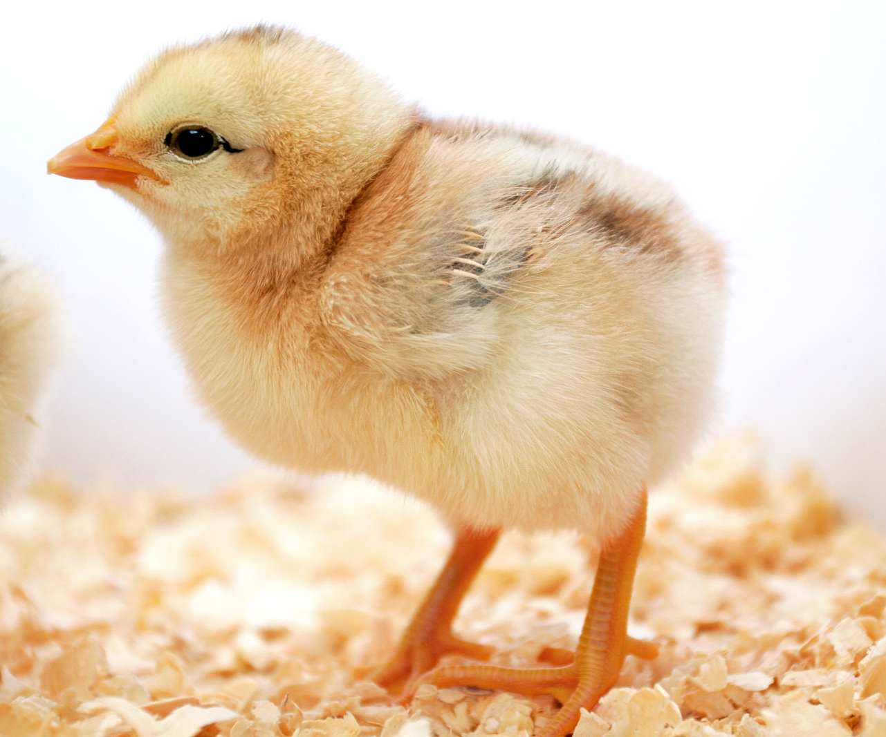
Getting Started
Typical ways to start a poultry operation
As day-old baby chicks- Most common method of starting or restocking a poultry operation
  Advantages: Have stored yolk so don’t need food or water during shipping for 2-3 days of shipping
  Disadvantages: During shipment there is danger of smothering if overheated or getting chilled in freezing weather. Groups of 25 provide enough body heat so just need holes for air
  Watering and feeding will be necessary if shipments are delayed more than 3 days.
This Photo by Unknown Author is licensed under CC BY-SA

Slide 3
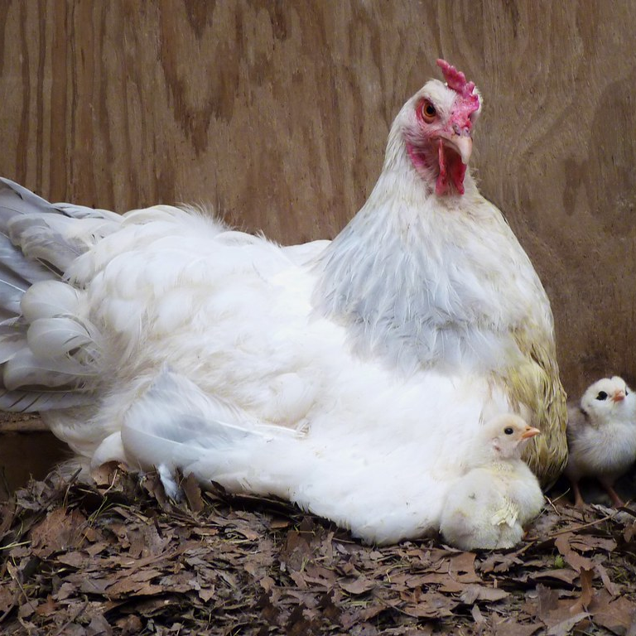
Getting Started
Typical ways to start a poultry operation
2. Purchase of hatching eggs. Although eggs may be easily broken if insecurely packed, temperature changes are less critical than with baby chicks. The producer must be prepared to incubate the eggs as soon as they are received. Hatching eggs cannot be stored for much longer than a week even if maintained at the optimum temperature of 10 degrees C.
3. Natural incubation- brooder hen turkey duck or other bird. Typically limited to 12-14 eggs but dependent on egg fertility, nutrition of the hen, condition of the eggshell, genetic constitution of the parents, egg storage time and temperature before incubation.
This Photo by Unknown Author is licensed under CC BY

Slide 4
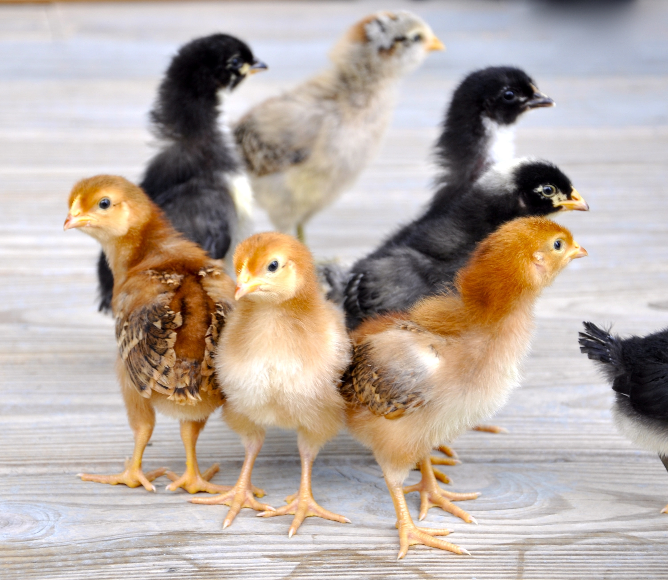
Getting Started
Typical ways to start a poultry operation
Purchase of started chicks three weeks or more of age Benefit do not need equipment for brooding, vaccinating early
Purchasing of started pullets ready to lay at about 20 weeks of age
  Advantages- males and inferior females are eliminated before purchase.. Vaccinations already done.
  Disadvantages Added costs added on a per bird basis

Slide 5
TYPES OF CHICKENS AND BREEDING PRACTICES

Slide 6
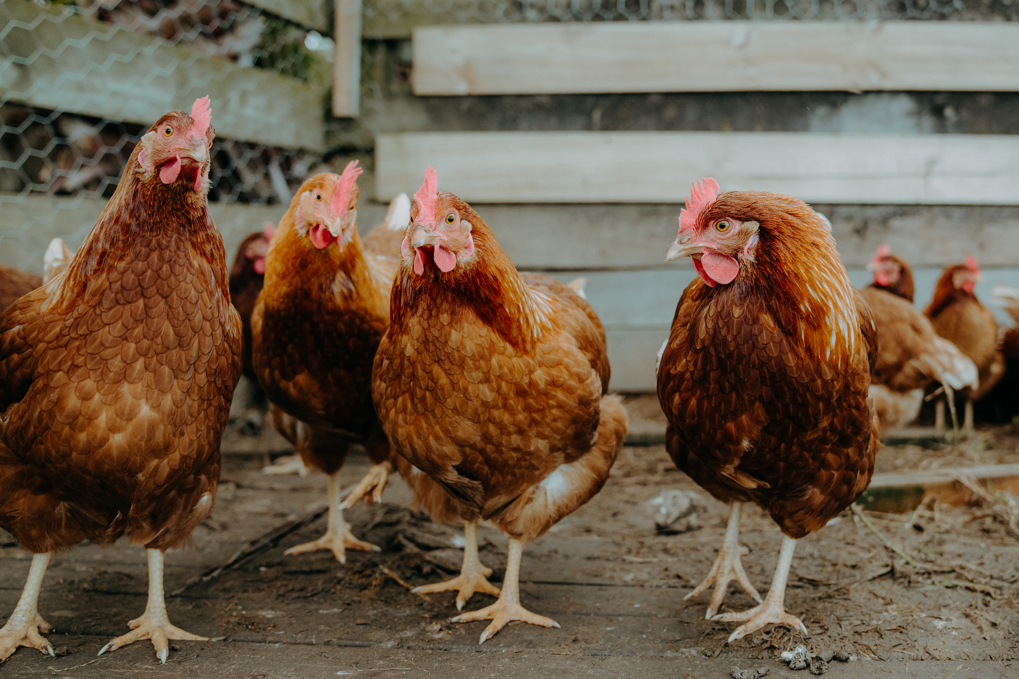
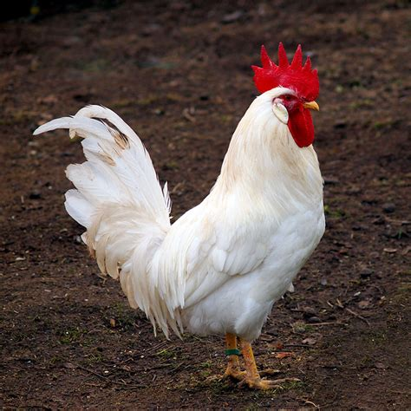
Dual-purpose chickens
Dual-Purpose chickens- produce eggs and meat
Males meat at 2-3 months. Females maintained up to one year for eggs. Preferred for small operations
Egg-layer strains- selected for good egg production. Surplus males eliminated at day old. Spent females may be salvaged for meat after egg production below 50%
Meat Chickens: Broilers of fryers are reared from strains selected for rapid growth. – can produce up to 4.4 lbs in 7 weeks.
Hybrids- feed-efficient strains – such as rhode island reds, barred Plymouth rocks.
Dual-purpose breeds are still preferred in many parts of the world
where brooding hens are used to hatch and start chicks. A running
debate has continued in many countries on whether to select native
breeds or imported hybridized stock.
Rhode Island Red
White leghorn

Slide 7
Housing and equipment

Slide 8
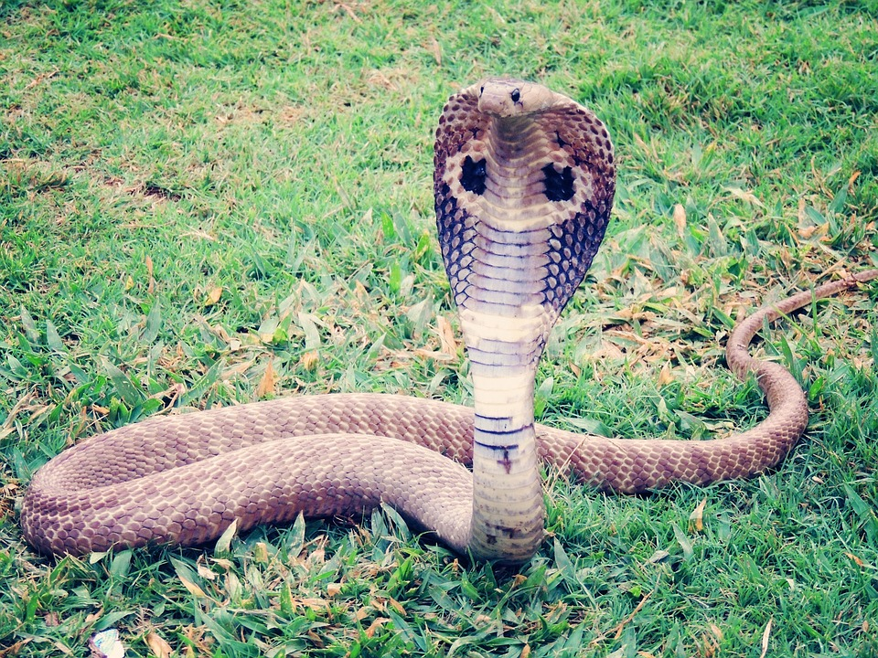
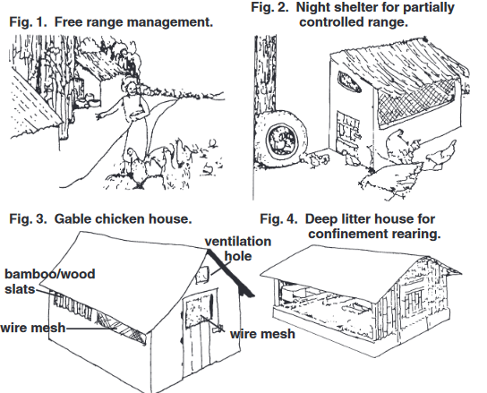
Housing
Considered essential for protection against predators.

Slide 9

Housing
Considered essential for protection against predators.
Location: Properly oriented to 1) Protect against wind but permit some air movement, 2) prevent too much heat from the sun, and 3) to ensure sufficient drainage to prevent wet floors. 4. shade and overhang may also be important.
Temperature Control- Temperature extremes in hot and cold weather create stressful conditions in poultry houses.
Ventilation: Air movement within the house is essential to prevent smothering. Chickens need more fresh air per unit of body weight than any other class of livestock.
This Photo by Unknown Author is licensed under CC BY-SA

Slide 10
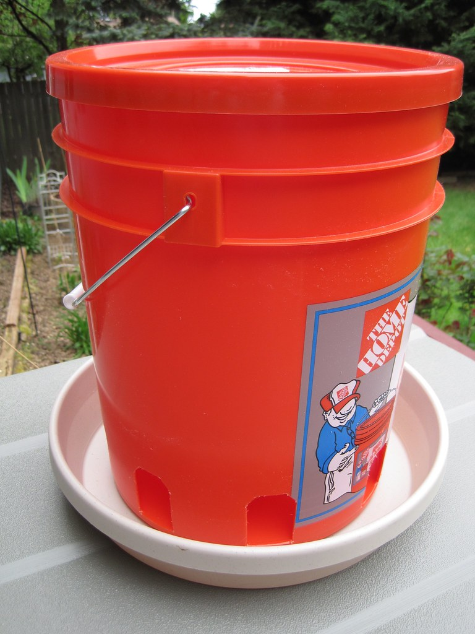
Housing
5. Insulation- Health of poultry is often promoted by insulating roofs and sidewalls against both hot and cold weather
6. Moisture Control: Large quantities of water are consumed by chickens. Layers require more than 1 liter per day. High humidity can result in wet droppings which cause disease problems.
7. Space: Minimum requirements for birds are 15 birds per square meter up to 6 weeks of age, 5 birds per square meter up to 16 weeks, and 3-4 birds per square meter for older birds.
8. Framing: Roof support is critical
9. Roof: Entirely rainproof, Overhang of at least one meter on the south side to permit shade in summer but permit sun to enter the house during winter.
This Photo by Unknown Author is licensed under CC BY-NC

Slide 11
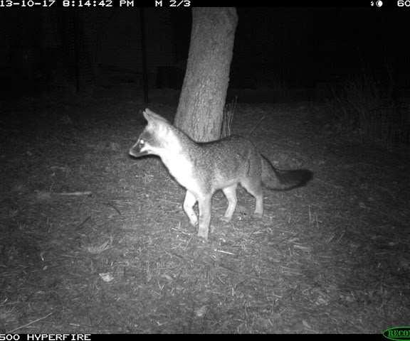
Housing
10. Floor- Cement with embedded wire mesh to keep rats our is desirable. Most places have dirt or heavy clay floors. Adequate drainage should be planned. Convenient clean-out systems for manure need to be considered. Deep litter is an option as well.
11. Animal and bird protection. Nighttime protects should be planned. Wire mesh is often used.
This Photo by Unknown Author is licensed under CC BY-SA-NC

Slide 12
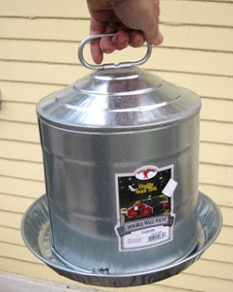
Waterers
Considered essential for protection against predators.
Chickens of any age should never be left without clean, cool water! Chickens need water every 15 to 20 minutes. Making certain that water supplies are adequate is one of the most important jobs of the caretaker. Waterers adapted for various ages of chickens are illustrated
This Photo by Unknown Author is licensed under CC BY-NC

Slide 13
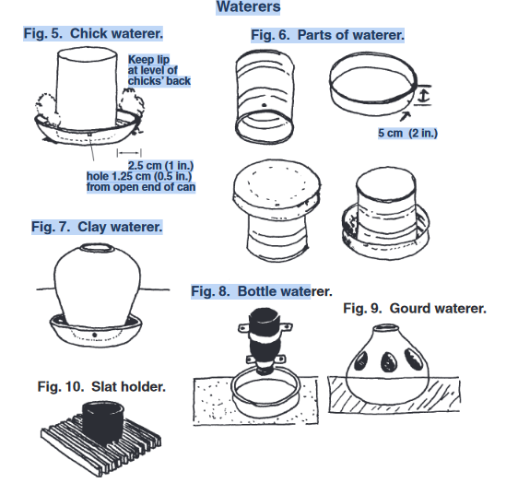
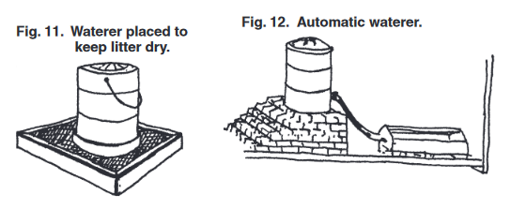
Waterers

Slide 14
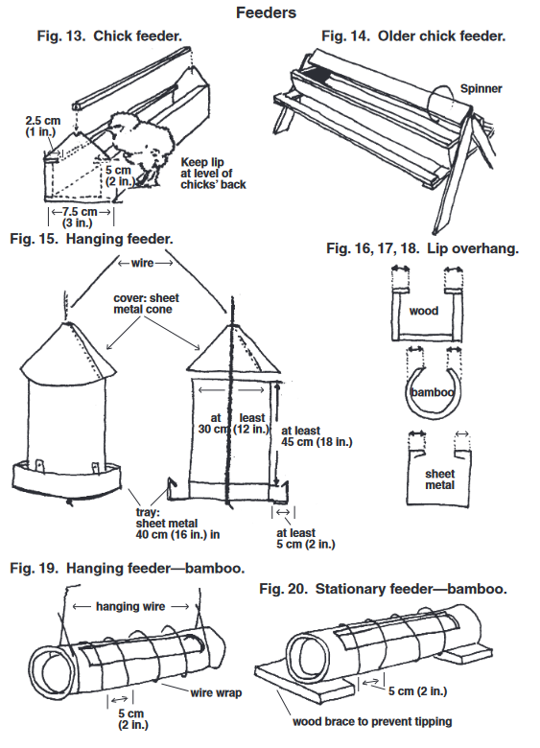
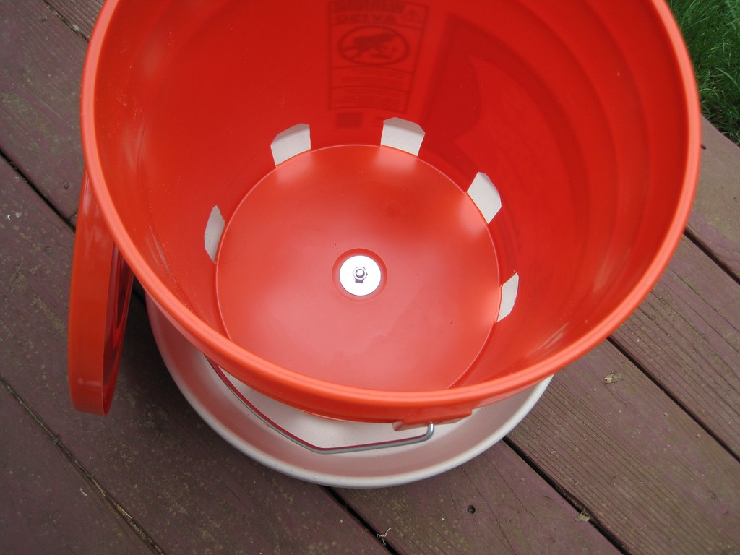
Feeders
This Photo by Unknown Author is licensed under CC BY-NC

Slide 15
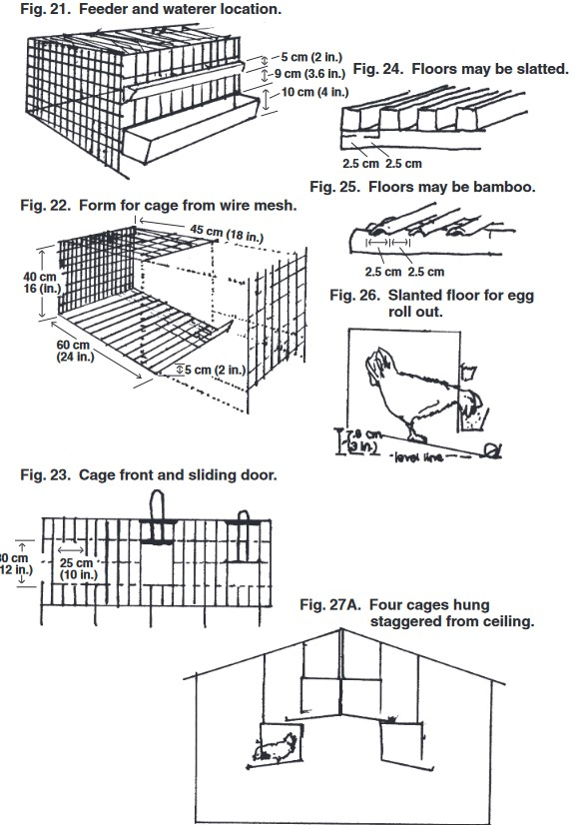
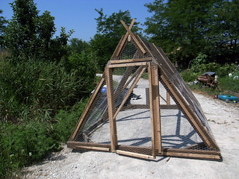
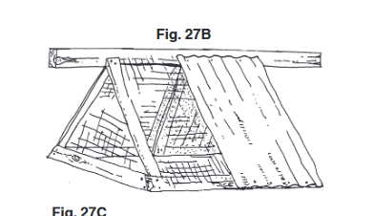
CAGES
This Photo by Unknown Author is licensed under CC BY-NC

Slide 16
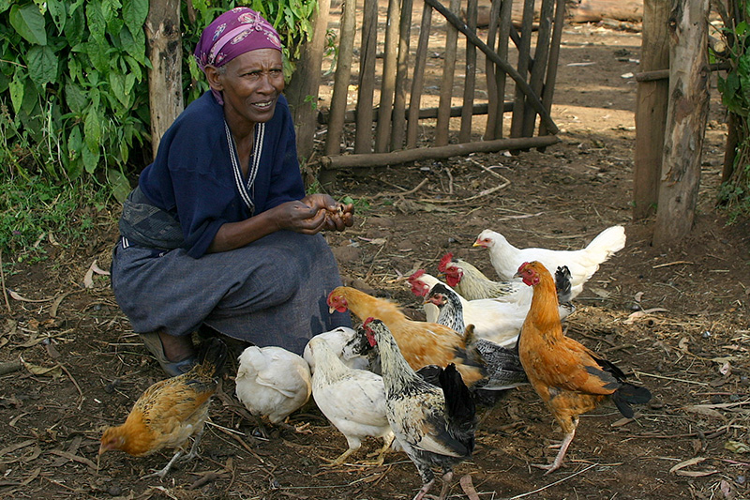
Management
A. Incubation and Hatching
First choice-natural brooding or incubator
Incubators
  Commercial or home-constructed
  With constant supply of electricity, kerosene can purchase inexpensive incubator.
  Need a thermostat for optimal temp of 37.5 C
  Need to rotate eggs several times a day
Commercial hatchery- can also do beak trimming , vaccination and sexing
Brooding- relies on brooding hens
  Decreases amount of chickens
  Possibility of disease introduction

Slide 17
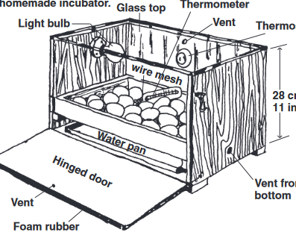
Home made incubator

Slide 18
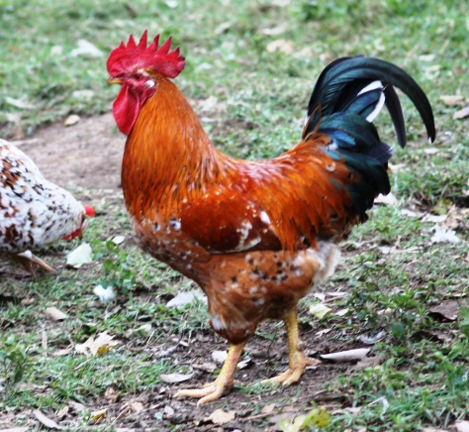
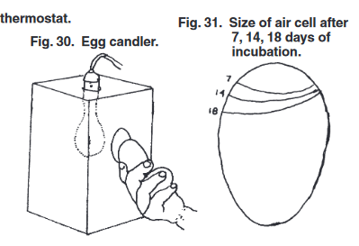
Management
Candling Eggs- progress in the developing embryo during incubation can be observed by rotating an egg in a beam of light.
If the air sac is more than 4/11 cm (1/2 in.) deep, the egg is probably spoiled
Infertile eggs (white shells only) can be detected after 4-5 days of incubation. Two or three days longer may be required for tinted or brown eggs. If thin blood vessels may be seen as emerging from a dark red spot, the egg is fertile and the chick developing
Boschweld

Slide 19
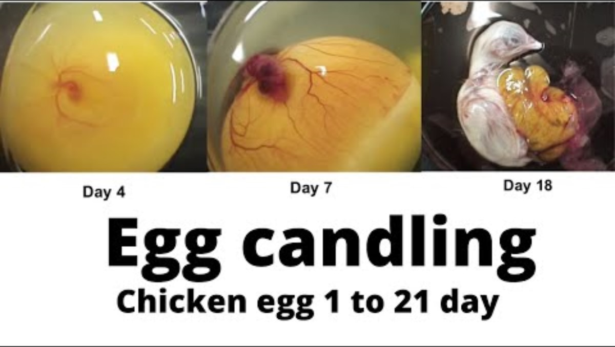
EGG CANDLING

Slide 20
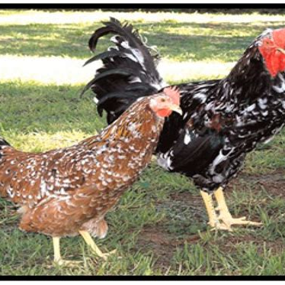
Management
Brooding
Three necessities: Heat, feed, and water
Heat
Heat for a brooder may be provided by electricity (Fig. 32-33), gas (Fig. 34),kerosene (Fig. 37), charcoal (Fig. 35) wood, coal, straw, or solar heat.
Preparations include testing and adjusting the heat source 24 hours before the chicks arrive. The old rule of thumb for maximum brooder temperature has been 35°C (95°F) for the first week, and a decrease of 2.8°C (5°F) for each succeeding week until 21°C (70°F) is reached.
Venda

Slide 21
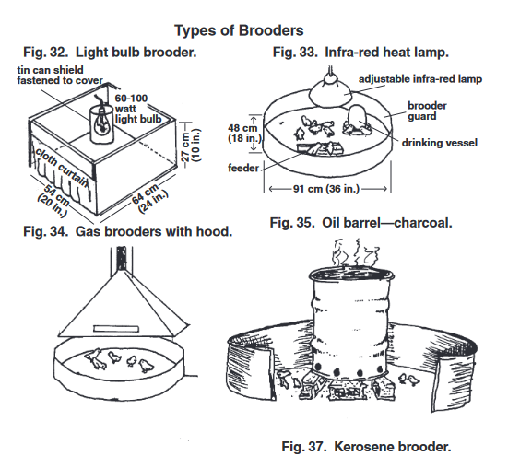
Brooders

Slide 22
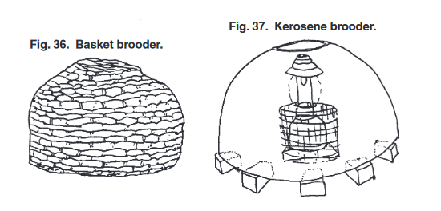
Brooders

Slide 23
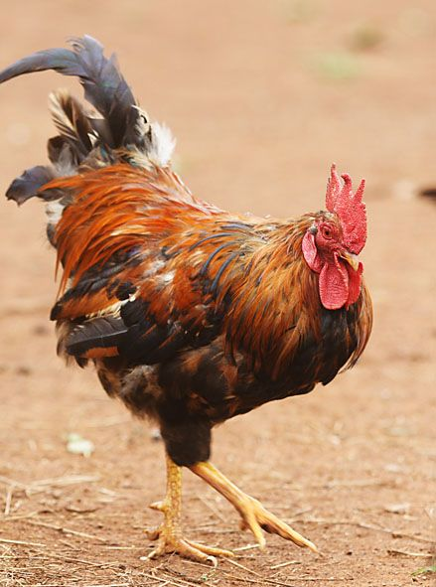
Chick Guard
For the first week a ring known as a “chick guard” (it may be card-board, metal, bricks, wood or any material that is clean and will keep the chicks close to heat source) or “brooder guard” is often placed beyond the rim of the brooder to prevent chicks from wandering too far from the heat source An experienced observer will be guided by temperature regulation by the chick behavior
Ovambo

Slide 24
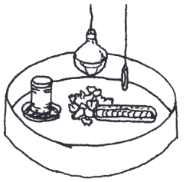
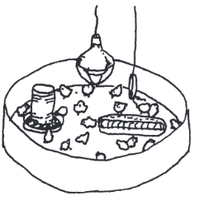
What is Going on in each of these

Slide 25
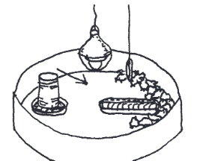
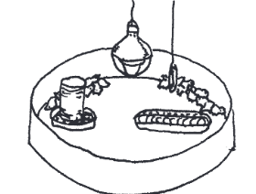
What is Going on in each of these

Slide 26
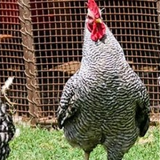
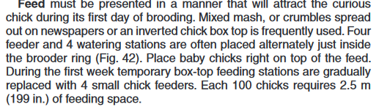
management
Potchefstroom Koekoek

Slide 27
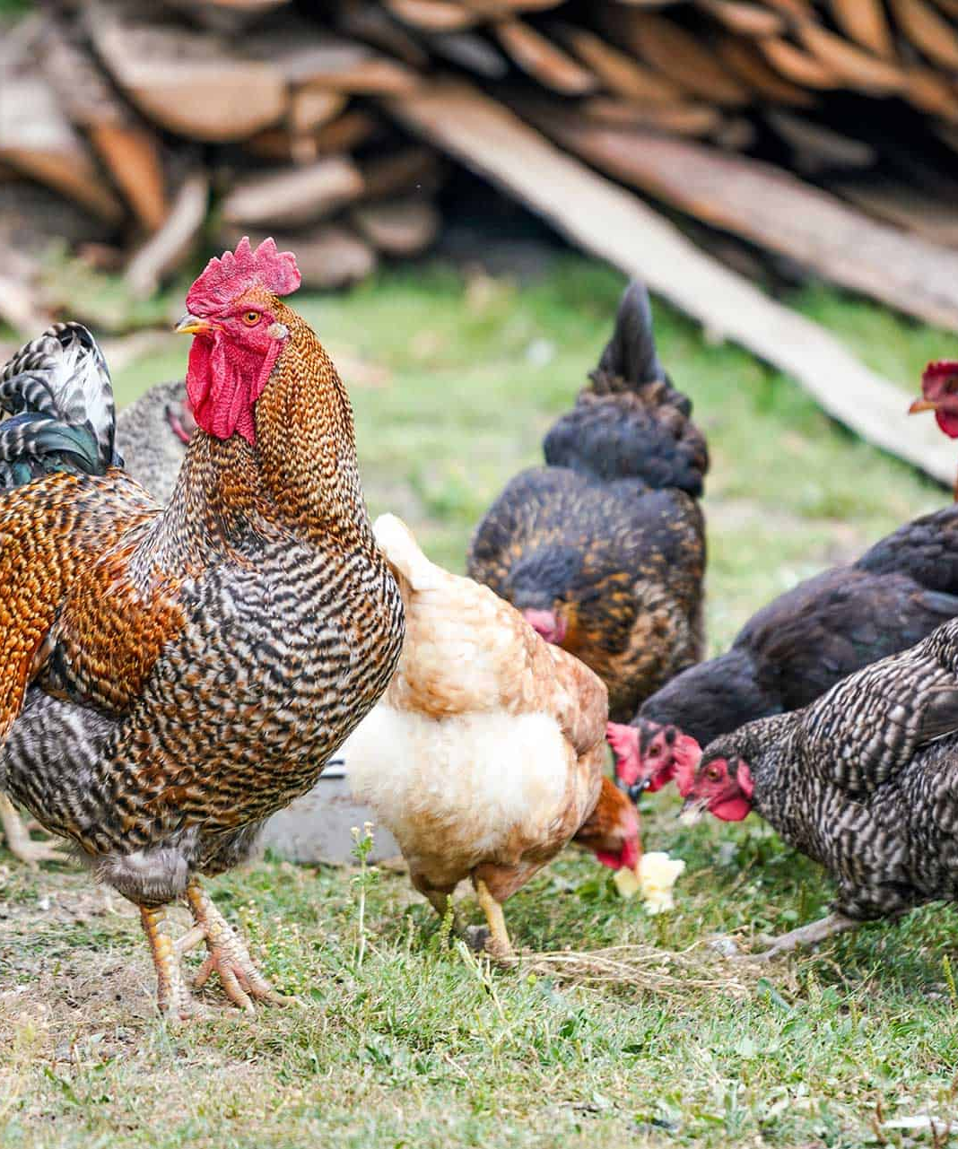
Management
Water-must be found by each chick during the first day even if some must be picked up by hand and their beaks inserted in the water
During first 2 weeks no chick should be more than 1 m from the waterer and thereafter not more than 3.5 m. Daily requirement for 100 chicks 2 liter .
Size of waterers should be increased as the chickens grow
One hundred hens may require 36 liters per day.
No spillage in litter

Slide 28
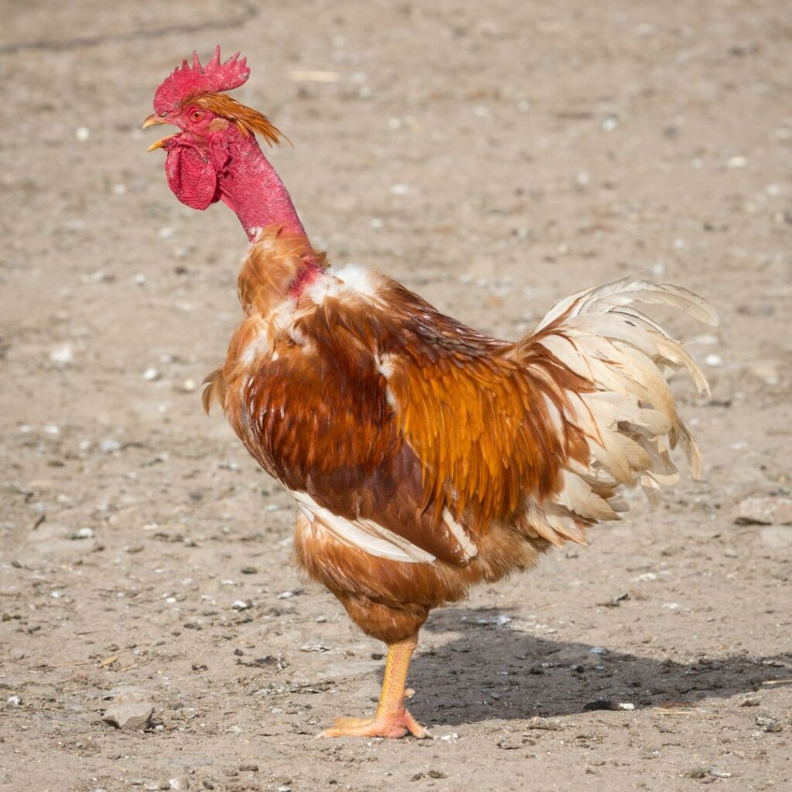
Management
Rearing
Extra heat can be discontinued after 3 weeks.
Types of systems of management
  Free Range
  Limited range
  Confinement within houses
Naked Neck

Slide 29
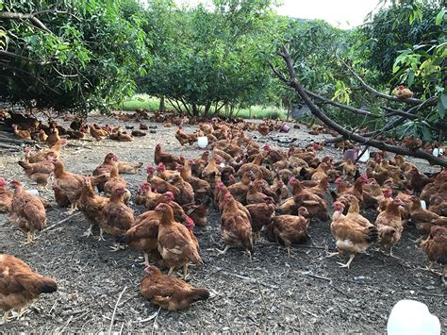
Free Range

Slide 30
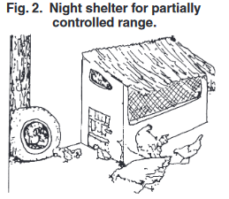
Free Range

Slide 31
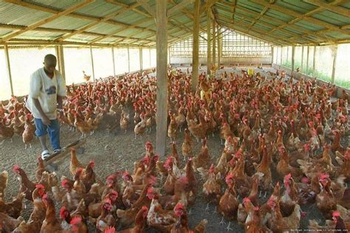
Confinement housing

Slide 32
Management housing
Advantages and disadvantages of different types of rearing
Free Range
  Adv. reduced feed costs as bids find source of food, reduced housing costs.
  Disadv. Loss from predators and close flock shepherding
Limited Range
  Adv less flock supervision, hen will take care of chicks with natural brooding
  Disadv. Predators can be a problem anytime
Confinement/Pen rearing
  Adv More protection from weather and predators
  Disadv.- cost and responsibility for furnishing all essential nutrients in the feed and cost of complete feeding, fencing, and problems arising from wet pens

Slide 33
Confinement rearing
Permits greater protection from predators
May prevent disease if exclude visitors, older chickens , pets or fomites
Space per bird 650 sq cm for the first 5 weeks, and increase to 2750 sq cm until reaches maturity.
Floor covered with 5-10 cm of litter.
If litter becomes wet- replace it.
Fine grass, straw or hard particles of incompletely ground feedstuffs may cause a blockage known as crop-bound- need to sacrifice these birds.

Slide 34
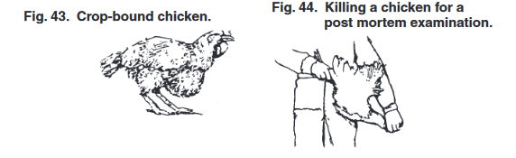
Crop bound and euthanasia of chickens

Slide 35
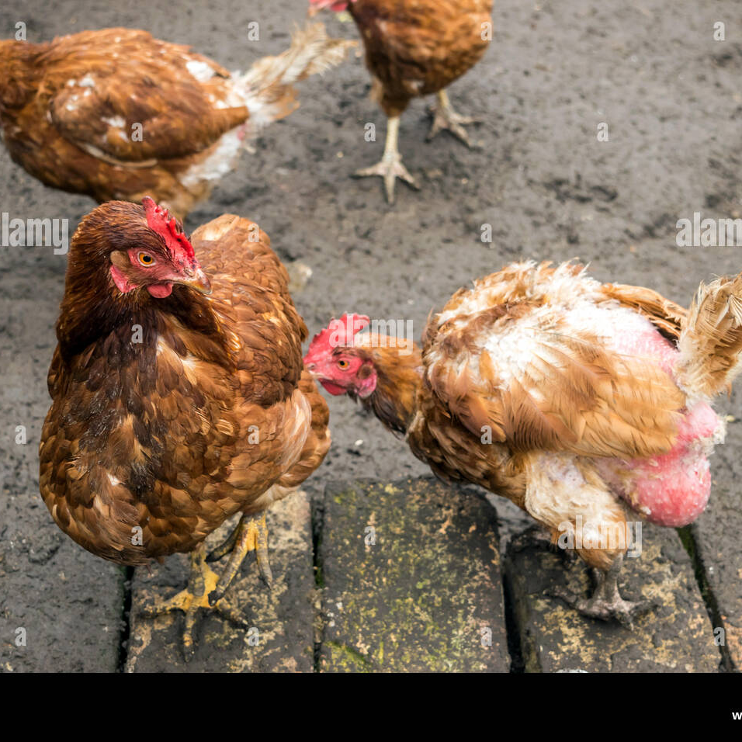
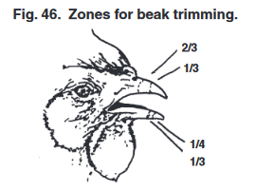
Cannibalism
Beak trimming is a method of cutting or burning off the tip of the upper and lower beaks. If properly done the minor operation prevents cannibalism which is a bad habit of pecking at feathers or injured areas of the other birds.
> For broilers only about 1/3 of the top beak is removed
For layers 1/3 to 2/3rds of the upper and ¼ to 1/3 of the lower beak
Scissors or a sharp knife may be used if a debeaking machine is not available.

Slide 36
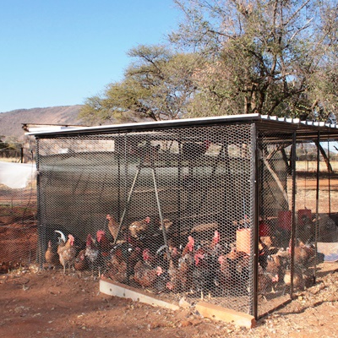
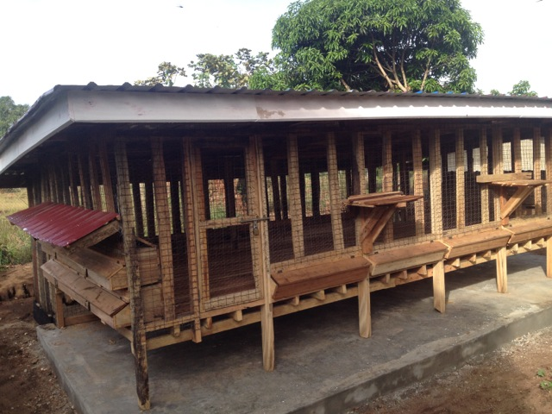
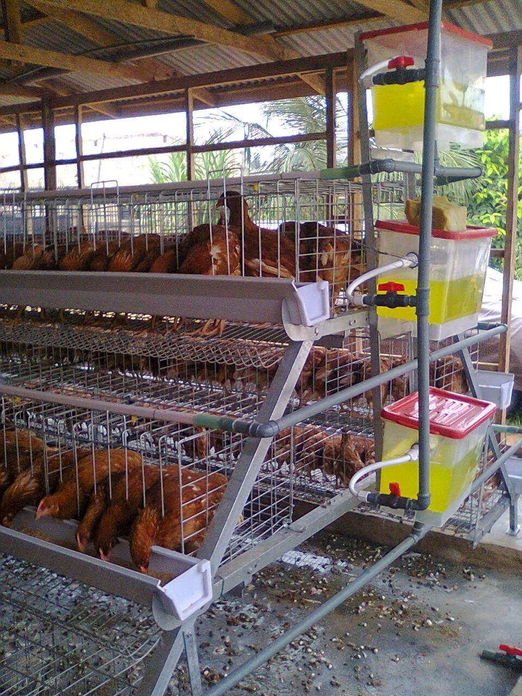
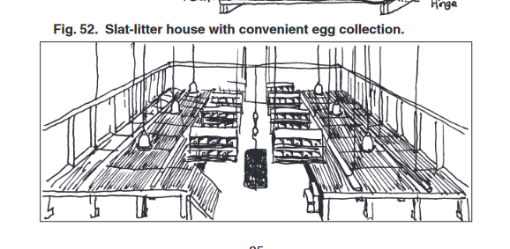
LAYErs
Free range vs confinement housing are two types typically used.
Confinement rearing on litter in floor pens , on elevated slatted floors or in cages is now widely practiced.

Slide 37
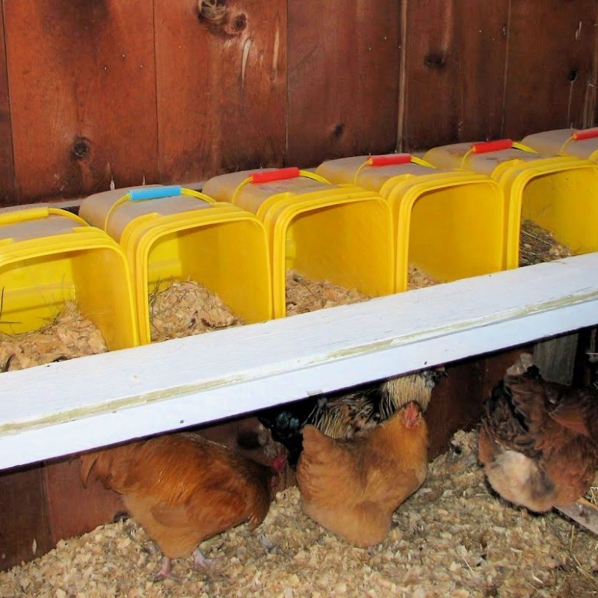
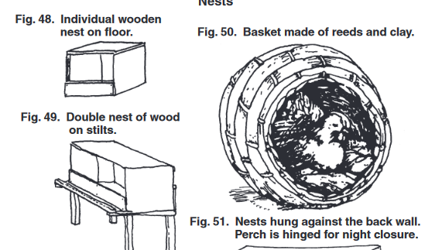
Layer tricks
Increasing light may increase egg production
Eggs laid as free range have darker yolks and can be sold as premium
Daily collection 3-4 times a day important unless hen permitted to naturally brood
Eggs should be stored in cool place
Roosts are important to provide
Nesting boxes are helpful

Slide 38
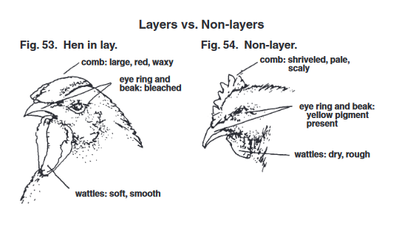
Culling – removing non layers from a flock

Slide 39
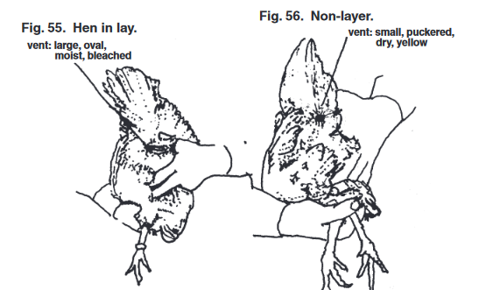
Culling – removing non layers from a flock

Slide 40
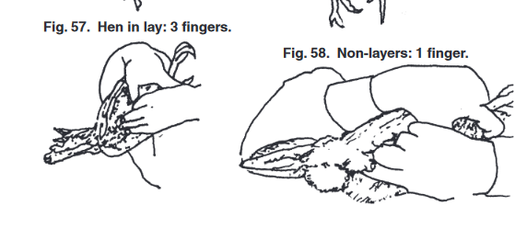
Culling – removing non layers from a flock

Slide 41
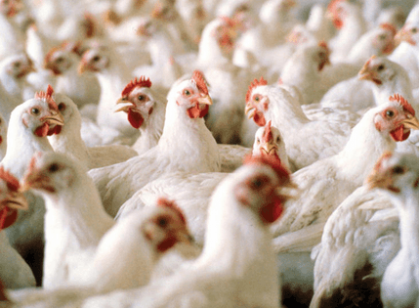
MEAT BIRD TRICKS
Commercial producers calculate that 50-70 percent of the expense of producing chickens is due to the cost of feedstuffs.
“Full feeding” keeping feed in front of the birds always is often recommended.
Weight of feed required will be at least 2 or more times the expected market weight of fast-growing meat birds.
  Feed conversion ration (Feed wight divided by market weight of the birds) requires
    A good broiler breeder stock
    A nutritious and well-balanced diet
    Good management
    Disease control

Slide 42

Poultry nutrition
If poultry are permitted to forage in open fields or barnyards, birds usually mange to obtain enough of a balanced diet to survive. A household flock of 10-20 birds may require no feed in addition to table scraps, green fodder and insects from nearby gardens
Slightly larger flocks survive better if fed a few handfuls of corn or other grain.
If get a lot larger then may need to supplement feed, cutting into profits.

Slide 43

Poultry nutrition
For optimal performance, some 40 different chemical substances, or nutrients, have been identified as essential in the diet.
Carbohydrates
Fats
Proteins
Vitamins
Minerals
Water
Nonnutritive additives
Reunion Game Sport

Slide 44
Poultry nutrition
Feedstuffs Rich in Energy
Hunger is the driving force which stimulates a chicken to eat and satisfy its energy requirement. Energy is required for muscular activity to carry on chemical processes like and digestion and for producing heat
Feedstuffs that contribute to energy needs
  Corn- 60-70 % of the ration
  Wheat- can be 70% of ration
  Other grains
  Rice
  Cassava- up to 25% of ratio
  Potatoes and yams
  Molasses up to 5%
  Cane Juice- for broilers
  Fats – oil and tallow- up to 3-6% of diet

Slide 45
Poultry nutrition
Feedstuffs rich in proteins and amino acids
Amino acids are building blocks of proteins. Some are essential and cannot be synthesized by chicks and must be present in diet (arginine, lysine, histidine, leucine, isoleucine, valine, methionine, phenylalanine, tryptophan, and threonine)
Feedstuffs which contribute to protein needs
Soybeans and soybean oil 44-49% protein
Peanut meal- may contain 47% protein
Cottonseed meal- 43% protein
Meals from sunflower, safflower, sesame, tung nut, kapok oil etc
Animal sources- fish, meat, blood, offal, and feathers
Synthetic amino acids- feed supplements lysine and methionine

Slide 46

Poultry nutrition
Vitamin Supplements
13 different ones required. , Vit A, E,D,K,B1, B2, Pantothenic acid, nicotinic acid, niacin, B6, Biotin, folacin, folic acid, choline, B 12
Vitamin A Deficiency- rough, dry skin, eye inflammation, ruffled feather, white-yellowish mouth sores, pale comb and wattles, decrease egg production, blood spots in eggs.

Slide 47

Sources of Vitamins and requirements
https://backyardchickenscoop.com/chicken-vitamins/

Slide 48
Mineral supplements
Nine essential elements needed
  Calcium 0.9-1.0% for pullet and broiler 3% for layers
  Phosphorus Ratio of CA:P 2:1 need at least 0.32%
  Sodium
  Potassium
  Chloride
  Iron
  Manganese
  Selenium
  Iodine

Slide 49
Element | Deficiency Signs | Feed Sources
Calcium | Rickets, soft bones thing eggshell growth retardation | Oyster shell, ground limestone
Phosphorus | Rickets, reduced egg production, thin eggshells | Cereals, bone and fish meal, milk products
Sodium | Poor growth cannibalism | Common salt animal products
Potassium | Poor growth | Plant feedstuffs
Iron | Anemia | Plant and animal products
Manganese | Slipped tendon, “star-gazing | Rice hulls, wheat middings
Selenium Iodine | Severe anemia, exudative diathesis, poor egg production Goiter | Fish meals, brewers yeast Fish meal, brewers yeast

Slide 50

Trace mineral tips

Slide 51
Water
Chickens require free access to clean, preferably cool drinking waters at all times
Water makes up 85% of the body weight of a hick.
Water deprivation can end up in death within one day in hot environments.
Be careful of salt poisoning if accidently added to water

Slide 52

Feeding systems
Producers with a few scavenging birds my first want to supplement their bird’s diet.
Green feeds may be grown in seasons for birds to range
Can cut and dry and store them
Green pastures are excellent source of high protein, high vitamin feeds.
Can give scavenging or free0-range birds grain or concentrate pre mixes.

Slide 53

Duck Farming
One of the most profitable livestock farming businesses is duck farming in Ghana.
Duck farming is not very popular in Ghana because of the several myths associated with ducks. A lot of people consider ducks as dirty birds and hence not consumed in many parts of Ghana
Recently many people are seeing an opportunity to start a duck farming business.

Slide 54

Why is duck farming on the rise
Muscovy
Advantages
Duck meat is an excellent and affordable source of protein and duck eggs can be a good protein source
Starting a duck farm requires a small amount of capital
If you already have a crop farm you can rear your ducks in the same place because they do not destroy flowers or vegetables
Ducks live longer compared to chickens
Ducks can lay eggs for a longer period.

Slide 55

Starting a duck farming business
Mallard
Minimum of 12 ducks
Do not require large housing and expensive feeds
Not easily affected by avian diseases that affect other poultry birds
You can leave them unsupervised because they can fend for themselves
Ducks can eat insects like termites, cockroaches and grasshoppers, fish eggs and snails.
Don’t necessarily need a pond to be able to rear your ducks but if you want fertile eggs you should consider it.

Slide 56
Starting a duck farming business
Minimum of 12 ducks
Do not require large housing and expensive feeds
Not easily affected by avian diseases that affect other poultry birds
You can leave them unsupervised because they can fend for themselves
Ducks can eat insects like termites, cockroaches and grasshoppers, fish eggs and snails.
Don’t necessarily need a pond to be able to rear your ducks but if you want fertile eggs you should consider it.

Slide 57

Advantages of duck farming
Khaki Campbell
Duck houses facility does not have to be expensive and elaborate
Ducks can easily adapt to any new environment
They lay eggs in the morning or at night which means that you can collect fresh eggs every morning
You can use your ducks for pest control.
Not a lot of money on duck feed- normally eat rice, corn, cassava and other easily available food. Ducks then to forage on algae, aquatic weeks, fungi, snails, insects etc

Slide 58

Duck production in Ghana
The minimum average amount of eggs a duck can produce in a year is 100 eggs and if well fed can do 200 eggs and eggs usually are big.
The weight of an adult duck depends on the sex. The average weight of most duck's ranges between 1 kg and 3 kg.
Muscovy are most popular duck breed
  Large
  Not picky where they stay
  If shelter is clean safe and comfortable will be fine
  Don’t require lot of care and management
  Meat and eggs are valuable.
Indian Runner

Slide 59

Duck Business in Ghana
Swedish Blue Duck
While preparing to venture into the duck farming business, you must define your purpose for rearing ducks.
  Egg production-can be used for a meal and as medicine
  Duckling production for sales and supply
  Meat

Slide 60

Popular duck breeds
Meat birds
Muscovy
Combination meat and eggs
Khaki Campbell
Indian Runners
Egg producers
Saxony
Ancona
Swedish blue duck
Saxony

Slide 61

Choosing your duck
Ancona
Once decided on reason for duck farm then
  What to look for
    From eight-week stock
    Movement should be normal and balanced
    Good eyesight
    Healthy feathers
    No obvious defects

Slide 62

Duck Eggs and rearing ducks
When you are collecting the duck eggs, you must check for the fertilized eggs. The fertilized eggs will be left to be hatched by the female ducks, while the unfertilized eggs will be taken for commercial purposes.
How will you check for fertilized eggs? Remember chicken information.
For your ducks to thrive, it is advisable to keep them in a place with ponds of water. If you rear ducks on dry land, they will still be fine, but they will produce unfertilized eggs that will not hatch into ducklings. Ducks require water to be able to mate.

Slide 63

Duck housing and management
Ducks adapt well to a wide range of management systems provided they receive essential basic care.
Protection from predators and extremes in weathert
A clean dry sheltered area- although they spend most of their time outdoors on ponds or in wet areas, they require a clean dry area to retreat, rest, clean and preen their feathers- allows them to waterproof their plumage which protects their skin from injury and help keep their body warm
Clean water for drinking- free from germs and toxins
A diet that provides all of the duck’s daily nutritional needs
Adequate light stimulation especially for layers
Protection from disease

Slide 64

Methods of raising ducks
Small home flock
Raising ducks on open ponds
Herding
Brooding

Slide 65

Small home flock
Typical requirements
Brooder for first week or so,
Yard space
A simple structure such as shed- should be bedded with straw shavings or dry absorbent material
Inexpensive fencing
A feed hopper
Well drained area of yard so will drain quickly if rains

Slide 66

Open ponds
Requirements
Nearby dry sheltered area
Can combine with raising fish for human needs such as tilapia
  Duck manure can be used by fish for food
  May need to supplement food for ducks

Slide 67

HERDING duck management
Typical for Indonesia herds of 90 to 130
During the day flock usually, mature females are allowed to search for food in areas where plentiful
At night flock is returned to confinement usually a bamboo pen, where eggs are laid during the night which are collected or sold
Major parts of diet are whole grains and snails, insects, leaf material crabs and frogs. Herder's job is to move to new source of food.
Portable fencing and other equipment is moved with the flock and as set up as a base camp.

Slide 68

Brooding- commercial
Sources of information
Orr, H.L., 1969. Duck and Goose Raising. Publication 532. Ontario
Department of Agric. and Food, Parliament Building, Toronto, Canada.
j. Scott, M.L., and Dean, W.F., 1991. Nutrition and Management of
Ducks. M.L. Scott, Ithaca, NY 14853.

Slide 69

Duck nutrition
Nutrient requirements of ducks
Require the same nutrients as chickens but in slightly different amounts
For small flock owners who have less than 15 ducks and are not able to obtain complete duck feeds, or the ingredients to make complete feeds, the following suggestions are offered. (1) If possible, allow ducks access to areas where the flock can forage for green plants, seeds, insects, insect larvae, earthworms, snails, crabs, mollusks, shrimp, cray-fish, small frogs, eels, and other material with some nutritive content.
(2) Feed ducks unused garden vegetables, table scraps (bones must be ground), and other food leftovers. (3) If affordable, supplement the flock’s diet with any locally available foodstuffs such as bakery waste, rice bran (if not rancid), wheat bran, brewers' yeast, distillers' grains, broken rice, trash fish (cooked and not putrefied), prawn meal, tapioca chips, palm oil, and similar products.

Slide 70

Duck Nutrition
If available and affordable, purchase nutritionally complete commercially prepared duck feeds. If duck rations are not available, and chicken feeds are, they will serve as a satisfactory substitute.
If poultry feed concentrates, which when fed with grain constitute a nutritionally complete diet, are available at a reasonable price, this may be a good option. The grain can sometimes be purchased from local farmers at a favorable price.
For those with sufficient knowledge of nutrition and feed formulation, complete duck rations may be mixed on the farm. This approach is dependent upon the availability of feed ingredients and vitamin and mineral premixes at affordable prices. Small batches can be mixed by turning the feed on a clean floor with a shovel.

Slide 71
POULTRY DISEASES

Slide 72
Rule Number Zero- increase the animals resistance
  Vaccination
Rule Number One- remember that there are non-infectious causes of disease
  For example- vitamin deficiencies
  Environmental problems- lack of water
Rule Number Two-Dilution is the solution to pollution
  For most diseases caused by infectious disease-causing agents (pathogens), the bird must be exposed to a relatively large number of organisms( pathogens) for infection to occur.
  This number of pathogens is known as the “minimum infectious dose.”
Notes:
If we can dilute the number of pathogens by sanitation then disease won’t occur.
Some techniques to do this include
Rotating the number of animals in an area
Replacing and changing bedding

Slide 73
3 Considerations for the prevention of infectious disease in poultry
1. Proper nutrition and management to minimize stress
2. Reduce exposure to disease causing agents
3. Specific appropriate vaccines can increase the resistance to challenge by a specific disease-causing agent.
  In healthy poultry, infectious disease can be prevented by maintaining resistance above the level of challenge, or by reducing challenge below the level of resistance (immunity)

Slide 74
Sanitation and Biosecurity
Two distinct sanitary principles that allow for maintaining large numbers of poultry for food production
1. Strict Isolation
  All in and all out
  Control vectors
2. Reduction of pathogen numbers
  Sanitation- reducing the number of infectious or potentially infectious agents in the environment
  In addition to sanitation- time also helps to decrease number of pathogens
Notes:
Show the biosecurity video

Slide 75


Slide 76

Anatomy of the digestive system

Slide 77

External anatomy

Slide 78


Slide 79
Types of disease
1. Bacterial pathogens
  Obligate normal pathogens
  Produce toxins
2. Viral pathogens
3. Fungal pathogens
  Mycotoxins- preformed toxins generally produced by fungal species that are non-pathogenic for poultry

Slide 80
Protection by Vaccination
Vaccination is the process by which specfici immunity can be induced by exposing the host to a weakened or killed organism that has the same external “appearance” as the field pathogen to the immune system.
Prior to the contact with the pathogens
Notes:
Importance of serotypes-in some cases a single disease agent can have alternative “appearances” to the birds immune system (serotypes) In this case I is essential that the vaccine chosen appears the same to the immune system as the actual disease-causing agent to which the birds are likely to be exposed in order to induce protective immunity.
Relationship of the vaccination to the infectious dose: It is very important to remember that protection by vaccination is also related to the concept of infectious dose. With exposure to higher infectious doses, immunity can often be overcome.

Slide 81
General Vaccination Considerations
1. Need to be specific
2. Minimal vaccination strategy for protection
3. Appropriate for the environment

Slide 82
Typical vaccination schedule
18 days- intra egg- Marek’s
Day of Hatch- Newcastle dx and infectious bronchitis via nasal spray
Pullets
  Maybe laryngotracheitis, avian encephalomyelitis, infectious coryza, fowl cholera, and fowl pox.

Slide 83
Diseases affecting the nervous system
1. Marek’s Disease
2. Botulism
3. Epidemic Tremor
4. Vitamin E/Selenium Deficiency
5. Aspergillosis
6. Fowl CHolorea

Slide 84
Diseases causing tumors
1. Marek’s Disease
2. Avian Leukosis Virus

Slide 85

Marek’s Disease
System: generalize, neurological
Etiologic Agent: herpes virus
Signs: depression, unilateral leg paresis, ataxic
Diagnosis: based on enlarged nerves and lymphoid tumors in various viscera
Treatment: depopulation
Prevention/Control: vaccinate
Zoonotic: No

Slide 86

Avian Leukosis
System: tumors of lymphoid
Etiologic Agent: avian leukosis virus
Signs:inappetence, weakness, diarrhea, dehydration, and emaciation, non lymphoid tumors
Diagnosis: tumors
Treatment: Depopulate
Prevention/Control: viral antigens in eggs
Zoonotic

Slide 87
Diseases Affecting the Musculoskeletal System
1. Nutritional
2. Mycoplasma Infection
3. Viral Arthritis
4. Bacterial Arthritis
5. Chronic Fowl Cholera

Slide 88

Mycoplasmosis
System: Respiratory/joints
Etiologic Agent: Mycoplasma gallisepticum
Signs: varying respiratory distress, sneezing
Diagnosis: Agglutination reactions and ELISA are commonly used for diagnosis
Treatment: chloamphenicol
Prevention/ControlP: serum agglutination/elisa
Zoonotic: No

Slide 89
Diseases Causing immunosuppression and General Conditions
1. Marek’s Disease
2. Infectious Bursal disease
3. Mycotoxicosis
4. Pullorum disease

Slide 90

Infectious Bursal Disease
System: Bursa
Etiologic Agent: birnavirus (IBDV)
Signs:severe prostration, incoordination, watery diarrhea, soiled vent feathers, vent picking, and inflammation of the cloaca.
Diagnosis: quantitative serologic test such as virus neutralization or ELISA
Treatment: Depopulation
Prevention/Control: Vaccination
Zoonotic: NO

Slide 91
Pullorum Disease
System:GI
Etiologic Agent: Salmonella pullorum
Signs:anorectic, appear weak, and have whitish fecal pasting around the vent (diarrhea)
Diagnosis: Pullorum testing
Treatment: Depopulatoin
Prevention/Control: Screening
Zoonotic: Yes

Slide 92
Pullorum disease
Acute or chronic, salmonella pullorum
Egg transmitted
Resp or gi
Young birds, mortality 90%
Pullorum testing- blood
Eradication/depopulation

Slide 93


Slide 94
Diseases Affecting the respiratory system
Infections involving the eyes and Face
1. Fowl Pox
2. Infectious Coryza
3. Fowl Cholera
4. Avian influenza

Slide 95

Fowl Pox
System: Integument
Etiologic Agent:large DNA virus (an avipoxvirus, family Poxviridae)
Signs: scabs
Diagnosis:PCR
Treatment: self limiting/ ELISA/ Virus neutralization
Prevention/Control: Vaccination
Zoonotic: Yes

Slide 96
Avian Influenza
System: Respirator
Etiologic Agent:Avian influenza (AI) viruses
Signs: cyanosis and edema of the head, comb, and wattle; edema and discoloration of the shanks and feet due to subcutaneous ecchymotic hemorrhages; petechial hemorrhages on visceral organs and in muscles; and blood-tinged oral and nasal discharges
Zoonotic

Slide 97
Diagnosis: hemagglutination/ viral RNA RT-PCR
Treatment: Depopulate
Prevention/Control: Vaccine

Slide 98


Avian influenza

Slide 99
Avian influenza viruses do not normally infect species other than birds and pigs. The first documented infection of humans with an avian influenza virus occurred in Hong Kong in 1997, when the H5N1 strain caused severe respiratory disease in 18 humans, of whom 6 died. The infection of humans coincided with an epidemic of highly pathogenic avian influenza, caused by the same strain, in Hong Kong’s poultry population.
Extensive investigation of that outbreak determined that close contact with live infected poultry was the source of human infection. Studies at the genetic level further determined that the virus had jumped directly from birds to humans. Limited transmission to health care workers occurred, but did not cause severe disease.

Slide 100
Diseases affecting the respiratory tract
Limited to the Upper Respiratory Tract
1. Infectious Bronchitis
2. Laryngotracheitis
3. Bordetellosis (turkeys)
4. Mycoplasmosis

Slide 101
Laryngotracheitis
System:
Etiologic Agent:herpesvirus infection
Signs: blood, mucus, and yellow caseous exudate or a hollow caseous cast in the trachea.
Diagnosis PCR/ isolation
Treatment Quiet, cough suppression
Prevention/Control Vaccination
ZoonoticNo

Slide 102

laryngotracheitis

Slide 103
Generalized Respiratory Diseases
Avian Influenza
Newcastle disease
Mycoplasmosis
Fowl cholera
Chlamydiosis
Avian tuberculosis
Aspergillosis

Slide 104

Avian Tuberculosis
System: GI, musculoskeletal
Etiologic Agent: Mycobacterium avium var avium
Signs:thin and sluggish, and lameness may be seen. In chickens, granulomatous nodules of varying size are usually found in the liver, spleen, bone marrow, and intestine.
Diagnosis: Live birds may be tested with avian tuberculins, although these are of little value in birds that do not have wattles. Large numbers of acid-fast bacteria in smears from lesions provide a tentative diagnosis.
Treatment: Chemotherapy is ineffective
Prevention/Control: New additions to the aviary should be quarantined for 2-3 mo
Zoonotic: NO

Slide 105
Diseases affecting the Gastrointestinal Tract
Esophagus/Gizard
1. Fowl Pox
2. Crop mycosis
3. Capillariasis
4. Gizzard/proventricular erosions/dialation

Slide 106
Cecal Worms
Heterakis gallinae
Small, white ½ inch in length
Vector of Histomonas meleagridis, which is the agent of blackhead
Life cycle- eggs produced in the ceca and pass in the feces- infective form in about 2 weeks
Tx- febendazole

Slide 107



Slide 108
Diseases affecting the Gastrointestinal Tract
Small Intestine
1. Coccidiosis
2. Necrotic enteritis
3. Colibacillosis
4. Roundworms
5. Tapeworms

Slide 109
Diseases affecting the Gastrointestinal Tract
Ceca and Large Intestines
1. Salmonellosis
2. Histomoniasis
3. Coccidiosis

Slide 110

Histomoniasis
System: Gastrointestinal
Etiologic Agent:protozoan parasite Histomonas meleagridis is transmitted most often in embryonated eggs of the cecal nematode Heterakis gallinarum , and sometimes directly by contact with infected birds
Signs: listlessness, drooping wings, unkempt feathers, and yellow droppings.
Diagnosis: Histopathology
Treatment: none
Prevention/Control contact between chickens and turkeys should be avoided nitarsone at 0.01875% of feed until 5 days before marketing
Zoonotic: NO

Slide 111
Diseases affecting both the respiratory tract and gastrointestinal tract
1. Newcastles Disease
2. Avian Influenza
3. Fowl Cholera

Slide 112
Diseases Affecting the renal system
1. Ochratoxin
2. Infectious Bronchitis

Slide 113
Diseases causing systemic generalized disease
1. Fowl cholera
2. Coccidiosis
3. Mycotoxicosis (Aflatoxicosis)
4. Ascites syndrome

Slide 114
Diseases affecting the Skin and feathers
1. Molt
2. External parasites
3. Wear on feathers
4. Gangrenous dermatitis
5. Cannibalism, scratches and scabs
6. Tumor causing disease

Slide 115

Poultry lice
Effects are via irritation
Become restless and don’t sleep well
Incubation period is four to seven days
Head, body and shaft louse

Slide 116


Poultry lice
Effects are via irritation
Become restless and don’t sleep well
Incubation period is four to seven days
Head, body and shaft louse

Slide 117
Fowl tick
Argas pesicus- can become serious parasite
Blood sucker
Spend most of time in cracks and hiding places- emerging at night

Slide 118
Diseases of Ducks
Duck Virus Hepatitis
Etiological agent:
Zoonotic: NO
Age 1-28 days of age
Prevention: vaccination of breeding ducks
Signs- 90% mortality
  Spasmodic contractions of legs and die within an hour in a typical arched-backward position.
  Liver enlarged

Slide 119

Duck Viral Enteritis
Duck Plaque
Etiological agent: Herpes virus
Zoonotic: No
Treatment: None-
Prevention: vaccination of breeders
Signs:
  Sluggishness, ruffled feathers, greenish-yellow diarrhea, blood dripping form nostirl.

Slide 120
Riemerella anatipestifer Infection
Etiological agent: Pasturella anatipestifer infestion
Signs: High mortality, weigh loss, listlessness, eye discharge and diarrhea, incoordination, shaking of head and twisted neck
Treatment: None-
Prevention: Bacterins
Preventative management

Slide 121

Cholera
Etiological agent: pastuerella multocida
Prevention: Mangement- no stangnent water
Signs: loss of appetite, muchous discharge from the mouth, diarrhea, and labored breathing.- PM liver is enlarged, copper colored,
Treatment: Antibiotics, good sanitation

Slide 122

Colibacillosis
Etiological agent: Eschericahia coli
Signs: reduced hatchability, infection of yolk sac, and a setpicemia
Age 2-8 weeks of age
Prevention: good sanitation
Treatment: sulfdimethoxine ormetoprin

Slide 123

Aspergillosis
Etiological agent: Aspergillus fumigatus spores that grow on straw or damp feed
Signs: death- gasping, listlessness, dehydration
Prevention: avoid moldy straw and preventing feed from getting wet and moldy.

Slide 124

Toxins
Aflatoxin poisoning
Etiological agent- aspergillus flavus and aspergillus parasiticus
Molds that grow on cereal grains and oilseeds

Slide 125


Duck Diseases
Toxins
  Aflatoxin- mold
  Botulism-stagnant pools
  Castor bean poisoning
  Insecticides rodenticides

Slide 126
Botulism
Etiological agent: Clostridium botulinum
Signs progressive flaccid (limp) paralysis of the neck, legs and winds
Death
Prevention: no stagnant waters

